Slide 1
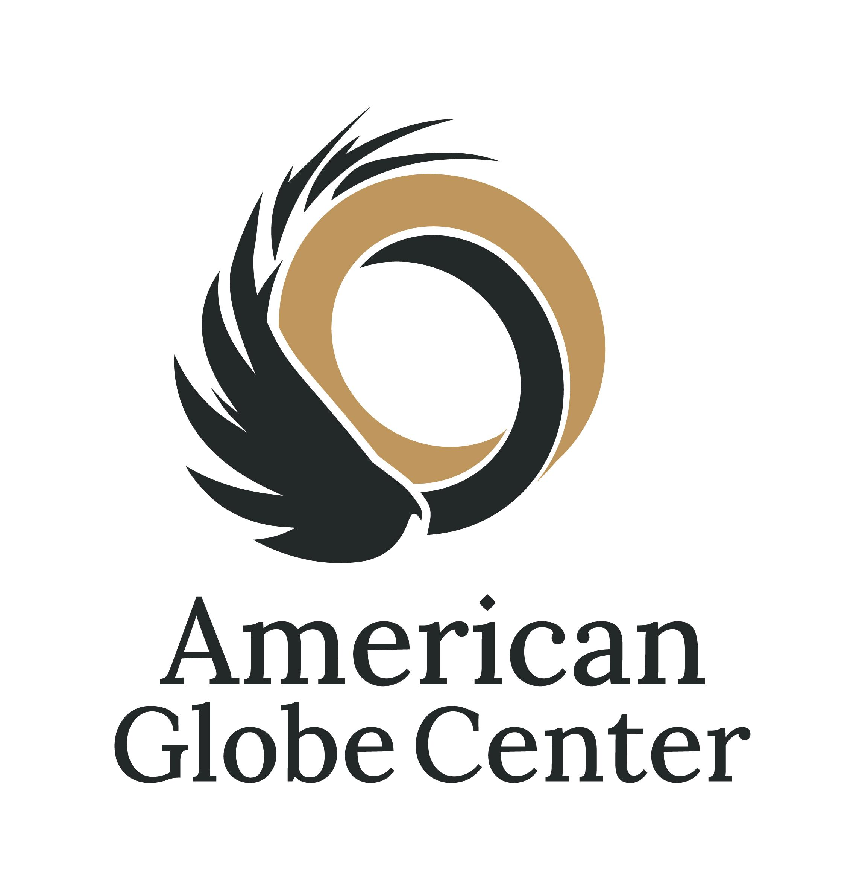

Slide 2
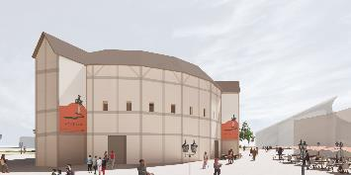
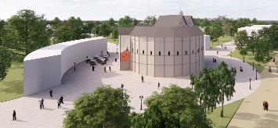
What is the American Globe Center?
a Visionary, Affordable Destination Theatre Center, including:
  the World’s only Timber-Frame 1614 Globe Re-creation
  the AGC Playhouse – a state-of-the-art performing arts and education center with:
    Mainstage Theatre
    Black Box Theatre
    Visual Arts Gallery/Museum
    Multi-Function Event Spaces
  Gathering Areas, Gardens, and Green Space.

Slide 3
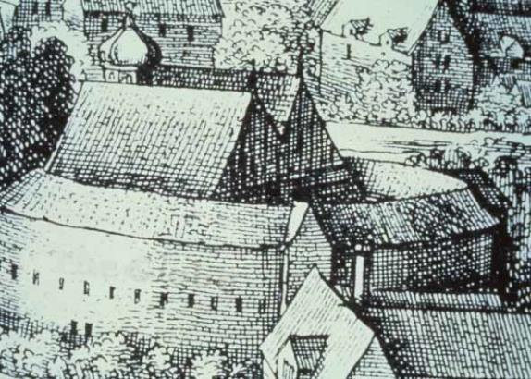
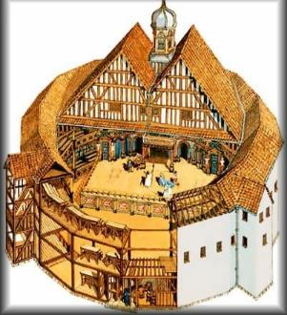
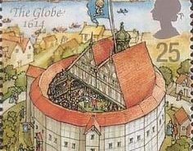
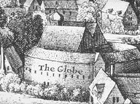

Slide 4
Why are we here and what can we do?
$132 Million Annual Economic Boost – Tourism, Hospitality, and associated wages will invigorate our home municipality’s economy.
Direct Municipal Revenue – a $1 per ticket surcharge generates $300,000-$500,000 annually – a program that ensures fiscal contribution in place of property taxes.
Sustained Job Creation – 100+ in-house jobs, with a ripple effect across hospitality, retail, and service industries.
Expanded Tax Base – AGC employees and the growing business ecosystem will attract new residents, strengthening the local economy.
City/Town Renaissance – a cultural hub, green spaces, and a steady influx of patrons—achieved through AGC investment in collaboration with local support and efforts.
Cultural & Educational Enrichment – AGC’s programming and touring performances will bridge funding gaps in arts education, ensuring lasting community impact.
Premier Tourism Hub – a one-of-a-kind destination blending entertainment, culture, and history, creating “Shakespeare Central”.
‹#›

Slide 5
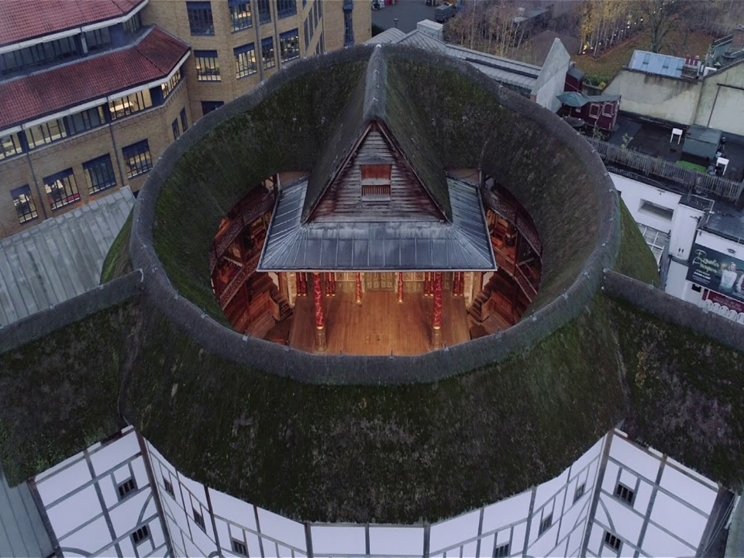

The Globe, PLUS
Mainstage &
Black Box Theatres
It’s more than just a project to build a timber-frame
re-creation of the
1614 Globe – It’s
The Globe, PLUS
ZERO Local Taxpayer Dollars
The Globe, PLUS
Beautiful Green Space
The Globe, PLUS
a Cultural Destination
The Globe, PLUS
Job Creation & Municipal Revenue
The Globe, PLUS
Expansive Educational
Programs
The Globe, PLUS
$132 Million
in Economic Development

Slide 6
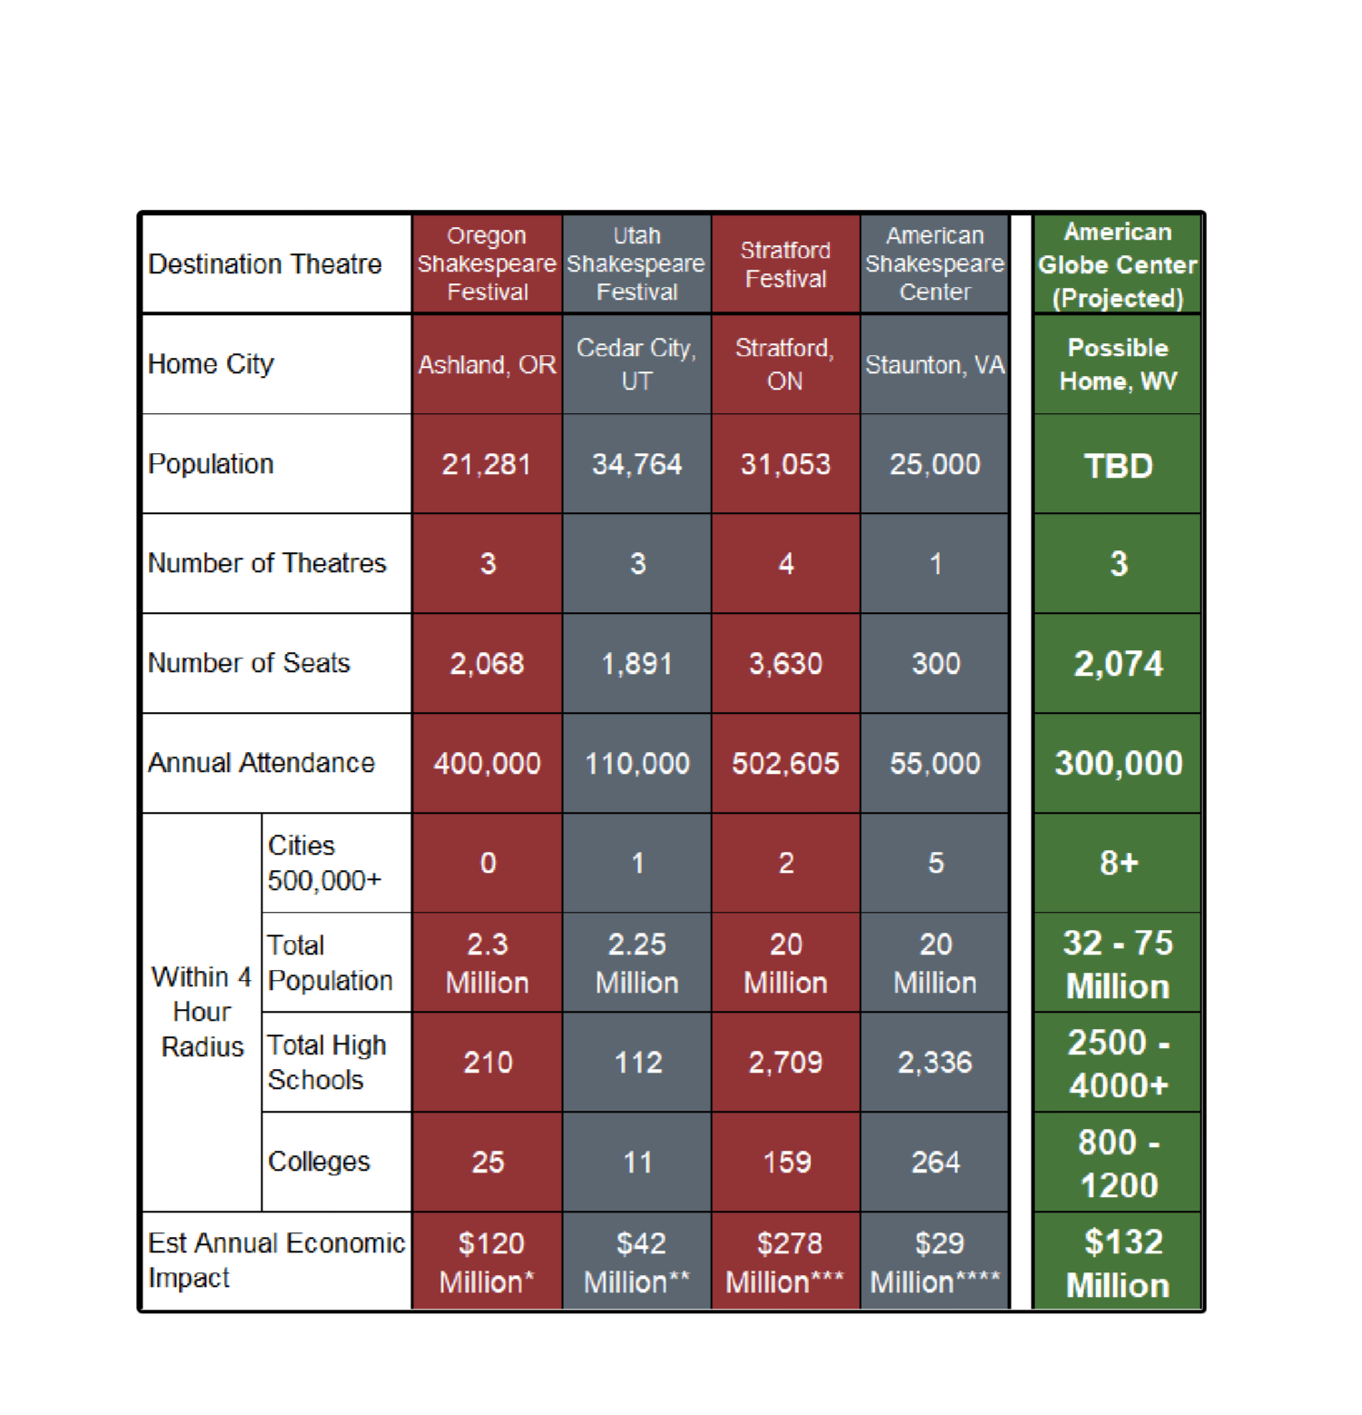
The Opportunity
Proven Models:
the best of the continent’s successful destination theatres, with repertory presentations in multiple venues
(Blackfriars Playhouse is proof of concept)
a Globe re-creation and Shakespeare’s Staging Conditions establishes a more popular and unique attraction
an extensive concentration of population and education within a 4-hour radius provides the AGC a clear runway as a haven for cultural tourism and educational enrichment
For organizations in the United States, this data came from their 2019 IRS Form 990, which is completed on an annual basis by tax-exempt organizations. Utah Shakespeare Festival is the one exception: because it is part of Southern Utah University, all financials are nested within the University’s budget and not easily itemized. Total revenue and program service revenue information was available, however, through the Festival’s annual report.Data for Stratford Festival was acquired through The Stratford Shakespearean Festival of Canada Consolidated Financial Statements (12/31/19). Est. Annual Economic Impact Stats: *Oregon Shakespeare Festival - https://oregonbusiness.com/in-ashland-the-plays-still-the-thing** Utah Shakespeare Festival - https://le.utah.gov/interim/2024/pdf/00000769.pdf***https://www.stratfordbeaconherald.com/news/local-news/stratford-festivals-economic-impact-pegged-at-276-7m-in-2023****https://americanshakespearecenter.com/2018/11/the-asc-welcomes-the-governors-summit-on-rural-prosperity-to-blackfriars-playhouse AGC economic development is a projection of average impact per attendee ($440.55) at other festivals times projected attendance.

Slide 7
Better Theatre AND Better Business
501(c)(3) non-profit operating with the efficiency and strategic planning of a for-profit business
Sustainable Financial Model – a robust pro forma built on impact partner financing rather than traditional donor-based models
Proven Success of Shakespeare’s Staging Conditions in Repertory – inviting audiences to experience five to six productions in a single weekend
Diverse Cultural and Educational Programming – from Shakespeare and Contemporary Theatre to Music, Dance, and more
Prime Location – leveraging a region’s rich cultural heritage to attract both local audiences and tourists
Mission-Driven Impact – advancing economic development, community engagement, education, and cultural enrichment through the arts

Slide 8
Why Invest in the Arts and in Shakespeare?
Research shows that cultural and heritage tourists:
  Spend more than other travelers ($623 vs. $457)
  Are more likely to spend $1,000 (19% vs. 12%)
  Are more likely to stay in a hotel, motel, or B&B (62% vs. 55%)
  Take longer trips (5.2 nights vs. 3.4 nights)
Sheryl Wagner, Director of Tourism for the City of Staunton, Virginia
  “When communities invest in the arts, as Staunton has done, they are supporting jobs, generating government revenue, and promoting a healthy tourism economy. Arts and cultural organizations are valued members of the business community. In 2000 before the Blackfriars Playhouse opened, the Economic Impact of Tourism in Staunton was $27 million. In 2017, the Economic Impact of Tourism was $56 million. That’s over a 100% increase in 17 years. You can always tell when a community’s tourism industry is strong because you start to see more restaurants, shops, breweries, wine bars, and hotels. We have 3 new hotels opening in 2018 accounting for 237 more rooms in Staunton’s hotel inventory. This is what the arts have built in our community.”

