Slide 1
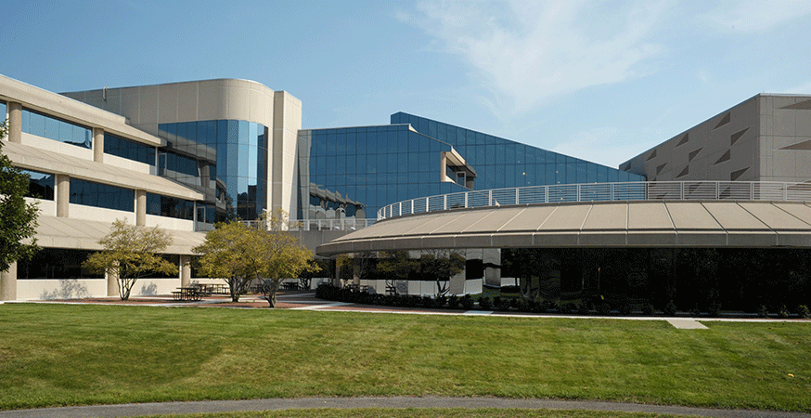
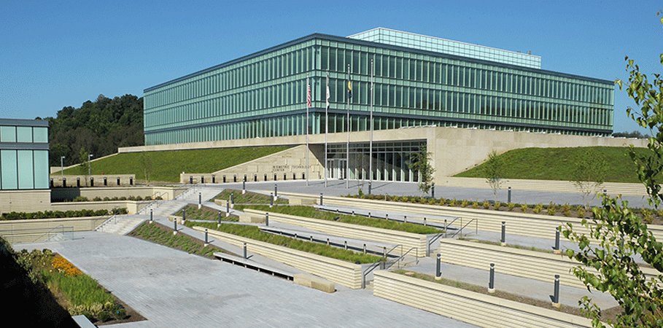
Criminal Justice Information Services Division
UNCLASSIFIED
Brian D. Griffith
Deputy Assistant Director
UNCLASSIFIED
Notes:
Welcome and introduce yourself.

Slide 2
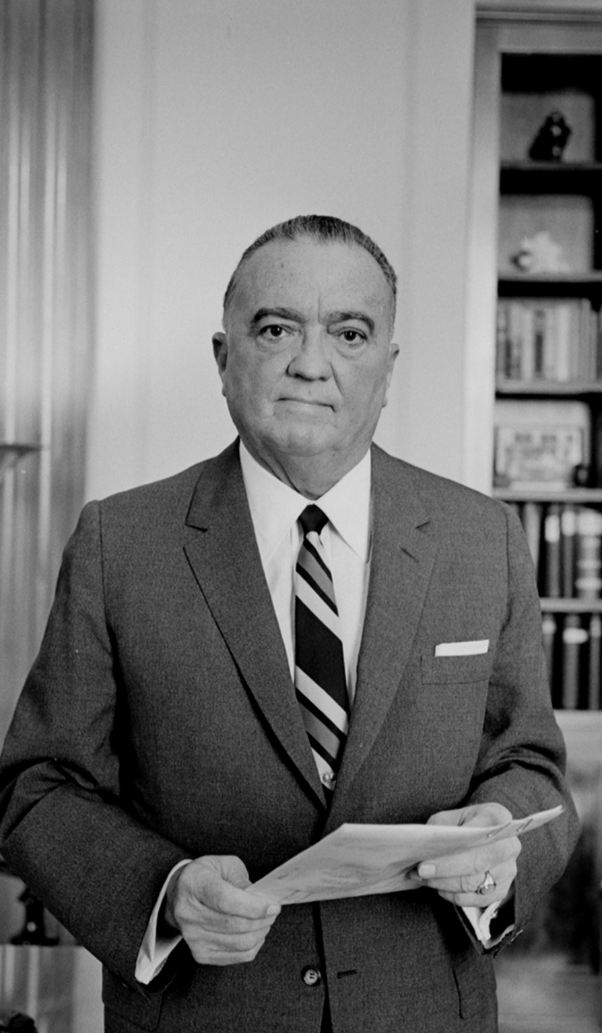
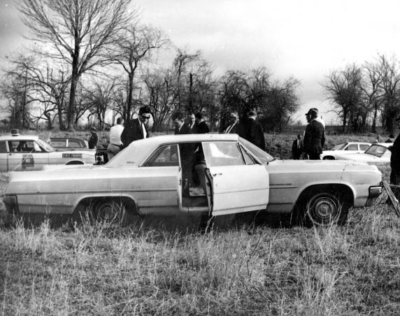
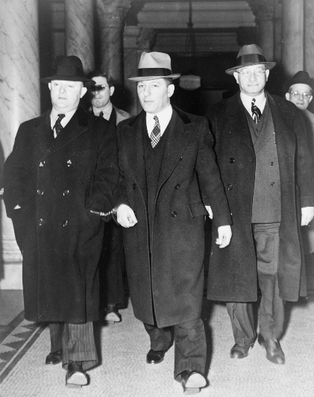

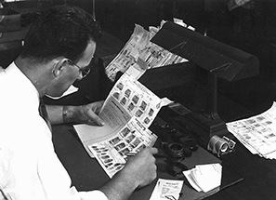
FBI: A Historic Look
UNCLASSIFIED
Body text style
  Bullet text style 1
    Bullet text style 2
2
UNCLASSIFIED
Notes:
Top Left: Law enforcement surrounds Viola Liuzzo’s car. She was a civil rights worker from Detroit who was killed by members of the KKK in March 1965. Three Klansmen indicted following FBI investigation.
Top Middle: Mobster Louis "Lepke" Buchalter (center) is escorted from a courthouse in 1940.
Far Right: Director Hoover in 1961.
Middle: Charles Ponzi. Ponzi fraud schemes are named after him.
Bottom left: A fingerprint examiner.
The FBI was founded in 1908. It was originally named the Bureau of Investigation.
In the beginning, agents mostly investigated things like:
White-collar crimes
Civil rights cases
Antitrust cases
Land & banking fraud
Forced labor
A few national security issues–such as treason and anarchist activity.

Slide 3
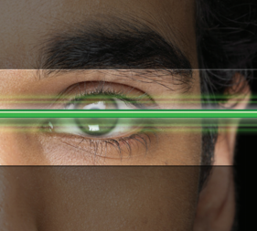



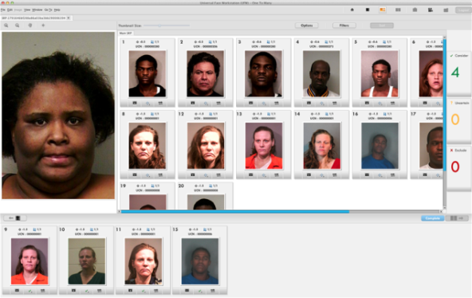
Biometrics Beginning
UNCLASSIFIED
UNCLASSIFIED
Notes:
In 1924, the FBI created an Identification Division, informally called “Ident” for years.
Ident gathered prints from police agencies nationwide and manually searched them upon request for matches to criminals and crime evidence.
The CJIS Division was established in February 1992 out of the former Identification Division to serve as the central repository for criminal justice information services in the FBI.
What was a very manual process of fingerprint identification has become highly automated. And as you can see, biometrics has grown from simply fingerprints. You’ll learn more about that today.

Slide 4
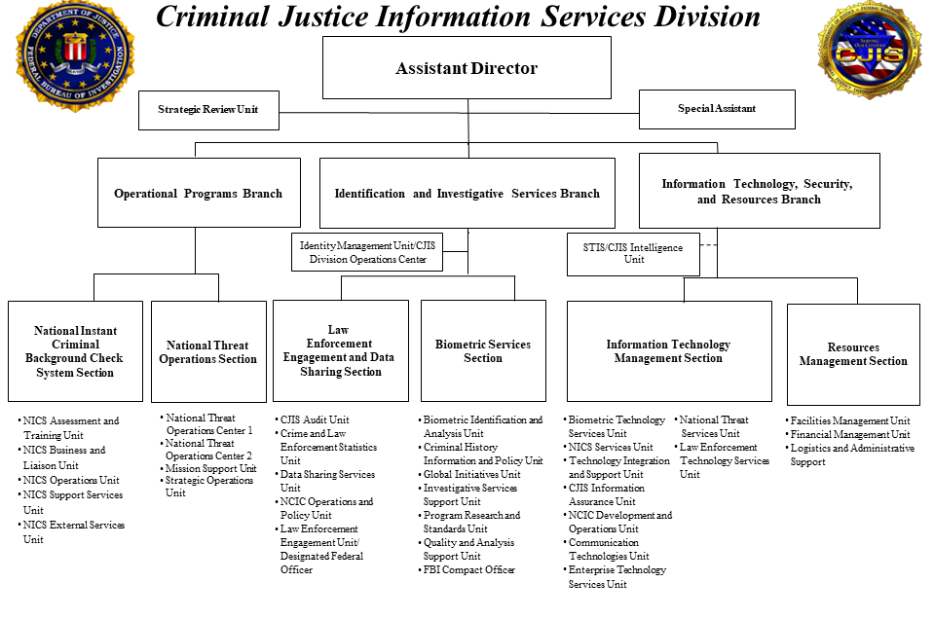
UNCLASSIFIED
UNCLASSIFIED
Notes:
As noted, the CJIS Division was established in 1992 to consolidate the Fingerprint Identification Division, the National Crime Information Center (NCIC), and the Uniform Crime Reporting (UCR) Program, to bring together all of the criminal justice information services into one entity.
CJIS is the largest division in the FBI. We have more than 4,000 employees and contractors between the main campus and the Biometric Technology Center (which we share with the Department of Defense).
We are committed to providing the best possible tools and services to fight crime and terrorism.
The CJIS Division is comprised of three branches:
Operational Programs Branch
Identification and Investigative Services Branch
Information Technology, Security and Resources Branch
Six sections are divided into those branches, with additional support from the Strategic Review Unit.
National Instant Criminal Background Check System Section
National Threat Operations Section
Law Enforcement Engagement and Data Sharing Section
Biometric Services Section
Information Technology Management Section
Resources Management Section

Slide 5


CJIS Division Mission
UNCLASSIFIED
To equip our partners with the criminal justice information they need to protect the United States while preserving civil liberties.
UNCLASSIFIED
Notes:
The CJIS Division’s mission is to equip our partners with the criminal justice information they need to protect the United States while preserving civil liberties.

Slide 6




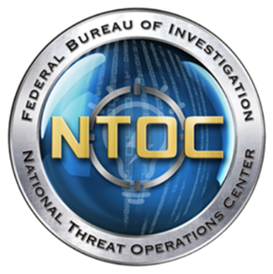


CJIS Division Major Programs
UNCLASSIFIED
National Crime Information
Center
Next Generation Identification
National Instant Criminal
Background Check System
Uniform Crime Reporting
Program
National Threat Operations
Center
National Data Exchange
Law Enforcement Enterprise Portal
UNCLASSIFIED
Notes:
We accomplishment that mission, in part, through our work with seven major programs.
National Crime Information Center (NCIC)
Next Generation Identification (NGI)
National Instant Criminal Background Check System (NICS)
Uniform Crime Reporting (UCR) Program
National Threat Operations Center (NTOC)
National Data Exchange (N-DEx)
Law Enforcement Enterprise Portal (LEEP)

Slide 7
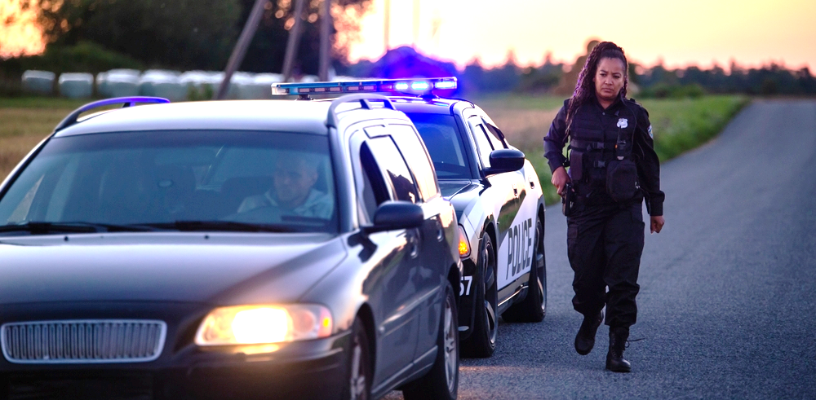
National Crime Information Center (NCIC) System
UNCLASSIFIED
18M+
NCIC Records
10.9 M
Average
Daily Transactions
Average Response Time 0.0076
seconds
UNCLASSIFIED
Notes:
The FBI's National Crime Information Center (NCIC) became operational on January 27, 1967, with the goal of assisting law enforcement in apprehending fugitives and locating stolen property.
More than 55 years in operation.
During its first year of operation, NCIC processed a modest 2.5 million transactions for the entire year.
By contrast, in fiscal year 2023, NCIC processed an average of 10.9 million transactions per day.
Violent Person File
Designed to alert law enforcement officers that the individual they are encountering may have the propensity for violence against law enforcement
Includes:
Persons who have been convicted of violence against a police officer
Persons who have expressed an intent of violence against a police officer
File is automatically searched with an NCIC Wanted Persons Query
(Note: Stats on slide are FY2023 numbers)

Slide 8

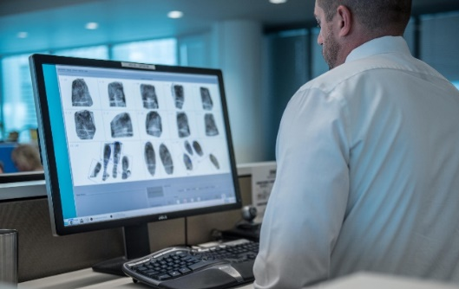

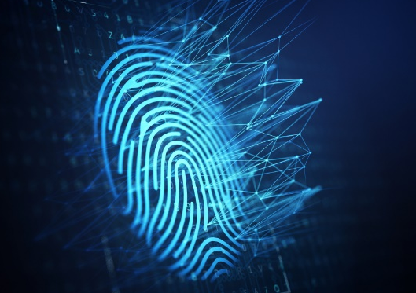
Next Generation Identification (NGI) System
UNCLASSIFIED
UNCLASSIFIED
Notes:
Next Generation Identification (NGI) System powers the FBI’s biometric services
offers services that provide a platform for multimodal functionality (beyond fingerprints)
Provides efficient and accurate biometric services.
Examples of services/different modalities:
Tenprint Repository (fingerprint-based criminal histories)
Latent searches (prints left behind at crime scenes)
Facial Recognition
National Palm Print System
Rap Back
NGI Iris Service

Slide 9

National Instant Criminal Background
Check System
UNCLASSIFIED
UNCLASSIFIED
Notes:
NICS is designed to immediately determine if a person is disqualified from possessing or receiving firearms, by conducting a search of available records.
The Brady Handgun Violence Prevention Act of 1993, otherwise known as the Brady Act, is a result of the attempted assassination of former President Ronald Reagan. During this tragic event, former Press Secretary James Brady sustained permanent injuries.
Some of the federal firearm prohibitions existed in the Gun Control Act of 1968, long before the Brady Act, and other federal firearm prohibitions were added after the passage of the Gun Control Act.
With the passage of the Brady Act, the Attorney General (AG) was required to establish a system that Federal Firearms Licensees (FFL) could contact to obtain information on whether a prospective purchaser was eligible to receive a firearm. The AG delegated this responsibility to the FBI.
The FBI created NICS and deployed it on November 30, 1998.
In order to release firearms, FFLs (gun sellers) must contact the NICS Section, or a designated state point of contact, to determine a person’s eligibility to possess or receive firearms.

Slide 10



Uniform Crime Reporting Program
UNCLASSIFIED
UNCLASSIFIED
Notes:
The UCR Program provides reliable crime and law enforcement statistics through collective effort of federal, state, county, city, university/college, and tribal law enforcement. Law enforcement agencies voluntarily report crime data to the FBI.
The program has been the starting place for law enforcement executives, students of criminal justice, researchers, members of the media, and the public at large seeking information on crime in the nation.
Considered the gold standard for referencing crime data.
The data is submitted either through a state UCR program or directly to the FBI's UCR Program.
Data collections include:
National Incident Based Reporting System statistics regarding violent crime and property crime
Hate Crime Statistics
Law Enforcement Officers Killed and Assaulted (in-the-line-of-duty statistics and accidental deaths tracked)
National Use-of-Force Data Collection
Law Enforcement Suicide Data Collection
Data released on the FBI’s publicly available Crime Data Explorer site.

Slide 11



National Threat Operations Center
UNCLASSIFIED
UNCLASSIFIED
Notes:
NTOC serves as the national intake for the public to provide information about potential federal crimes or threats to national security.
Threat Intake Examiners within NTOC receive more than 3,600 phone calls and electronic tips that come in each day.
They evaluate the information and then determine where that information needs to go for action (e.g., FBI field office [most often], law enforcement partner).
Cover all threats….to include counterterrorism, criminal, counterintelligence, and domestic terrorism-type threats.
Staff on duty 24 hours a day, 7 days a week, 365 days a year.
Recent enhancements of interest:
9-1-1 center connections—direct transfer of callers to applicable 9-1-1 agencies
9-8-8 center connections—direct transfer of callers to mental health/suicide prevention support
(Note: Stats are FY2023 numbers)

Slide 12

National Data Exchange
UNCLASSIFIED
UNCLASSIFIED
Notes:
N-DEx is a national online investigative information sharing system that brings together records from across the nation.
The N-DEx System provides access to over 1.2 billion records from more than 8,400 agencies. (Note: Stats are FY2023 numbers)
N-DEx is a no fee service which is available 24/7 from any secure internet-capable device.
Investigators and analysts have the ability to discover information from across the nation in one spot that will display the entire life cycle, from initial contact to release from prison, including probation and parole of their suspects.
All information in the N-DEx System is unclassified and includes:
incident reports
arrest reports
booking and incarceration reports pre-trial investigations
probation and parole records.
The records show anything that an agency maintains in its record management system and wishes to share (to include narratives, images, etc.)
The N-DEx System helps to complete the criminal justice lifecycle—complementing FBI existing systems and centralizing the source of criminal justice information.

Slide 13

Law Enforcement Enterprise Portal
UNCLASSIFIED
Single
sign-on access
Federated
identity access
management system
Users can customize their view based on frequently used services
Provides access
to many critical services
UNCLASSIFIED
Notes:
The Law Enforcement Enterprise portal provides a single access point to dozens of law enforcement services.
Examples of services include:
N-DEx
JusticeConnect
Virtual Command Center
SWATTING VCC example
In May 2023, the FBI initiated the VCC known as the National Common Operational Picture (NCOP).
The NCOP-VCC is an awareness initiative jointly spearheaded by the FBI’s Office of Partner Engagement and the CJIS Division to serve as a collaborative space for domestic public safety partners to input their swatting incidents in a secure environment for national awareness.
Swatting is the malicious practice of making hoax emergency calls to an emergency service, such as a police department, to falsely report an ongoing emergency at a particular location.
The VCC creates a near real-time operational picture of swatting events in an effort to mitigate criminal activities associated with swatting.
During FY2023, the program logged more than 300 swatting incidents.

Slide 14

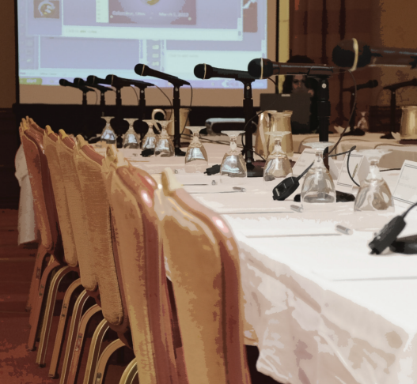
CJIS Advisory Policy Board (APB)
35 representatives from criminal justice and national security agencies
Proposals vetted through
regional working groups
and subcommittees
CJIS APB recommendations
are sent to the FBI Director
14
UNCLASSIFIED
Notes:
Most CJIS Division services operate under a “shared management concept:”
Agencies contribute data to system repositories, and are customers (searching these repositories for information to prevent, investigate, and solve crimes),
These agencies and users have a voice in service development, enhancement, and policy.
Established in 1994 and chartered under the provisions of the Federal Advisory Committee Act, the CJIS Advisory Policy Board consists of 35 representatives from criminal justice and national security agencies nationwide
The CJIS APB makes recommendations to the FBI Director.

Slide 15
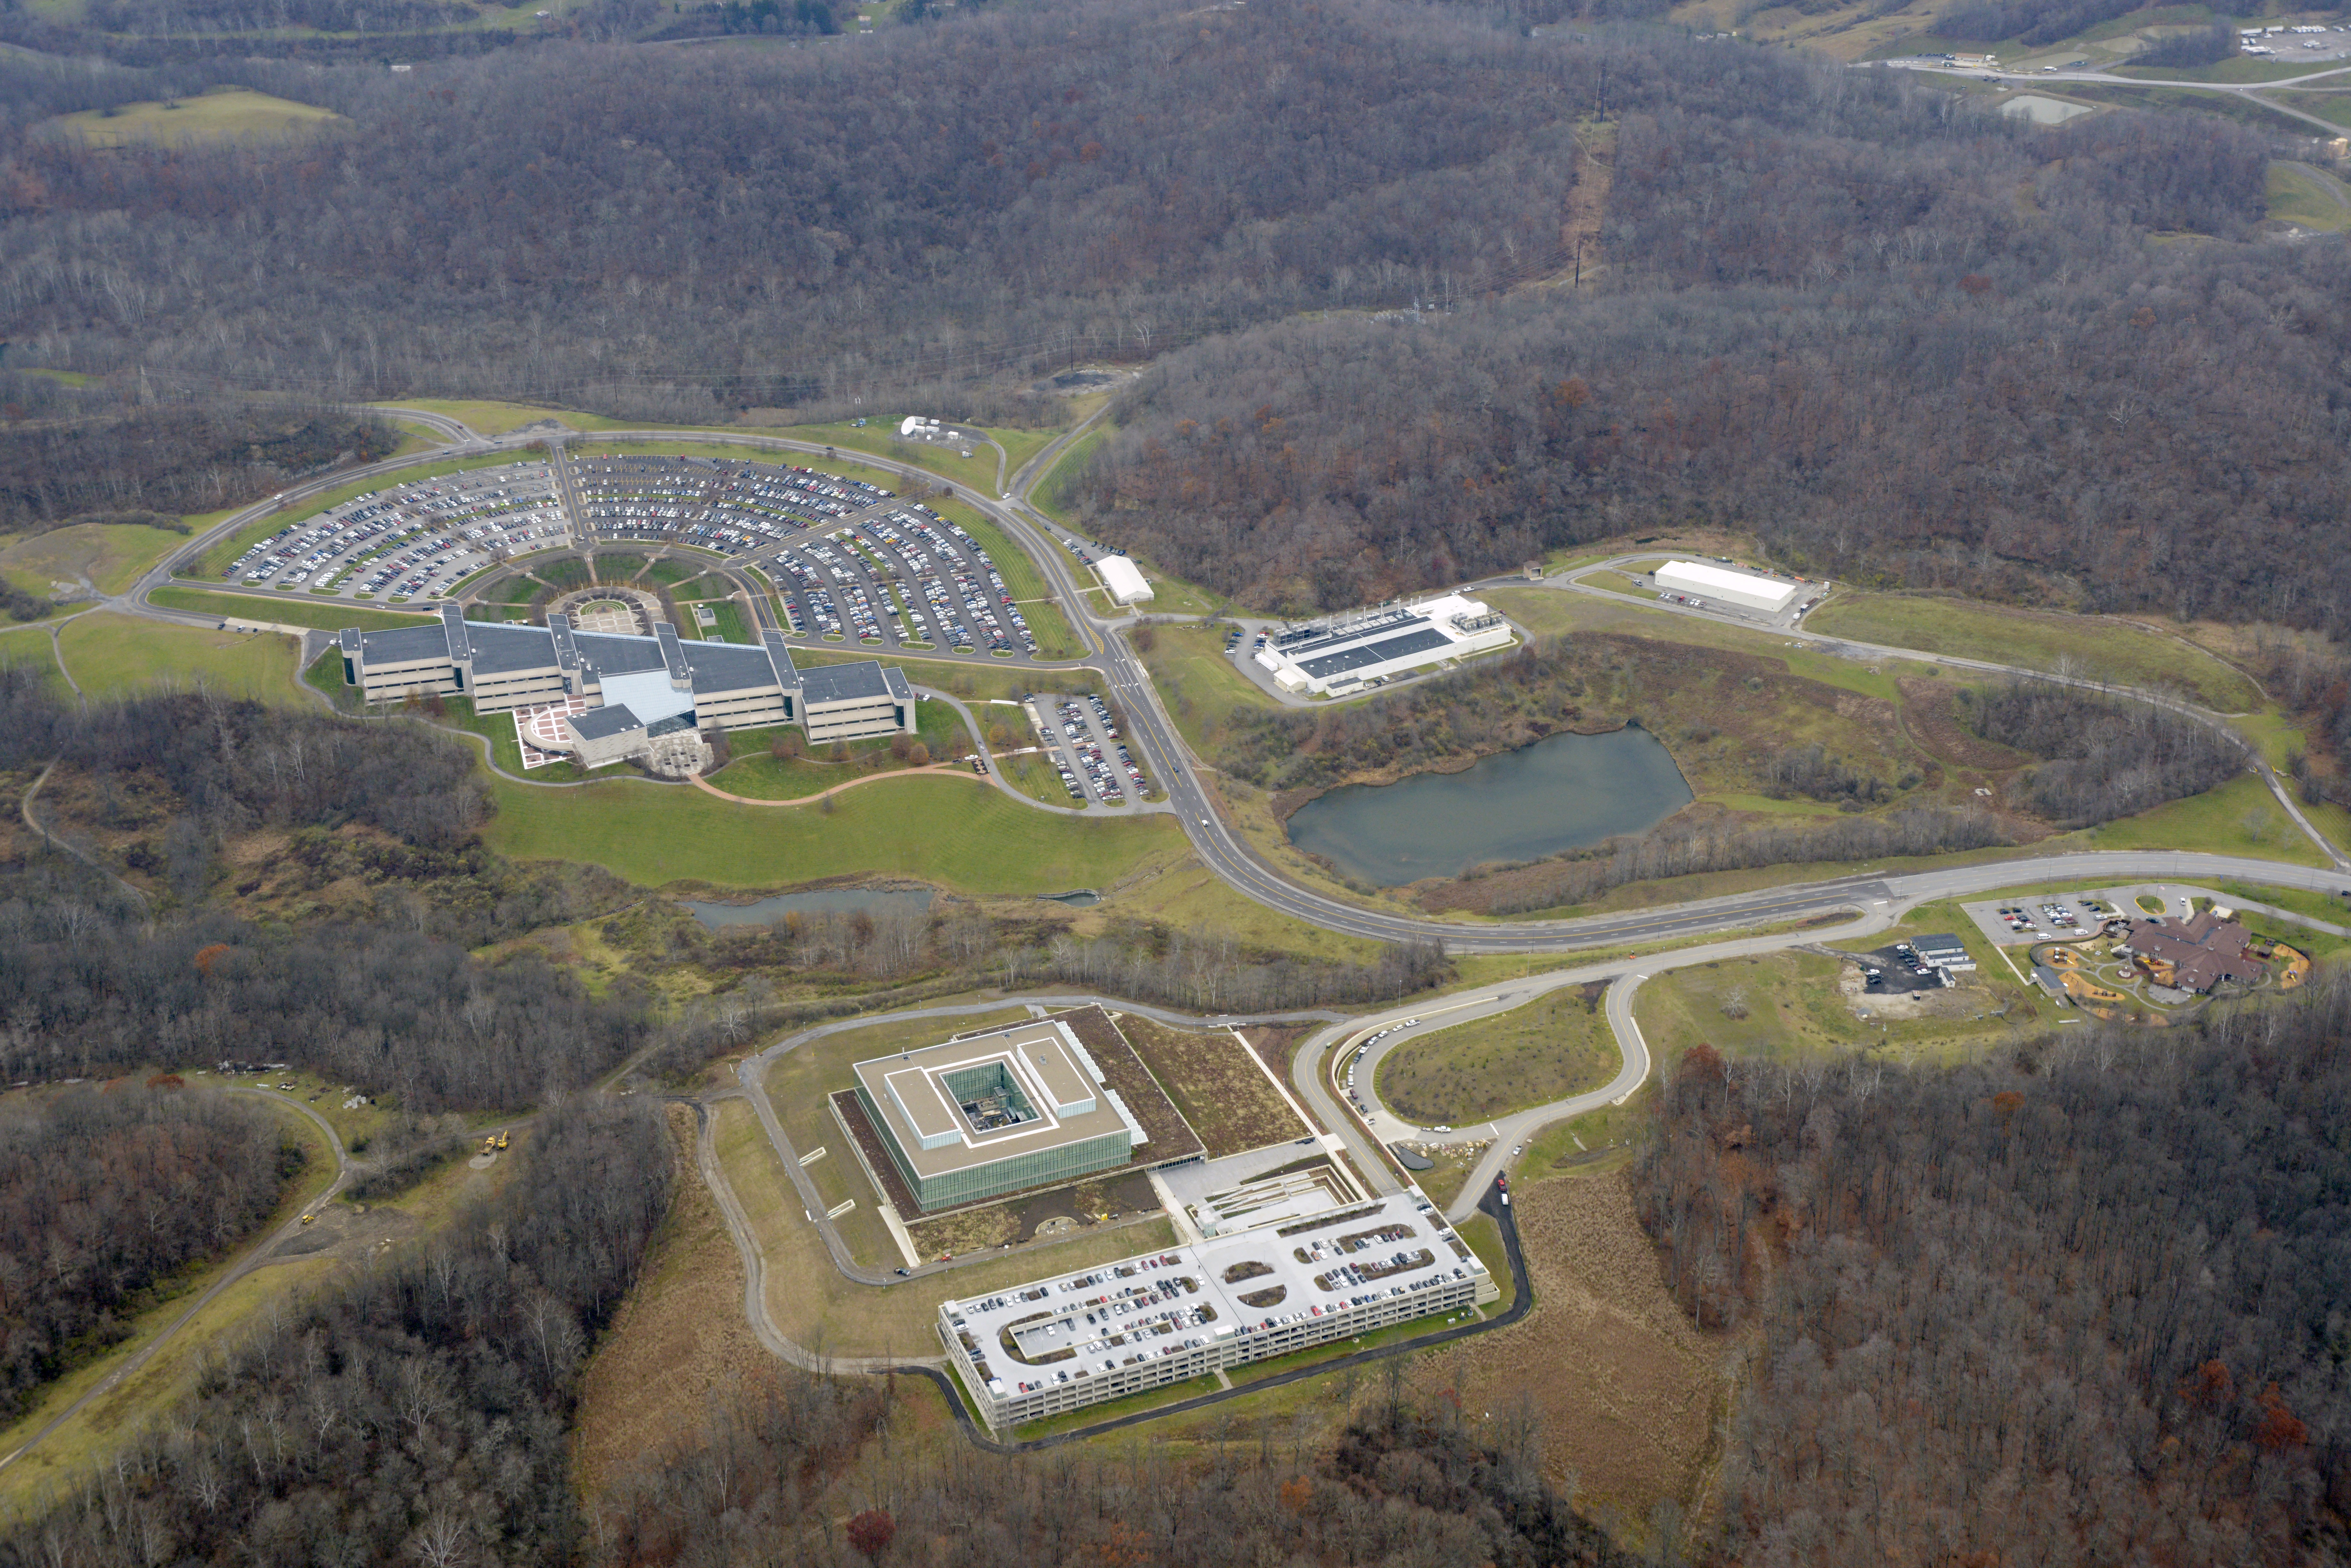
About the CJIS Campus
UNCLASSIFIED
UNCLASSIFIED
Notes:
The ones that were able to go on the tour, hope you enjoyed for those that were unable, here is the campus picture.
CJIS is located in Clarksburg, West Virginia, and is situated on a campus of approximately 1,000 acres.
The road that leads into the campus is called Jerry Dove Drive and named in the honor of the late Special Agent Jerry Dove who was a native of West Virginia. Special Agent Dove was killed in the line of duty in a tragic incident referred to as the “Miami Firefight” in 1986.
Most of our staff work in one of two buildings – this one, which is called CJIS Main, and the Biometric Technology Center, or BTC.
Facts:
986 Acres
22 Buildings (including the RA building at east gate)
1.7 millions sqft, 1.2 million conditioned
12 miles of two lane roads
481 street lights
4,000 people onsite
17 elevators onsite
11 generators – 24 megawatts
Dual high voltage 12,470 feeds from first energy
To maintain the campus, we have our own Facilities Management Unit with facilities personnel. We also contract out technical SMEs and contract with Job Squad Inc for custodial and grounds maintenance.

Slide 16

Frequently recruited positions for the CJIS Division in Clarksburg, WV:
UNCLASSIFIED
Biometric Images Examiner (BIE)
Legal Instruments Examiner (LIE)
Threat Intake Examiner (TIE)
Information Technology Specialists (ITS)
  Apply at www.fbijobs.gov.
UNCLASSIFIED
Notes:
We have a great campus, but the heart of our division is our people.
Here is a list of the positions frequently posted for employment the CJIS Division.
If you know folks who might be good candidates for these positions, send them to fbijobs.gov.
The FBI has a great mission. It is a good feeling to be part of making our nation safer and improving officer safety.

Slide 17
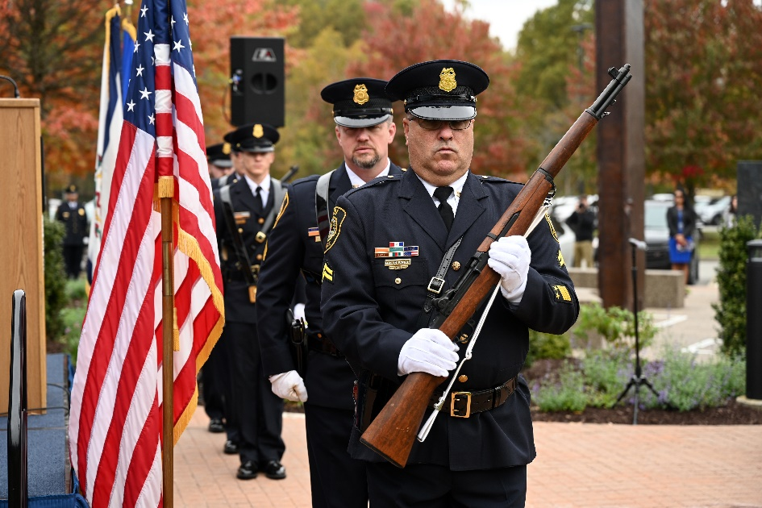
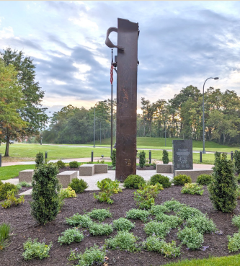
9/11 Memorial on the CJIS campus
UNCLASSIFIED
9/11 Memorial and Museum in
New York offered loan of artifact
22-foot steel box column recovered from one of the towers
Reminder of FBI’s goal to stay “ahead of the threat.”
UNCLASSIFIED
Notes:
During FY2023, construction was completed on a 9/11 memorial on the FBI CJIS campus.
The 9/11 Memorial project began in 2018 when the 9/11 Memorial and Museum in New York offered the loan of an artifact to display on the CJIS Division’s campus.
A tall steel beam salvaged from one of the twin towers in New York City is the focal point of the memorial.
Concrete benches surround the beam and symbolize buildings that were destroyed on that tragic September day.
The memorial is situated outside of the campus entrance on Jerry Dove Drive and is open to the public. CJIS staff hope the memorial will create an experience that connects employees and visitors to the events of September 11, 2001, that transformed the FBI and how it operates.
The 9/11 Memorial also serves as a constant reminder of the FBI’s mission to protect the American people and uphold the Constitution of the United States and the FBI’s goal to stay “ahead of the threat.”

Slide 18
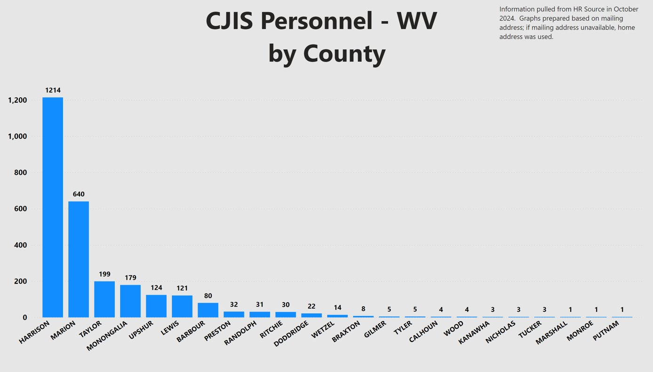

UNCLASSIFIED
UNCLASSIFIED
Notes:
Economic Development
23 WV counties are represented within the CJIS Division workforce

Slide 19

UNCLASSIFIED
FBI CJIS Division
UNCLASSIFIED
Notes:
Closing and questions

