Slide 1

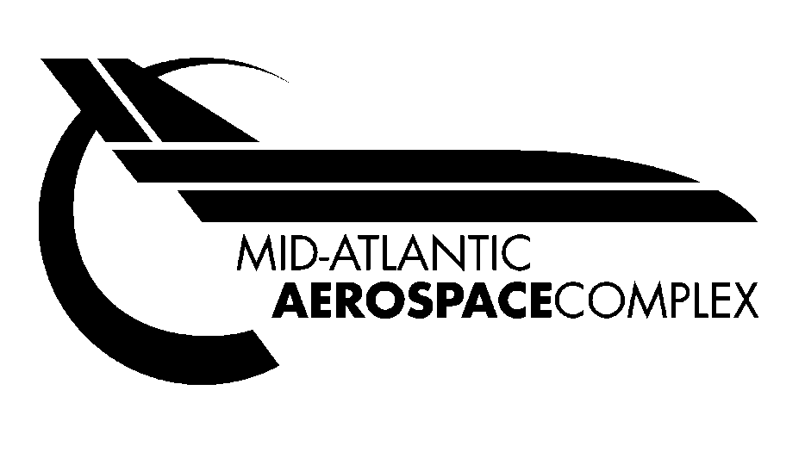

North Central
West Virginia Airport

Slide 2
North Central West Virginia Market Update
Our local economy is one of the strongest in West Virginia; local unemployment the lowest in history.
Significant MRO expansion at CKB, hundreds of new aerospace jobs being added to what is already the largest aerospace industrial cluster in the region.
Aerospace, health care, energy, high-tech, WVU and the FBI Criminal Justice Information System (CJIS cluster) are local high travel generators.

Slide 3


NCWV Aerospace Industry Stats
There are approximately 1500 people in aviation related jobs in Bridgeport
Provide an economic impact over $1.1+ billion annually
Total direct and indirect jobs attributed to the aerospace industry – 3200
Longest commercial runway in WV

Slide 4
WV Aerotech Park
Over 3 million cubic yards of excavation work was moved to create approximately 70 site-ready acres to form the WV AeroTech Park
Direct taxiway access to the airport’s 7,800-foot runway and is to be used for commercial and industrial use
New investment at the WV Aerotech Park, will double our current footprint of our current total square footage under roof to 2,000,000 SF and double our economic impact to $2 billion annually to the WV economy

Slide 5
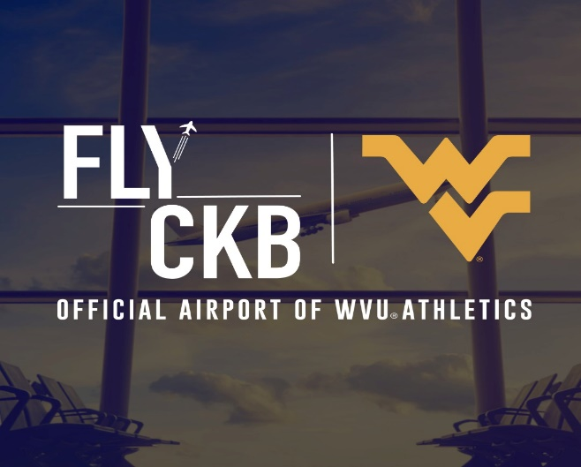
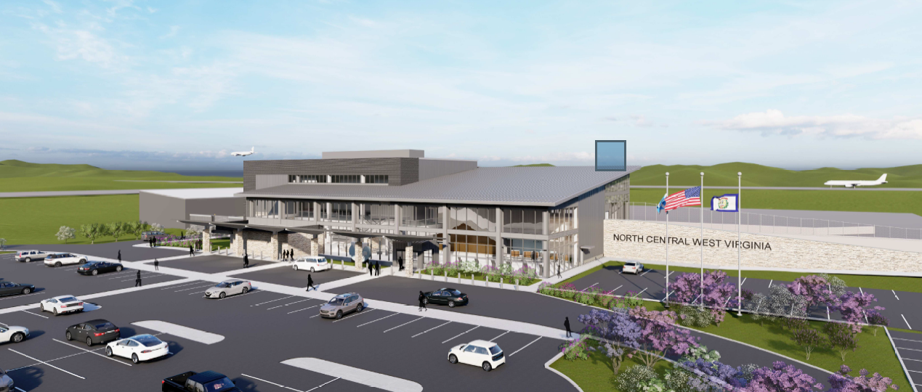
North Central West Virginia Airport
The North Central WV Airport’s new terminal is three stories, approximately 50,000 sq ft, has four gates, and a capacity of 400,000 passengers
The terminal can accommodate up to a Boeing 757
The North Central West Virginia Airport, CKB, is home to the longest commercial service runway in West Virginia
CKB has daily flights on Contour Airlines to Charlotte Douglas International Airport (CLT) and countless connections through their partnership with American Airlines
Allegiant provides service to Orlando/Sanford, FL and seasonal service to Myrtle Beach, SC as well as Tampa/St. Pete and Destin-Fort Walton Beach, FL
CKB is the official airport of WVU Athletics

Slide 6
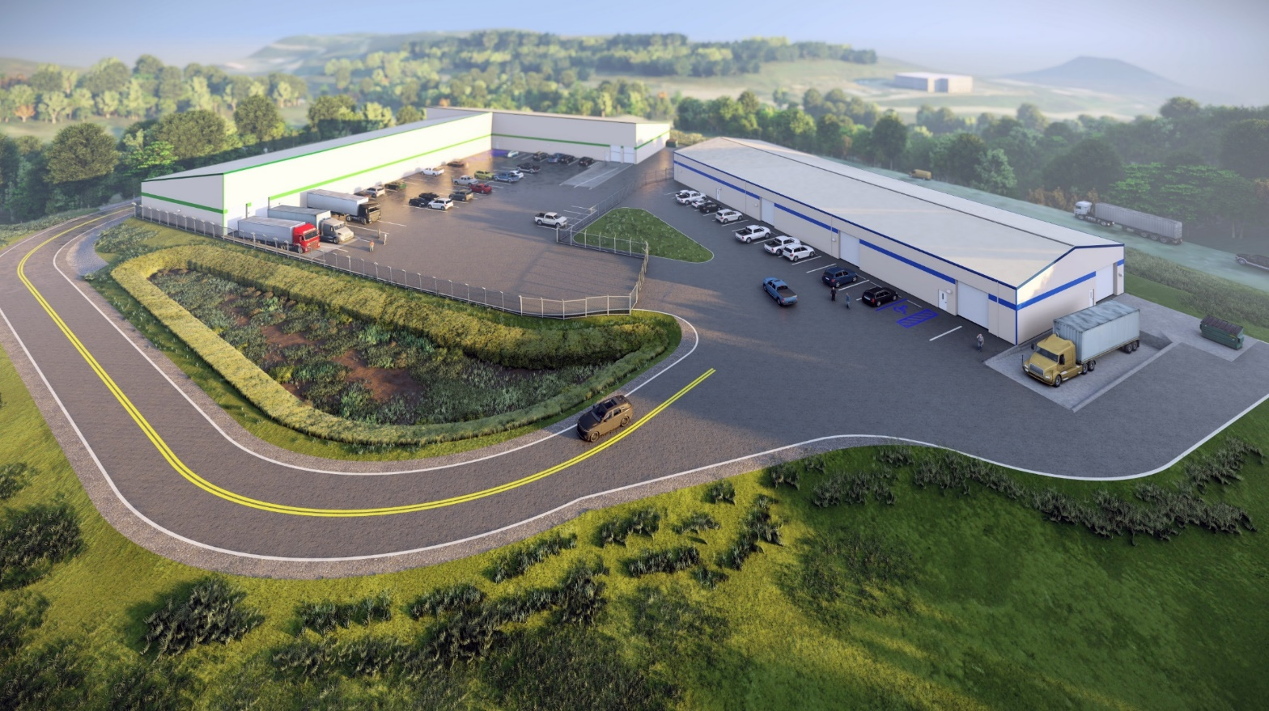
Benedum Logistic Park
18,000 SF building, occupied by MHIRJ, in 5 acre park
Additional 40,000 SF building space available

Slide 7
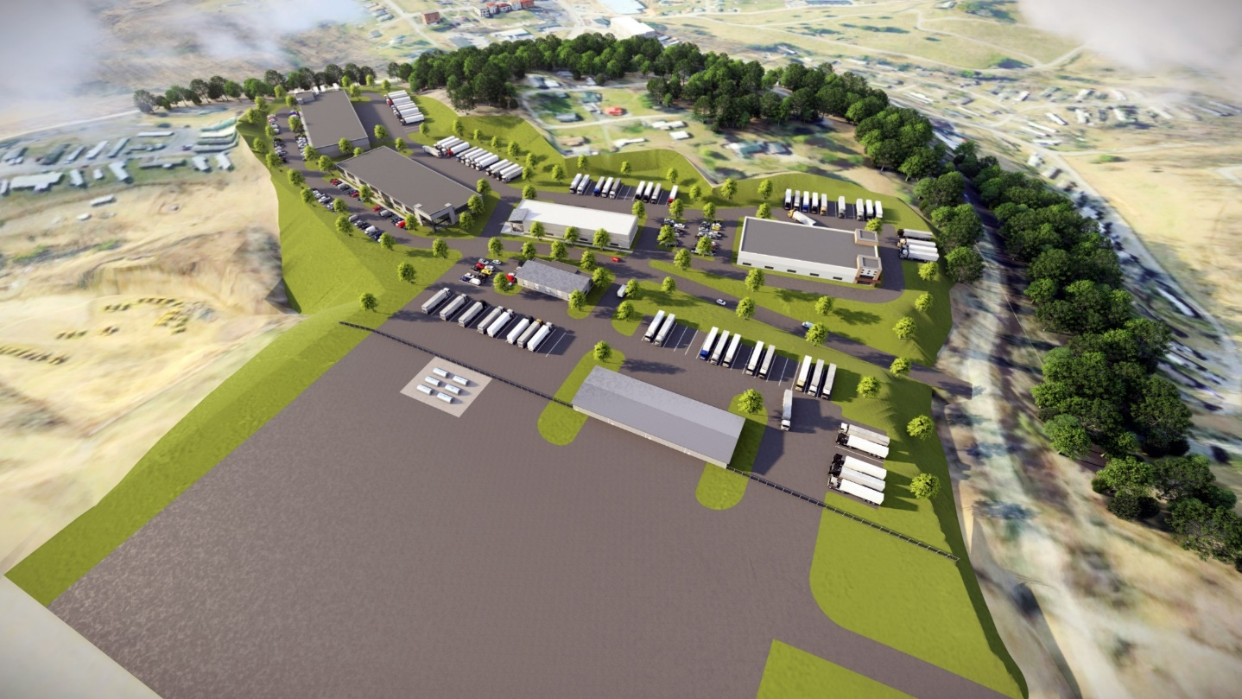
Harrison Regional Industrial Park
New 50,000 SF proposed shell building in 20 acre park
  $2.6 Million USEDA Grant
9 acres available
Harrison Economic Development Corporation is the developer
HARRISON REGIONAL INDUSTRIAL PARK

Slide 8
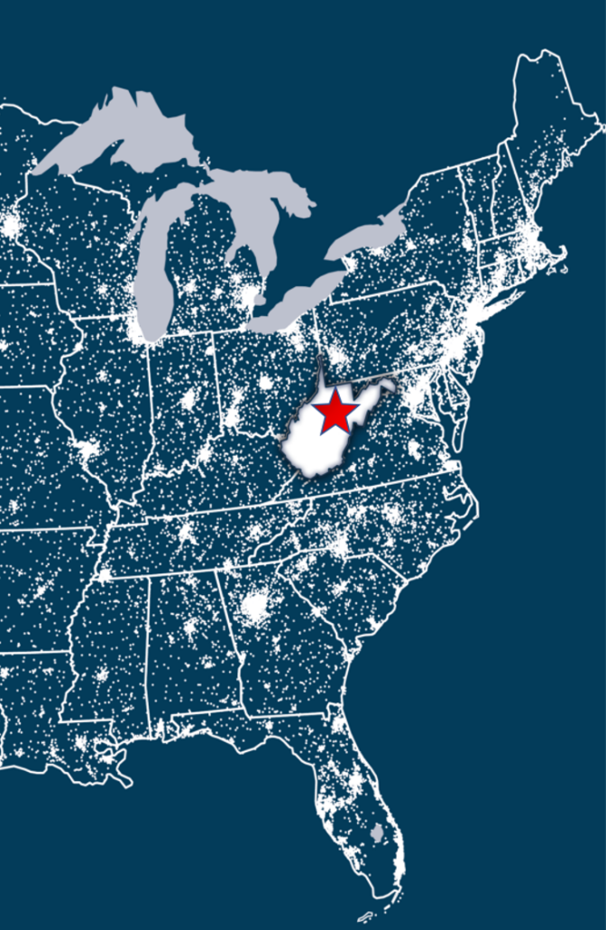
North Central WV Airport Flight Path
North Central WV Airport &
WV AeroTech Park, Bridgeport WV
CKB is Strategically located to more than half of the US Population and is situated in the center of the east coast flight path on the longest commercial runway in WV
CKB is located by major highways that provide access to more than half of the US population and a third of the Canadian Market
We supply North Central WV with jobs in aerospace, technology, and supply chain; and are poised to continue this growth now and into the future

Slide 9









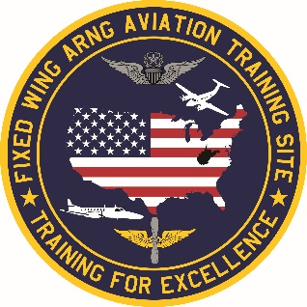





THE MID-ATLANTIC AEROSPACE COMPLEX
CKB & Mid-Atlantic Aerospace Complex have more than a dozen aerospace companies or entities in our cluster.
The on-field aerospace entities employ more than 1,500 locally and have a local annual economic impact of over $1.1 billion.

Slide 10
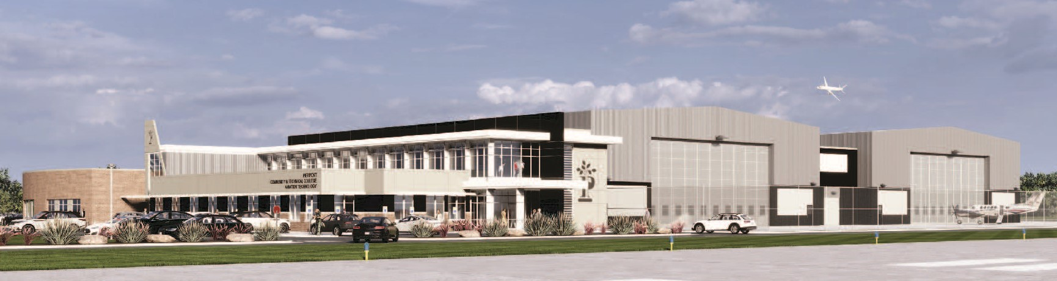
Pierpont Community & Technical College Aviation Technology Center
First flagship Part 147 FAA Aviation Maintenance Technician facility built in WV in 1992
Specializes in two-year associate degree programs and customized industry training
Designated FAA Written Test Center
WV Invests - last dollar in, free community college for WV students, available for AMT students
LevelUpWV, state-funded dual enrollment, allows high school students to take aviation college courses for free

Slide 11


Questions?

