Slide 1


Matt Herridge
Cabinet Secretary
West Virginia Department of Commerce
(304) 558-2234 | Matt.Herridge@wv.gov

Slide 2


Gradually, Then Suddenly

Slide 3
Keeping it Simple – Principle of Parsimony
Smart Growth : The Basics
Expand Supply of Essentials: energy, housing, careers…
Desirable Place to Live – Quality of Life
How?

Slide 4

The Call – Opportunity and Optimism

Slide 5


#YESWV Strategy
Economic development focus, alignment and priorities

Slide 6

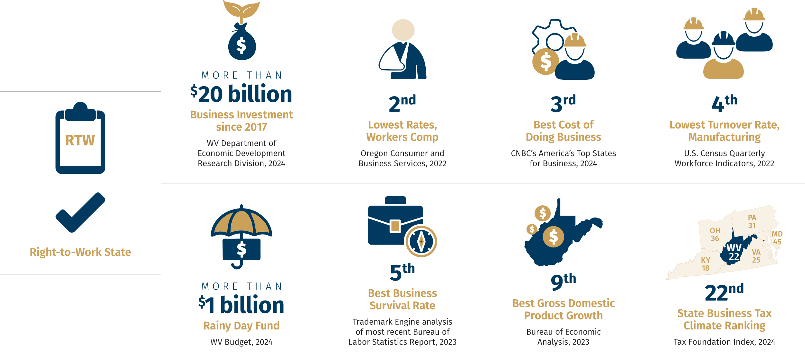
#YESWV Advantages

Slide 7

Link strategy and policy
Connect economic development strategy to energy policy
and workforce development strategy.

Slide 8



Industry Focus
Advanced Manufacturing
Technology
Energy
Agriculture and Biotechnology
Artificial Intelligence/
Data Centers
Broadband and IT Infrastructure
Cryptocurrency
Cybersecurity
Material Science
Telecommunications
Biometrics
Digital Identity and Security
Life Science
Electricity Generation
COAL:
Graphite, Graphene and Steel
GAS:
Fertilizer, Chemicals
and Polymers
HYDROGEN:
Food/Metal Processing
MINERALS:
Clay, Quartz and Limestone
Energy Infrastructure
Aerospace, Aviation, AAM
Automotive
Building Products
Metals
Pharmaceuticals
SMR Manufacturing
General Manufacturing
Petrochemicals
Life Science
Defense

Slide 9
#YESWV

Slide 10
The Turning Point

Slide 11


Slide 12
Matt Herridge
Cabinet Secretary
West Virginia Department of Commerce
(304) 558-2234 | Matt.Herridge@wv.gov

