Slide 1
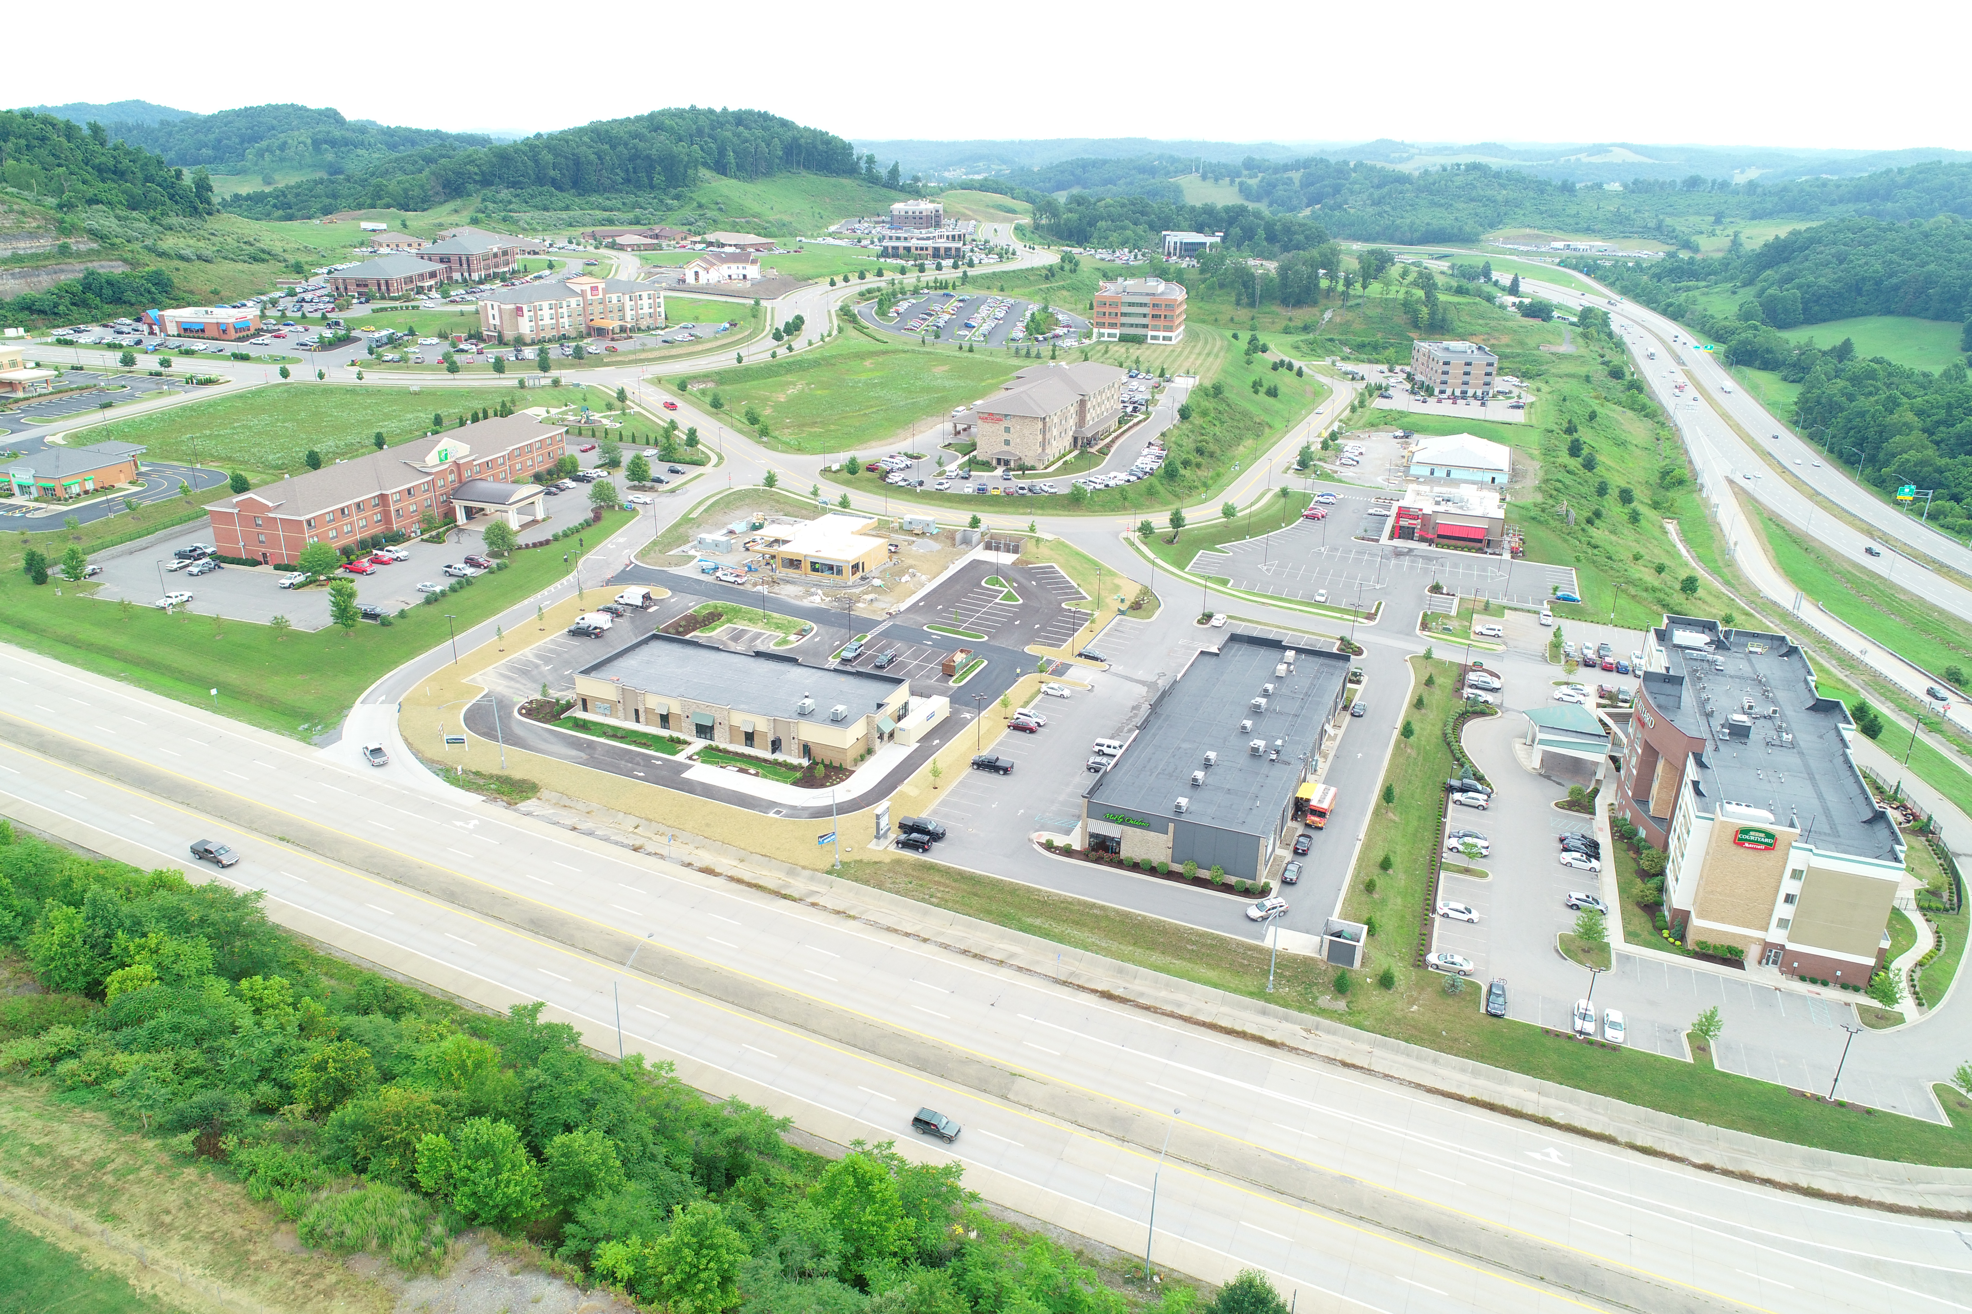

Strengthening Rural Economies through Developer Partnerships:
How White Oaks Came to Be

Slide 2
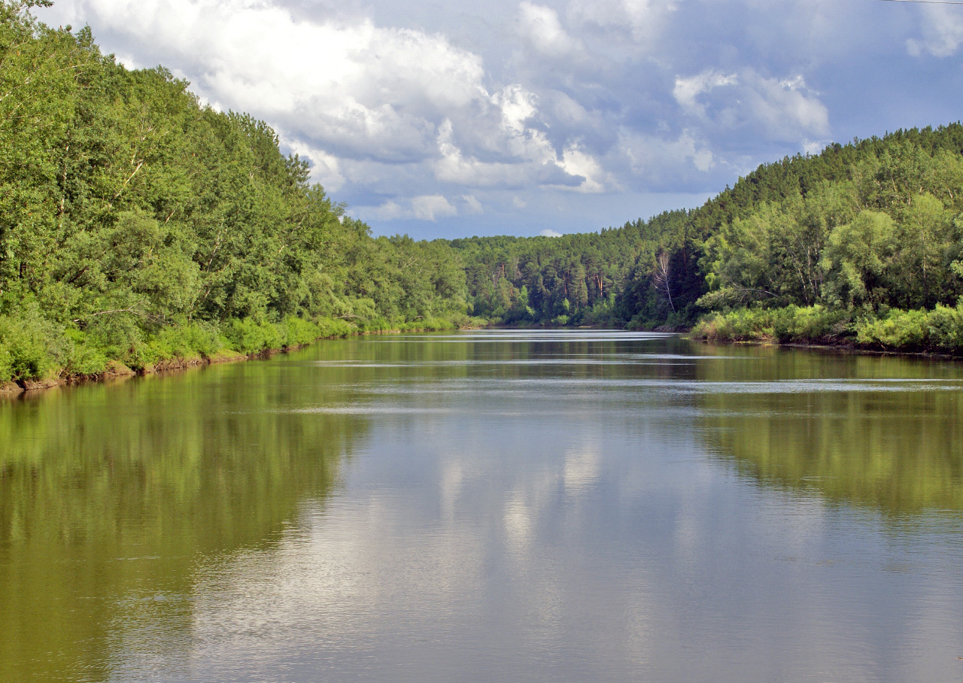
Partnerships build bridges.
Without them… you just stare at the river.

Slide 3
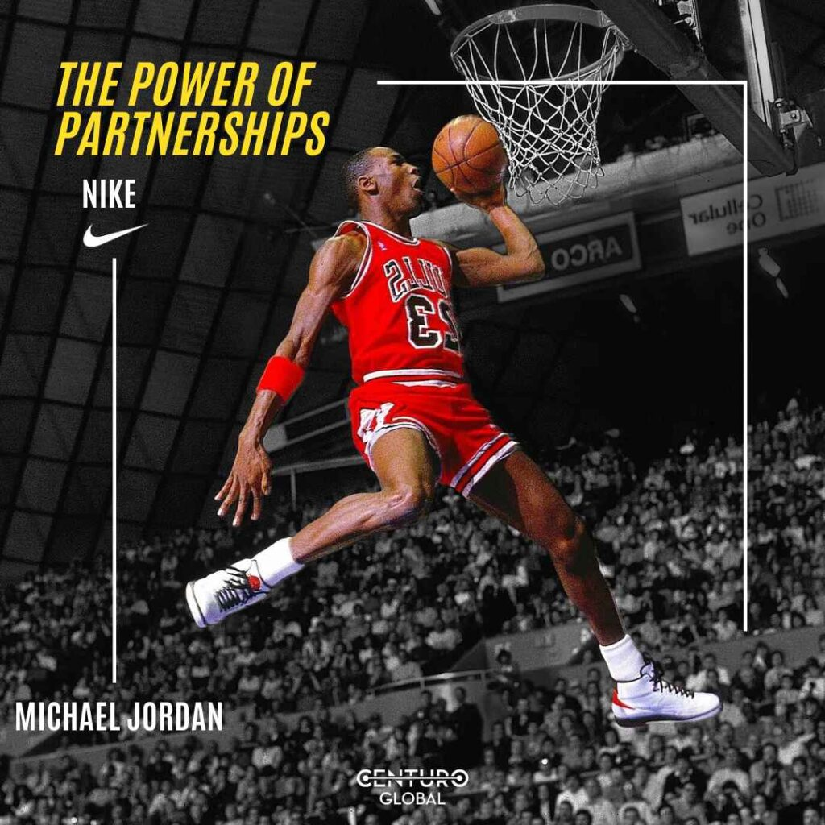
When it works: 1 + 1 = 11.
Nike & Michael Jordan (Air Jordan) – Partnership turned a sneaker into a cultural phenomenon and still prints money decades later.

Slide 4
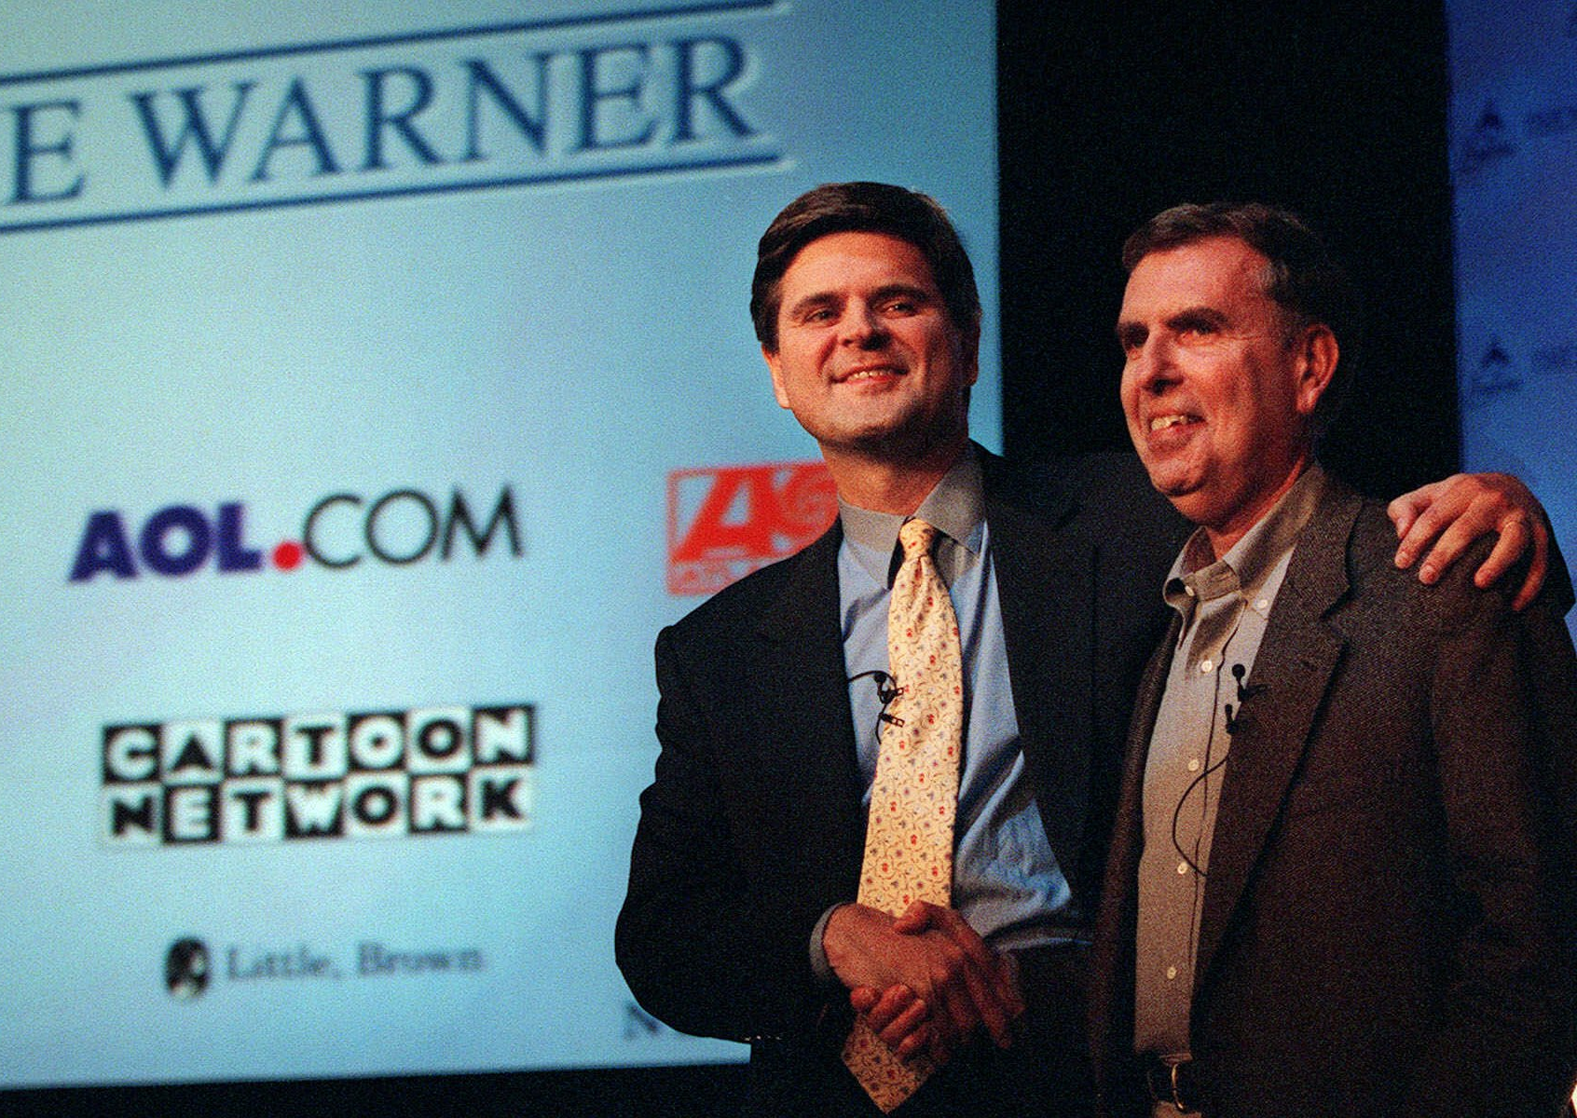
When it doesn’t: 1 + 1 = 0.5.
AOL & Time Warner – The “worst merger in history.” $165B deal collapsed under culture clash and
tech missteps.

Slide 5
Partnership:
Different Skill Sets
Vested Interest/Skin in the Game
Need to be Adaptable
One Thing You Can Count on is Change
Large vs. Small Endeavors
Sweet Spot for Local Development Authorities to Team with Local Developers
Site Readiness

Slide 6
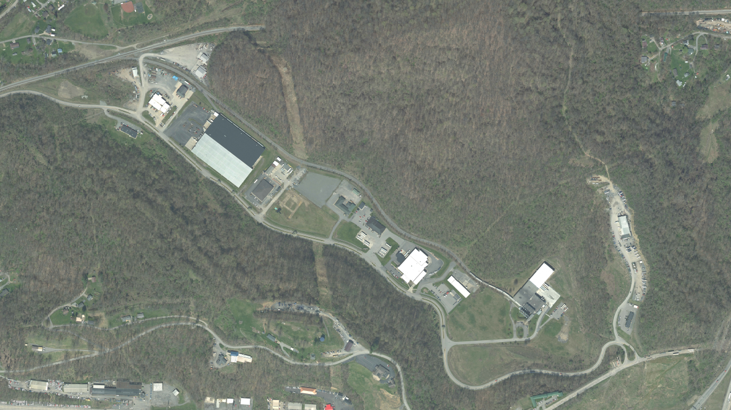
West Virginia Life Sciences Center
It Wasn’t a Lack of Land. It Was a Lack of Partnership

Slide 7
So…Then What Happened?
Harrison County Business & Technology Center
Same dirt, new story — partnership made it grow.

Slide 8
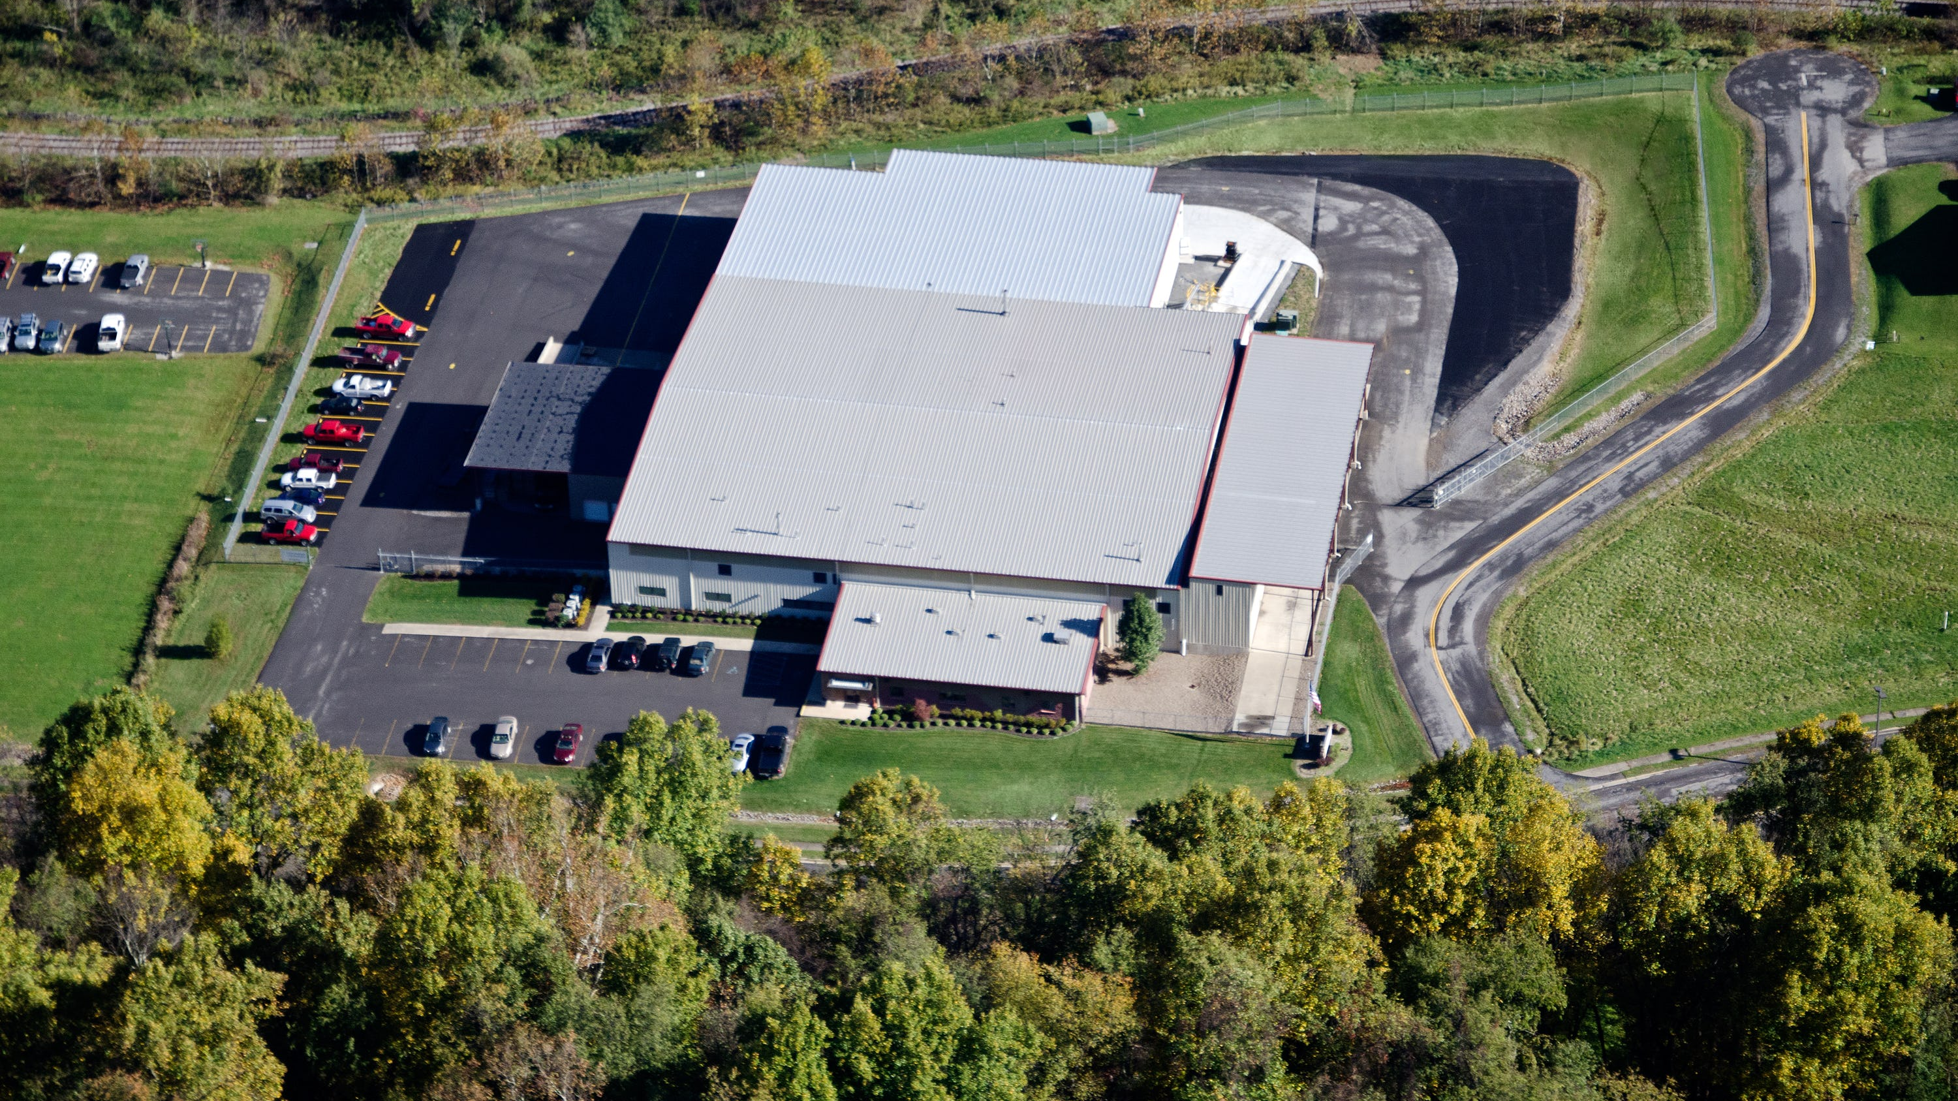

Slide 9
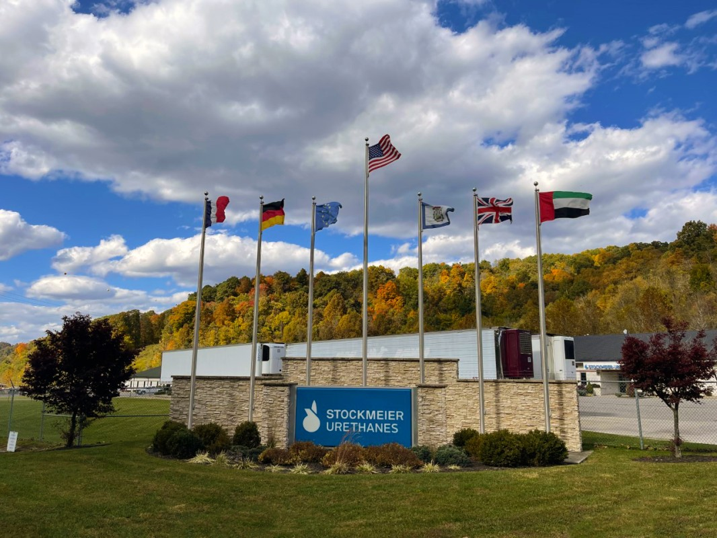

Slide 10
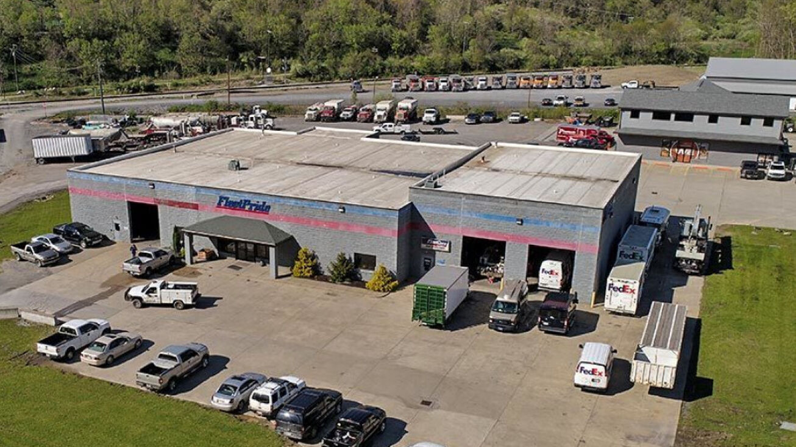

Slide 11
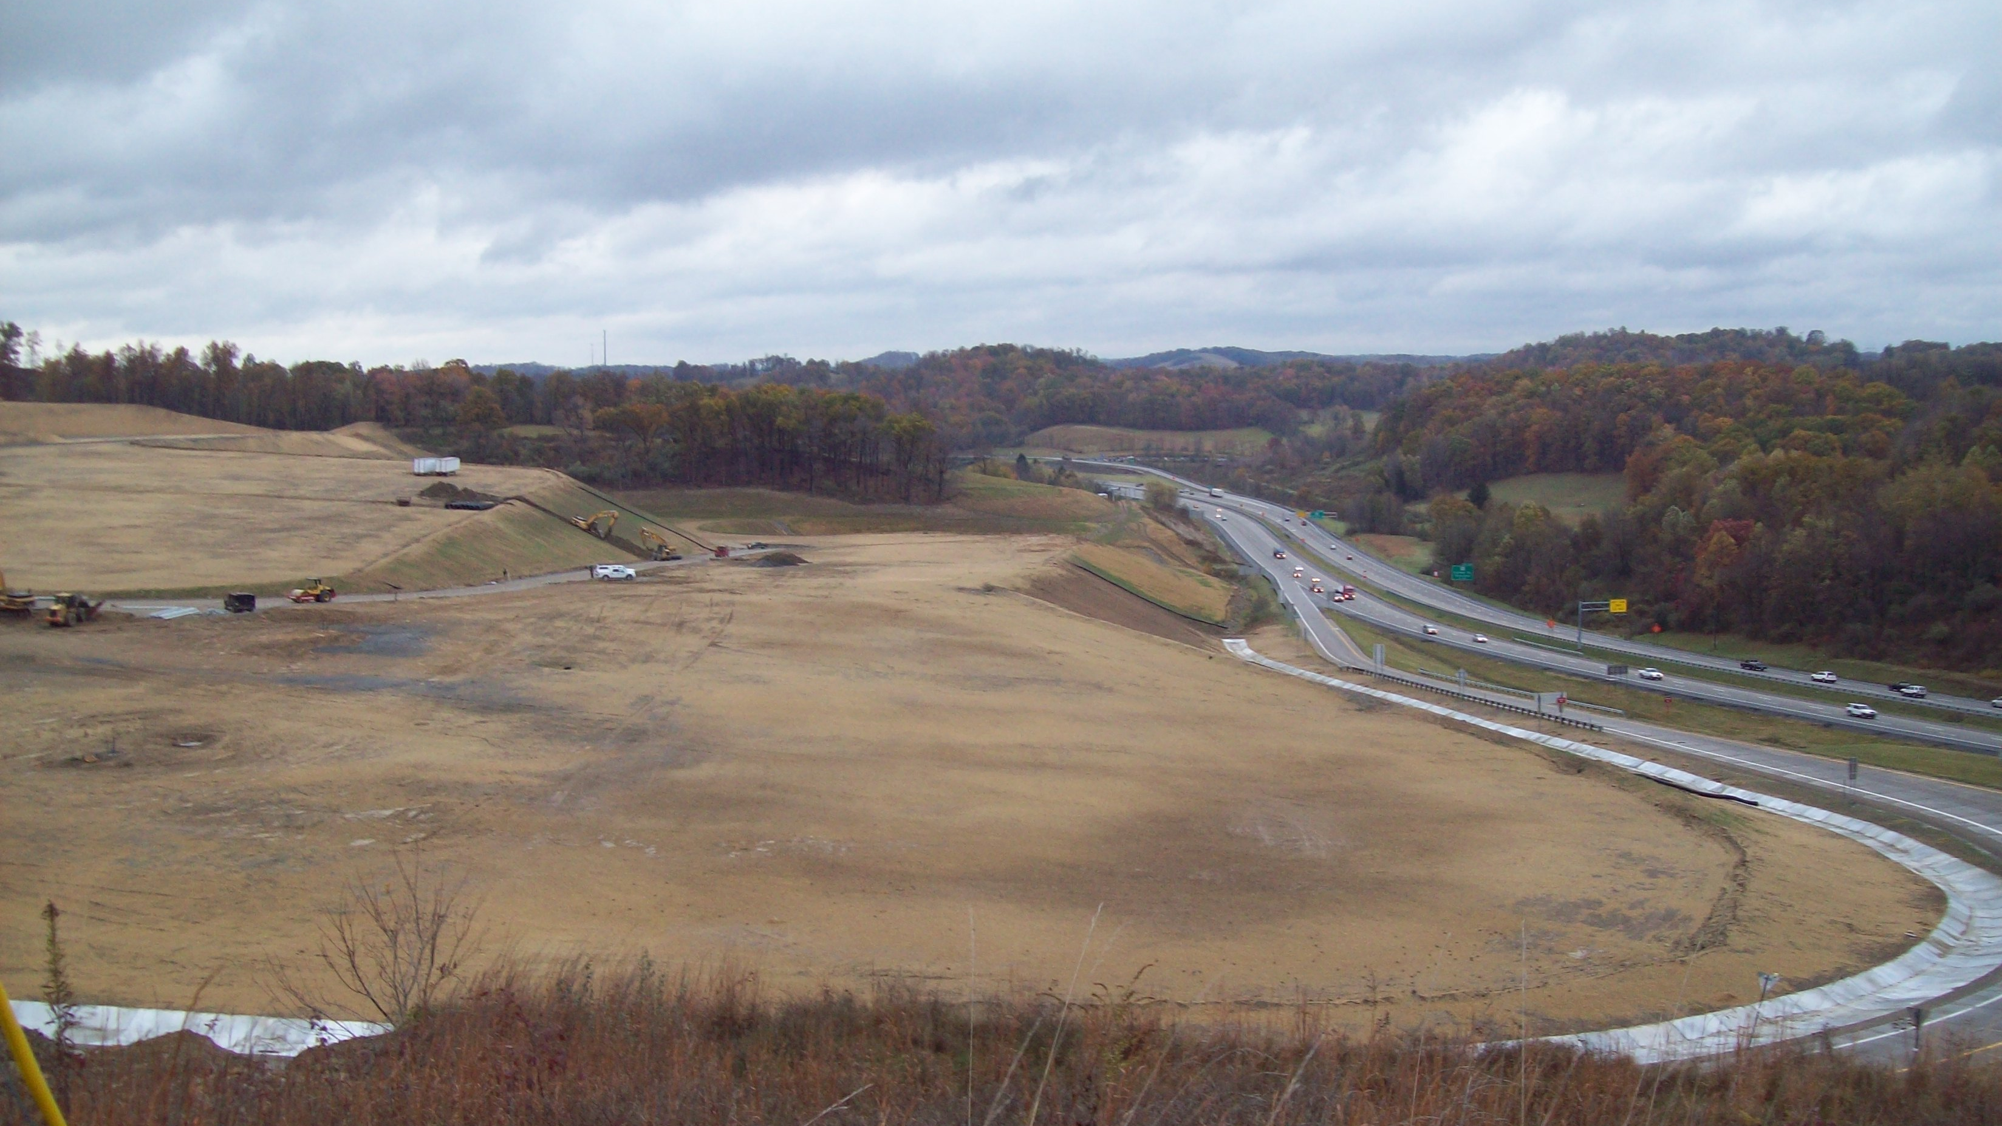
Call it vision… or maybe just not knowing how to sit still.
White Oaks: proof that vision + persistence =
progress you can see from the highway.

Slide 12
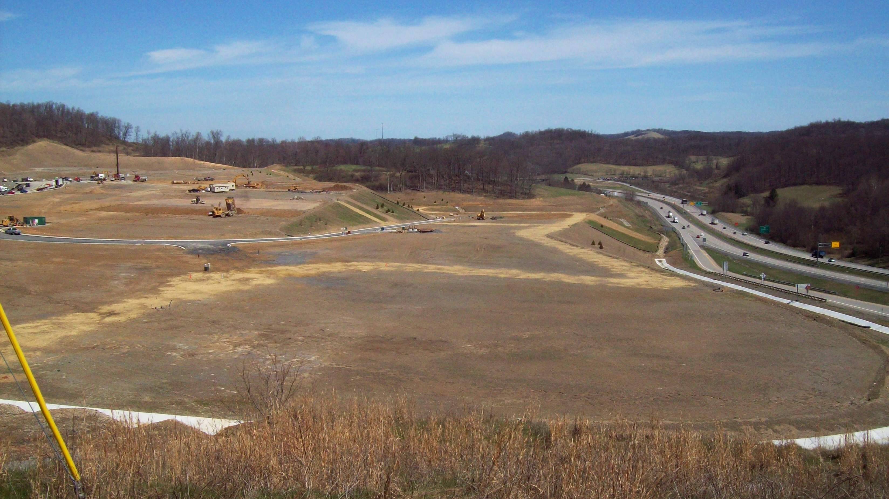

Slide 13
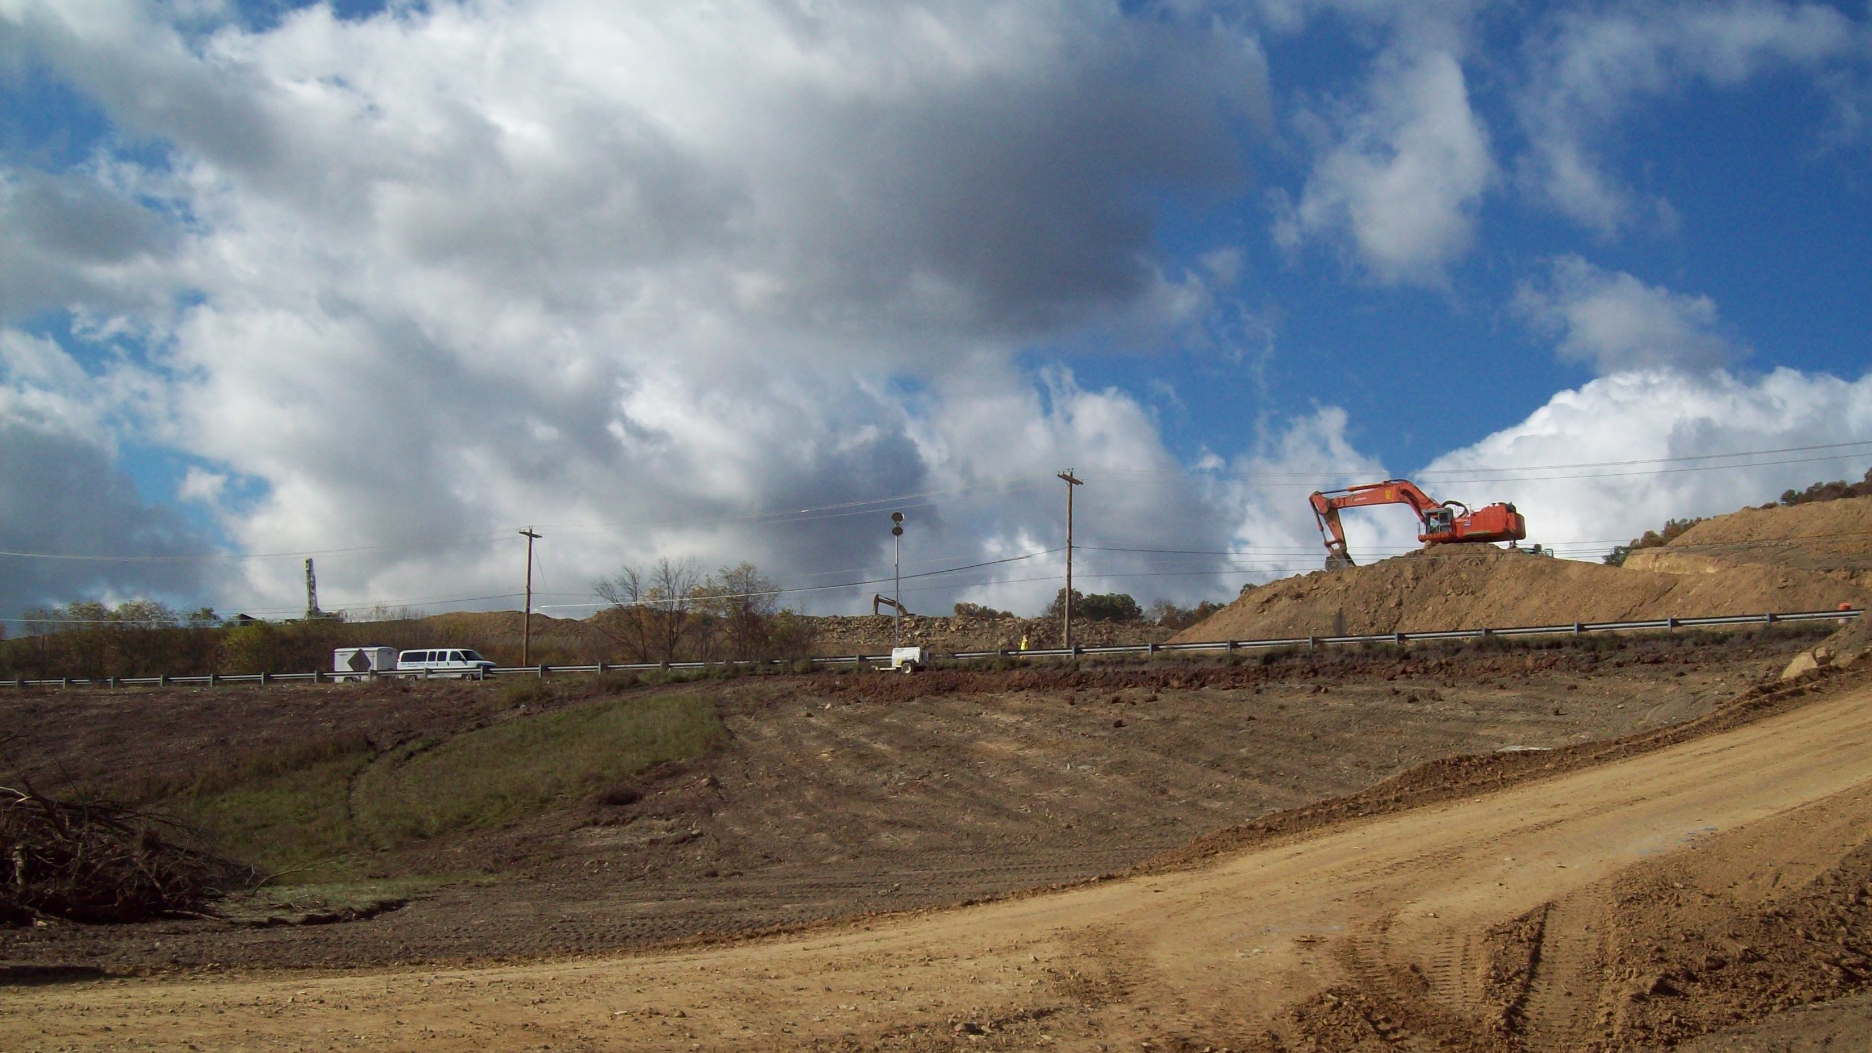

Slide 14
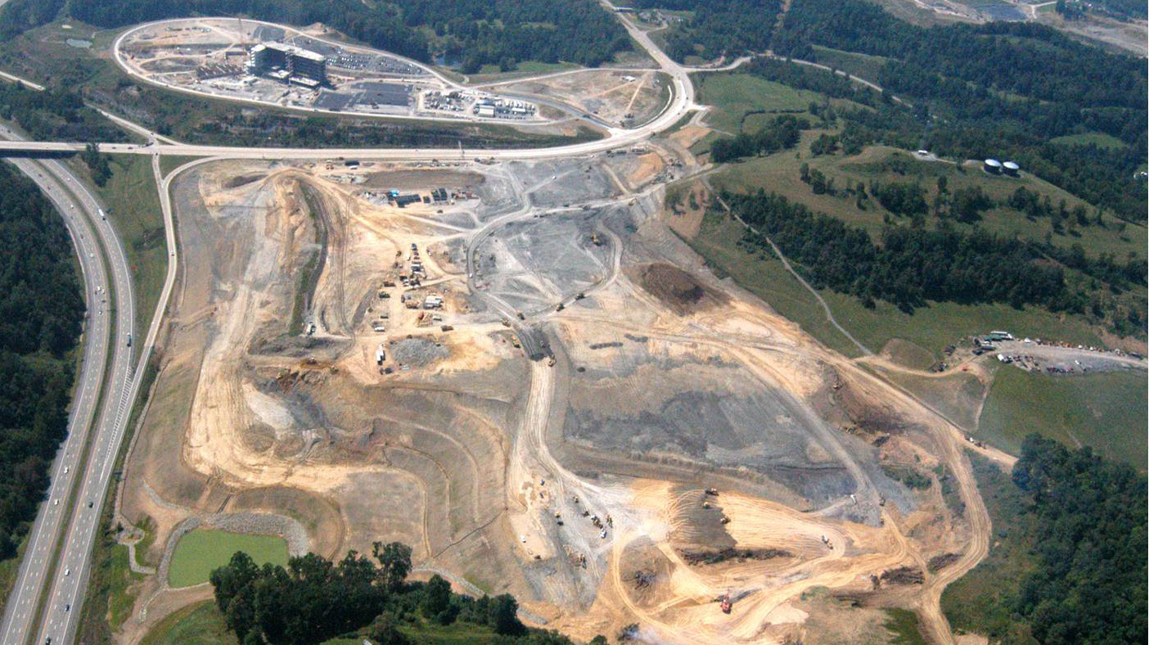

Slide 15
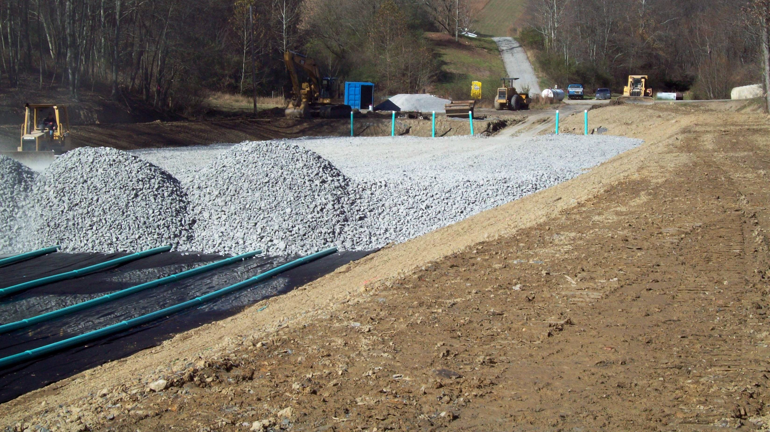

Slide 16
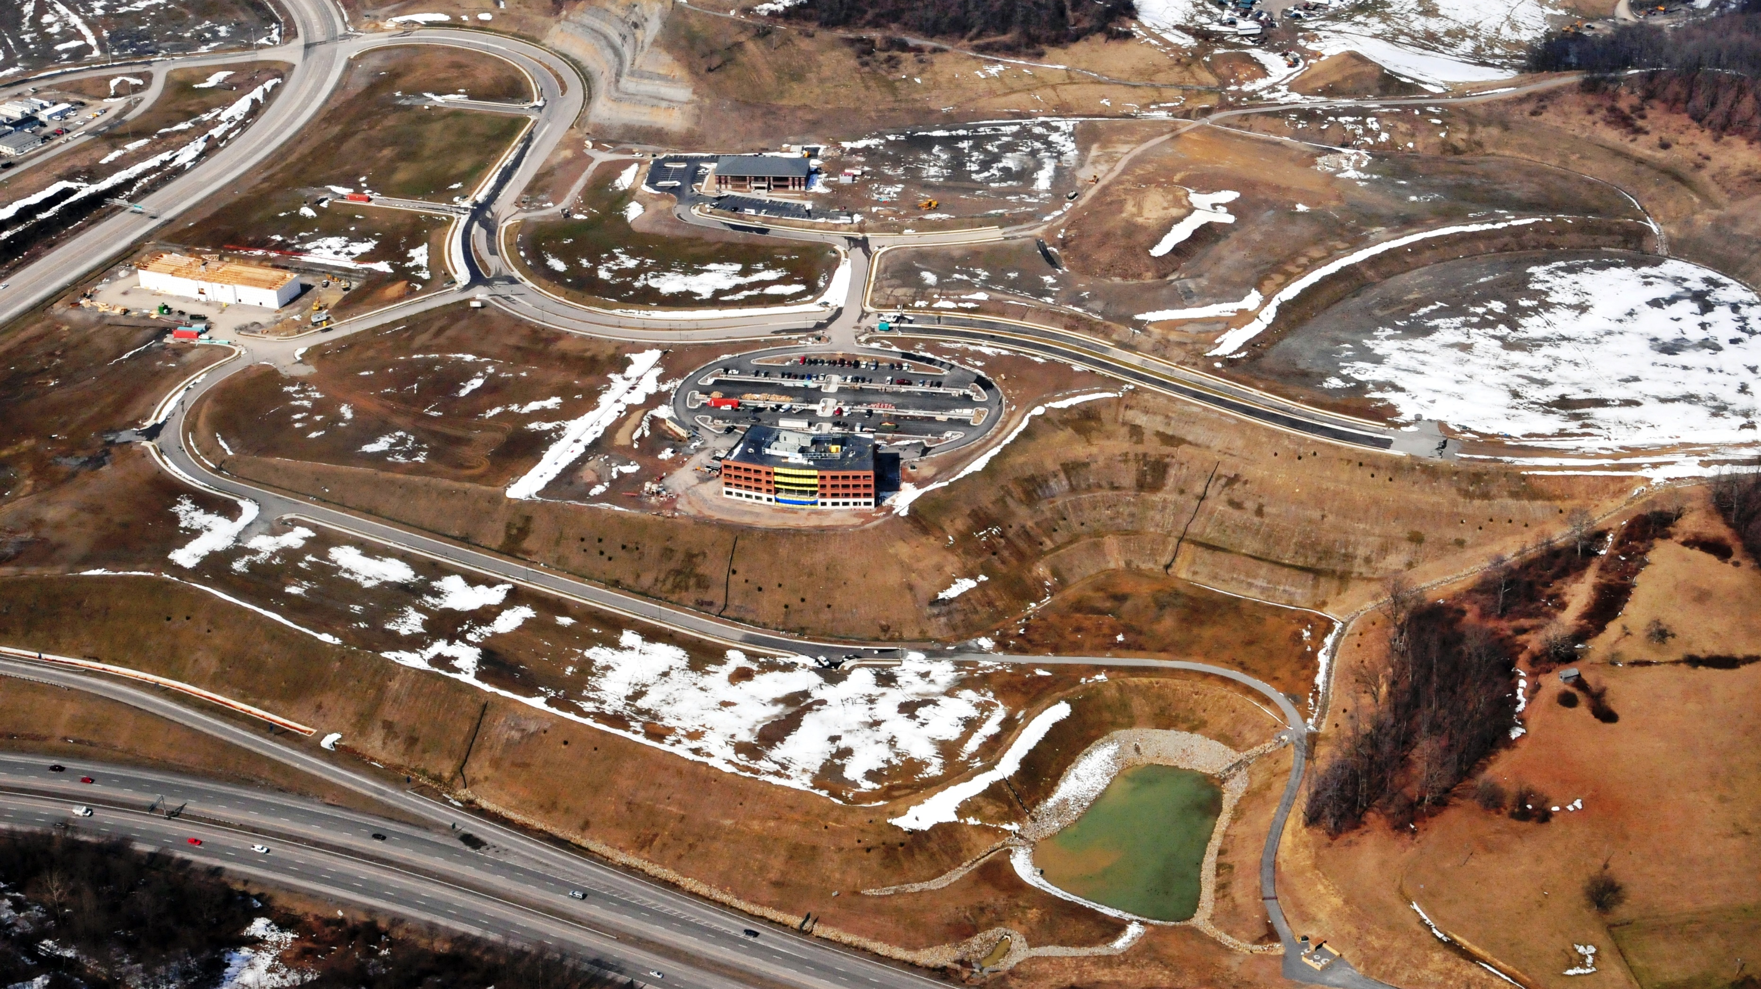

Slide 17
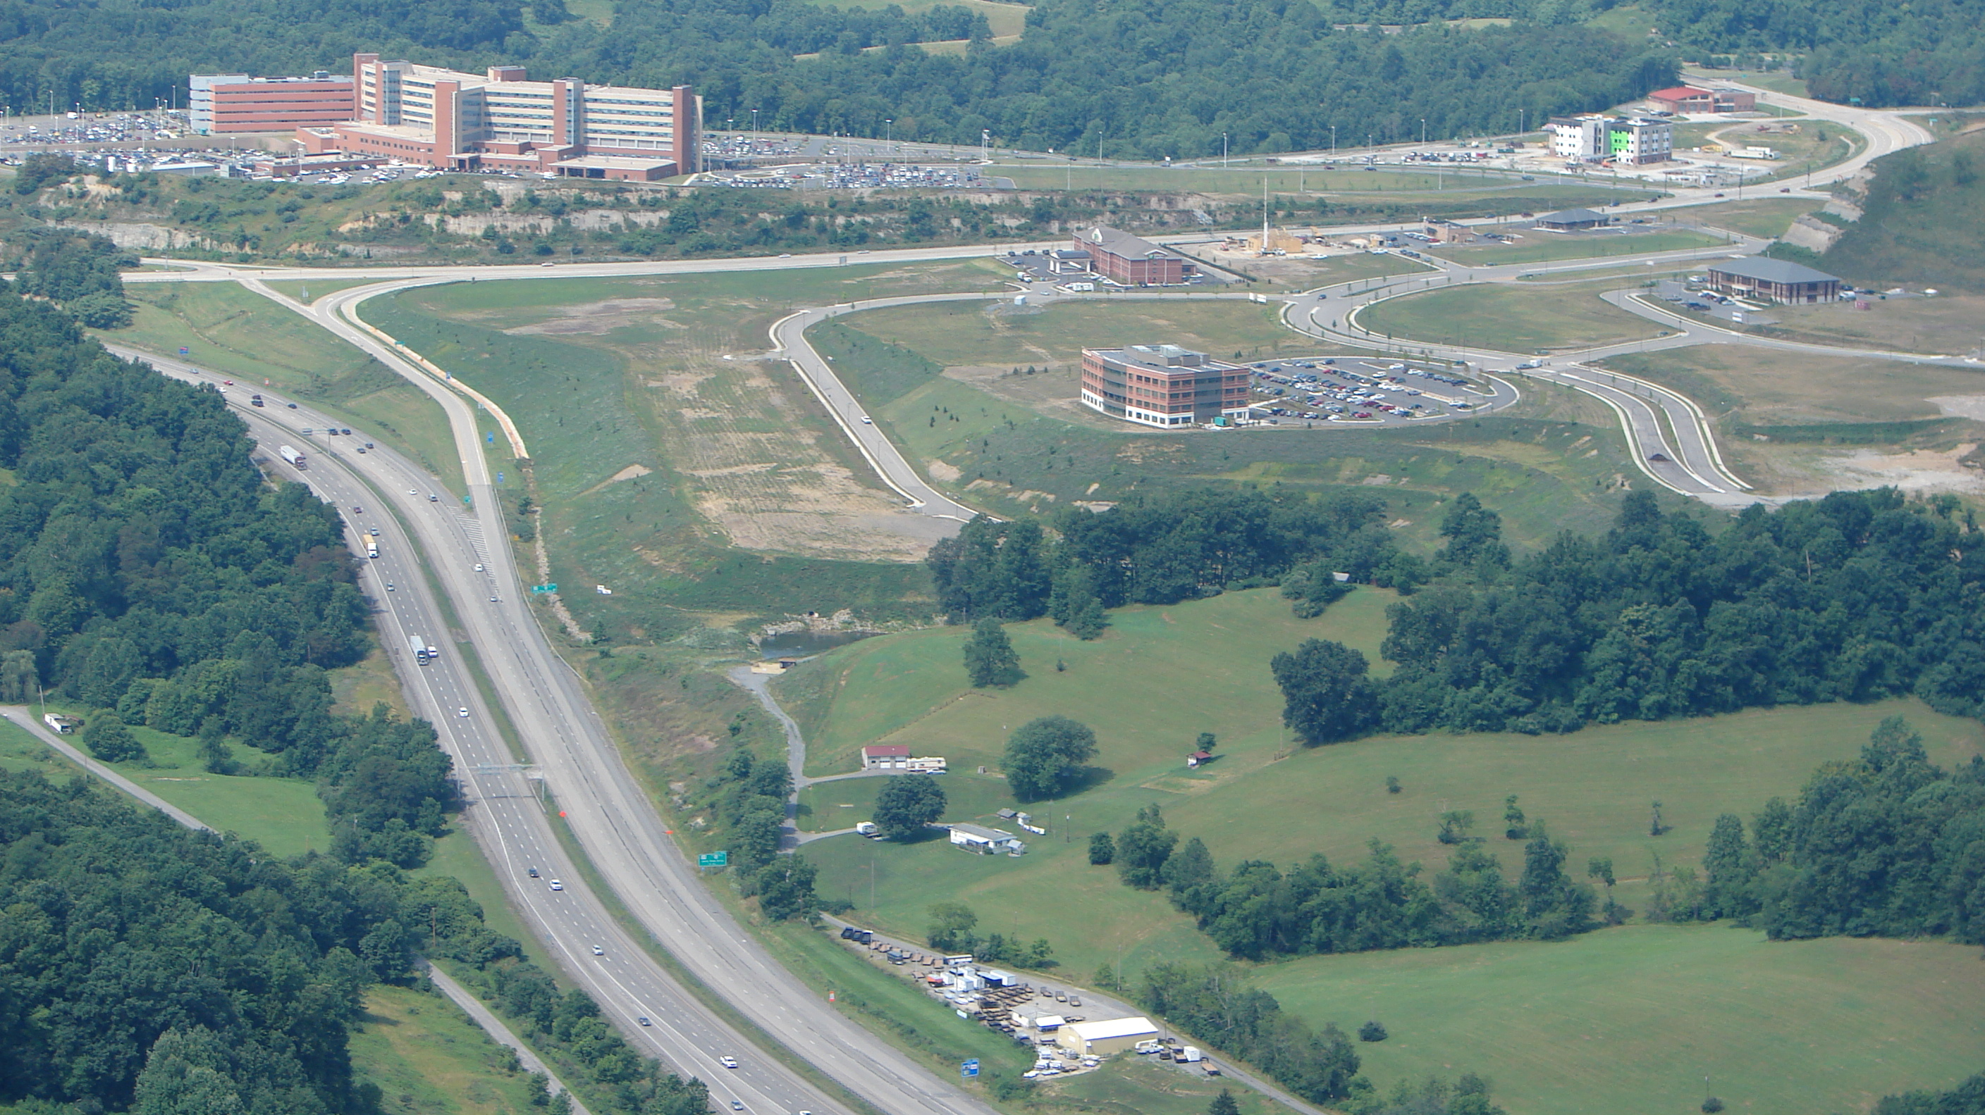

Slide 18
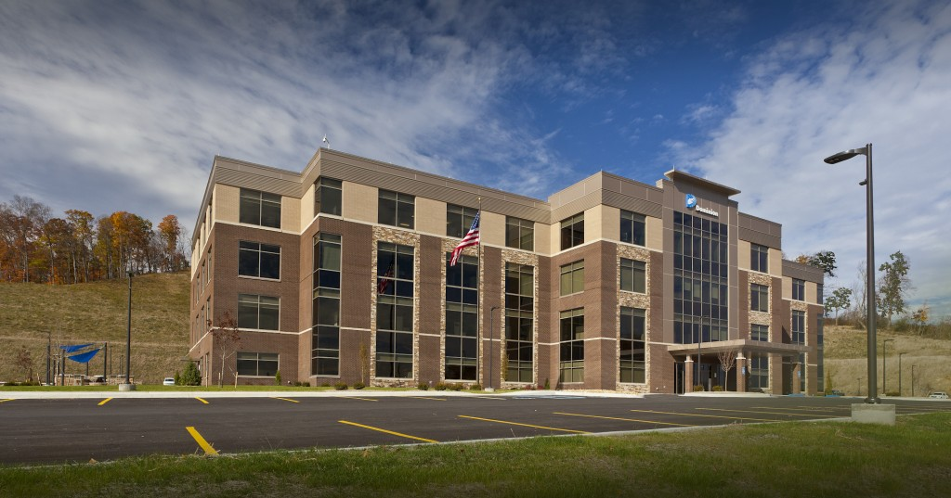

Slide 19
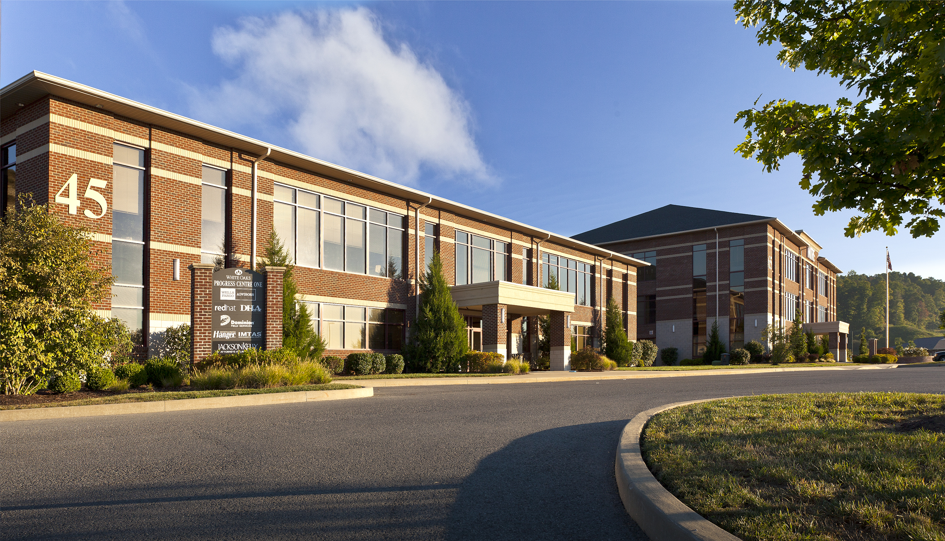

Slide 20
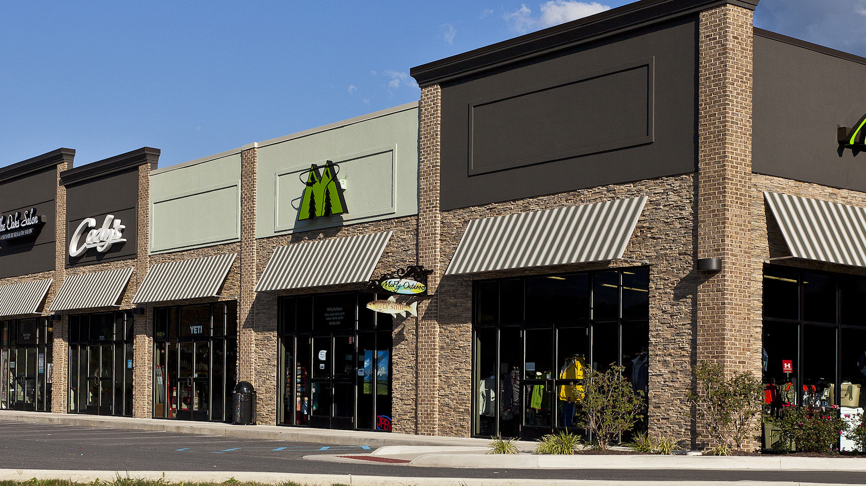

Slide 21
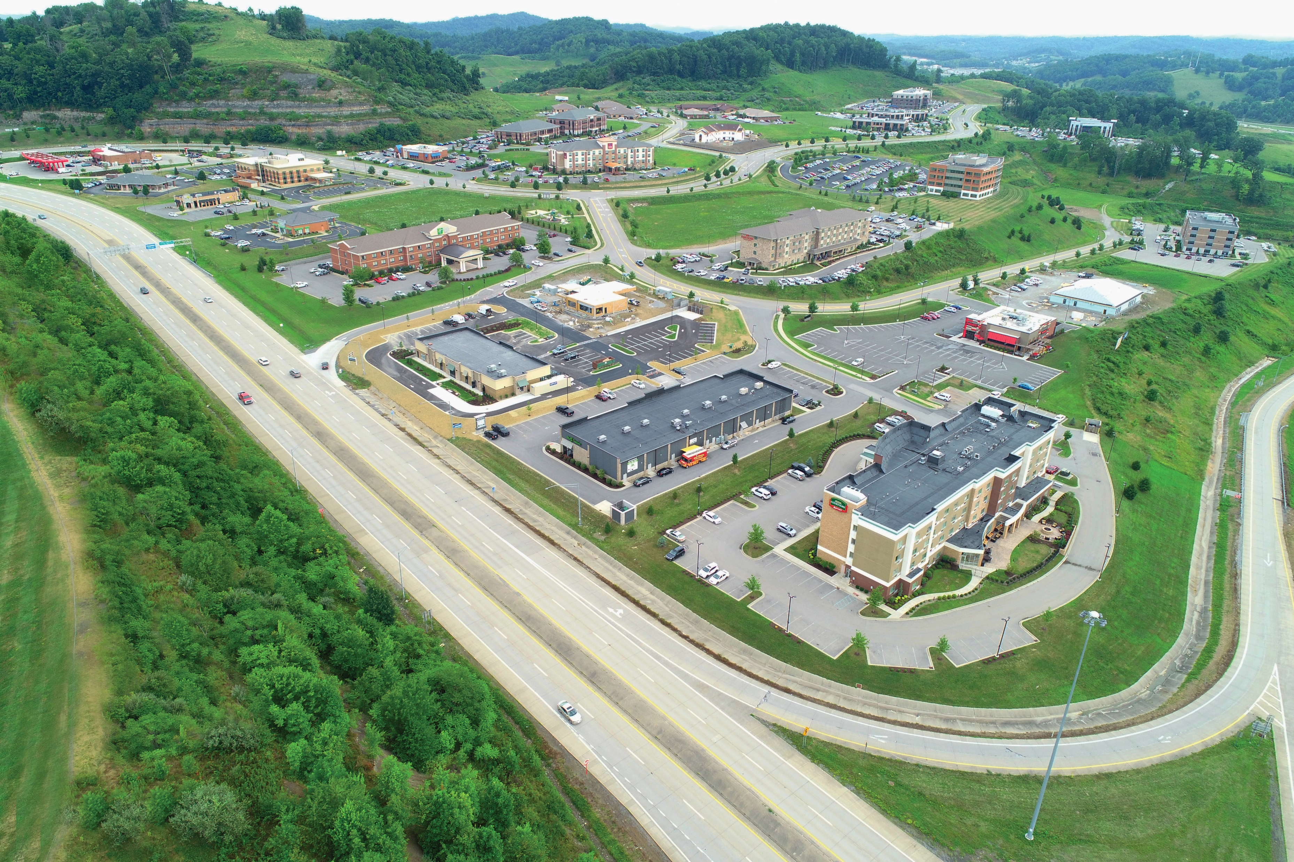

Slide 22
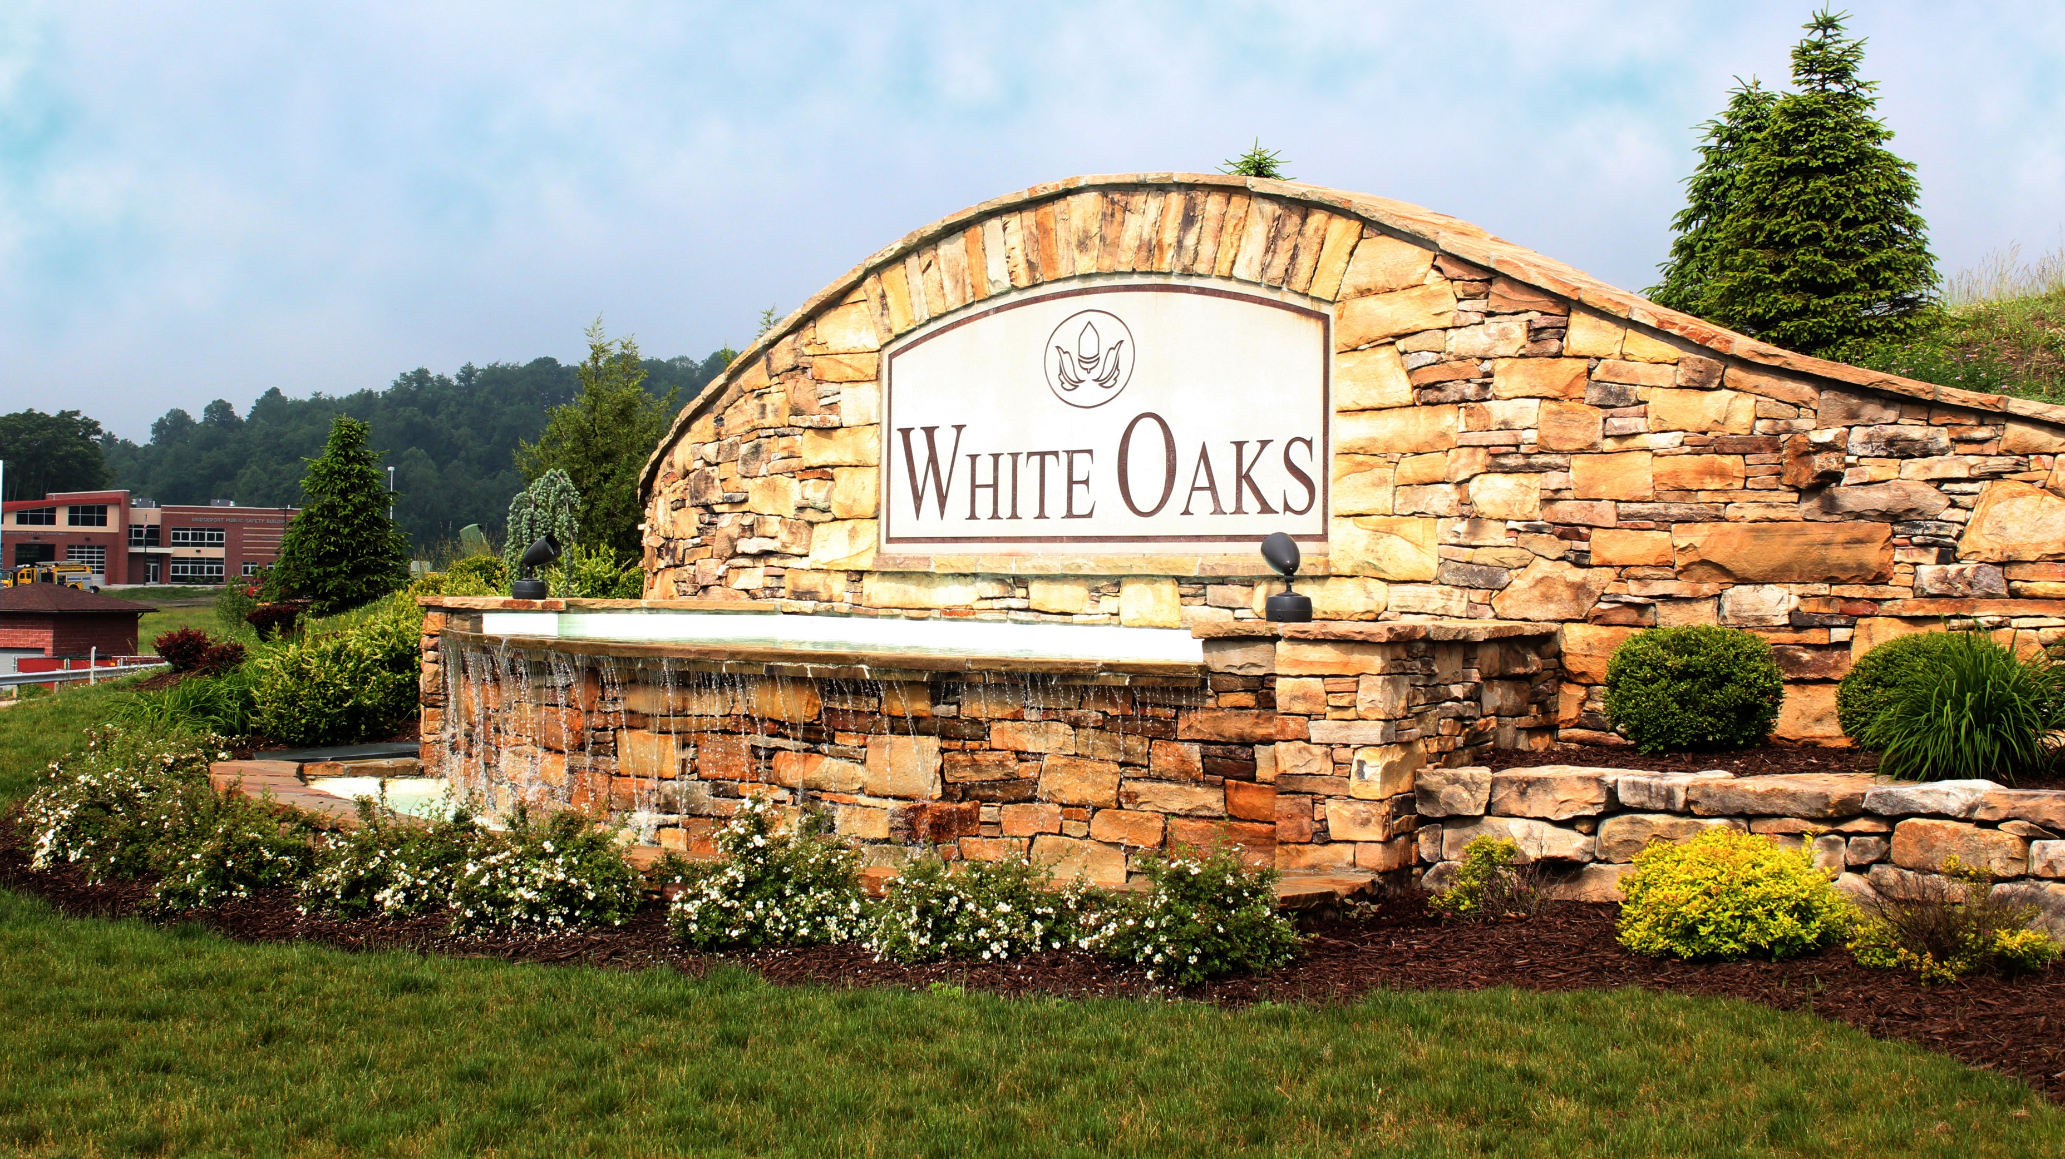

Slide 23

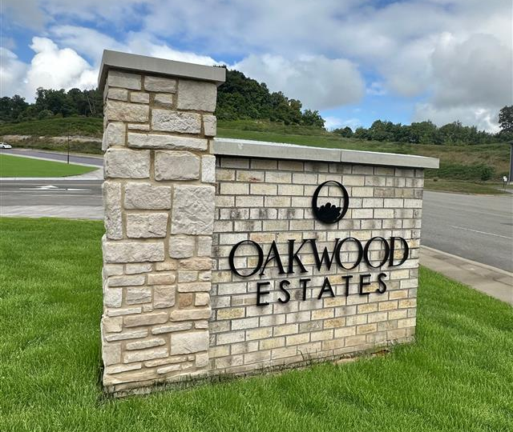

The latest at White Oaks…
Not just business anymore — welcome home.

Slide 24
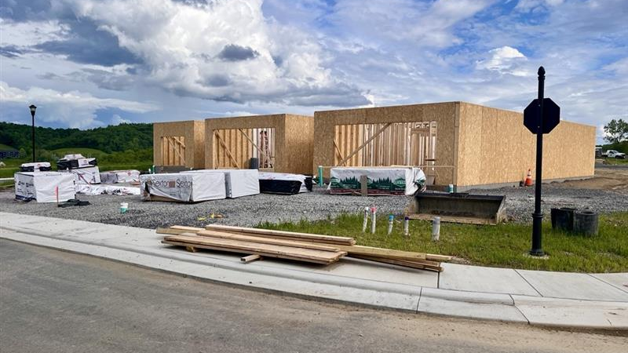

Slide 25


Slide 26


Slide 27


Slide 28


Slide 29
Thank you!
Questions?

