Slide 1
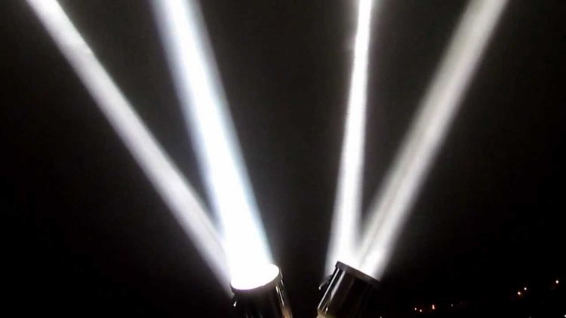
The Robinson Grand Performing Arts Center
Bringing Arts & Culture to Life
City of Clarksburg, WV

Slide 2
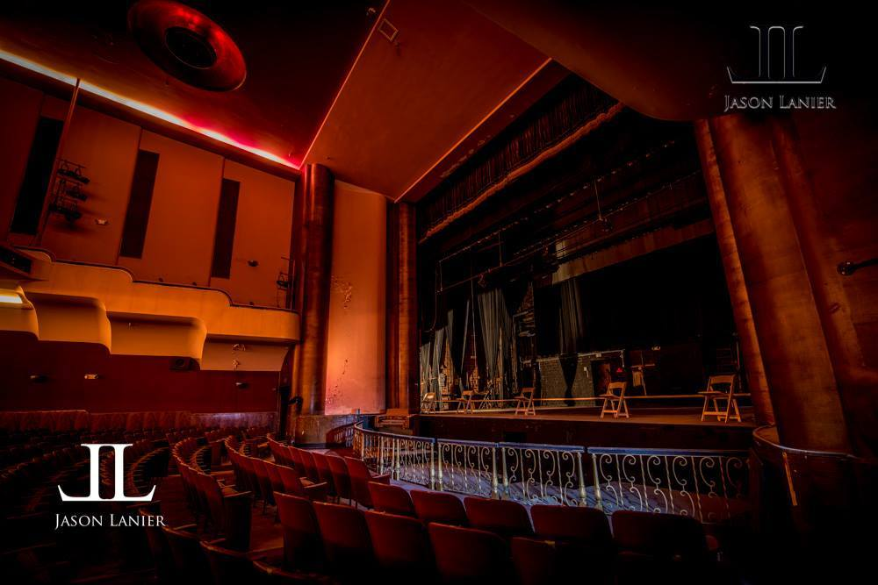

Slide 3
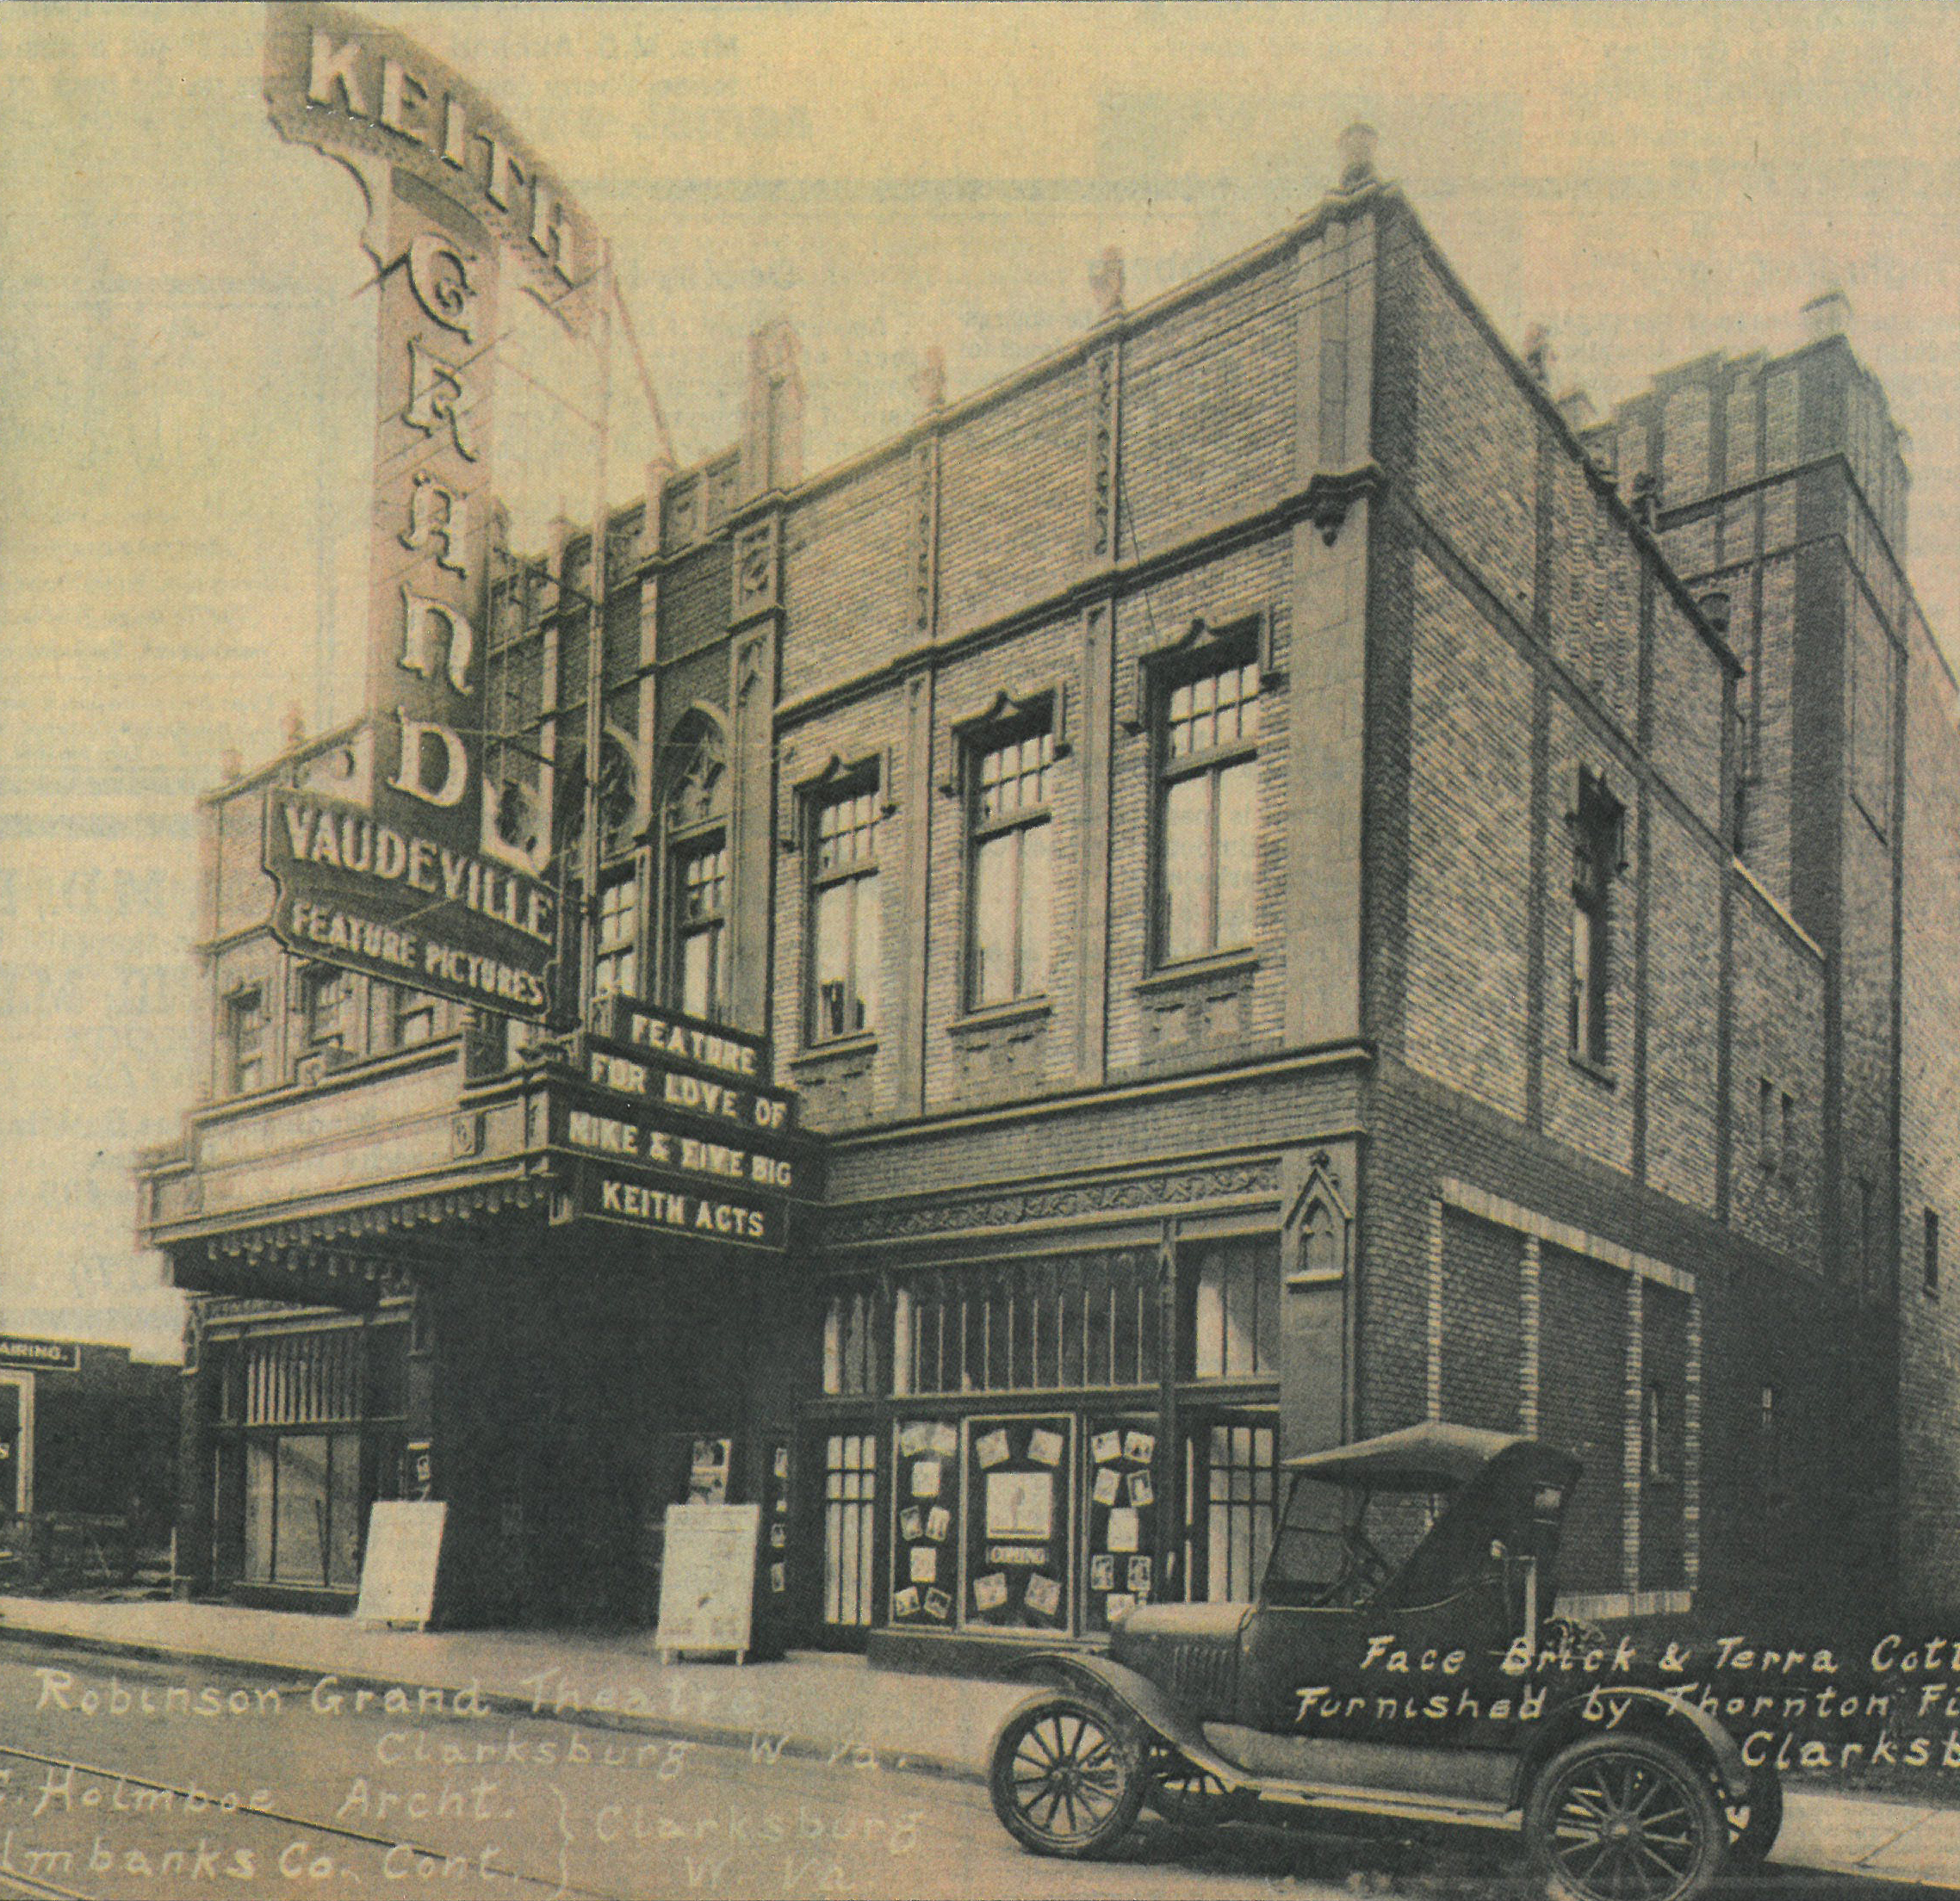
History & Mission
History
  Opened in 1913 by Claude & Reuben Robinson
  In 1927, one of only 13 theatres wired for sound
  Caught fire in May 1939
  Renovated in just 7 months after fire
  Became a hub for movies and live performances
  Vacant for last 10-15 Years
  City of Clarksburg purchased the building in 2014
  Purchased two abutting properties in 2016
  Renovation and restoration began March 1, 2017
Mission
  Preserve a regional historic landmark
  Bring arts and culture to our city, region, and state
  Spark economic development in the area through increased traffic and visibility

Slide 4
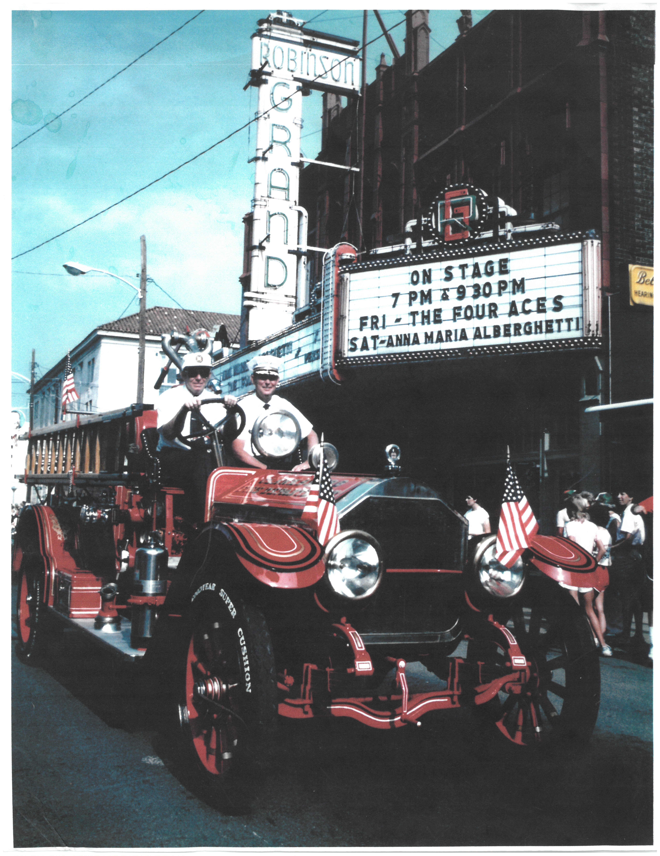
RENOVATION & RESTORATION
44,656 total sq. ft.
Completely restored exterior
Seating capacity for 1000 patrons
New concession area
All new stage rigging, curtains, lighting, sound systems
Educational Center
High-definition projection screen
All new dressing rooms & green room

Slide 5
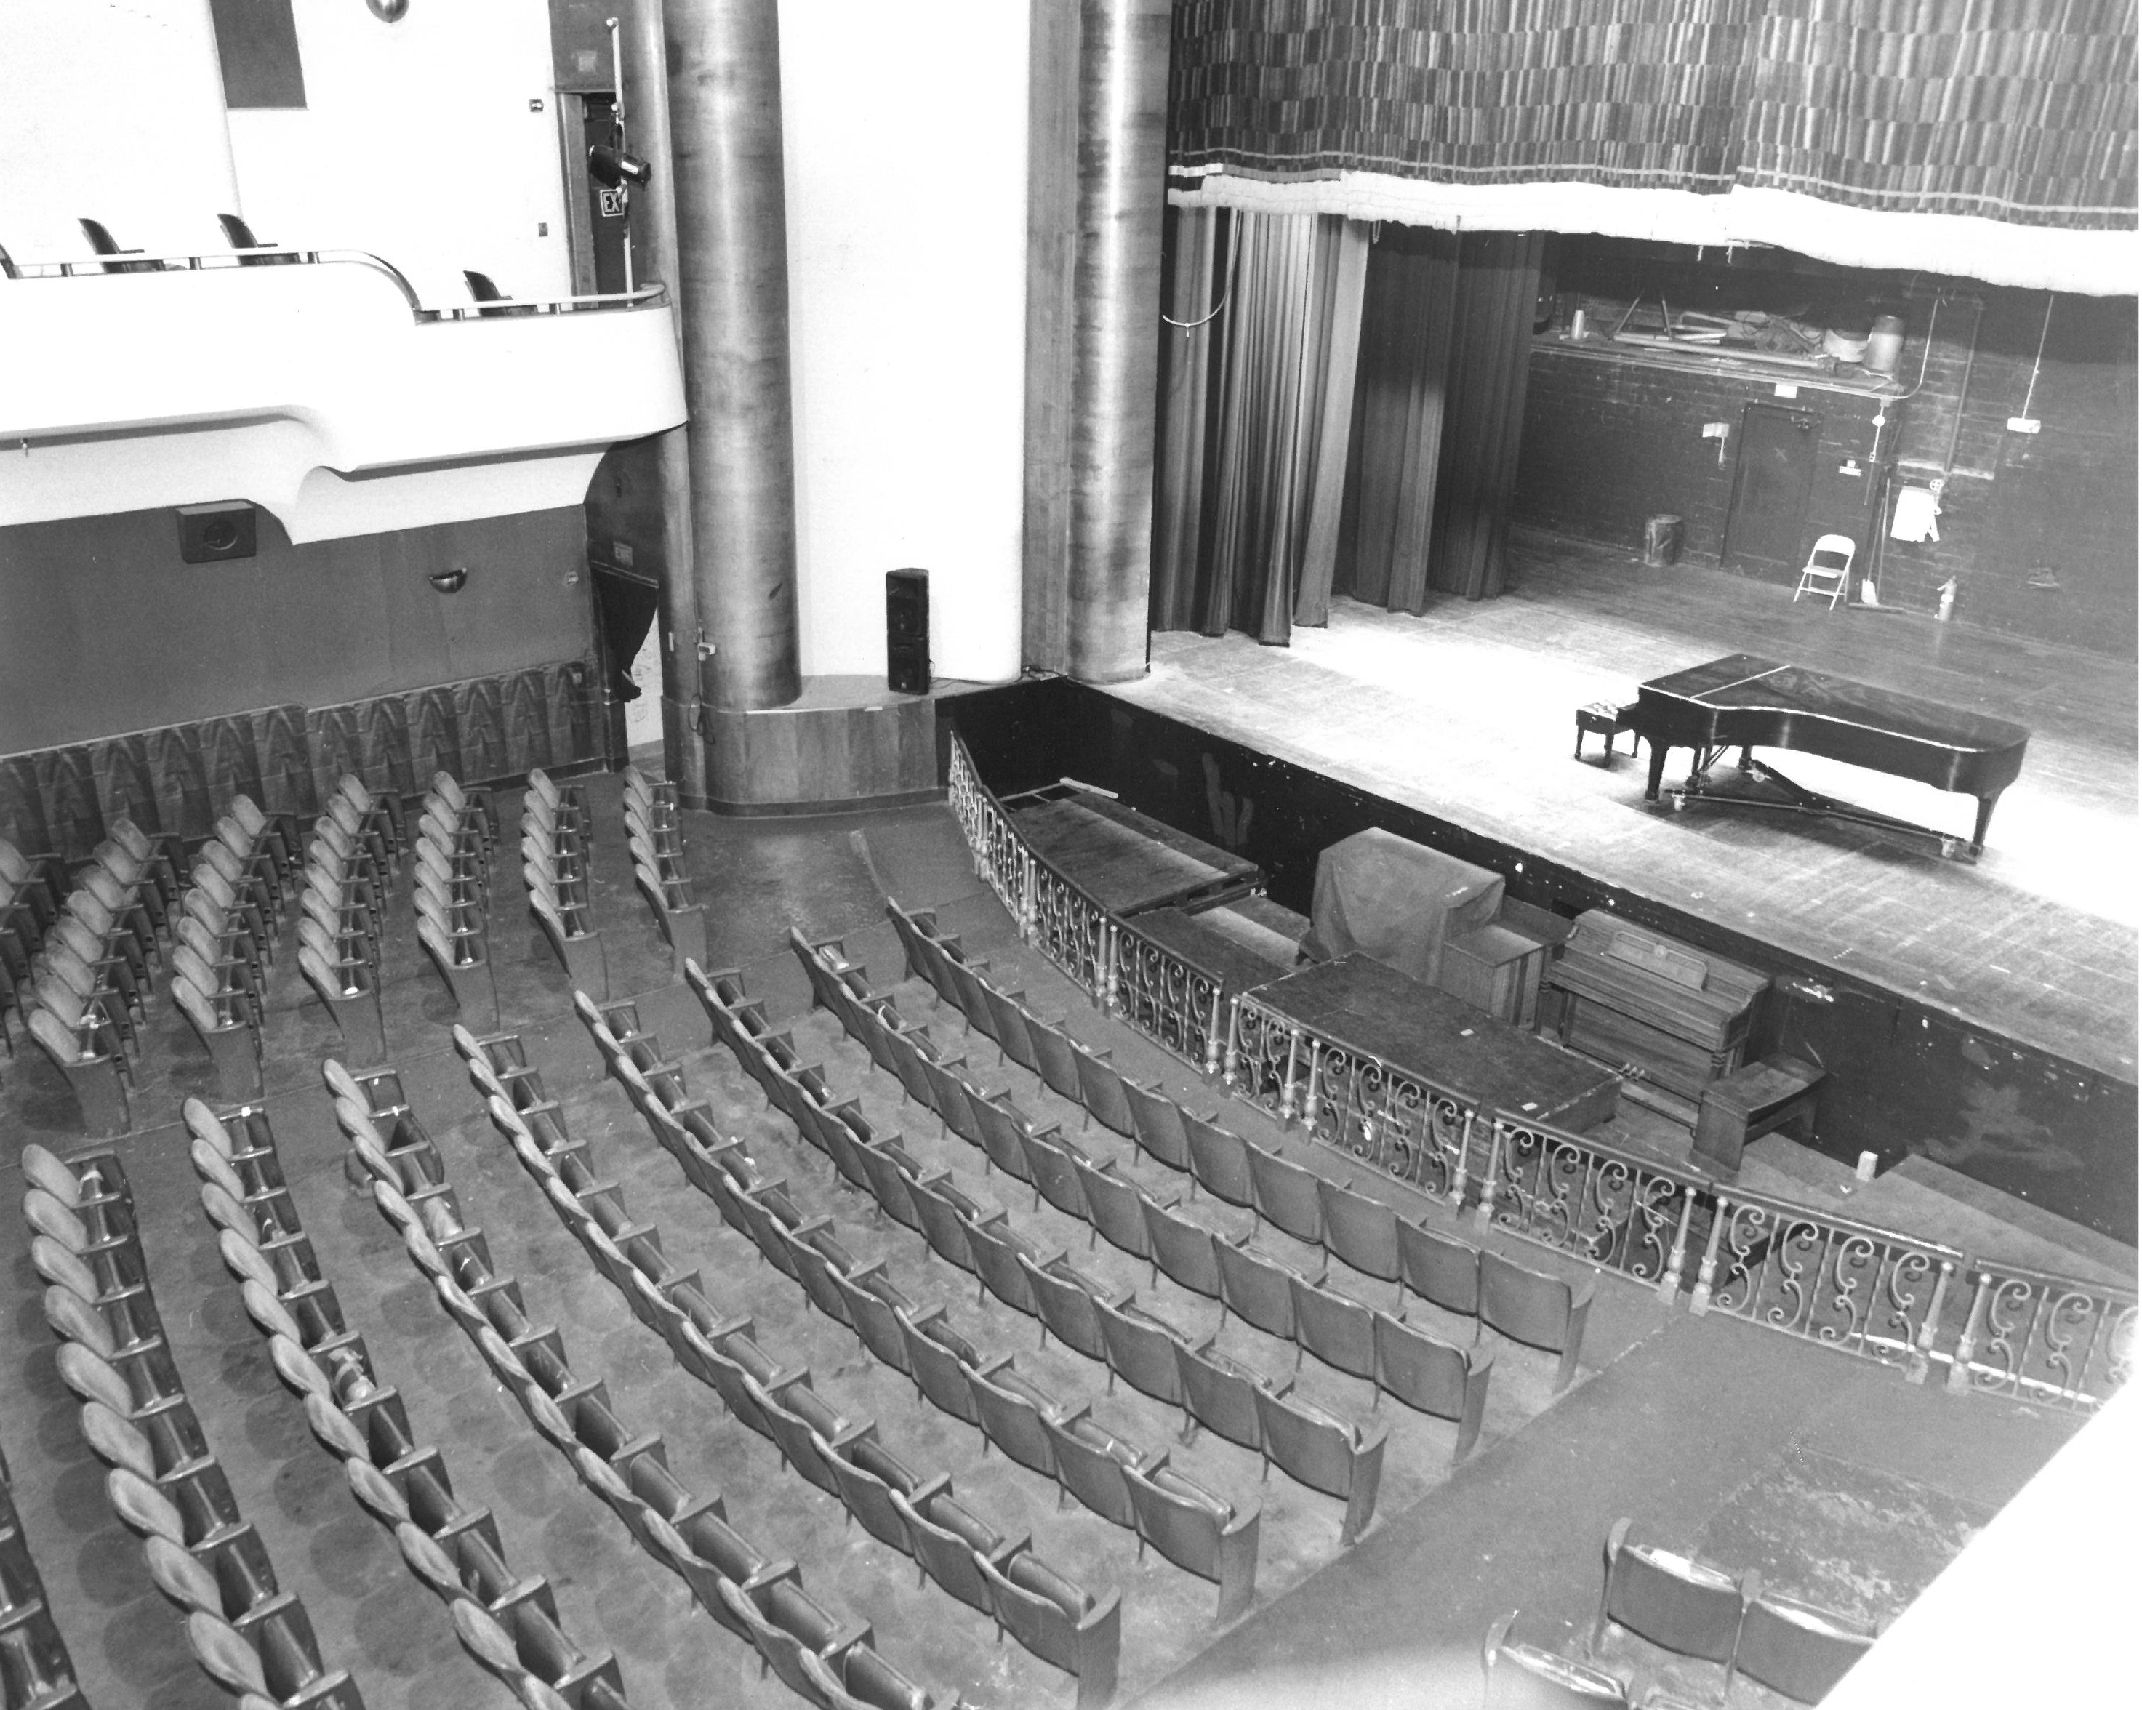
RENOVATION & RESTORATION
State-of-the-art building systems
An 1,800 sq. ft. multi-purpose banquet room
Caterer’s kitchen
Circular bar
Two new elevators
New loading dock
ADA accessible
Parking: more than 1,300 public parking spots nearby

Slide 6
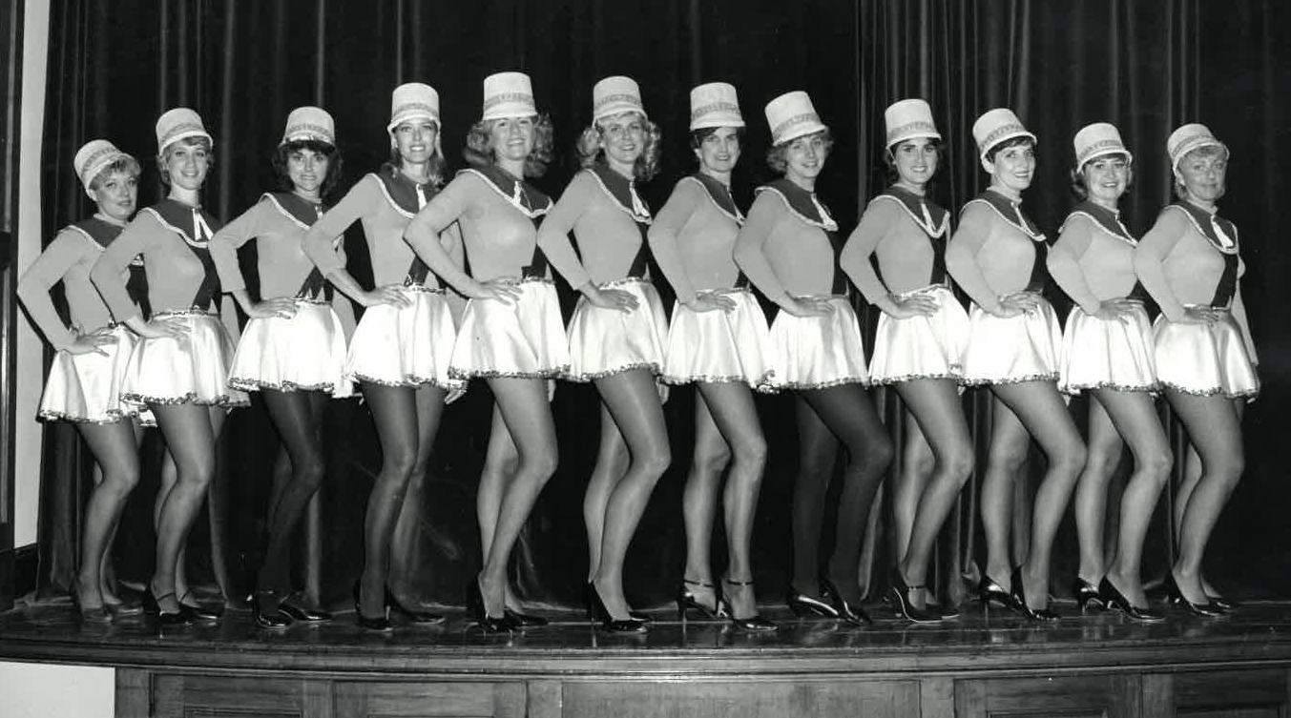
FACILITY Capabilities
Self-Produced Events
Co-Produced Events
Rentals
  Performance Hall (1,000 Guests)
  Ballroom (80 - 200 Guests)
  Educational Center (80 - 300 Guests)
Theatrical Events / Plays
Concerts
Comedy
Lectures
Corporate Presentations/Training
Social Events
  Weddings
  Reunions
  Birthdays
Movies
Art & Literature

Slide 7
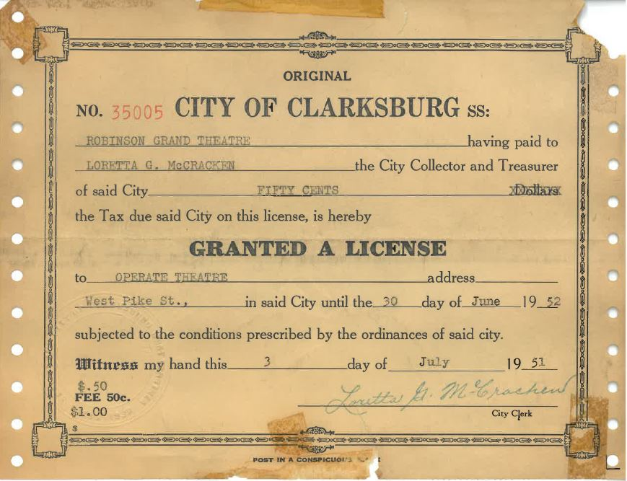
THE LEADING CAST
City of Clarksburg – Developer
Harrison County municipalities – Partners
Project experts – Planning and execution
Capital Campaign Committee – Project philanthropy
Clarksburg-Harrison Cultural Trust – Accepts, manages and disburses contributions for Capital Campaign
Antero Resources ($600,000) – Largest Corporate Sponsor

Slide 8
Events & Performances in year one
Local & Regional artists for SOFT OPENING: Qiet
Grand Performance Series, school performances and educational components
Big bands: Shades of Blue, Beginnings: A Tribute to Chicago
Headliner for GRAND OPENING: Jay Leno & The Guess Who
Comedy: Bill Engvall
Holiday entertainment: Christmas, New Year’s Eve
Movie Screenings (children, family, and more)
Go to tickets.therobinsongrand.com for a FULL list

Slide 9
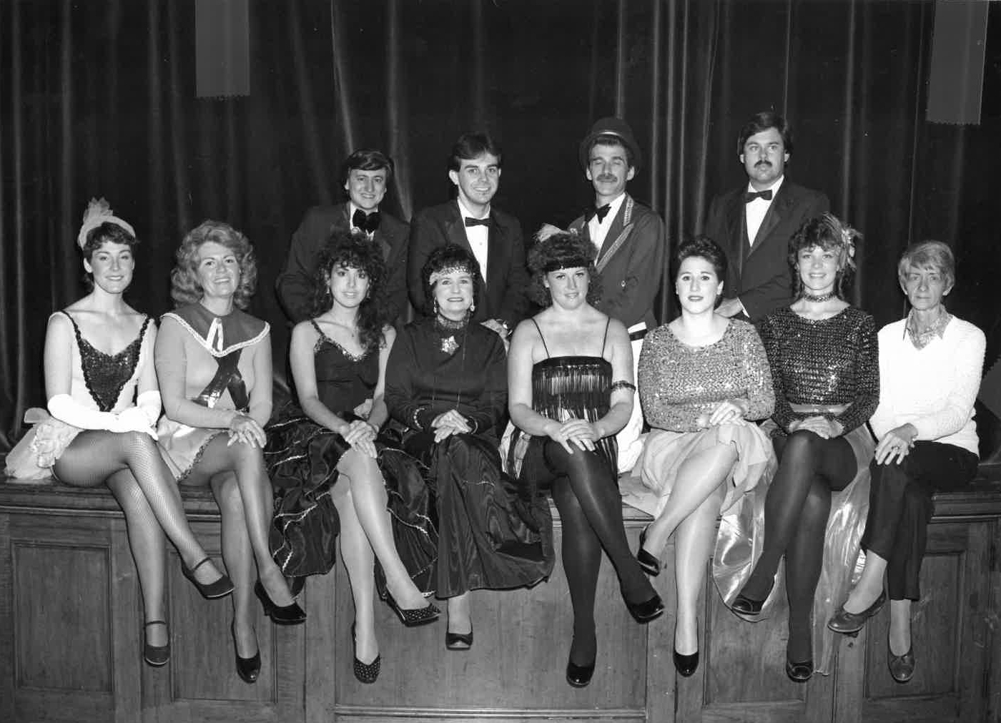
Project costs
Pre-Construction: $2.5 million+
Construction, Equipment & Furnishings: $15 million*
Operating (once opened): $900k (est.)
*Includes contingency

Slide 10
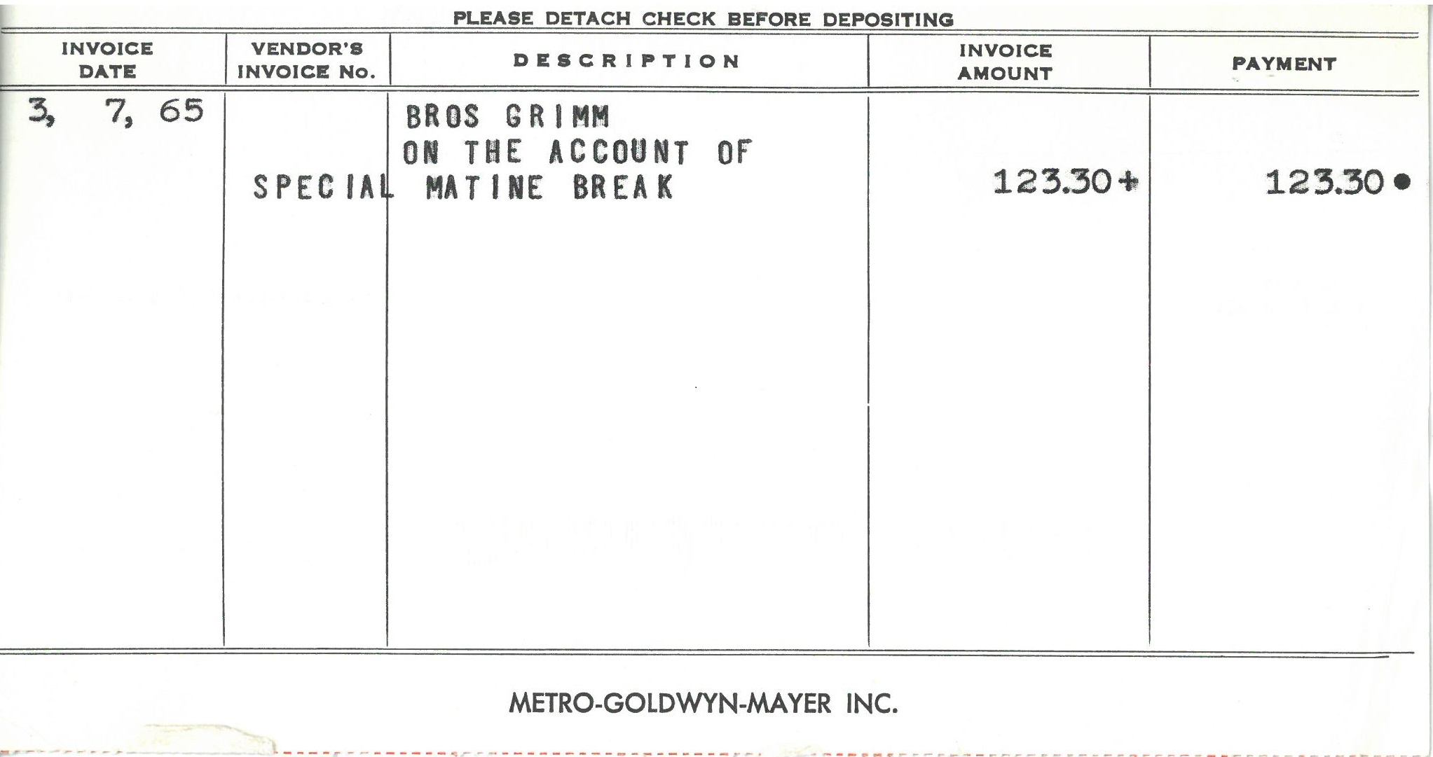
Project financing
City of Clarksburg securing the working capital:
  Series A Bond (Financial Loans) - $20 million
  City of Clarksburg 1% sales and use tax (Home Rule)
  Historic Rehabilitation & New Market Tax Credits
    Net Benefit - $6,550,607
  Capital Campaign - $4 to $6 million

Slide 11
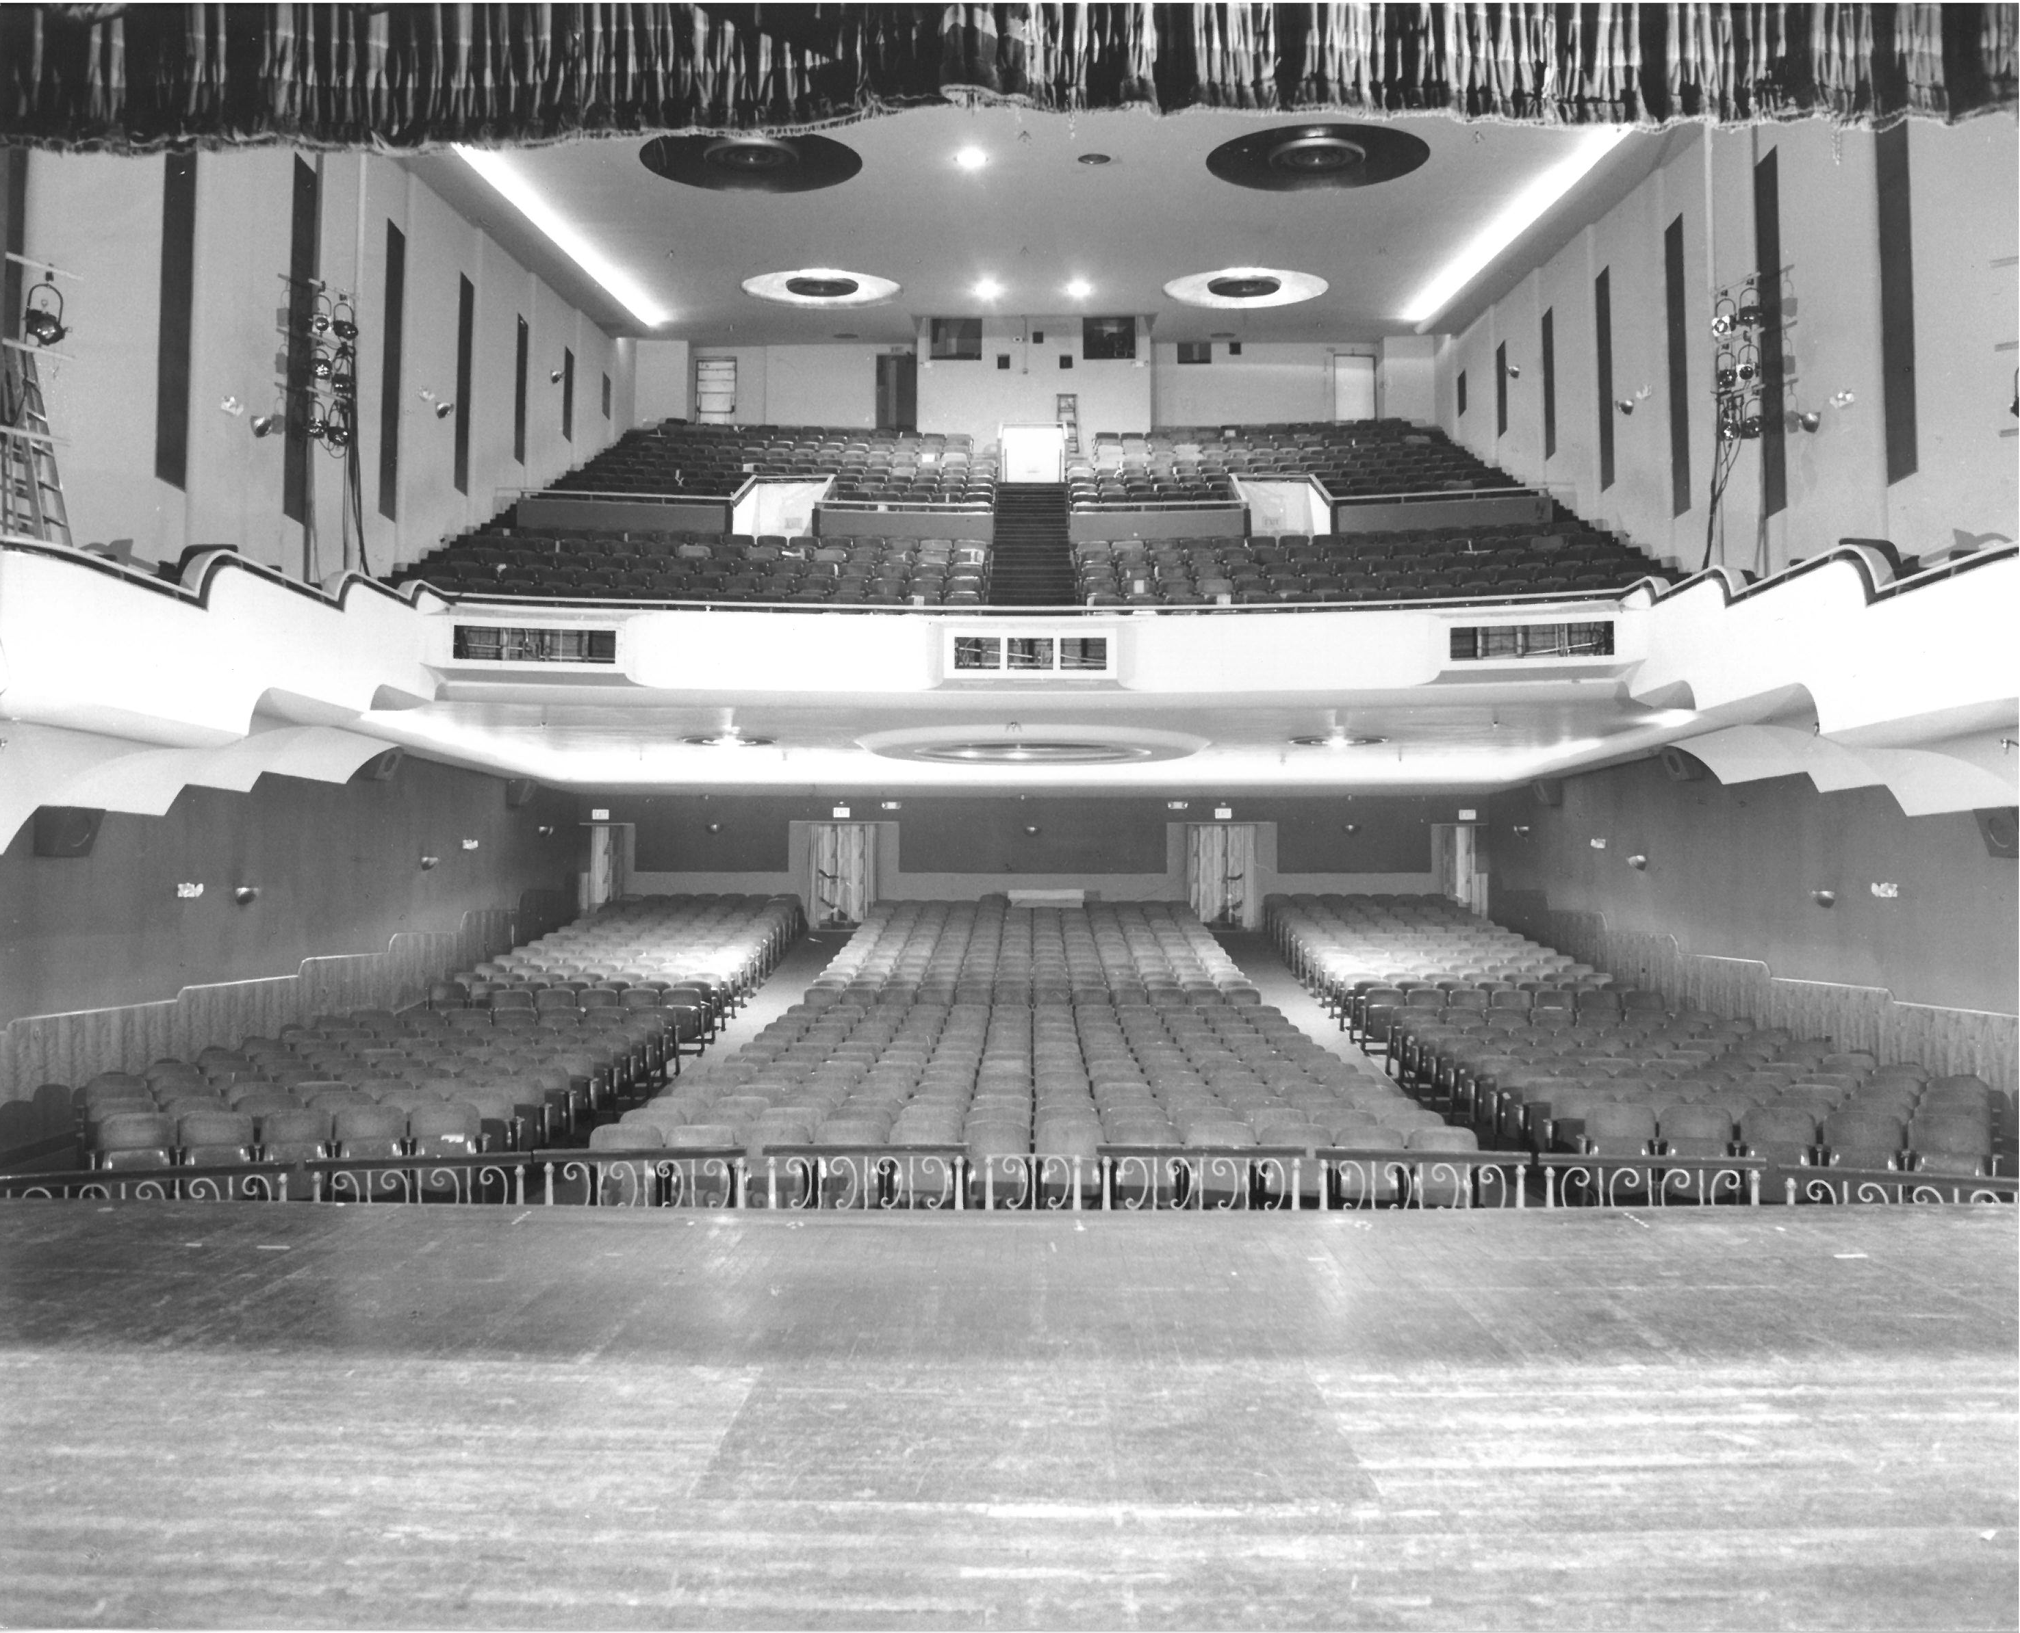
FUNDING
HISTORIC & NEW MARKET TAX CREDITS

Slide 12
CDA OVERVIEW
CLARKSBURG DEVELOPMENT AUTHORITY CREATED BY CITY COUNCIL APRIL 21, 2016
    The CDA was created to assist the City in Economic Development. This body has the ability to assist through loans, investments and other business transactions within the City and to rehabilitate, stimulate and promote the expansion of business and development. The CDA can cooperate and act in conjunction with other organizations, federal, state or local municipality.

Slide 13
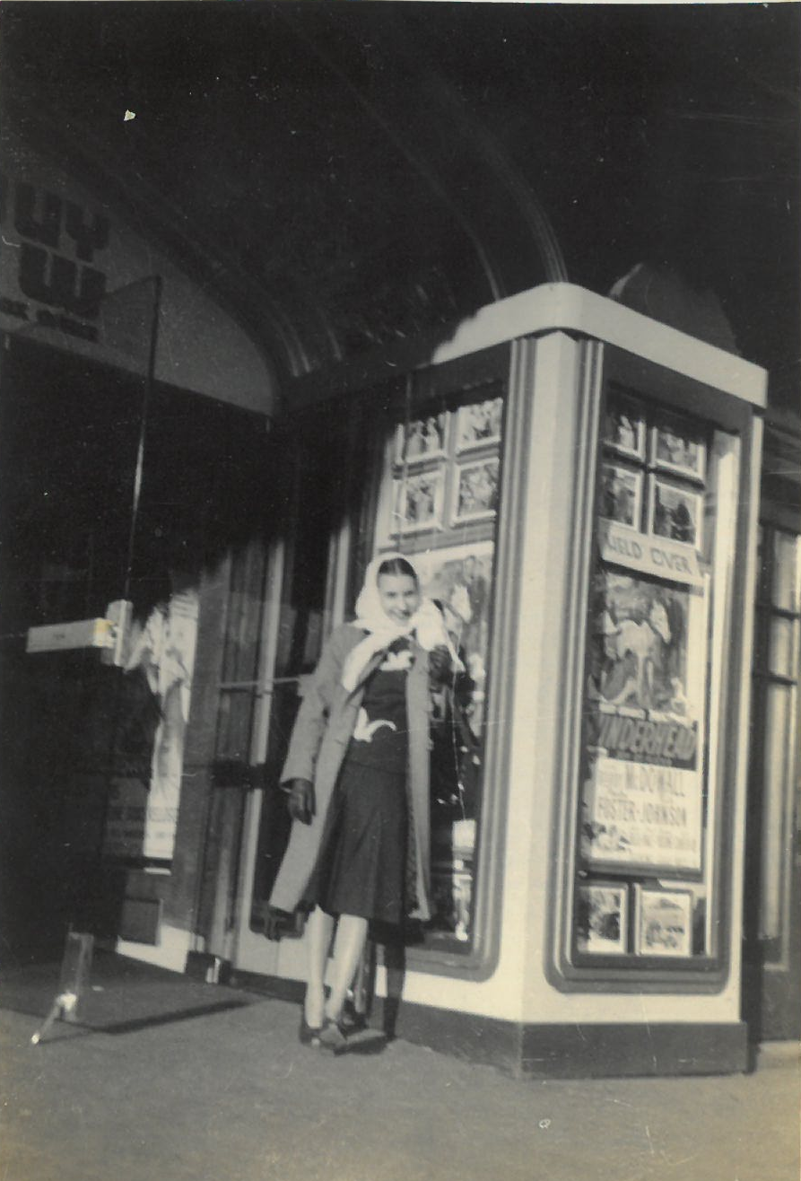
TYPES OF TAX CREDITS
Historic Rehabilitation Tax Credits
  - Federal @ 20%
  - State @ 10%
New Markets Tax Credits
- Commercial Tax Credit
- Low Income Communities (LIC)
- 39% of Project is purchased/eligible.
- Community Development Entities (CDE’s) The allocations / credits are awarded from US Dept. of Treasury.
- CDE’s partner with projects for development.
- These credits are then purchased by investor.

Slide 14
The 20% FEDERAL HISTORIC
TAX CREDIT: Basic Rules
20% of Qualified Rehabilitation Expenses (QRE.)
QRE includes renovation and associated soft costs. Does not include acquisition, site work, furniture, and anything not permanently affixed.
Certified Historic Building – Must be on National Register of Historic Places.
Certified Rehabilitation – Plans/construction must be reviewed for compliance with the Secretary’s Standards for Rehabilitation. (National Park Service)
  Three-part approval process by State SHPO (Historical Commission) and National Park Service.

Slide 15
The secretary’s standards: a practical interpretation
Renovation should be tailored to the Period of Significance
When possible, restore rather than replace
Building circulation and common space are very important.
Additions should be non-intrusive and distinct from historic building. Do not add faux historical features.

Slide 16
Federal htc benefit
Total Estimated QREs (Qualified Rehabilitation Expenditures) $14,739,314
Tax Credit Percentage 20%
Total Fed. HTCs Generated $ 2,947,863
Investor Price / Credit $0.85
Investor Ownership Allocation 99.00%
Total Equity Generated $ 2,480,627
Upfront HTC Benefit $ 744,188
PIS/Cost Certification HTC Benefit (Put In Service) $ 1,488,376
NPS Part III HTC Benefit $ 248,063

Slide 17
The West Virginia HISTORIC TAX CREDIT: Basic Rules
  10% of QRE
  Same definition of QRE as federal program
  Mirrors 20% federal HTC application process
  Can also be used by tax-exempt entities

Slide 18
Wv htc benefit
Total Estimated QREs $14,739,314
Tax Credit Percentage 10.00%
Total WVHTC Generated $ 1,473,931
Investor Price / Credit $0.85
Investor Ownership Allocation 100.00%
Total Equity Generated $ 1,252,841
Upfront HTC Benefit $ 375,852
PIS/Cost Certification HTC Benefit $ 751,705
NPS Part III HTC Benefit $ 125,284

Slide 19
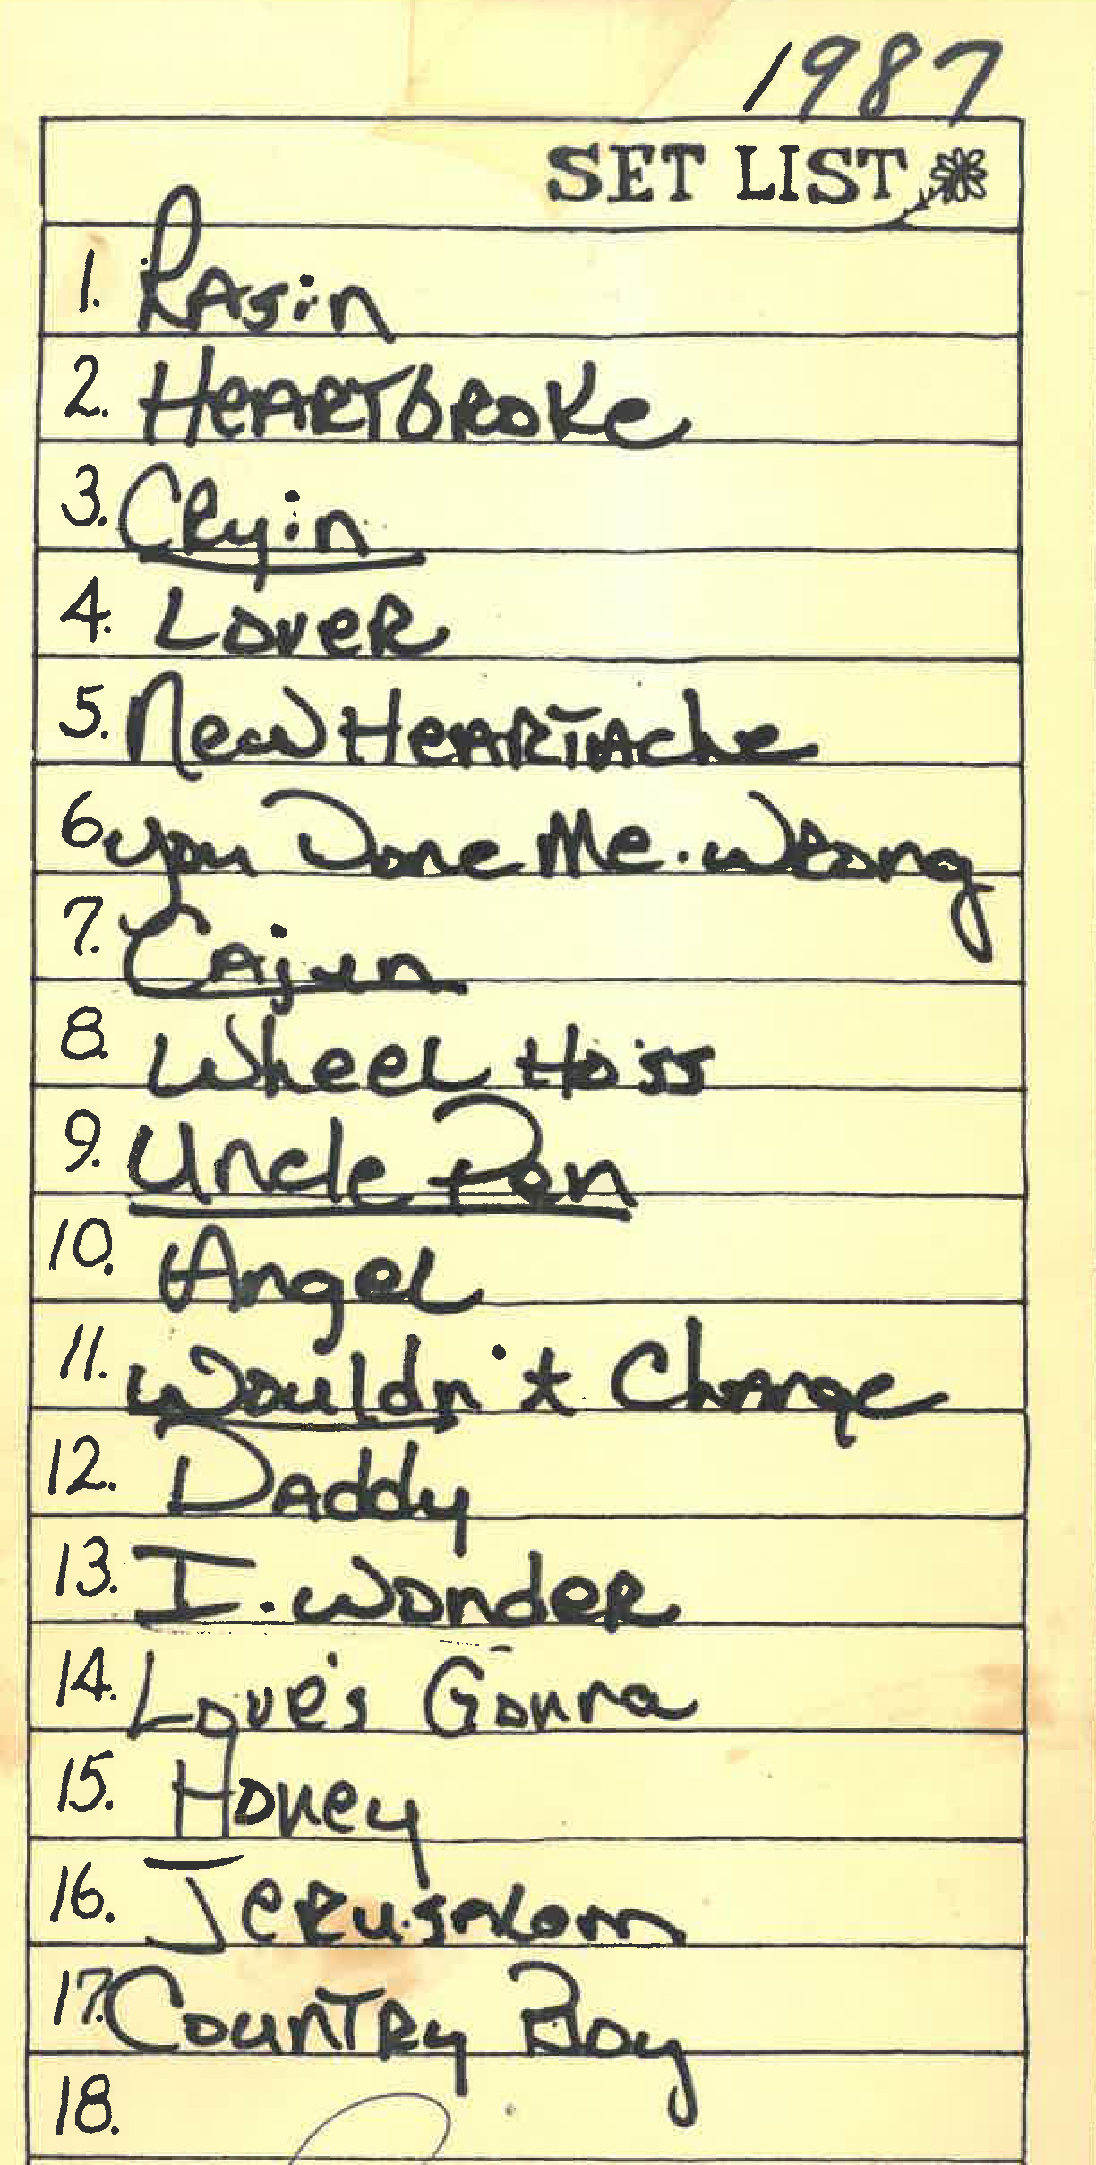
Monetizing Historic Tax Credits
Tax Credit Investor becomes limited partner
and makes investment into project.
Owner maintains control of organizational/development decisions.
Structure
  Long-term lease to tax credit partnership
  For tax-exempt entities, boards authorize chairman/
  executive director to carry this out. (CDA)

Slide 20
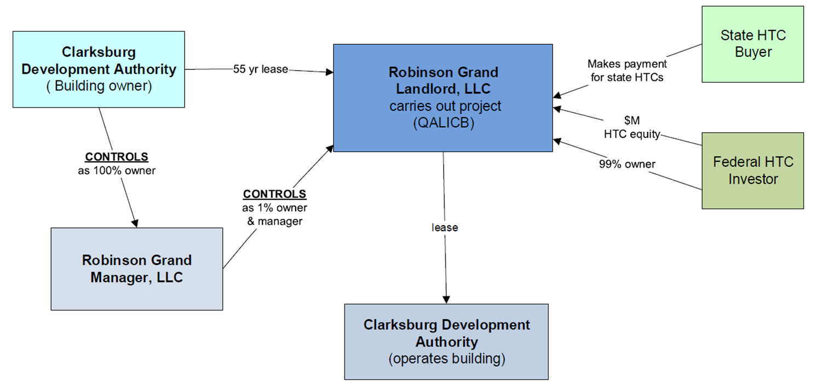
HTC Legal Structure
Clarksburg Development Authority | June 8, 2016

Slide 21
NEW MARKET TAX CREDITS
Unlike HTCs, NMTCs are competitive.
Must be in an Eligible Census Tract.
Then, attract allocation from Community Development Entities (CDEs), who apply annually to the CDFI fund for an allocation of tax credits.
CDEs that receive allocation provide funding to projects. Targeted projects for CDEs include expanding educational opportunities, health care provision, job training and job creation.

Slide 22
NEW MARKET TAX CREDITS
Federal NMTC Program is a lynchpin financing tool that feeds economic development projects.
May be applied to different kinds of projects, but they have to be located in economically distressed census tracts, create or preserve jobs, and have a solid business plan.
NMTC’s are not grants – The recipients are subject to capital market discipline and compliance for (up to) 7 years.
Congress designed the NMTC Program in 2000 to stimulate private investment and economic growth in low-income communities that lack access to capital needed to support and grow business.

Slide 23
NEW MARKET TAX CREDITS
Projects can get as much as NMTC allocation as project costs.
Projects typically realize net benefit between 15-20% of total allocation received.
Generally, projects must be at least $5 million in total development costs to justify NMTC allocation (up to) 7 years.
Program offers debt & equity investors a major federal income tax credit for projects in eligible areas

Slide 24
NEW MARKET TAX CREDITS
Eligible projects are known as Qualified Active Low Income Community Business (QALICB).

Slide 25
BENEFIT OF NMtc
Total QEIs (Qualified Equity Investment) $20,000,000
Tax Credit Percentage 39.00%
Total NMTCs Generated $ 7,800,000
Purchase Price / Credit ____ $0.85
Total Equity Generated $ 6,630,000

Slide 26
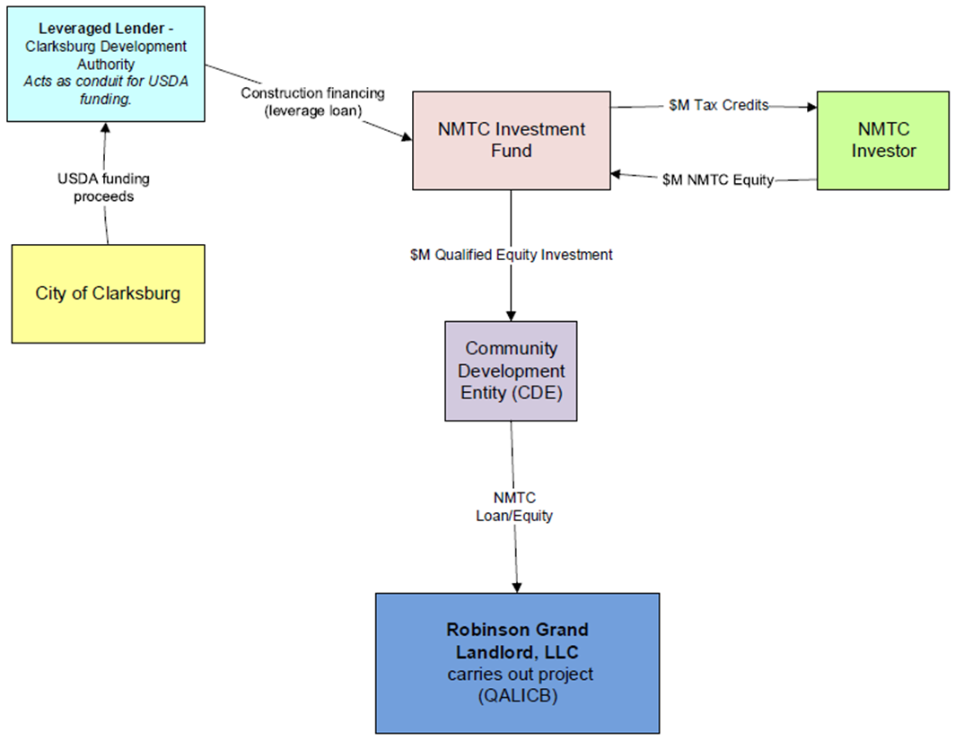
NMTC Structure
Clarksburg Development Authority | June 8, 2016

Slide 27
NET Tax Credit benefit
Total NMTC Benefit $5,035,000
Total Fed. HTC Benefit $2,480,627
Total WV HTC Benefit $1,252,841
Less: Transaction Closing Costs ($1,423,936)
Less: Fund Management Fees ($45,000)
Less: PIFS Success Fee ($300,000)
Less: HTC Priority Return Distributions ($157,894)
Less: QALICB & MT A/T Expense ($166,000)
Less: HTC Put ($124,031)
Less: NMTC Put ($1,000)
Net Tax Credit Benefit $6,550,607

Slide 28
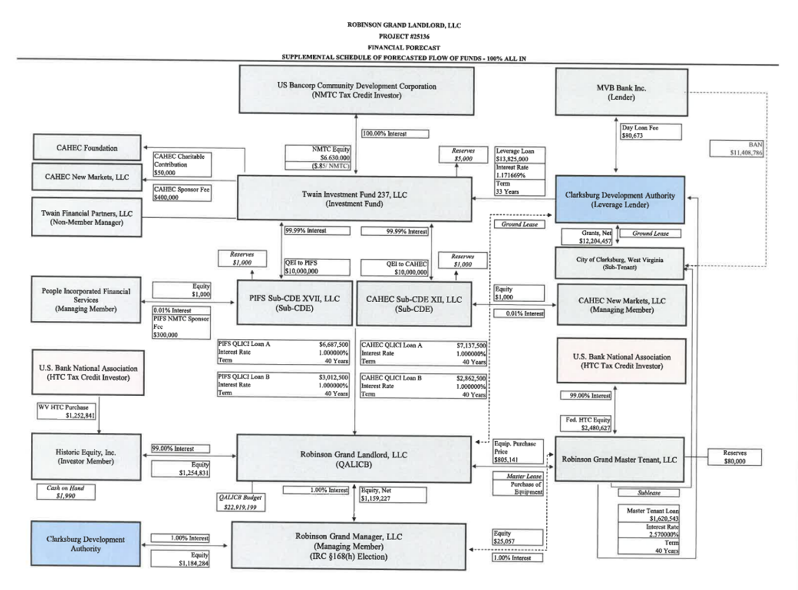

Slide 29
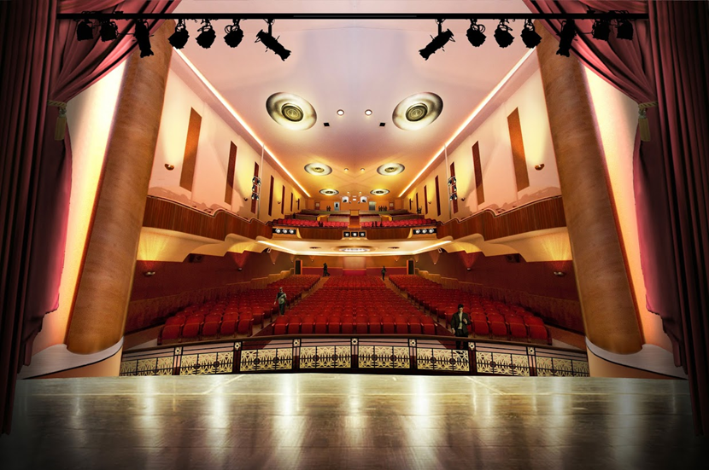
NET BENEFIT
$6,550,607

Slide 30
PARTNERS:
Brian Wishneff & Associates – Washington, DC
Spencer Fane – St. Louis, Missouri – City’s Legal Representative
Novogradac & Co., LLP – CPA Firm specializing in Tax Credit Programs. Provide financial NMTC Projections/Audits/Financial Modeling – Dover, OH
PIFS – People Incorporated Financial Services – Abingdon, VA ($10,000,000 NMTC Allocation)
CAHEC - Community Affordable Housing Equity Corporation – Raleigh, NC ($10,000,000 NMTC Allocation)
US BANK – US Bank Community Development (Syndicator purchased all tax credits)
TWAIN Investment Fund –
WV State Historic Preservation Office –
Department of Interior - National Park Service
Summit Studio’s – Mark McConnel
MVB Bank - Bond Anticipation Note (BANS) – Provided 1 day Loan $10,000,000

Slide 31
PARTNERS:
March-Westin – Contractor
Thrasher Engineering
Hornor Bros. Engineering
USDA – Permanent Financing
Steptoe & Johnson
First American Title Insurance Co.
Spilman, Thomas & Battle, LLC
WesBanco Bank
Husch Blackwell, LLP – Kansas City, MO
Klein Hornig, LLP – Washington, DC
Law Office of Andrew Foster, PLLC – Chapel Hill, NC
Traxler & Tong, Inc. – San Anselmo, CA
Capital Consultants – Orlando, FL – Consultant to certify historical work completed on behalf of US Bank.

Slide 32
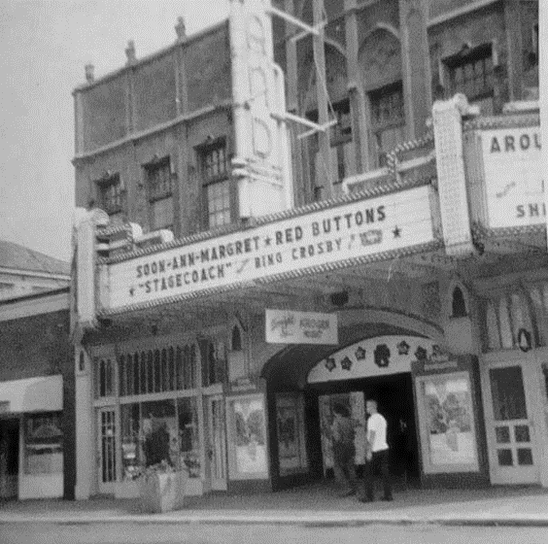
Capital campaign
Why a Capital Campaign?
  Ensure a regional project vs. a Clarksburg project
  Community investors are key to long-term success
  Foster community buy-in
  Build a sustainable culture of philanthropy for performing arts
  & entertainment, along with a creative economy

Slide 33
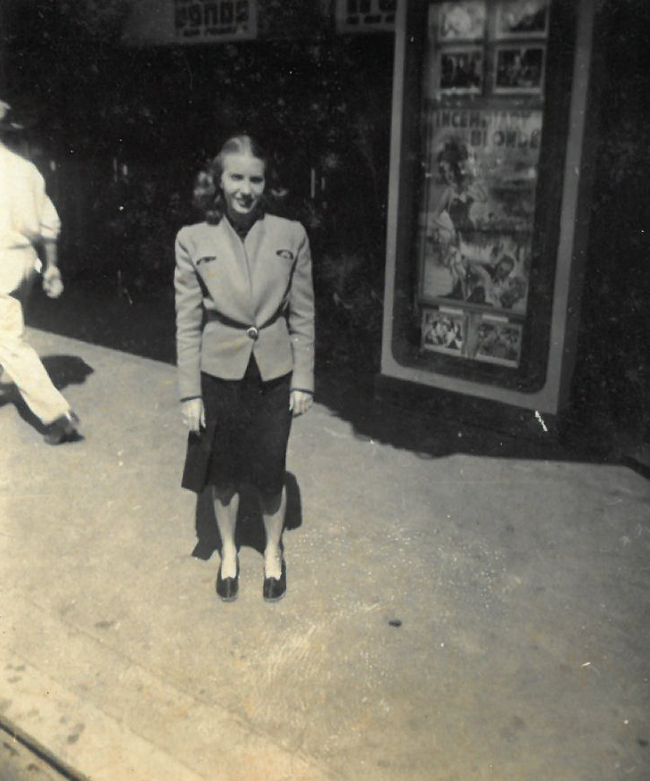
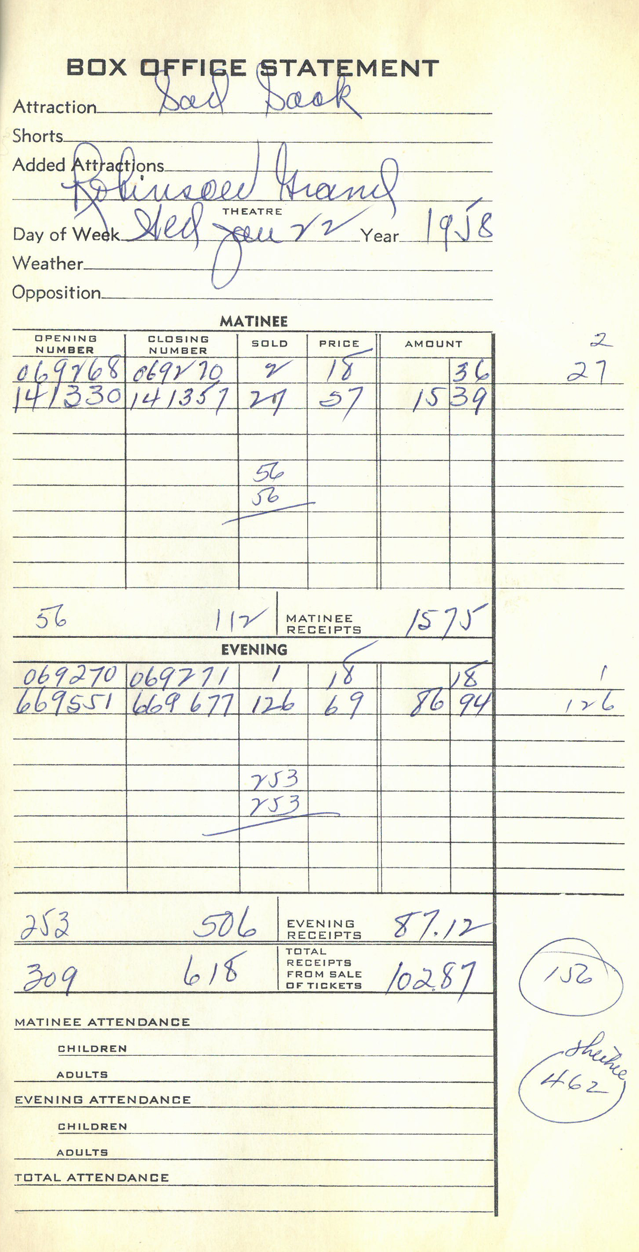
OPERATING FINANCING
Ongoing private fundraising
Sponsorships
Ticket sales
Concession revenue
Rental income
Grants
Clarksburg-Harrison Cultural Foundation Highland Fund
*City will own and maintain building
**Executive Director will be a City employee at the onset

Slide 34
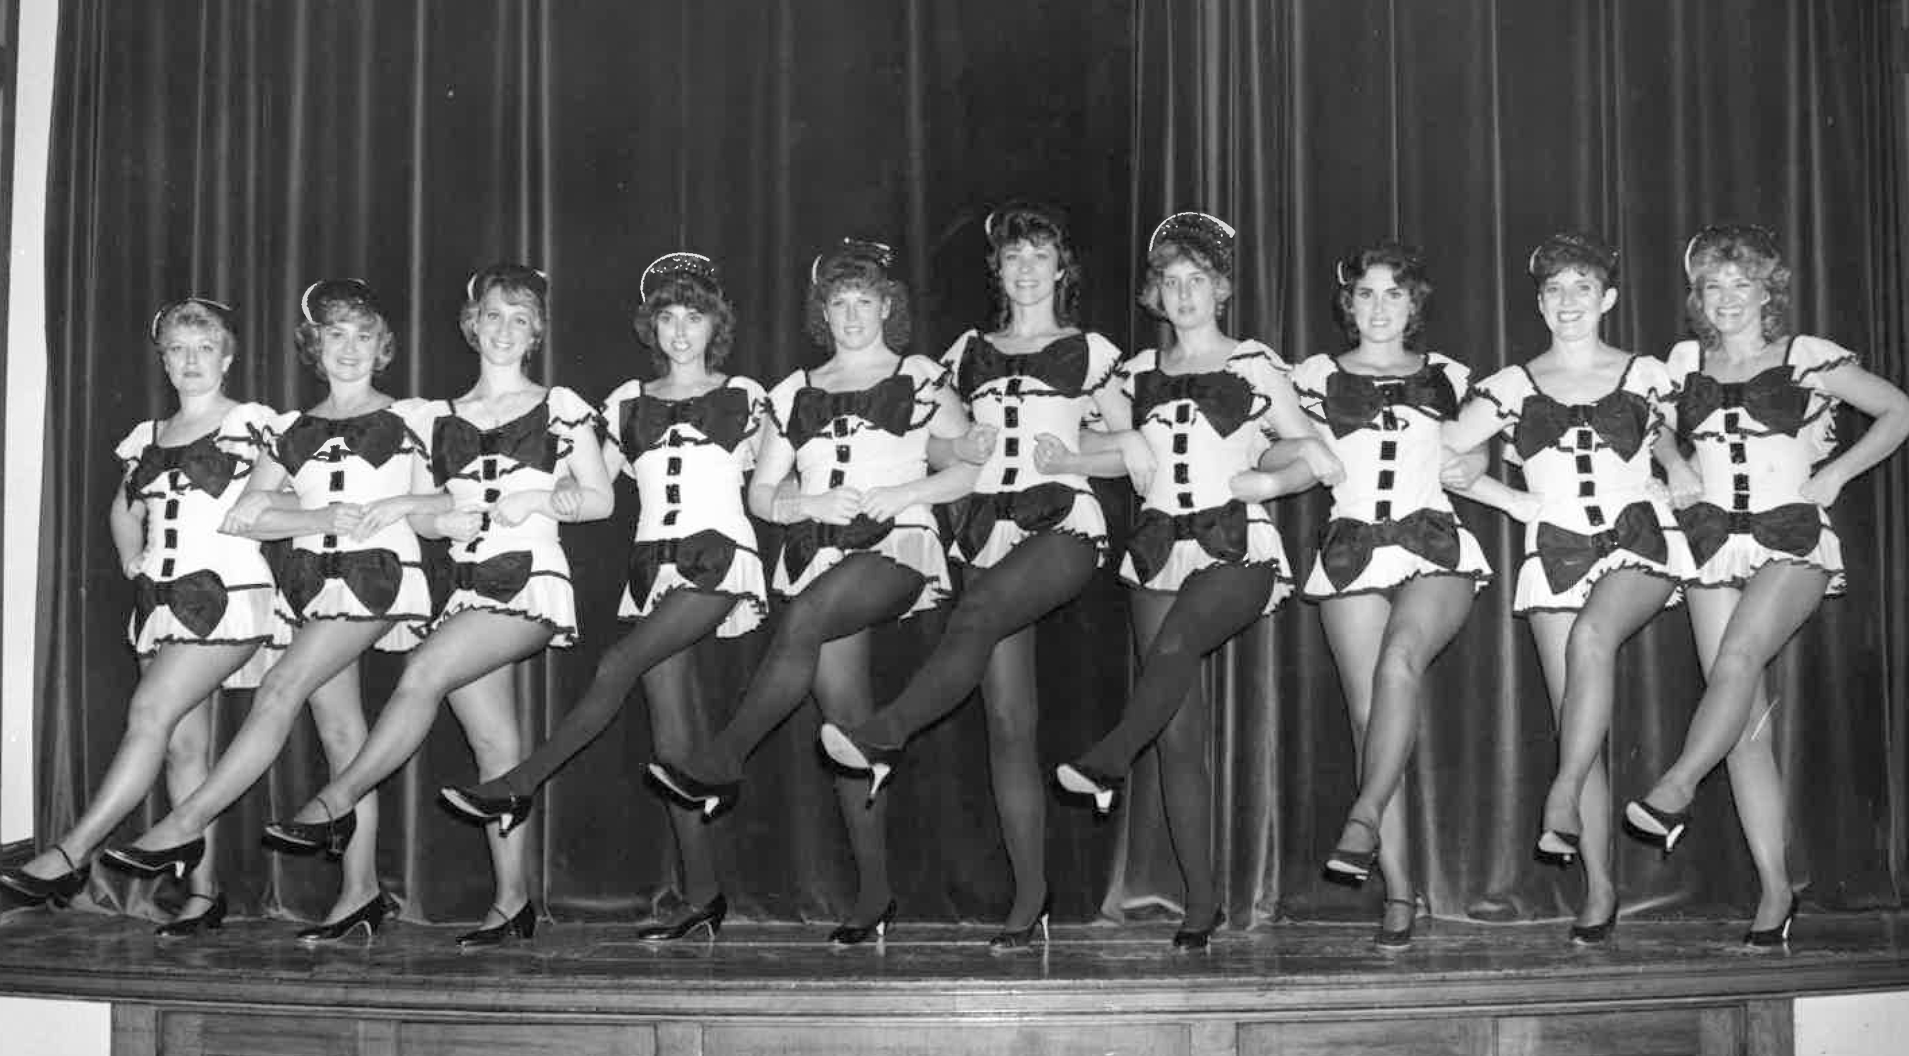
Economic benefits
Economic impact study presented by:
Dr. Deskins, Director, WVU Bureau of Business and Economic Research
Jobs
New opportunities
Impact on local/regional businesses
Expansion of arts and entertainment for area residents
$0.50 of economic activity to Harrison County for every $1 spent
Project will result in an additional $32 Million through first 5 years in operation

Slide 35
PROGRESS PHOTOS

Slide 36
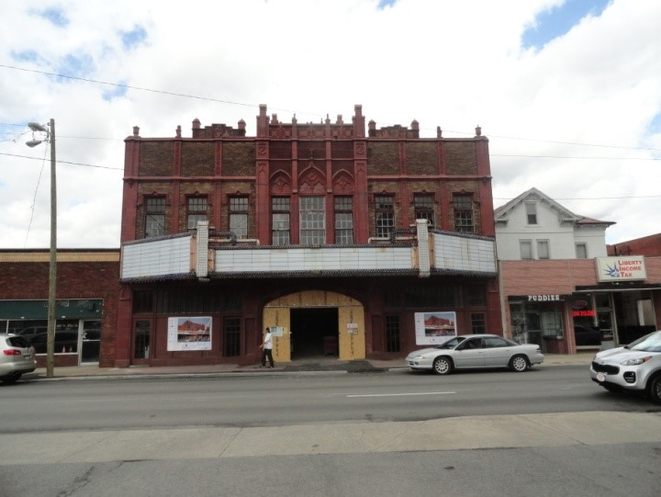

Slide 37
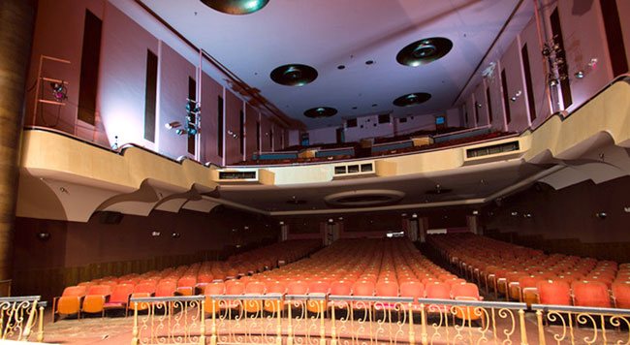

Slide 38
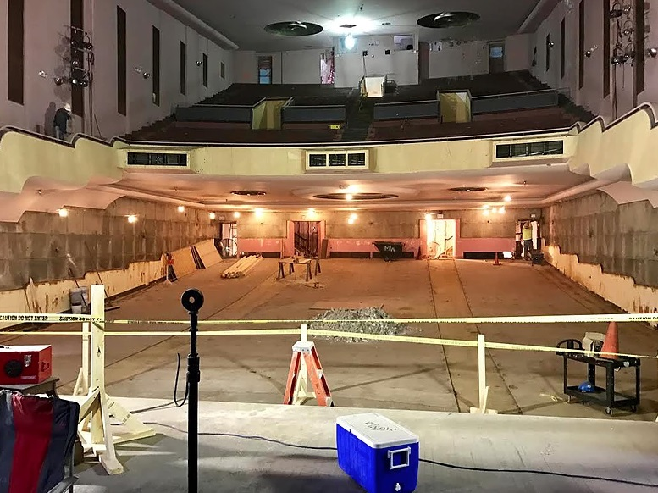

Slide 39
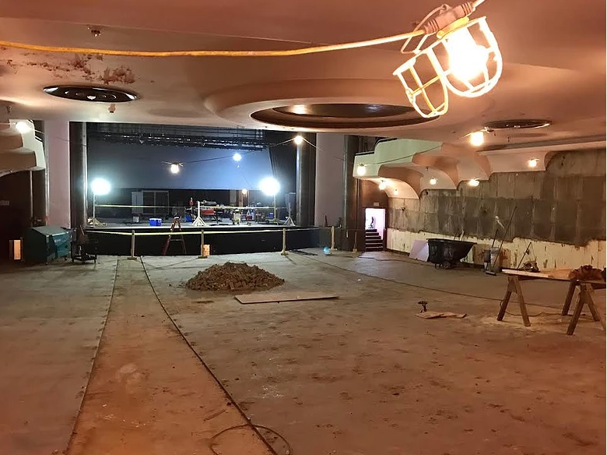

Slide 40
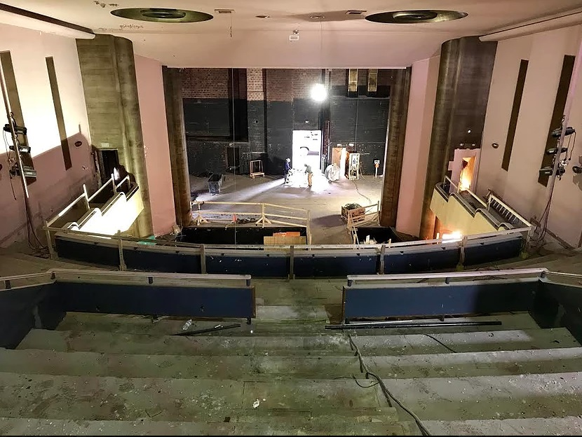

Slide 41
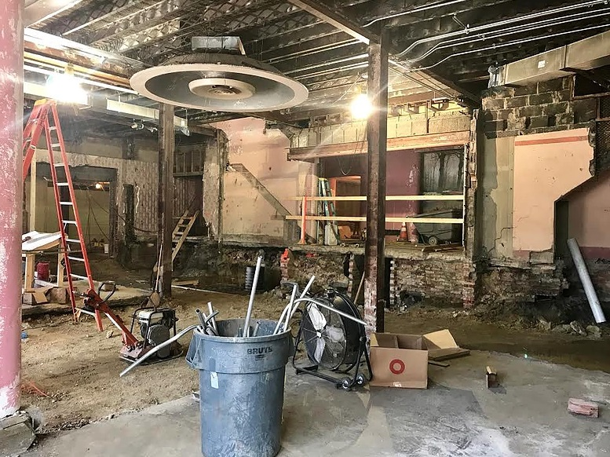

Slide 42
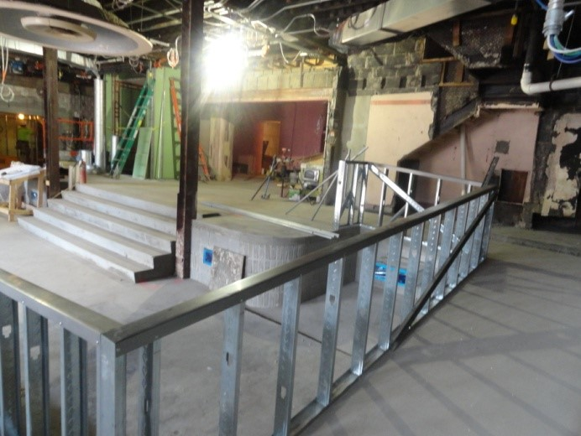

Slide 43
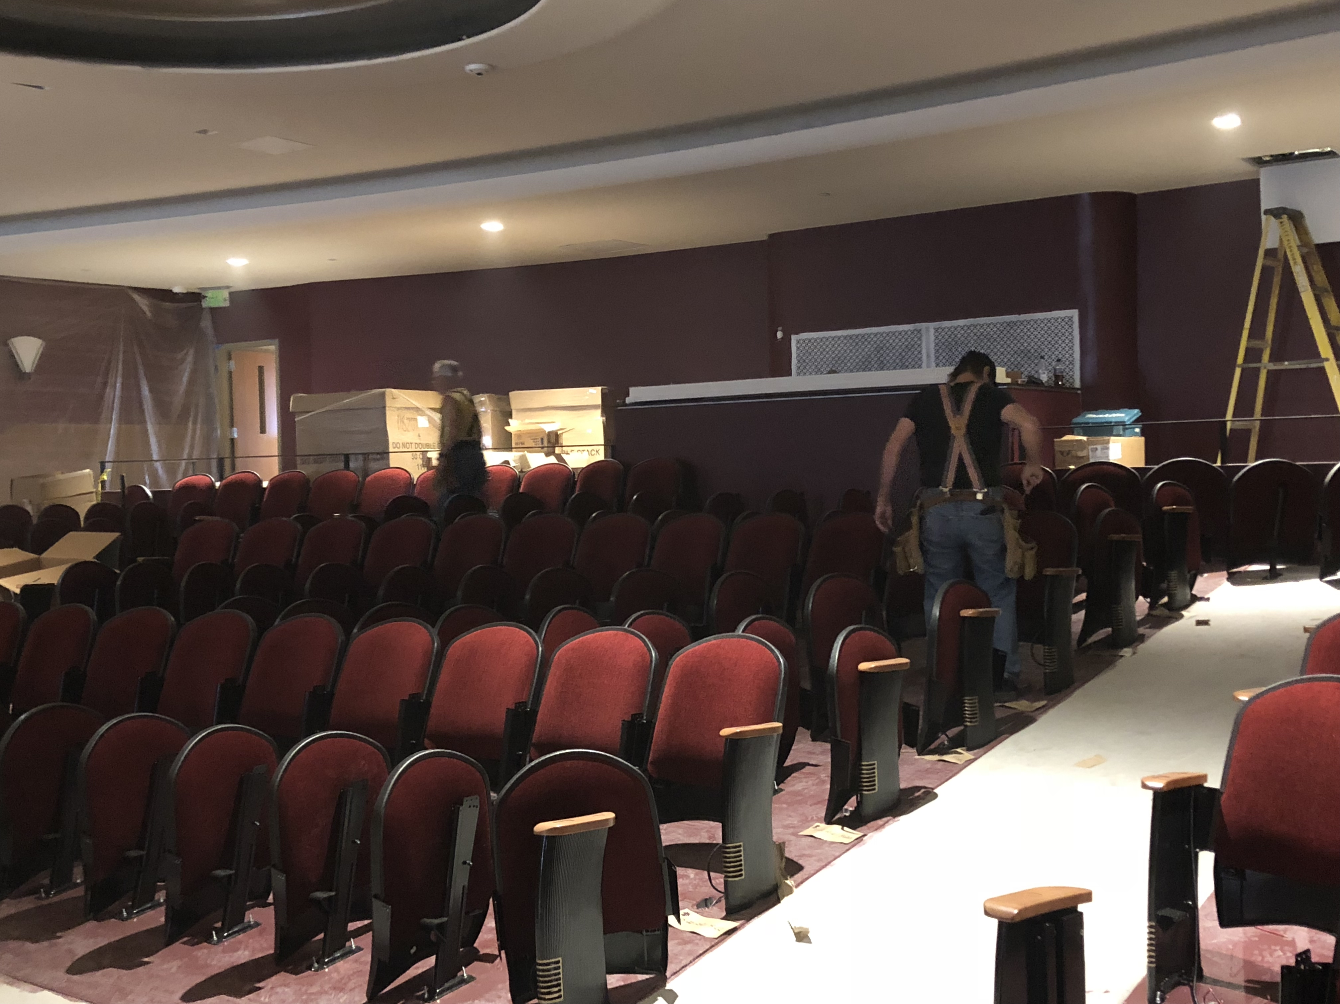

Slide 44
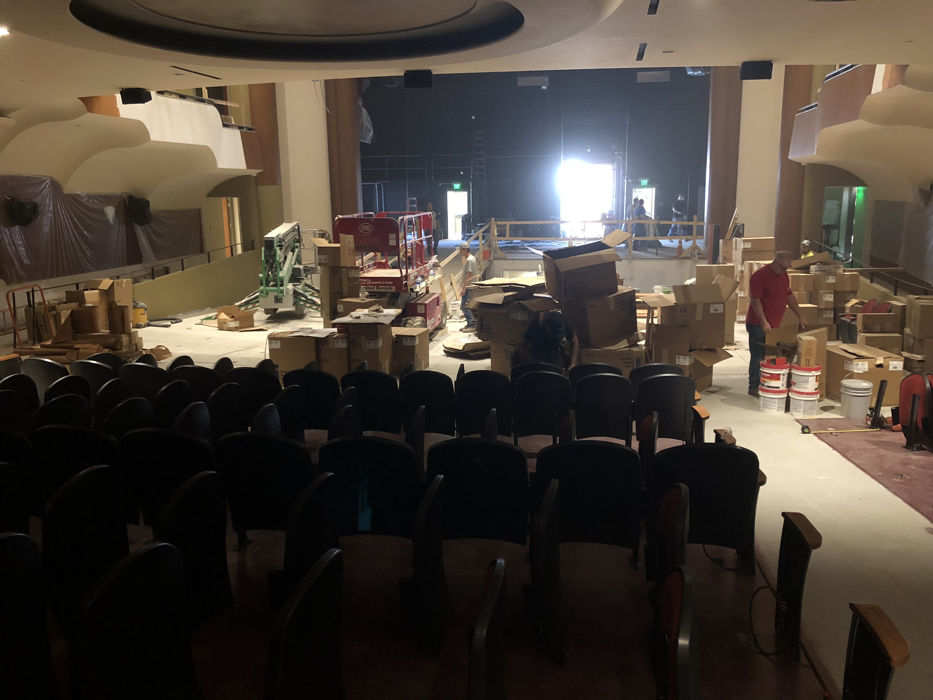

Slide 45
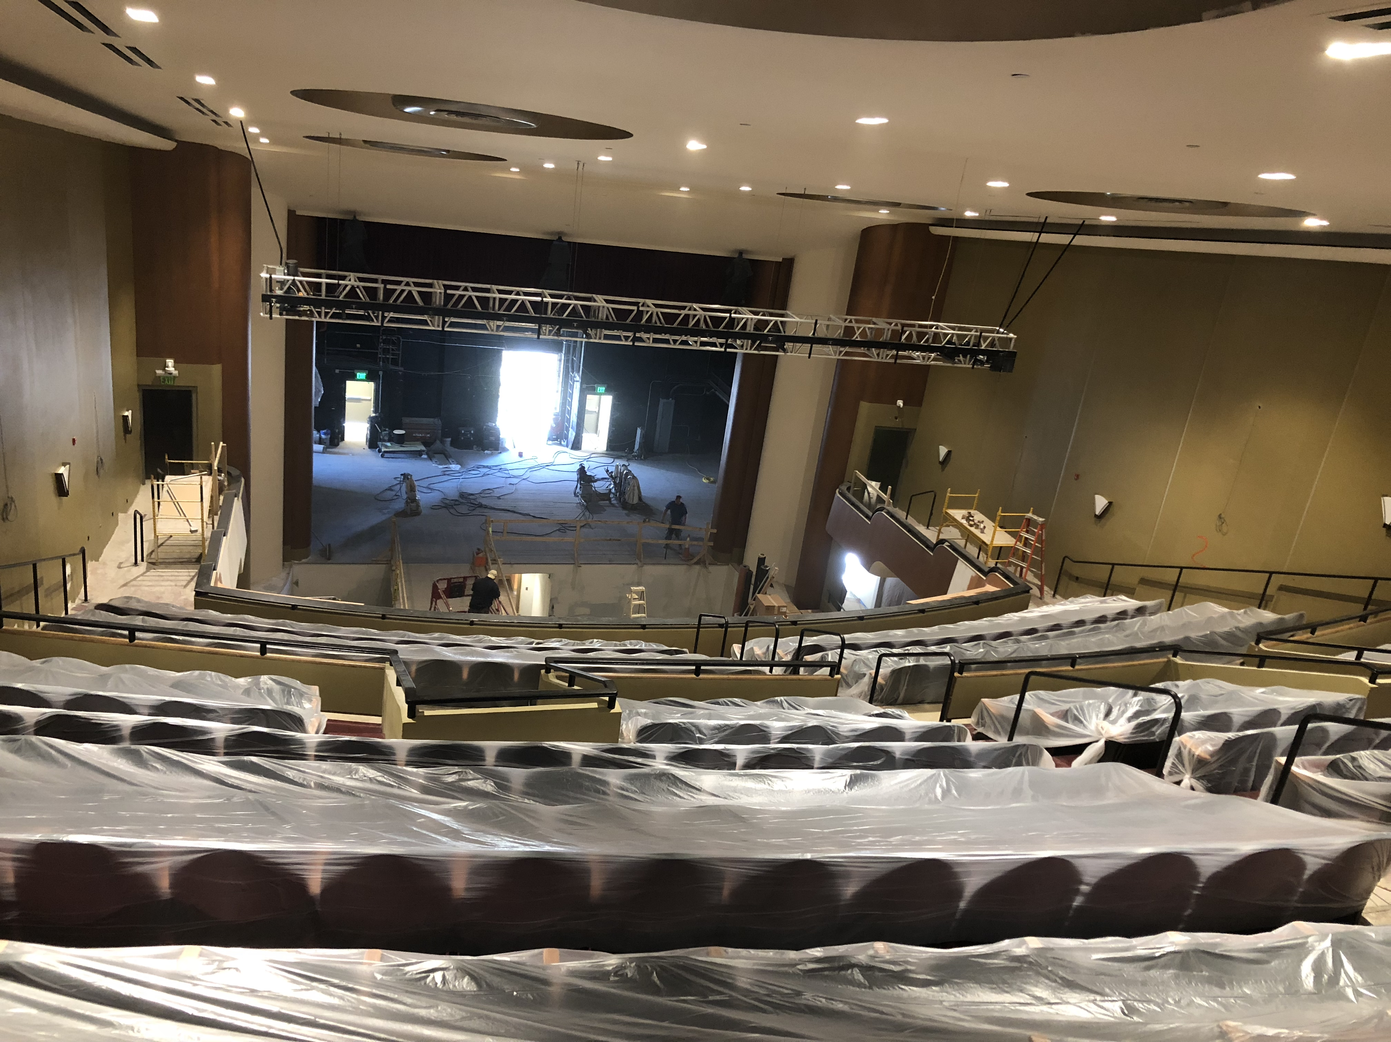

Slide 46
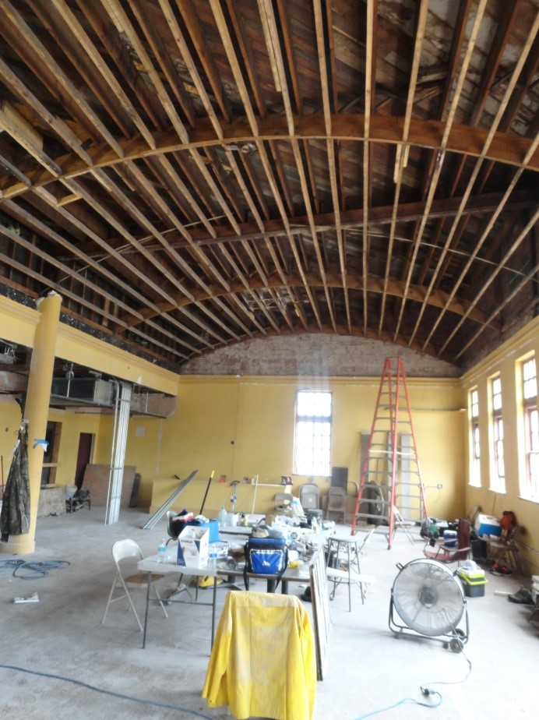
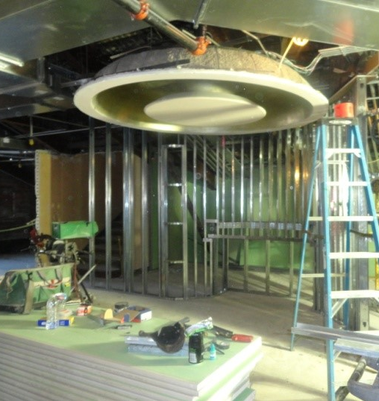

Slide 47
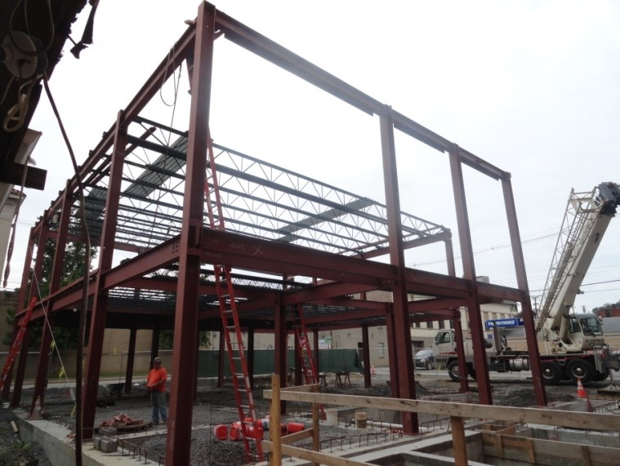

Slide 48
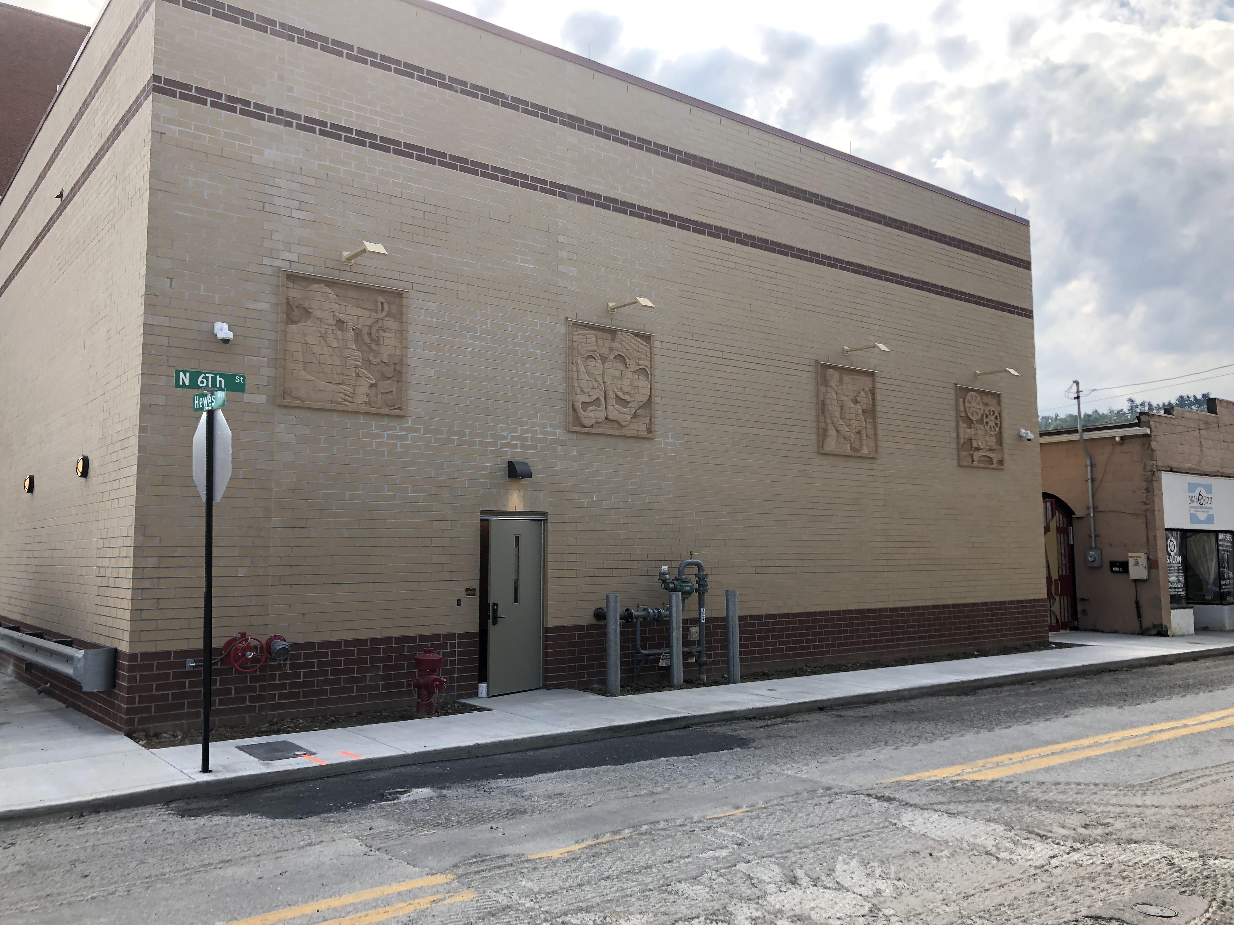

Slide 49
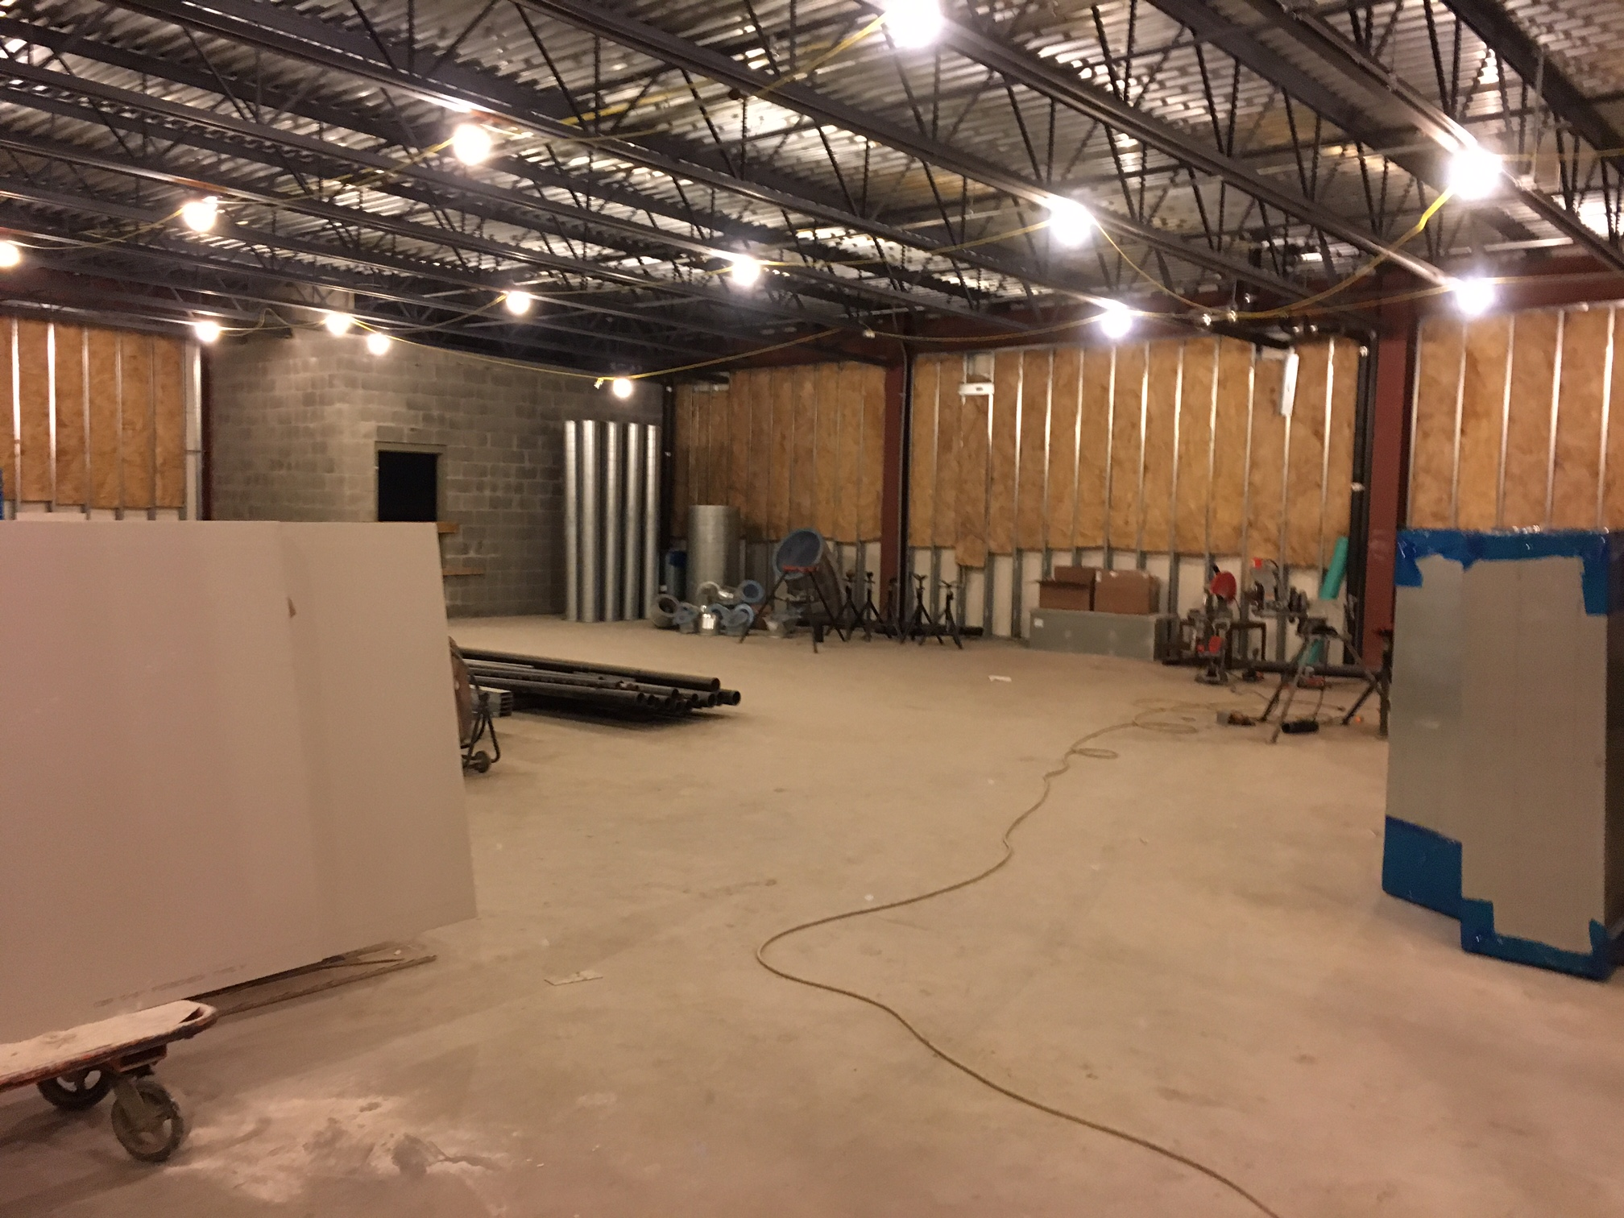

Slide 50
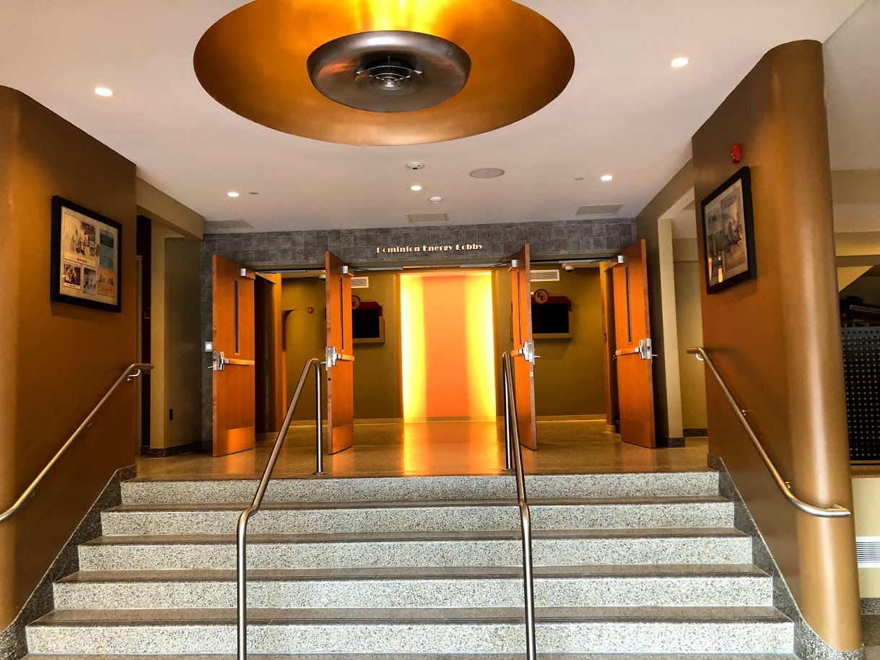

Slide 51
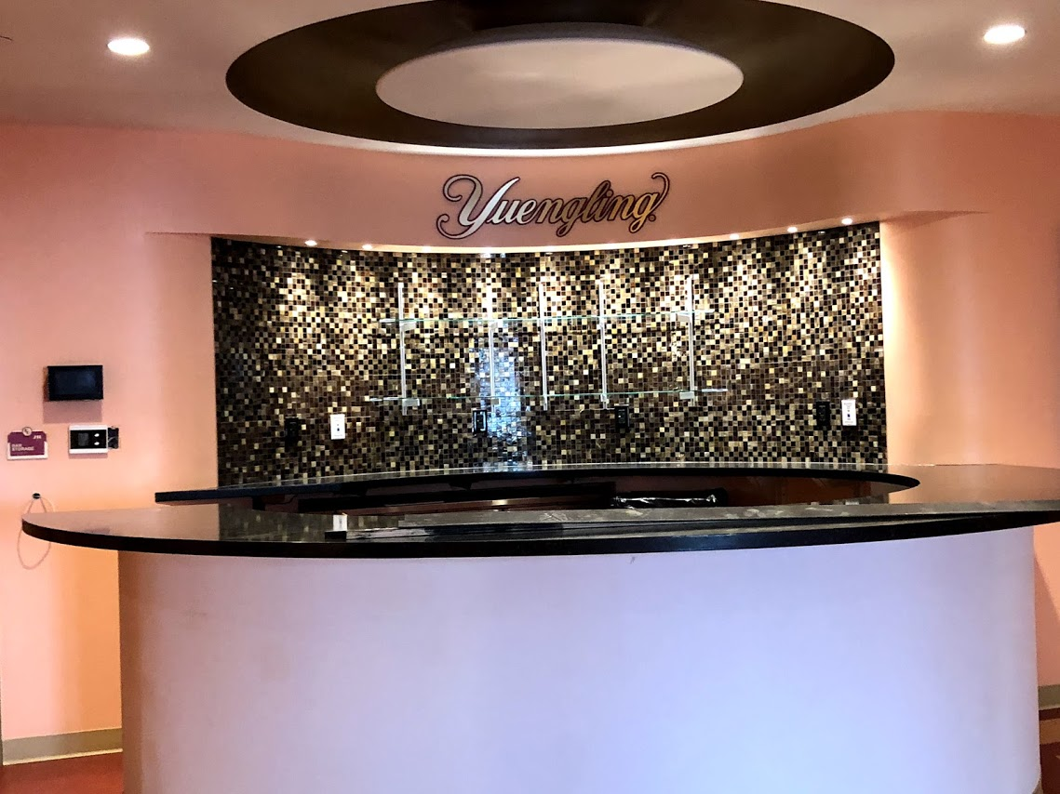

Slide 52
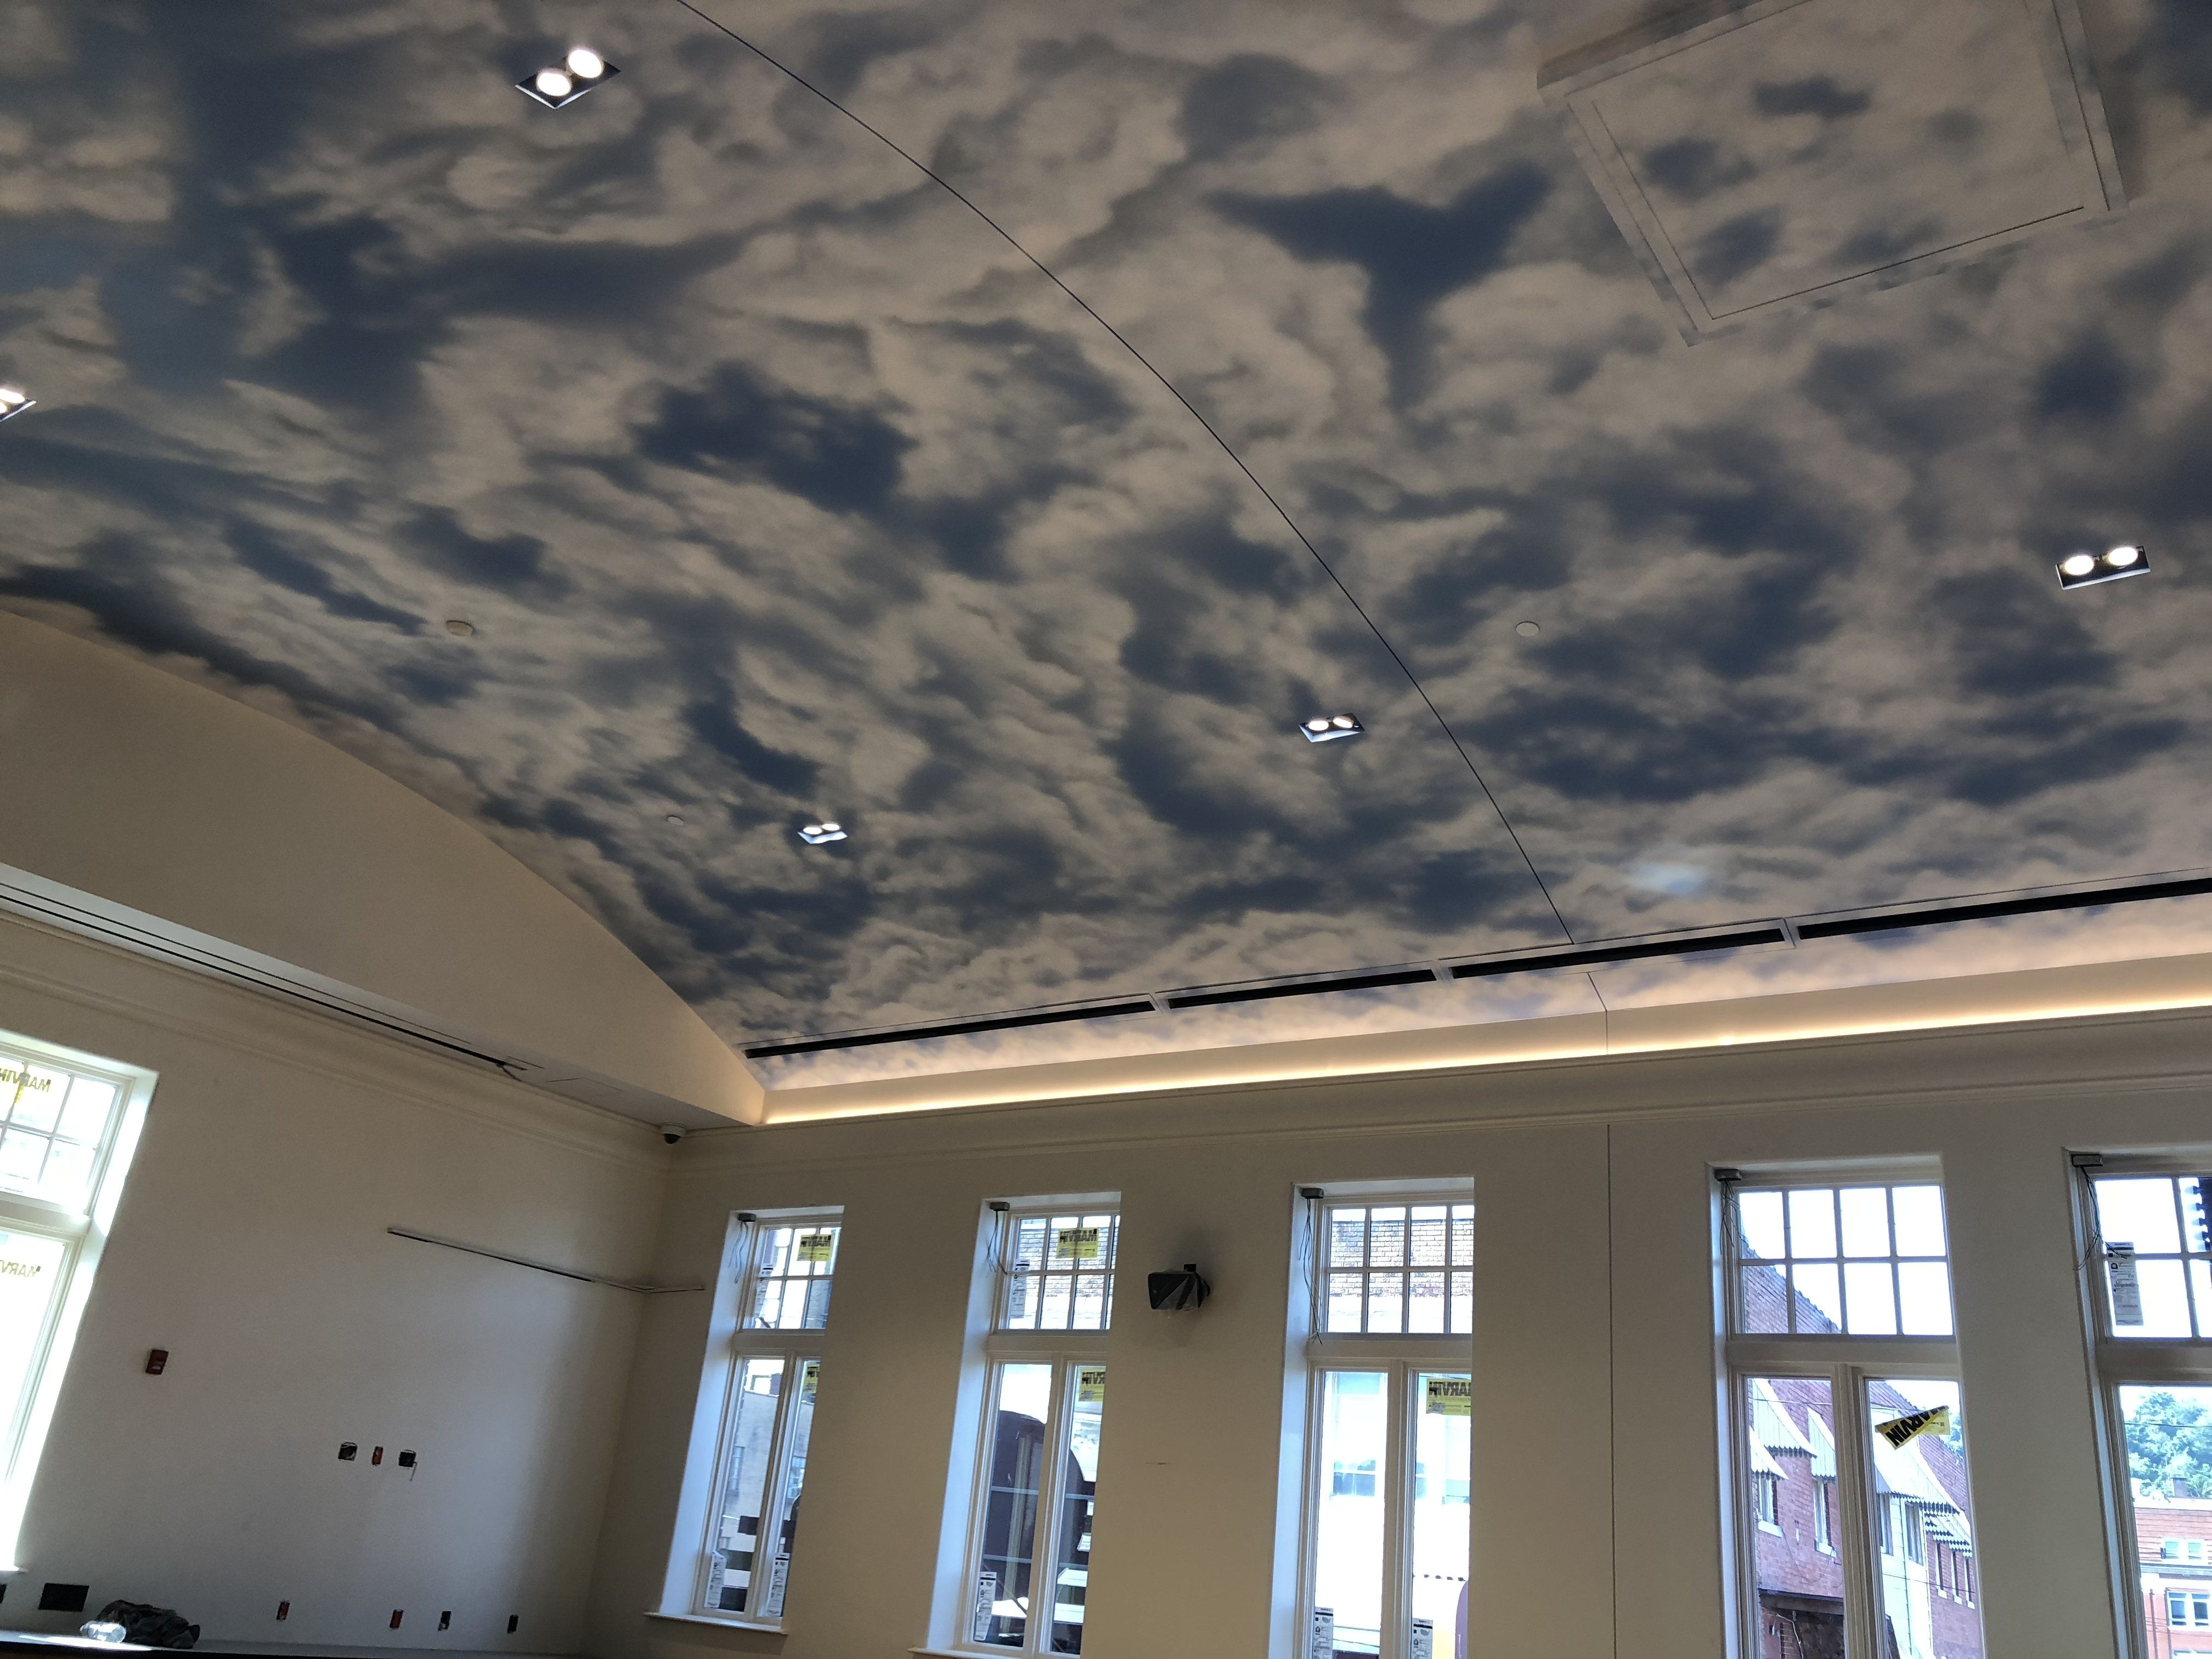

Slide 53
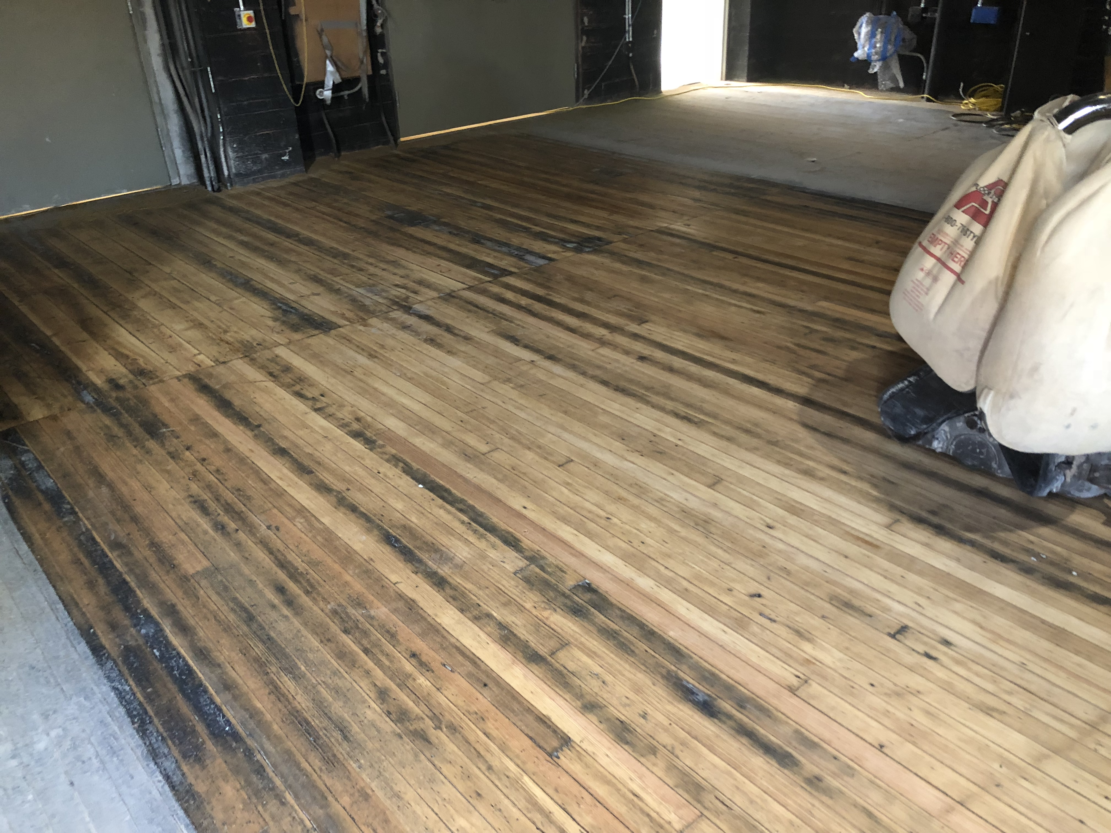

Slide 54
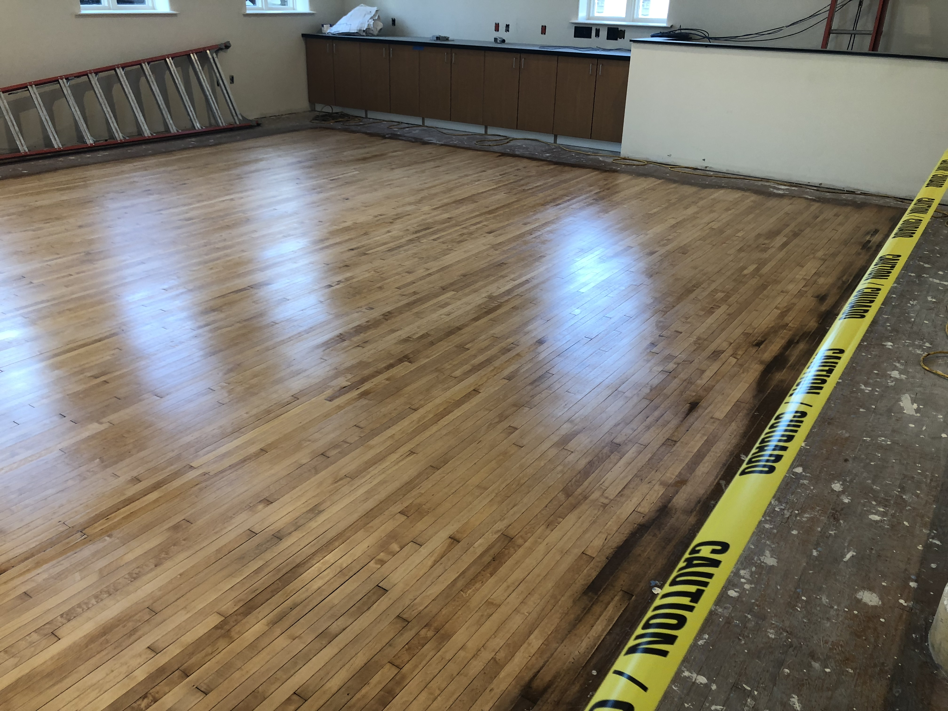

Slide 55
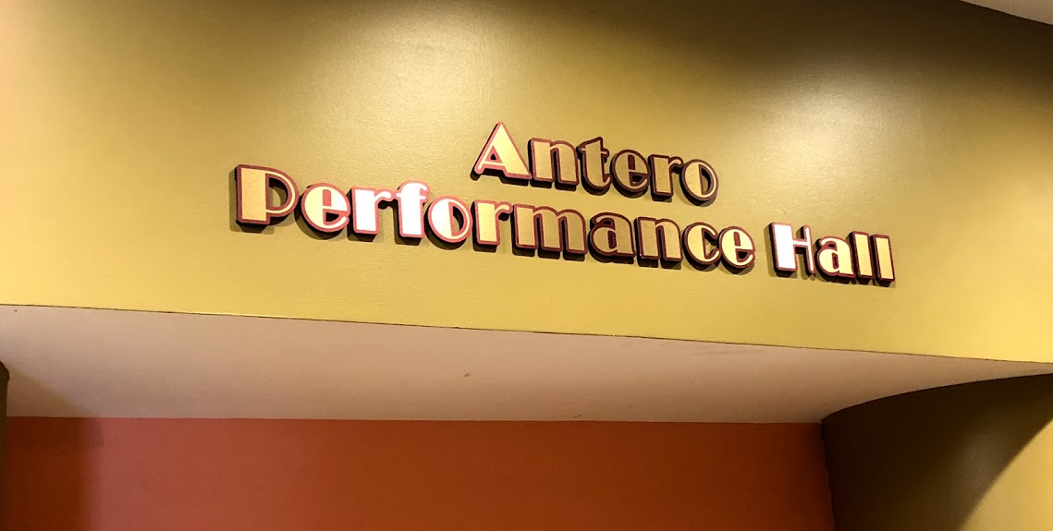

Slide 56
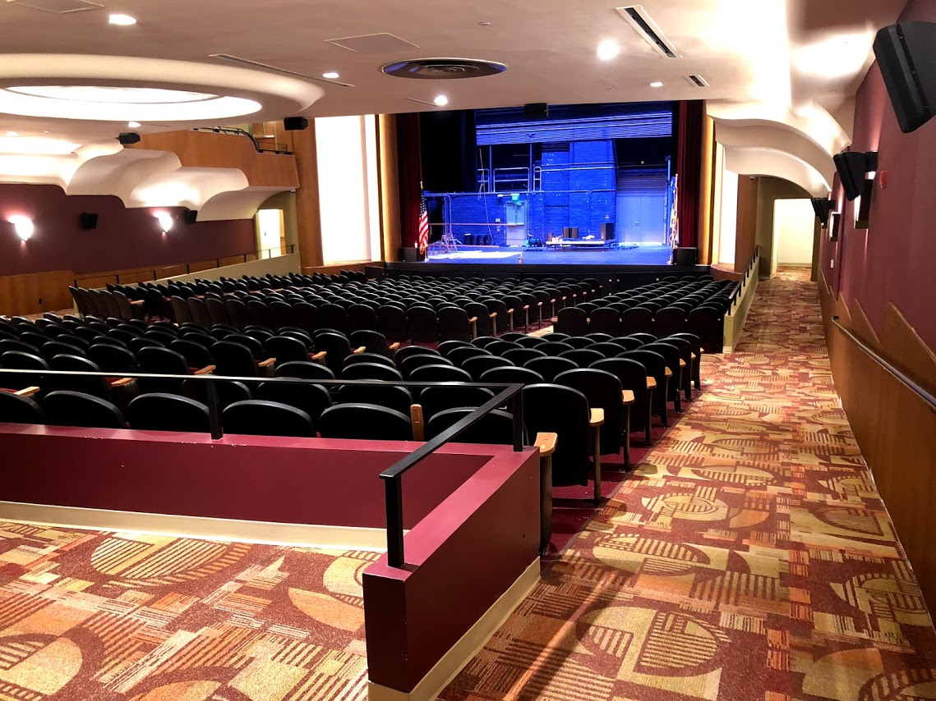

Slide 57
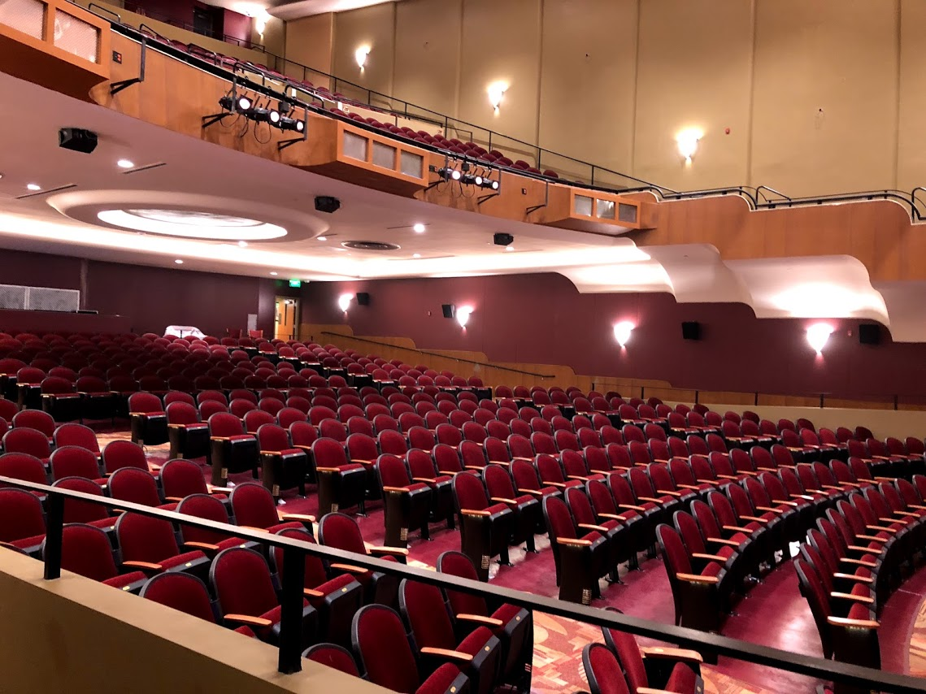

Slide 58
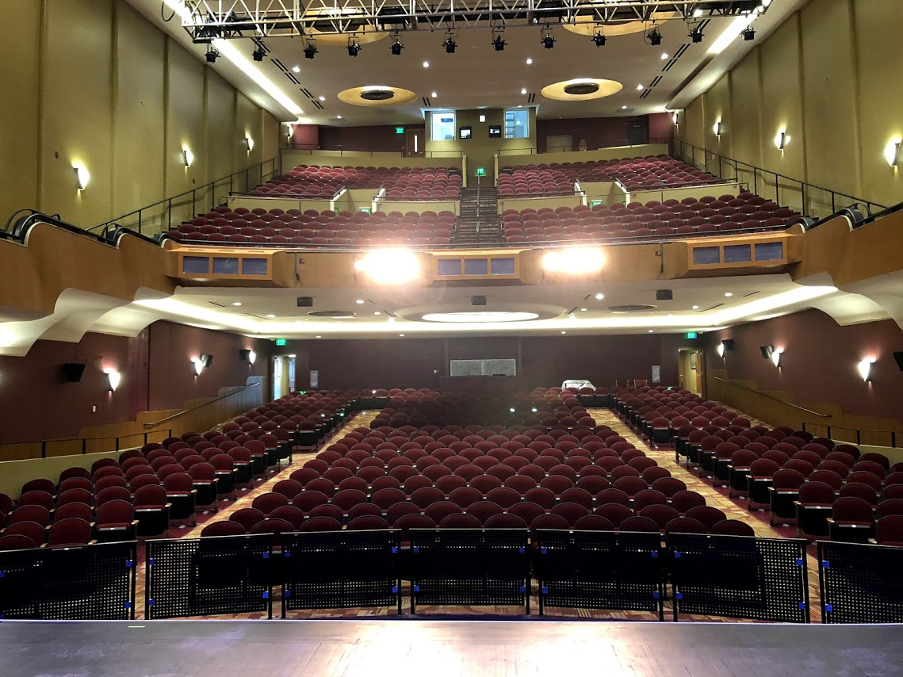

Slide 59
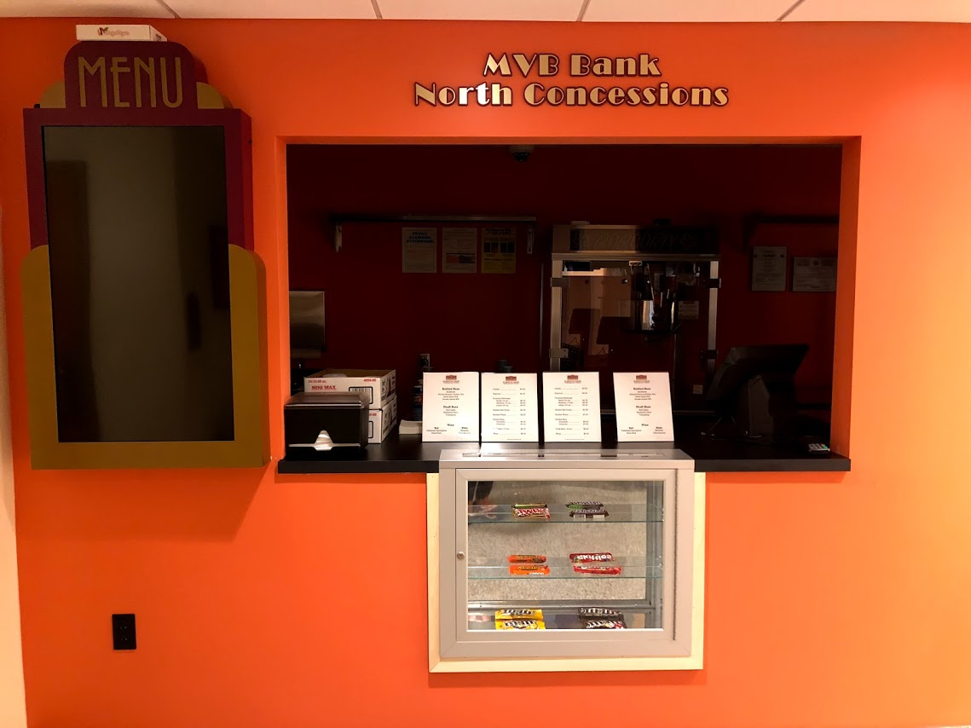

Slide 60
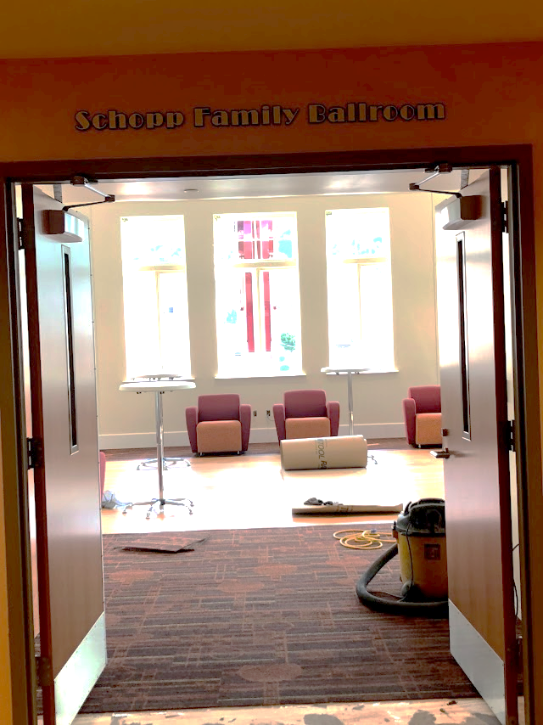
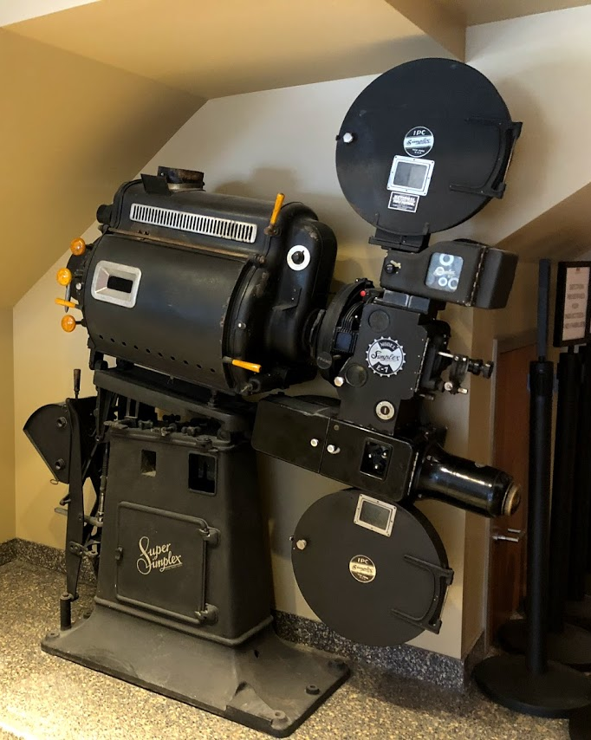

Slide 61
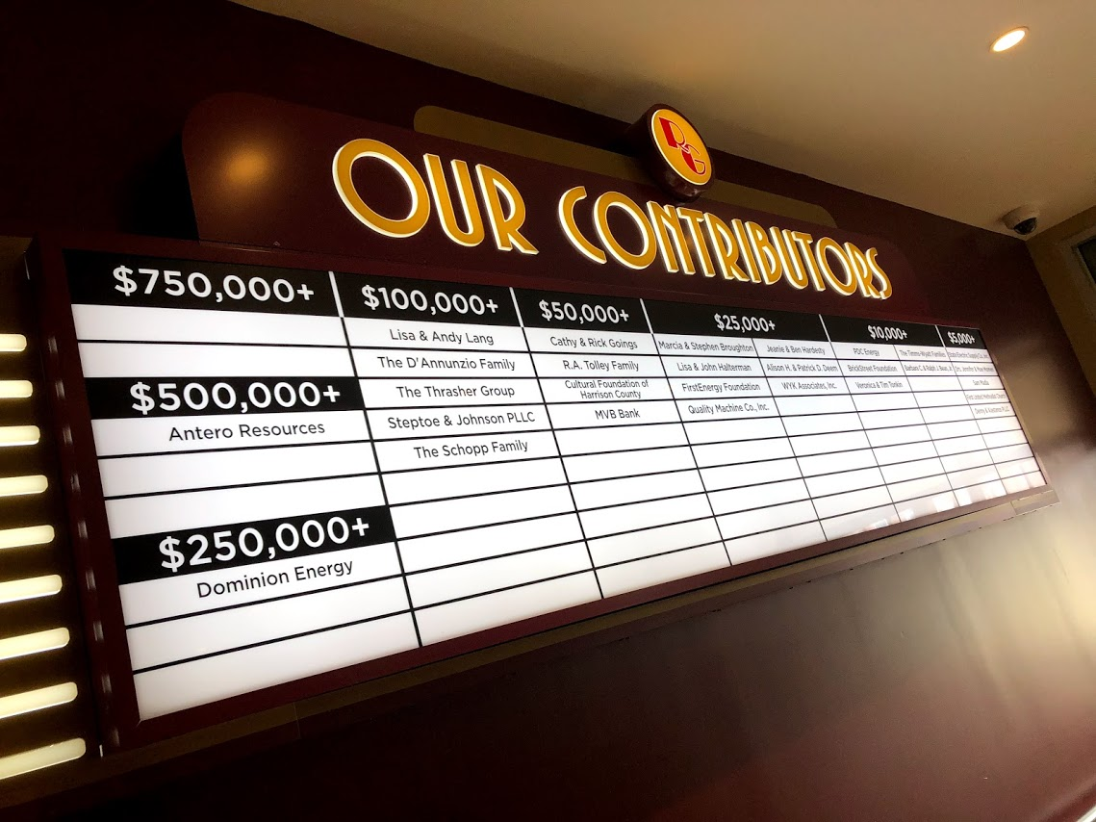

Slide 62
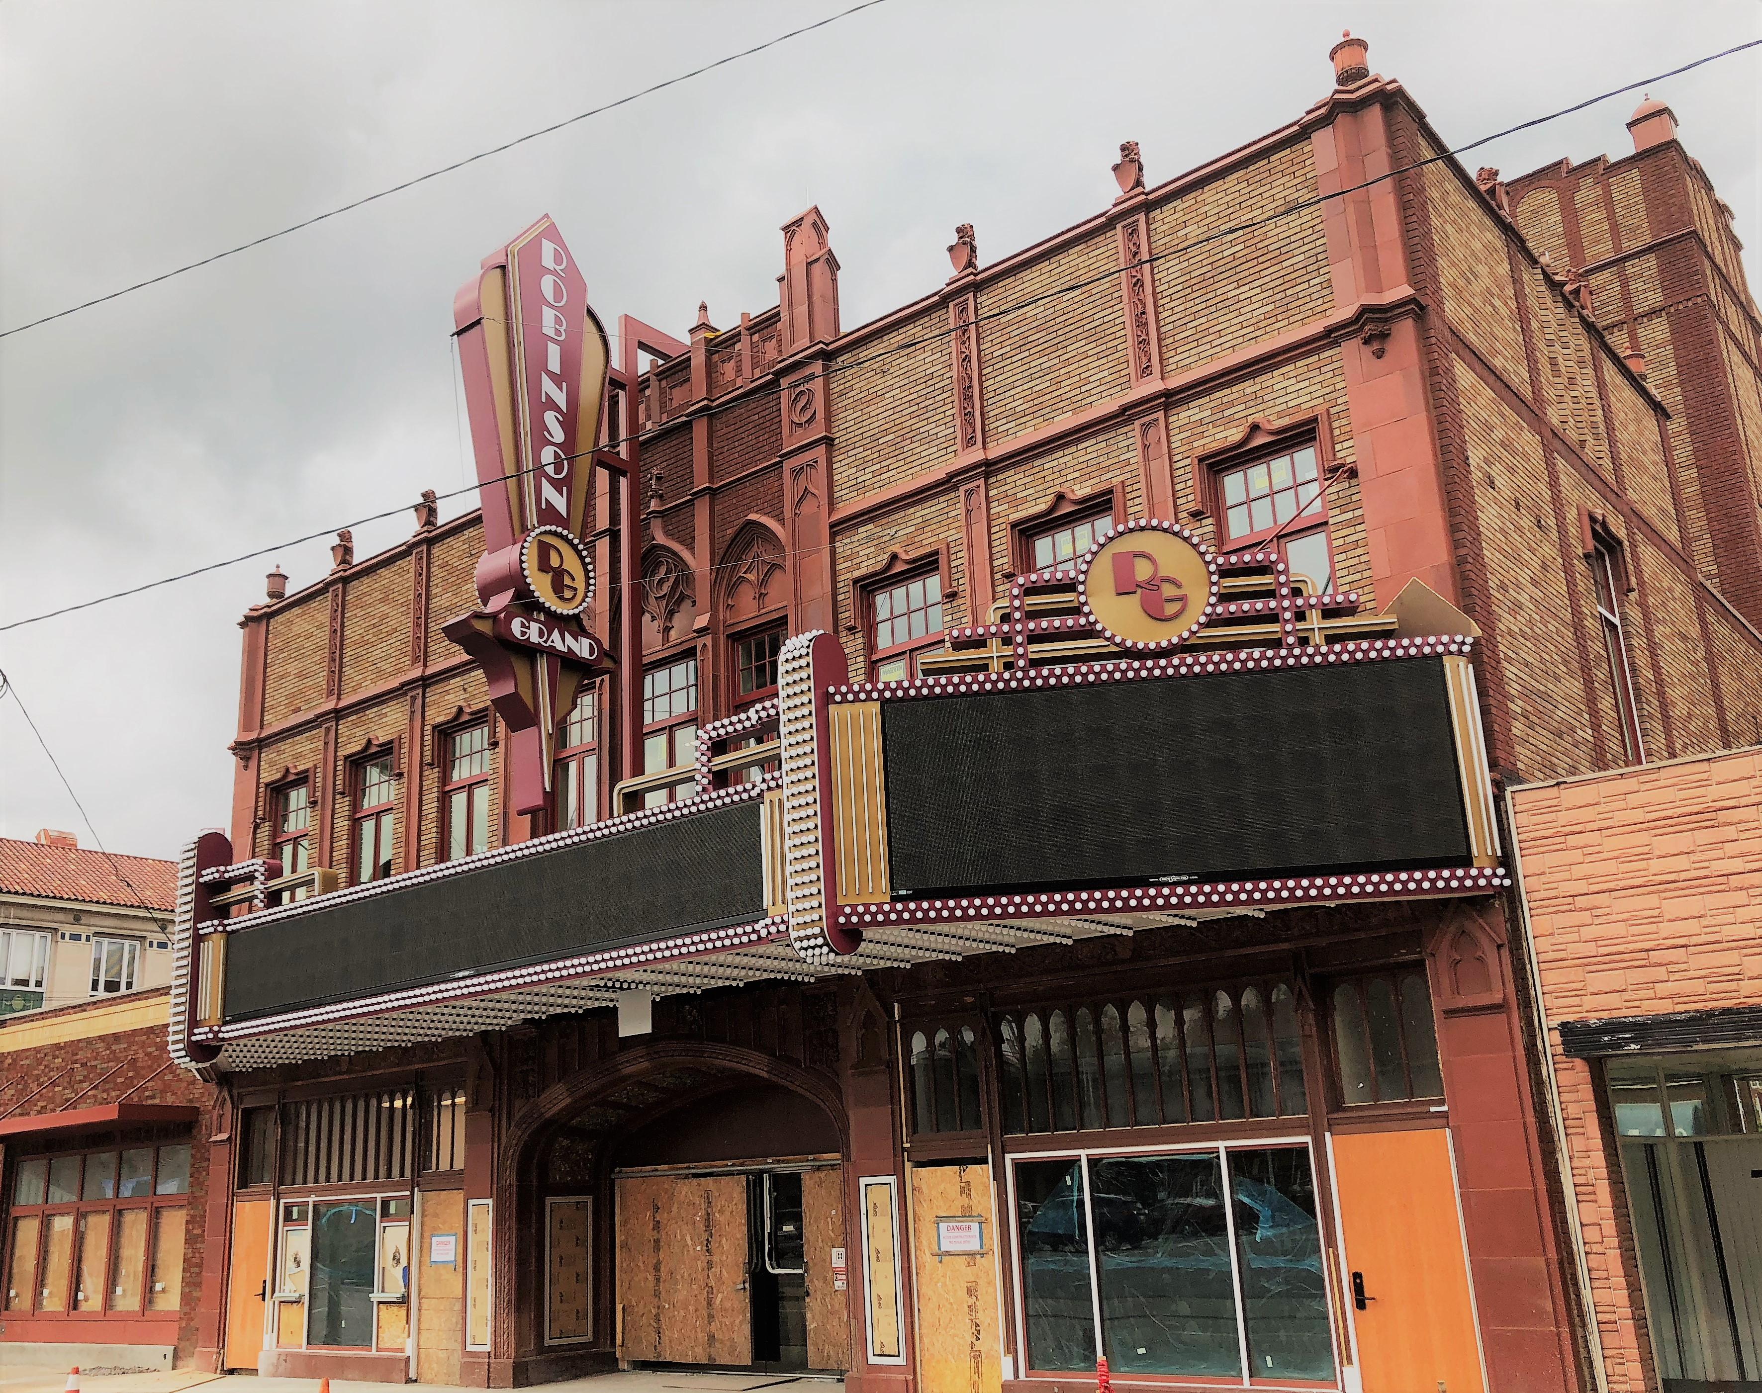

Slide 63
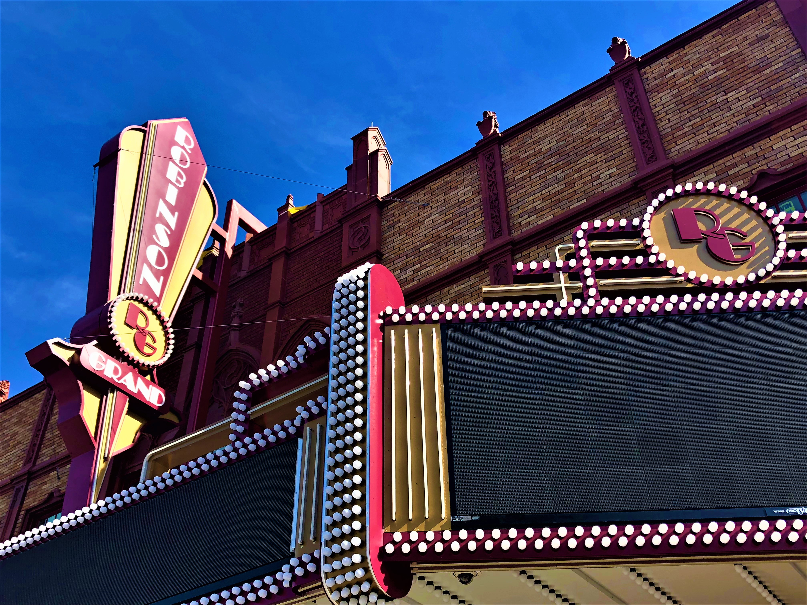

Slide 64



Slide 65


The City of Clarksburg invites you to find out more
by going to
TheRobinsonGrand.com
Find us on

