Slide 1
WV Economic Development Council
Annual Fall Conference
David F. Hess, M.D.
Regional President, WVU Medicine
September 23, 2025

Slide 2
WVU Medicine at a Glance
25 hospital campuses in four states
2,800+ total beds
35,000+ team members
3,000+ medical staff members
~ $7 billion in annual revenue
~ 50,000 health plan lives covered
~ 300,000 total value-based lives
~ 2.6 million outpatient encounters

Slide 3
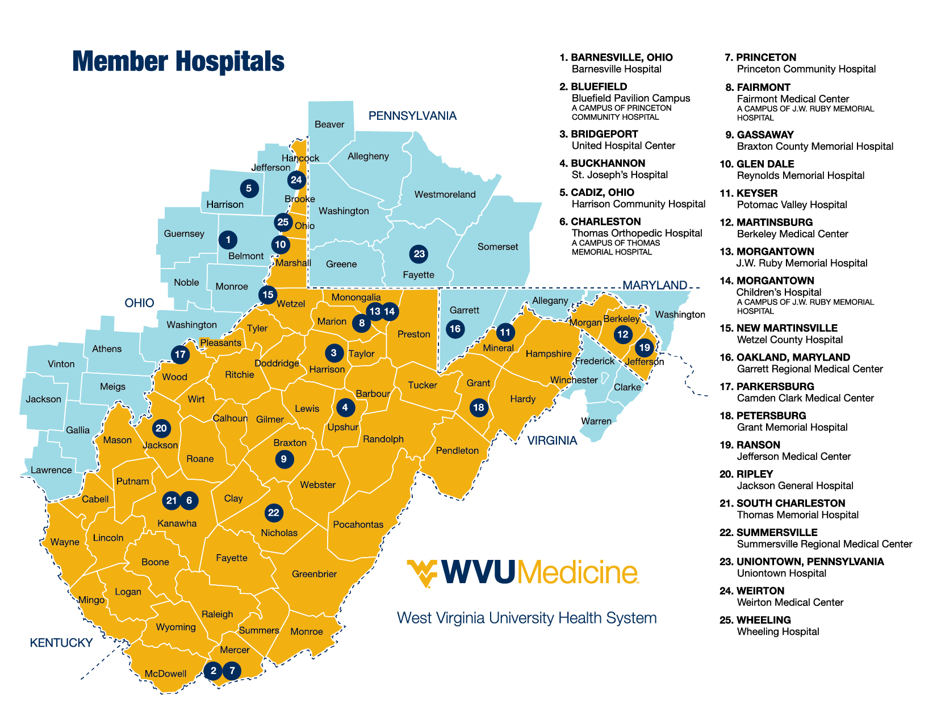
WVU Medicine Service Area

Slide 4
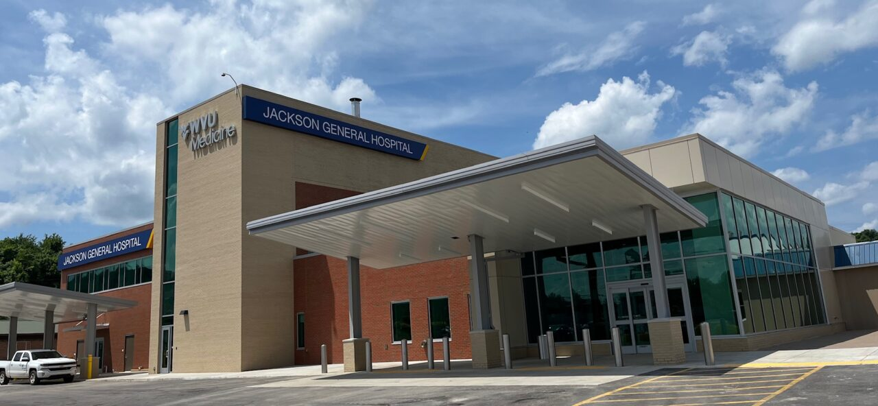
Significant Investments into Provider Network

Slide 5
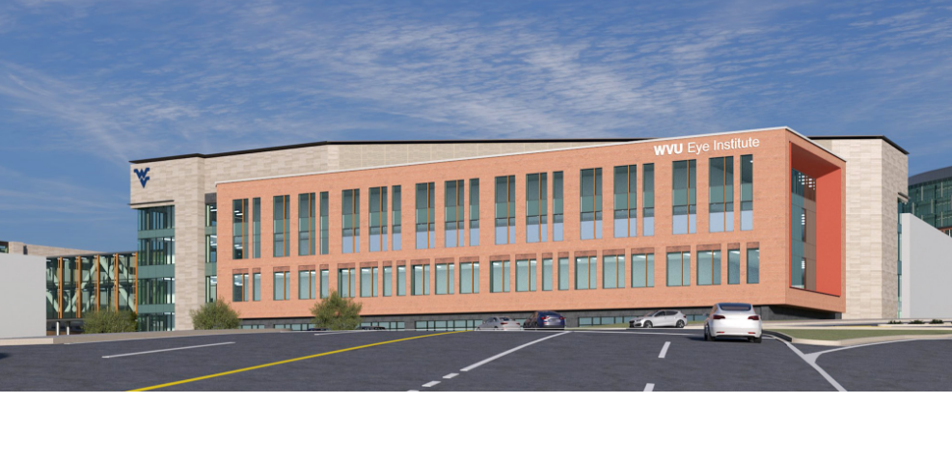
Prior Year Board Approved Projects
At its April 17, 2024 meeting, WVUHS Board of Directors approved $379M in new strategic capital projects, including:
WVU Hospitals – Eye Institute
Groundbreaking Date : January 24, 2025
Anticipated Completion: Fall 2027

Slide 6

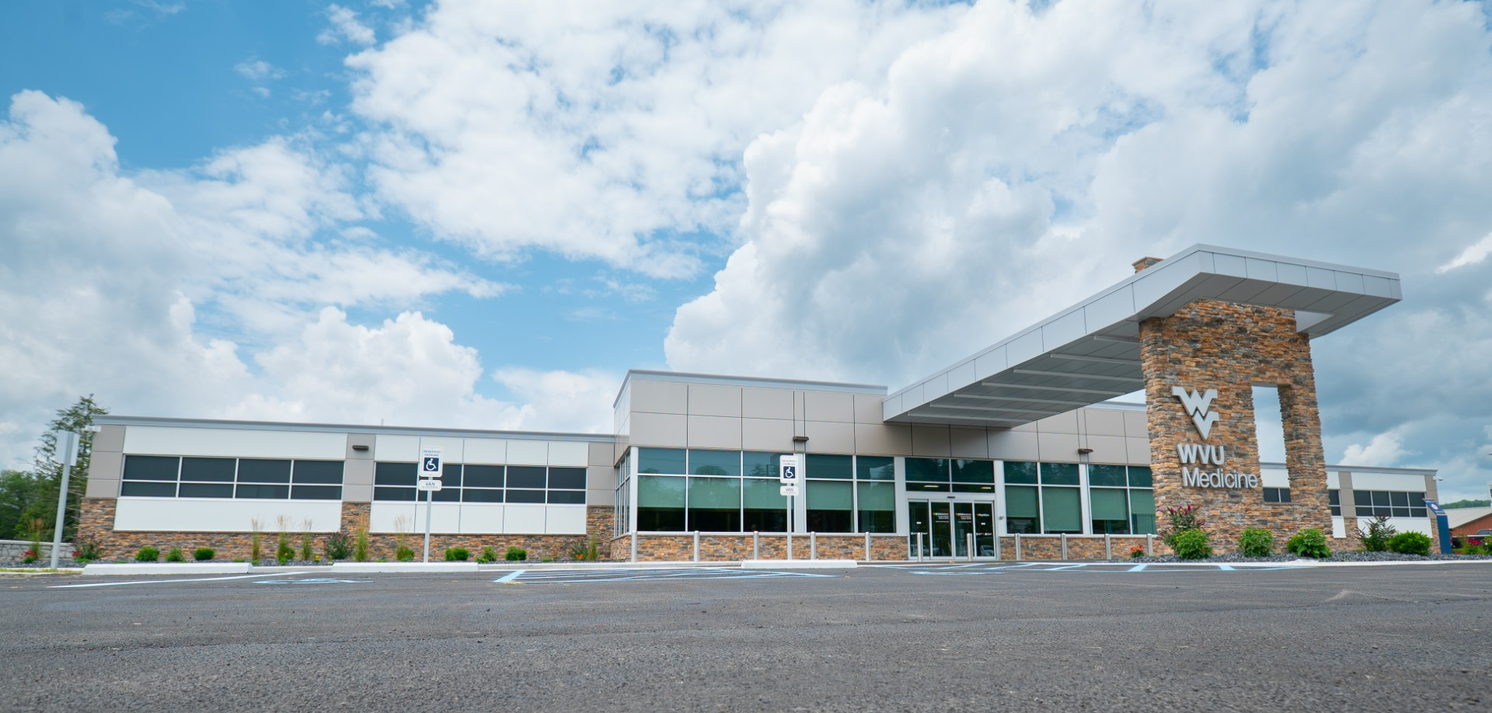
Prior Year Board Approved Projects
At its April 17, 2024 meeting, WVUHS Board of Directors approved $379M in new strategic capital projects, including:
United Hospital Center - Elkins
Groundbreaking Date : June 6, 2024
Anticipated Completion: July 1, 2025

Slide 7
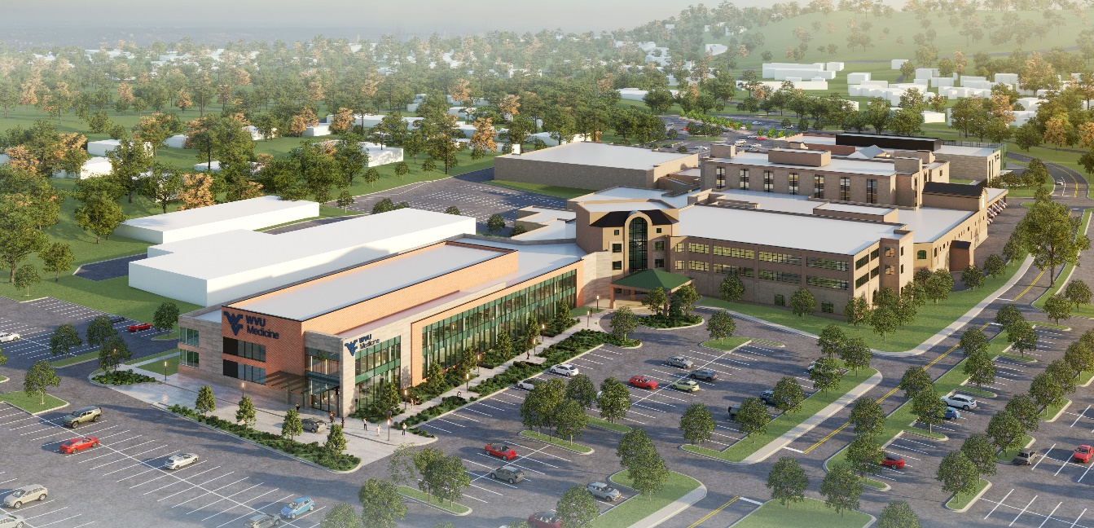
Prior Year Board Approved Projects
At its April 17, 2024 meeting, WVUHS Board of Directors approved $379M in new strategic capital projects, including:
Princeton Community Hospital - Cancer Center
Groundbreaking Date : August 21, 2025
Anticipated Completion: December 2027

Slide 8
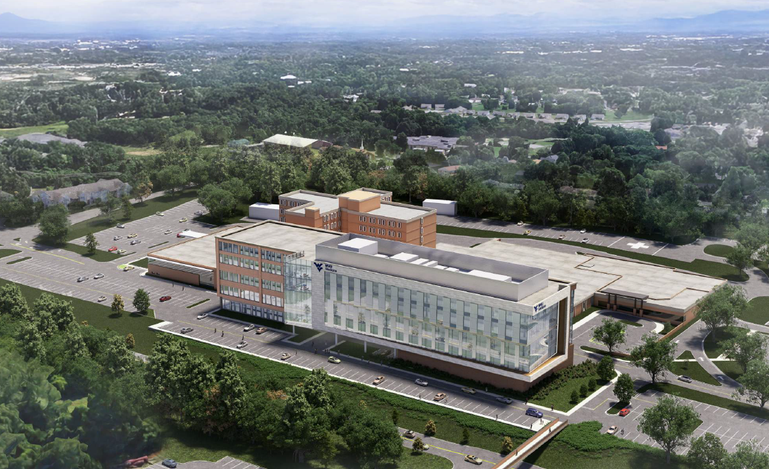
Recent Board Approved Projects
At its April 16, 2025 meeting, WVUHS Board of Directors approved $460M in new strategic capital projects, including:
Berkeley Medical Center – New Patient Tower
Groundbreaking Date : September 16, 2025
Anticipated Completion: June 2028

Slide 9
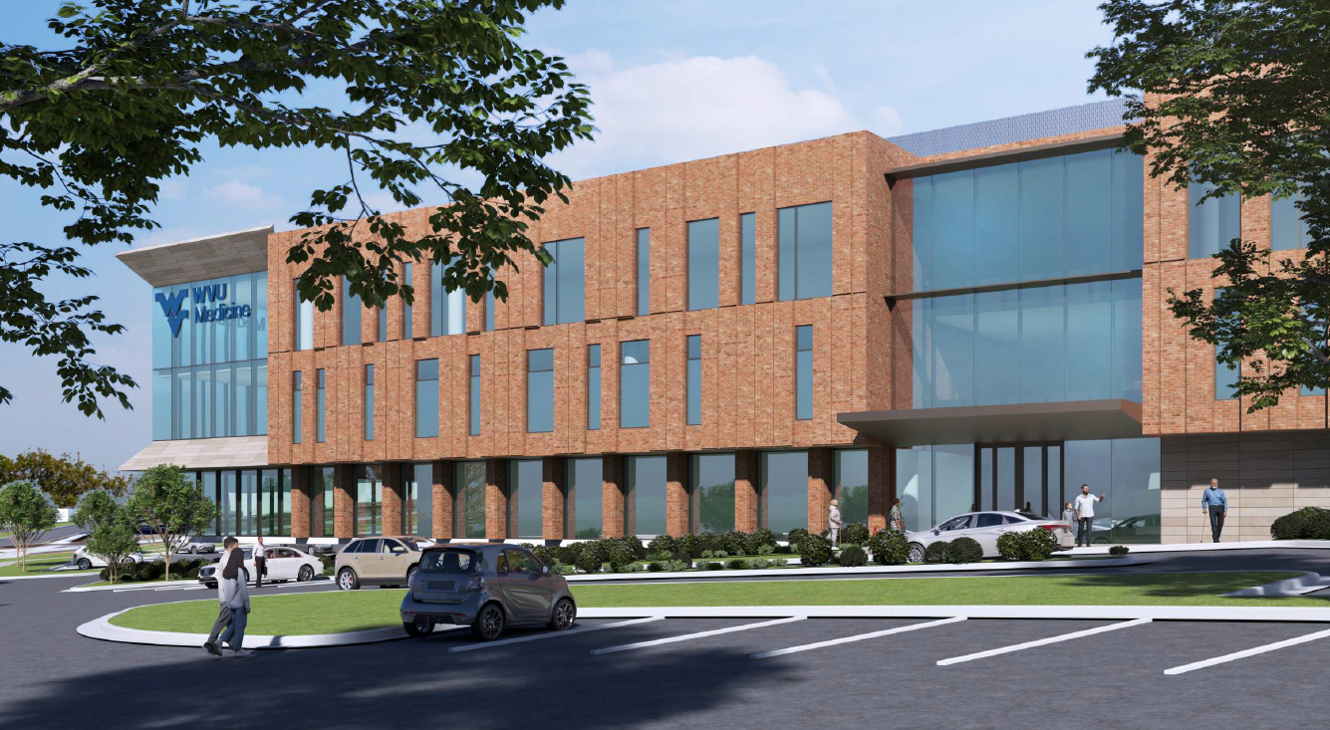
Recent Board Approved Projects
At its April 16, 2025 meeting, WVUHS Board of Directors approved $460M in new strategic capital projects, including:
Jefferson Medical Center – Hospital Addition
Groundbreaking Date : April 2026
Anticipated Completion: April 2028

Slide 10
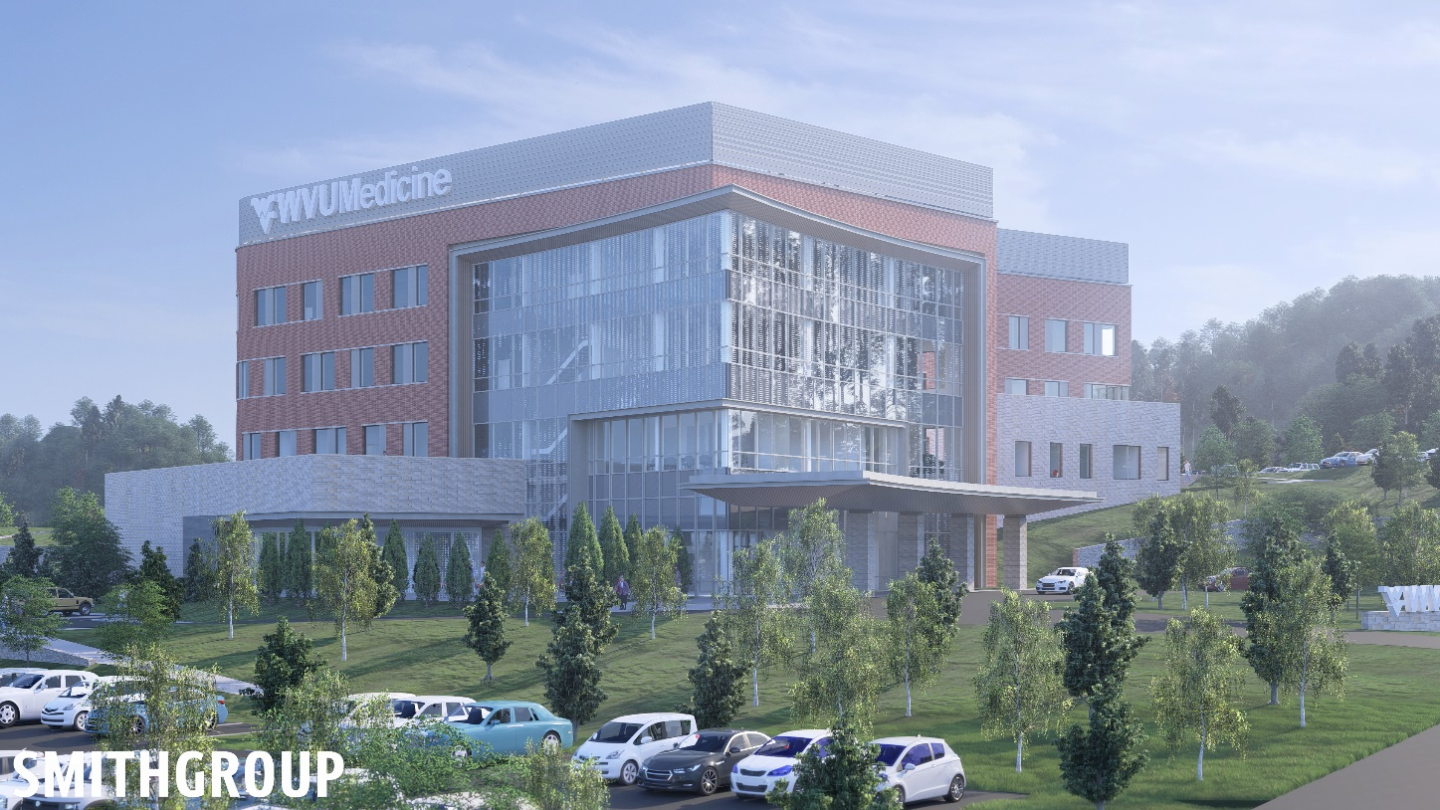
Recent Board Approved Projects
At its April 16, 2025 meeting, WVUHS Board of Directors approved $460M in new strategic capital projects, including:
Wheeling Hospital – Regional Cancer Center
Groundbreaking Date : Second Quarter 2026
Anticipated Completion: Fourth Quarter 2028

Slide 11
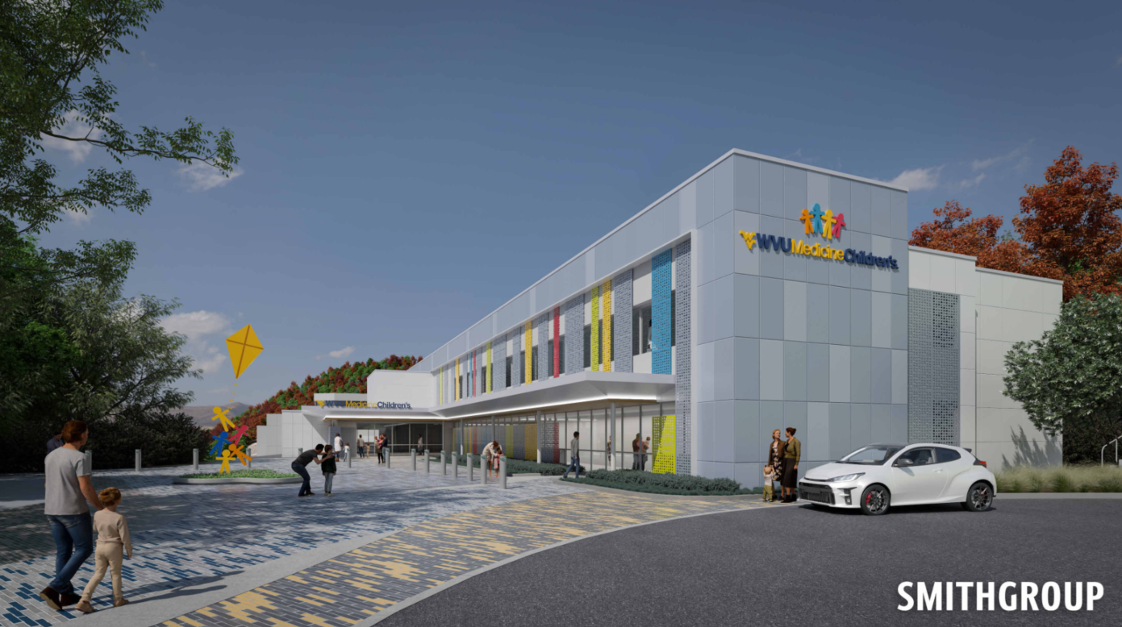
Recent Board Approved Projects
At its April 16, 2025 meeting, WVUHS Board of Directors approved $460M in new strategic capital projects, including:
Wheeling Hospital – Pediatrics Outpatient Clinic
Groundbreaking Date : August 12, 2025
Anticipated Completion: December 2026

Slide 12
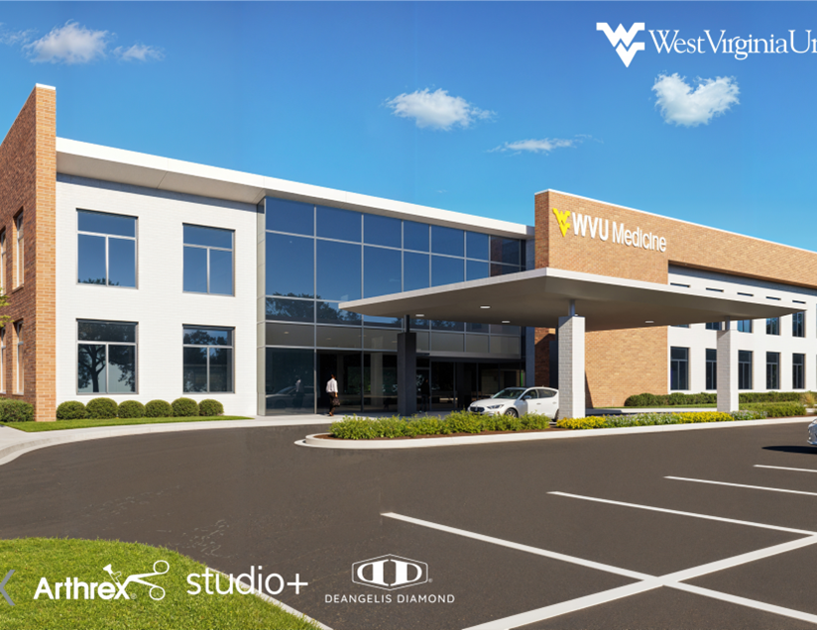
Recent Board Approved Projects
At its April 16, 2025 meeting, WVUHS Board of Directors approved $460M in new strategic capital projects, including:
United Hospital Center – Outpatient Surgery Center
Groundbreaking Date: TBD
Anticipated Completion: TBD

Slide 13
WVU Medicine
Workforce

Slide 14
Recruitment & Retention
Total Agency & Overtime Costs as % of NPR
Total Agency & Overtime Costs (in Millions)
Key Nurse Recruitment & Retention initiatives:
Clinical Advancement Career Ladder
Enhanced Student Loan Assistance Program (max annual benefit of $5,250 with $26,250 lifetime)
Sign-on and Retention Bonuses
Critical Staffing Incentives
Tuition Reimbursement
Aspiring Nurse Program
Nursing School Development
Internal Agency Pool

Slide 15
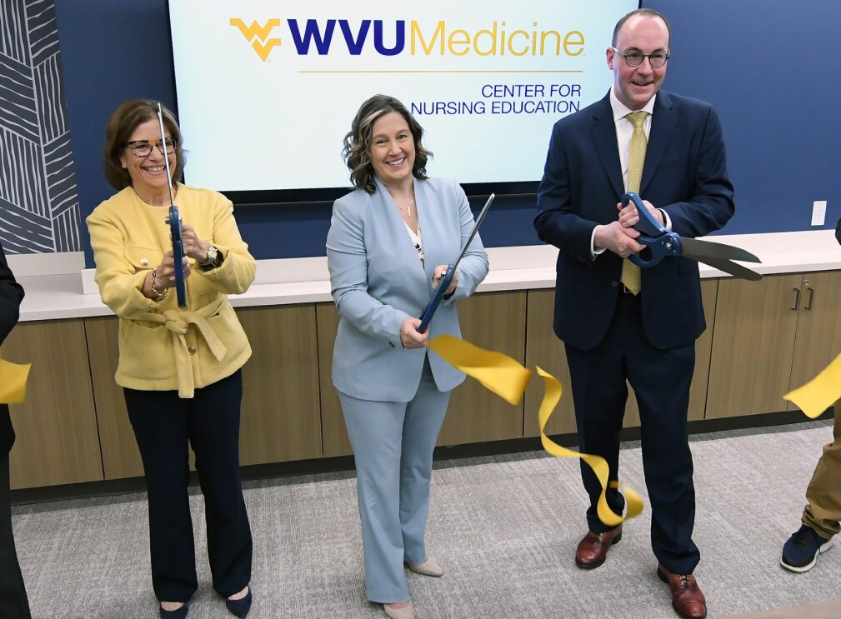
Center for Nursing Education
Build state-of-the-art, hospital-based, nursing school and registered nurse program at WVU Innovation Corporation
Offer quality education with focus on students who never thought they could go to nursing school
Attempt to eliminate barriers with free tuition, free books, no fees, and extensive wraparound services
Guarantee graduates a nursing position and an early place in the WVU Medicine family
Develop new and innovative ways to address nursing vacancies and add to the number of nursing graduates

Slide 16
Turnover Rate By Year
RN Annual Turnover by Year
Annual Turnover by Year
Source: 2025 NSI National Health Care Retention & RN Staffing Report; 2025 YTD median assumes FY 2024 median

Slide 17
Peak

Slide 18



















Integrated Delivery & Finance System
Insurance License
Administrative Services
Capitation
Model
Population
Health
PBM
Partnership
Network
Management
MA Plans
Clinics
Pharmacy
Home Health
Lab
SNF
Rehab
DME
Hospice

Slide 19



Peak Ownership Overview

Slide 20
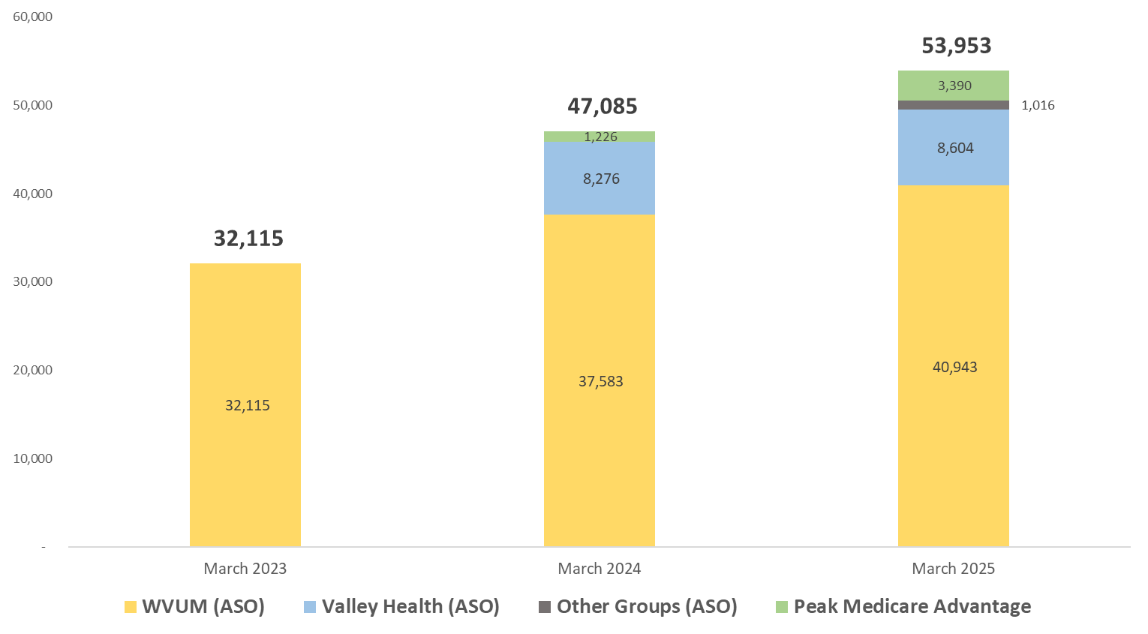
Peak’s Total Covered Lives
2024-2025:
15% growth
2.8x growth in MA
Non-owner customer acquisition in 2025
Continued organic growth in WVUM
2023-2024:
47% growth
Go-Live Valley Health (15% TPA owner)
Continued organic growth in WVUM

Slide 21
Peak’s Journey
2024
2025
2026 & Beyond
Successful go-live of Valley Health employee plans in ASO arrangement
Successful launch of Medicare Advantage in 29 counties of WV
Deepening of WVUM Population Health Services integration and coordination for disease management and coding
Successful launch of WVUM on Peak PBM for Rx Management
Launched ASO arrangements with non-owner employers
Medicare Advantage (MA) enrollment grows to ~3,400 (7% market share¹ in 29 counties )
‘26 total lives under management expected to grow over 70k
  ~6k MA
  ~67k ASO
‘26 planned MA service area expansion (next slide)
‘26 TPA co. targeting financial break even
Continued evaluation of MA D-SNP and Medicaid business case and timing
1. Market includes general enrollment and excludes Special Needs and Group Plans

Slide 22
Peak’s Medicare Advantage Reach
2026 Service Area
Hancock
‘24 & ‘25 Service Area
Brooke
Highlights:
Service area expected¹ to grow from 29 counties in 2024/2025 to 51 counties in 2026
WV: expand to 49 counties
PA: expand in 2 counties
~135k MA enrolled in the 2026 addressable market²
Future Service Area
Ohio
Greene
Fayette
Marshall
Wetzel
Monongalia
Morgan
Tyler
Marion
Preston
Berkeley
Pleasants
Harrison
Taylor
Mineral
Hampshire
Jefferson
Wood
Ritchie
Doddridge
Grant
Barbour
Tucker
Hardy
Wirt
Lewis
Jackson
Calhoun
Gilmer
Upshur
Mason
Randolph
Roane
Braxton
Pendleton
Putnam
Webster
Cabell
Kanawha
Clay
Nicholas
Pocahontas
Wayne
Lincoln
Boone
Fayette
Logan
Greenbrier
Mingo
Raleigh
Wyoming
Summers
Monroe
McDowell
Mercer
1. Expansion Subject to CMS Approval 2. Enrollment excludes SNP and Group

Slide 23
WV Health Statistics
Hospital Expense per Inpatient Day (2022)
West Virginia ranking in the United States:
50th for life expectancy at birth
1st for adults who report smoking
1st for adults who are obese
2nd highest prescription drugs filled per capita
4th highest hospital inpatient days per 1,000
5th highest number of hospital beds per 1,000
6th lowest hospital expense per inpatient day
13th lowest private insurance spend per enrollee
Source: Kaiser Family Foundation State Health Facts
WA
NH
MT
ND
MN
VT
ME
OR
MA
ID
SD
WI
NY
WY
MI
RI
NE
IA
OH
PA
CT
NV
UT
IL
IN
DC
NJ
CA
CO
KS
WV
VA
DE
MO
KY
TN
NC
MD
AZ
NM
OK
AR
SC
MS
AL
GA
TX
LA
AK
U.S. | $3,025
WV | $2,240
VA | $2,612
KY | $2,871
PA | $2,989
OH | $3,392
MD | $3,609
FL
HI
>$3,359
$2,989 - $3,358
$2,410 - $2,988
<$2,409
Source: Kaiser Family Foundation State Health Facts

Slide 24
WV Payer Mix
U.S. Hospital
Revenue by Source
West Virginia Hospitals
Revenue by Source
Source: National Health Care Expenditures, 2020
Centers for Medicare and Medicaid Services
Source: Medicare Cost Report

Slide 25
WVU Medicine
Redefining Rural Health Care

Slide 26

West Virginia is Rugged Rural
Census tracts in Category 6 (the highest category of ruggedness) are more numerous in West Virginia, Kentucky, and North Carolina. This reflects the unique landscape of southern Appalachia, where dissected plateaus and the ridge and valley terrain restrict road travel.
Dobis, E.A., Cromartie, J., Williams, R. & Reed, K. (2023). Characterizing Rugged Terrain in the United States. U.S. Department of Agriculture, Economic Research Service. ERR-322.

Slide 27
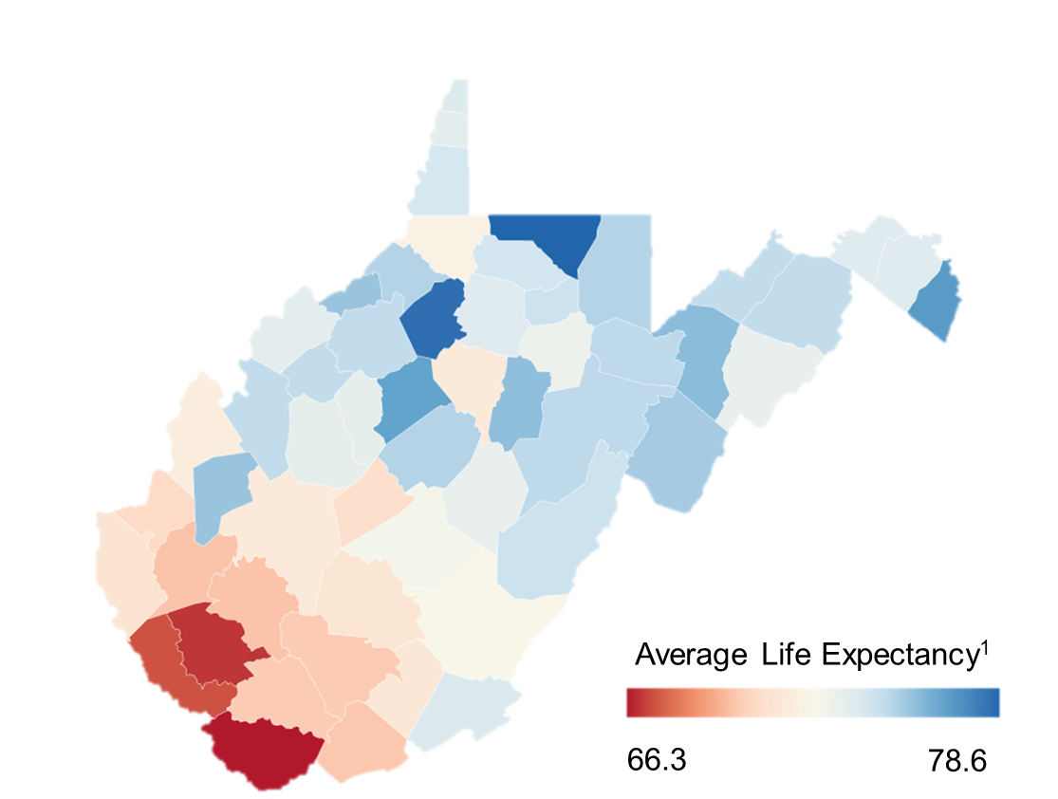
Health Disparities Amongst our Patient Population
Socio-economic Barriers
Geographic access to care
  Access to surgical specialists
  Poor medical funding
  Outdated equipment
1. https://www.cdc.gov/nchs/pressroom/stats_of_the_states.htm

Slide 28
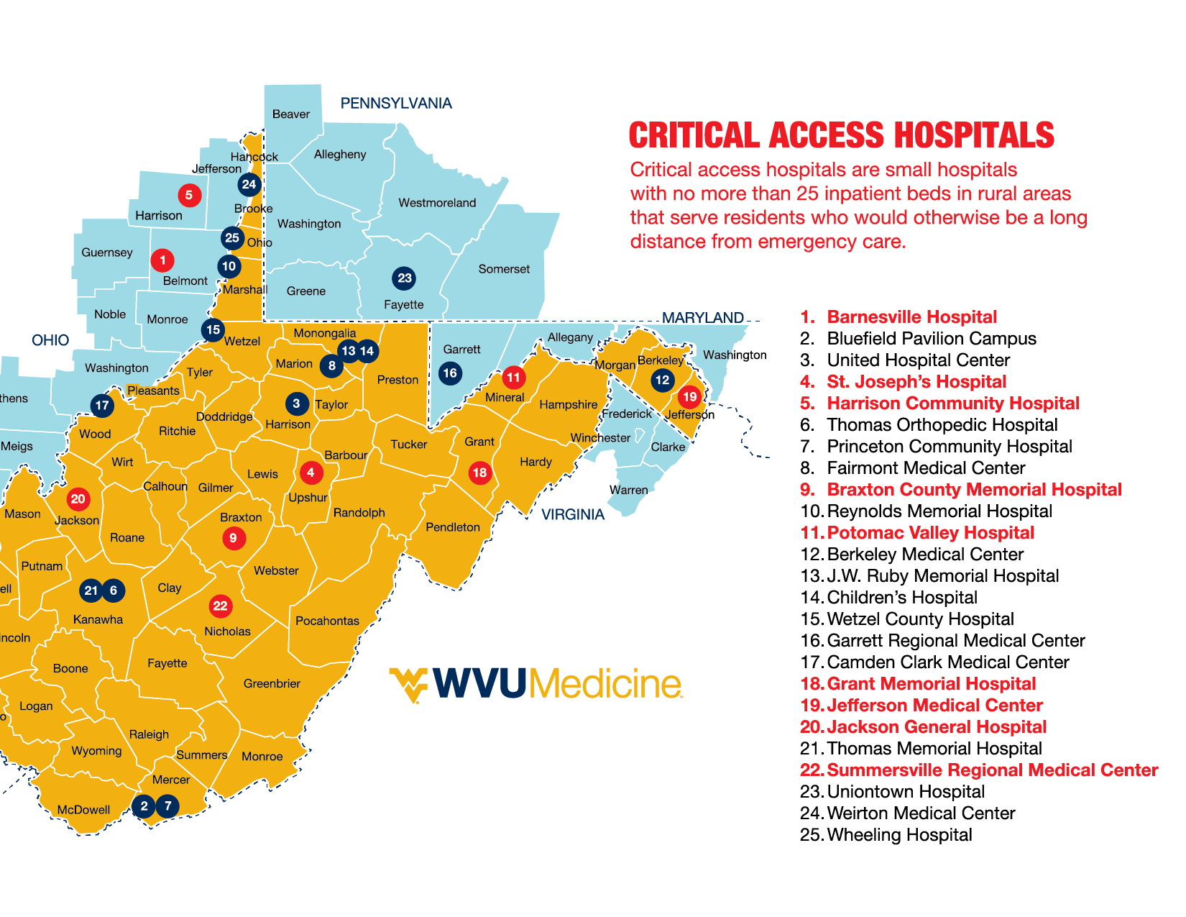
WVU Medicine Service Area – CAH’s

Slide 29

Long-term Aspiration
To accelerate value and population health, we will be a clinically integrated system that offers full-spectrum health care, easy and convenient access, and a seamless end-to-end experience to patients and providers across the communities we serve.

Slide 30
Refreshed Core Strategies
Be an exceptional place to work, learn, and practice
Deliver superior access, care, and experience to all we serve
Invest in health care education and career development
Promote a culture of health, wellness, and inclusion
Become a destination of choice for great talent to join and stay
Build a seamless health care experience through digital tools
Implement system-wide processes and initiatives that advance care and experience
Enhance patient access and service across our continuum of care
Offer a complete and integrated continuum of care
Become the national leader in rural population health management
Enable patients to receive the right level of care in the right spot at the right time
Expand capabilities and reach of our AMC through a network of regional hubs
Integrate our system of care to harness benefits of scare and standardization
Align provider roles, recruitment, and incentives to support value-based care
Transform rural health care through innovative care models and applied AMC research
Scale Peak Health as a vehicle to align and transform care delivery
Mission
To improve the health of West Virginians and all we serve through excellence in patient care, research, and education

