Slide 1


Securing and strengthening West Virginia against tomorrow's cyber-threats

Slide 2
98%
CYBER-THREATS
of ransomware attacks on local governments resulted in malicious data encryption
43%
$4.8 M
60%
16
of Cyberattacks target small businesses
Average cost of a data breach in 2024
of SMBs shut down within six months of a cyberattack
Critical
infrastructure sectors at risk

Slide 3





OUR MISSION
Improve the cybersecurity and cyber-resilience of WV businesses, start-ups, non-profits, municipalities, and critical infrastructure.
SECURE
Secure WV businesses, critical infrastructure, and municipalities through providing free, direct cybersecurity assistance
EDUCATE
Train the next generation of WV’s cyber workforce
Placing students on experiential learning cybersecurity projects
ENHANCE
Enhance WV citizens’ and consumers’ data security by helping businesses build strong cybersecurity programs
LEAD
Transform West Virginia into a national leader in cyber-resilience & cybersecurity education
EMPOWER
Empower and attract businesses and start-ups to WV through providing robust, free cybersecurity assistance

Slide 4
CYBER-RESILIENCE
The CRRC is dedicated to helping small businesses, non-profits, critical infrastructure, state and local governments strengthen their cybersecurity posture. We provide free expert guidance, hands-on support, and practical solutions to safeguard sensitive data, systems, and infrastructure.
Example services that we offer:
Cyber Risk Assessments
Identify vulnerabilities in your systems and networks
Incident Response & Recovery Planning
Develop strategies to minimize the impact of cyber threats
Security Awareness & Training
Equip employees and officials with cybersecurity best practices
Compliance Assistance
Ensure alignment with federal, state, and industry regulations
Network & Data Solutions
Help implement security measures to safeguard sensitive information or improve your business processes
IT & Business Process Optimization
Help improve your organizational technology and business processes to gain the competitive edge

Slide 5

OUR PROCESS
Assessment
Collaborate with WV organizations to identify cybersecurity challenges
Target solutions to address root causes
Project Kickoff
Pair organizations with skilled students and expert faculty mentors
Work together to develop practical, innovative solutions
Development
Create solutions to meet organizations specific needs
Ensure projects are scalable and aligned with organizational goals
Delivery
Provide actionable insights, recommendations, strategies, and solutions for organizations
Improvement
Present the finished solution and provide support
Organizations take ownership of continual improvement and maintenance
Supported by a $1.5 Million ARC POWER award

Slide 6















STATE-WIDE EFFORT
The CRRC, although based at WVU, operates as a state-wide initiative
Partners with WV higher education, municipalities, and business associations across the state
Aims to impact all 55 WV counties
The only state-wide cybersecurity support organization in the nation

Slide 7
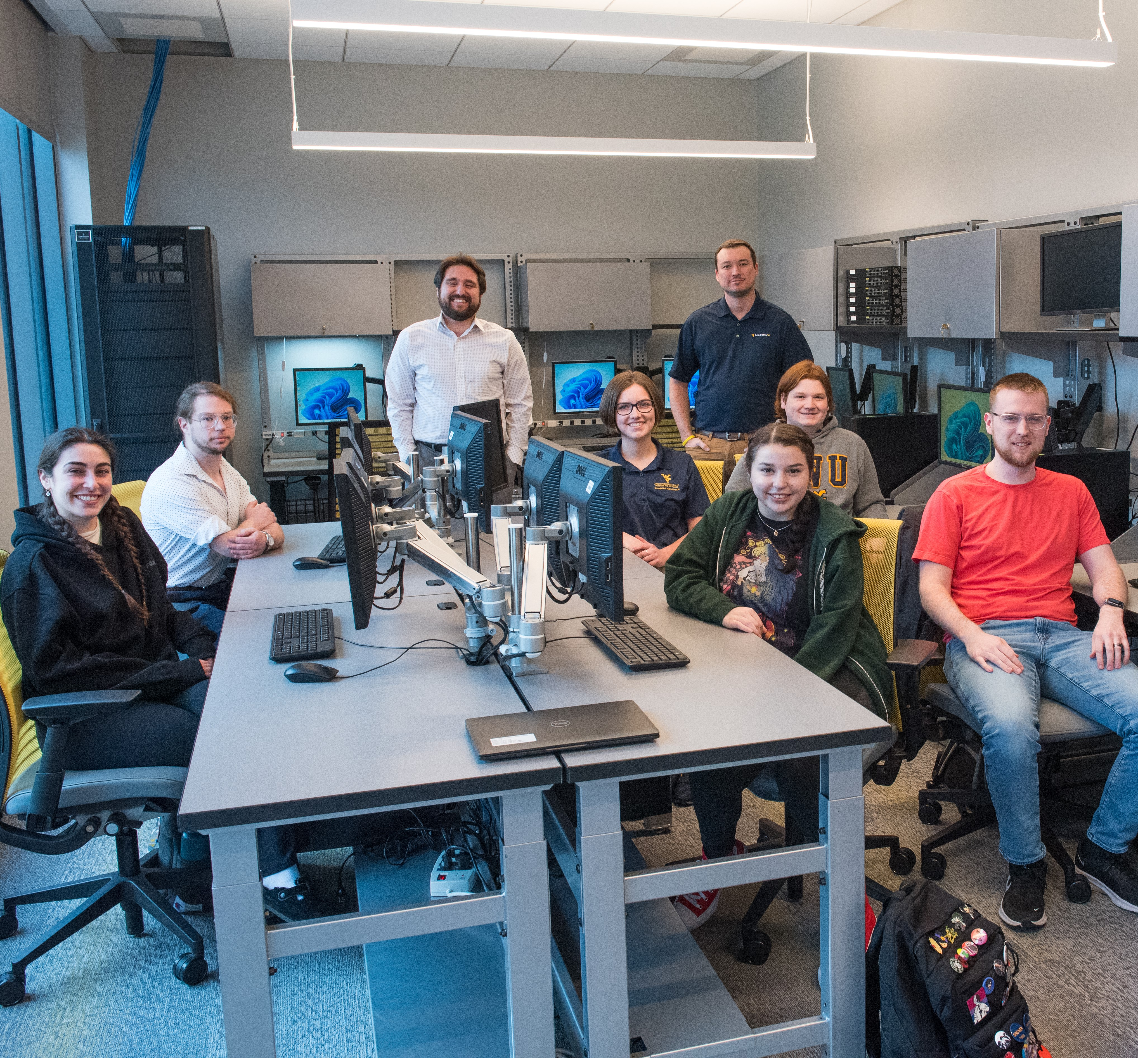
Training the next-generation of WV’s Cybersecurity workforce
STUDENT IMPACT
Students get hands-on experiential learning opportunities.
One-of-a-kind experience in the nation
Students from any WV 2-year or 4-year college or university are able to apply for a Cyber-Resilience Fellowship
Fellowships offer up to $5,000 stipend. Perfect for students in need, and for gaining work experience
The CRRC places West Virginia at the tip of the spear in cybersecurity education

Slide 8
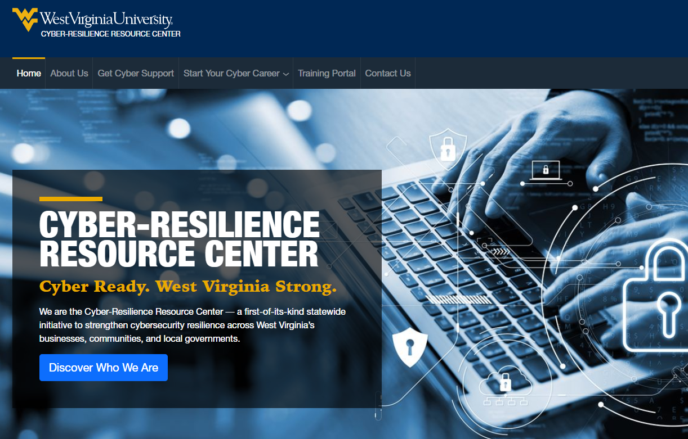
We look forward to assisting you!
SIGN UP
TODAY
https://cyberresilience.wvu.edu
Visit our website!

Slide 9



CONTACT US
Dr. Chris Ramezan
CRRC Executive Director,
Assistant Professor of Cybersecurity
cramezan@mail.wvu.edu
Mr. Frank Hatten,
Director of CRRC Operations & Outreach
Frank.Hatten@mail.wvu.edu
Dr. Elizabeth Vitullo
Assistant Vice President,
West Virginia University
eavitullo@mail.wvu.edu

