Slide 1

INFRASTRUCTURE & TIF
Notes:
Good Morning , My name is Mark Dellana. I am glad to have the opportunity to present Charles Pointe today. I am excited to be part of this outstanding team. I want to introduce my colleagues at Genesis Partners who are here today – ???
Charles Pointe is a state-of-the-art master-planned community. We are a $1.4 Billion dollar project spanning over 1,700 acres of land.

Slide 2
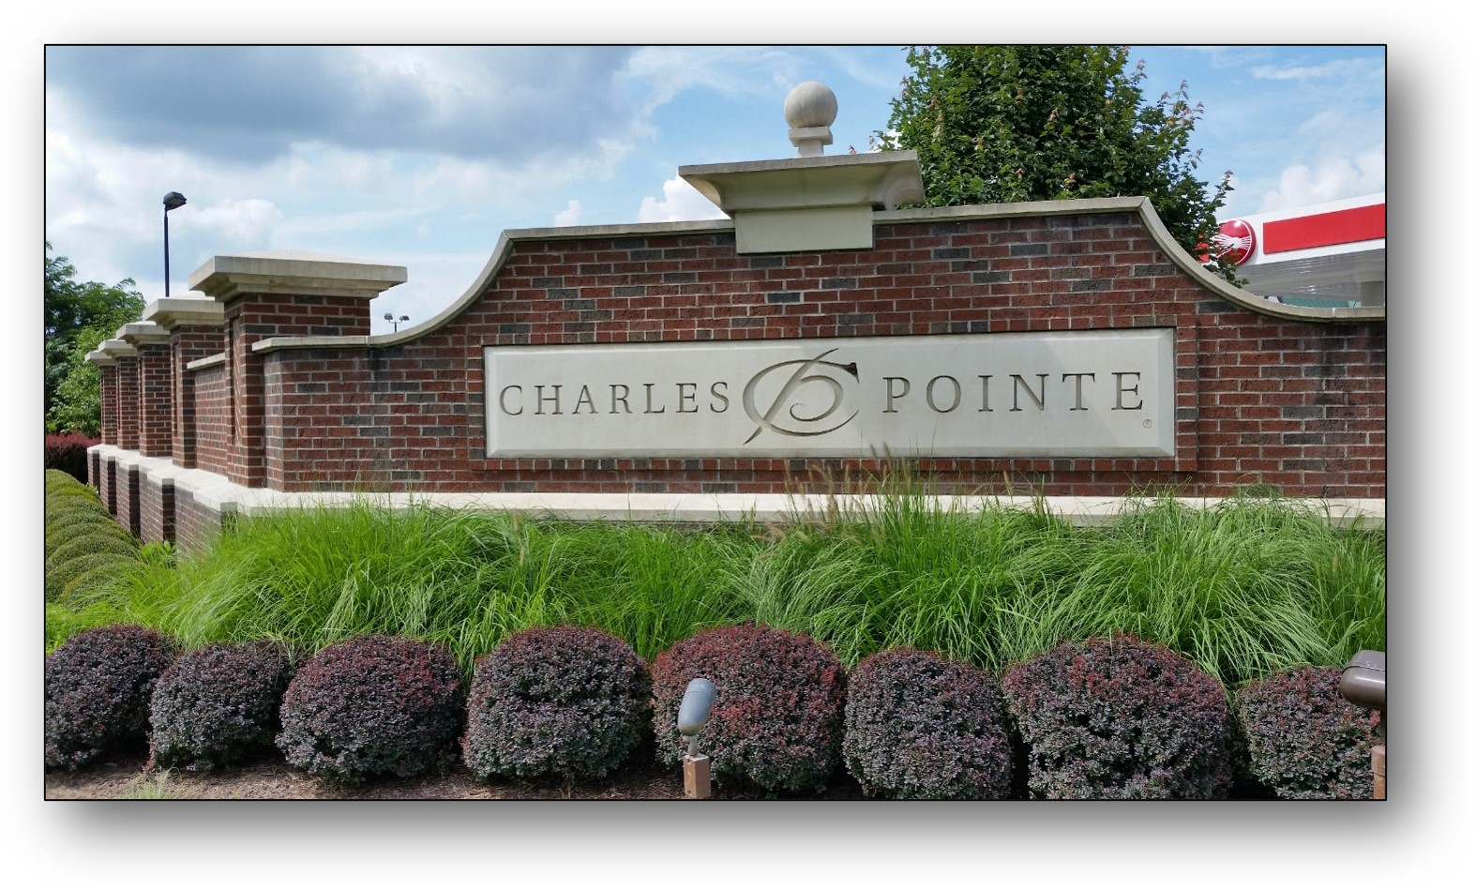
“Charles Pointe, is an award winning $1.5 billion Master Planned Community, encompasses over 1,700 acres strategically located in the heart of north-central West Virginia’s growth area and is unquestionably about opportunity, job creation, improving quality of life and certainly focused on attracting talent to West Virginia.“
Notes:
Now that I’ve given you a little history on our companies, let’s go to Charles Pointe. What is Charles Pointe? Charles Pointe is ……

Slide 3
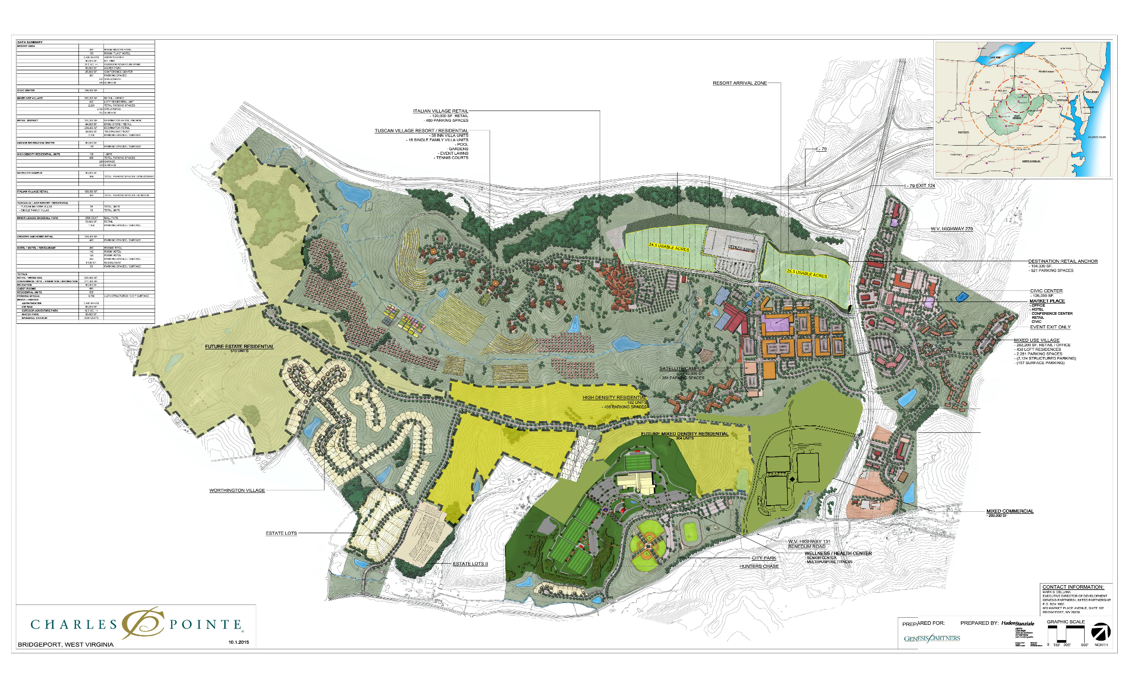
Award Winning - MASTER PLAN
Notes:
OVERVIEW
Charles Pointe is located within the high-growth area of North Central West Virginia along the I-79 High Technology Corridor, conveniently situated between Charleston and Pittsburgh.

Slide 4
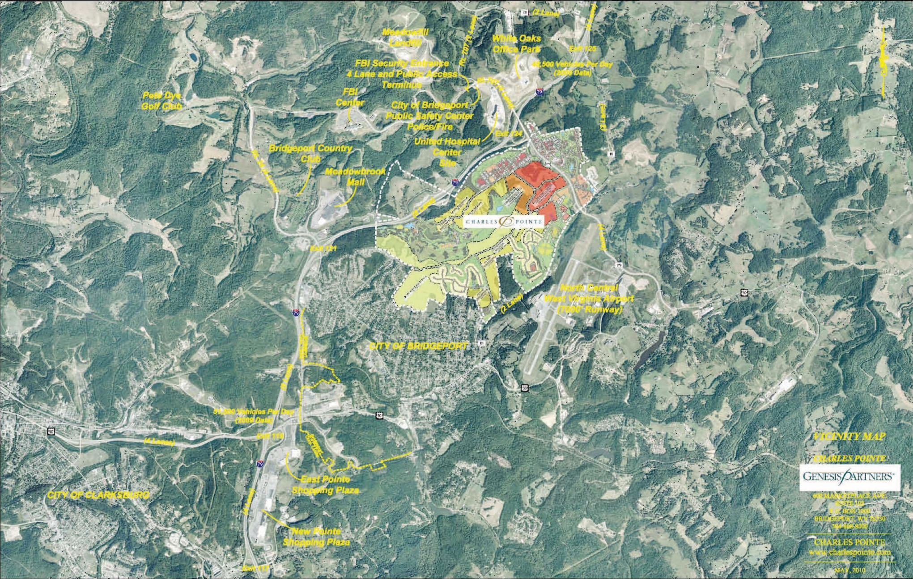
ECONOMIC GENERATORS
Key Economic Sectors:
Federal Government
Aviation
Education
Energy
Health Care
Hospitality
Engineering and Technology
Arts and Recreation
Notes:
Key Economic Sectors, for a small town we do not rely on one economic sector but many that balance any change in the economy. All Adjacent or within the Property.

Slide 5
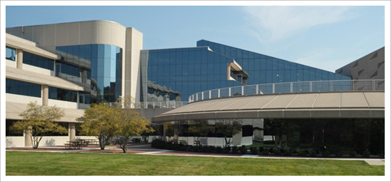
ECONOMIC GENERATORS - FBI (CJIS)
Notes:
Over 3,000 workers! The World relies on what goes on here (Biometrics and Fingerprinting)! Interpol, etc…

Slide 6
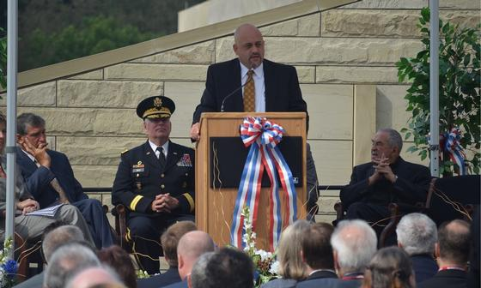
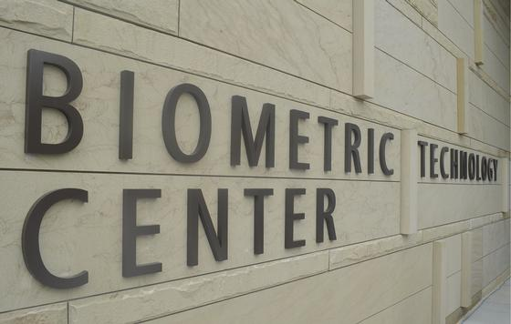
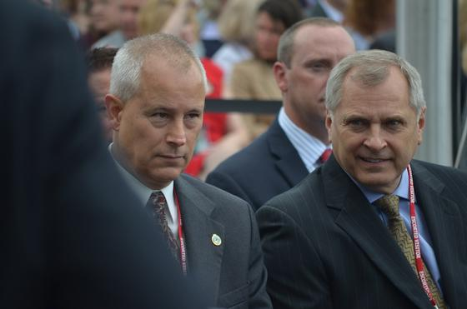
ECONOMIC GENERATORS - DoD (BTC)
Notes:
Biometric Technology Center - Dept of Defense

Slide 7


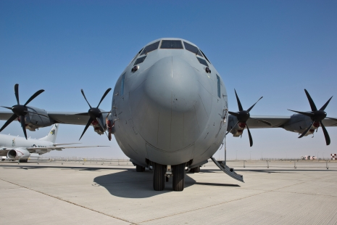




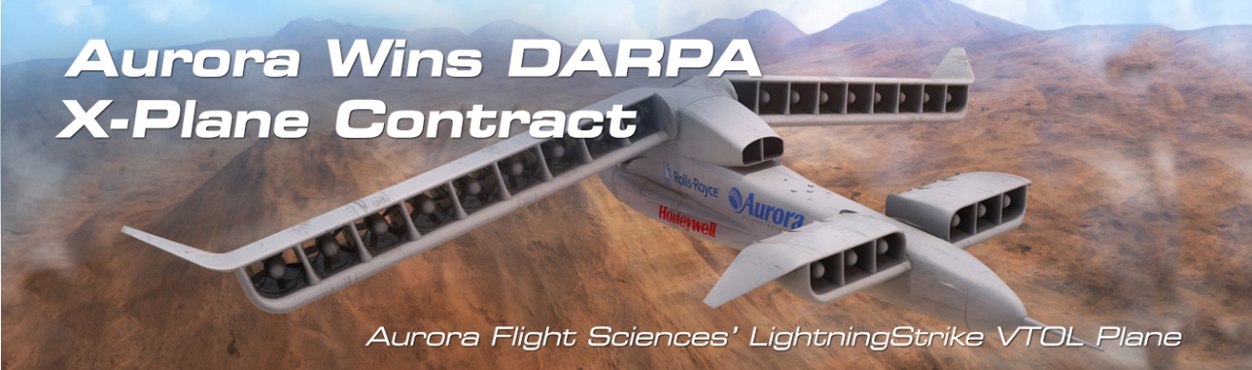




ECONOMIC GENERATORS - Aviation
Aviation Center of Excellence
MHIRJ is the merging of two important heritages:
Mitsubishi Heavy Industries (MHI) and the CRJ Series program from Bombardier.
FIXED WING ARNG AVIATION TRAINING SITE (FWAATS)
Notes:
CKB - Airport tenants and flight services.

Slide 8




ECONOMIC GENERATORS - Education
Notes:
Fairmont State annex campus at Charles Pointe with an increasing presence.

Slide 9
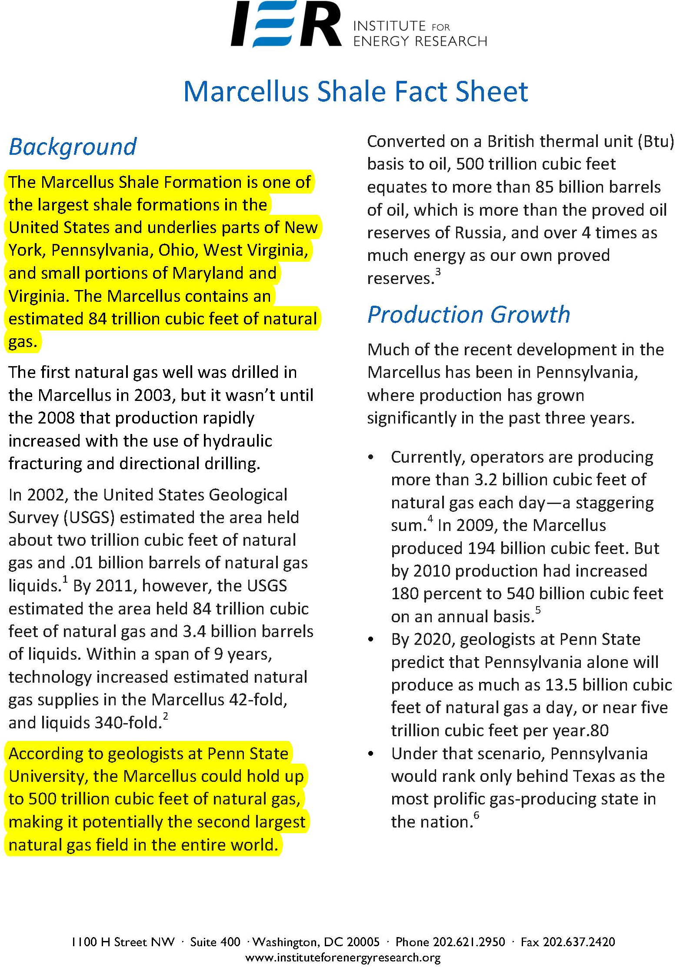
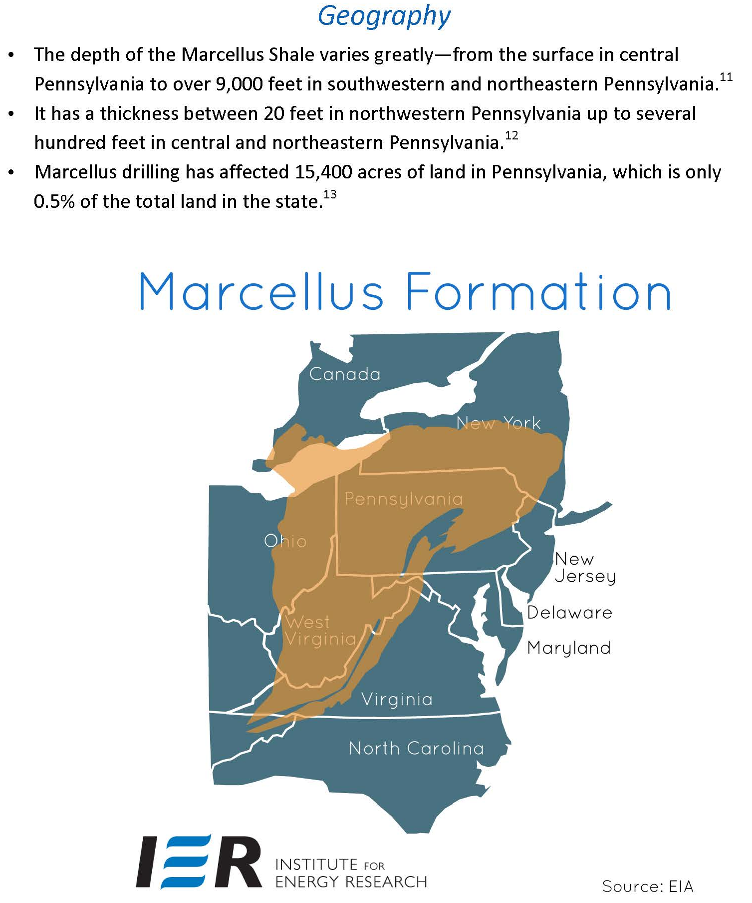
ECONOMIC GENERATORS - Energy
Notes:
We are in the heart of the major gas storage fields and pipeline extension to the rest of the US, especially with Marcellus Formation.

Slide 10
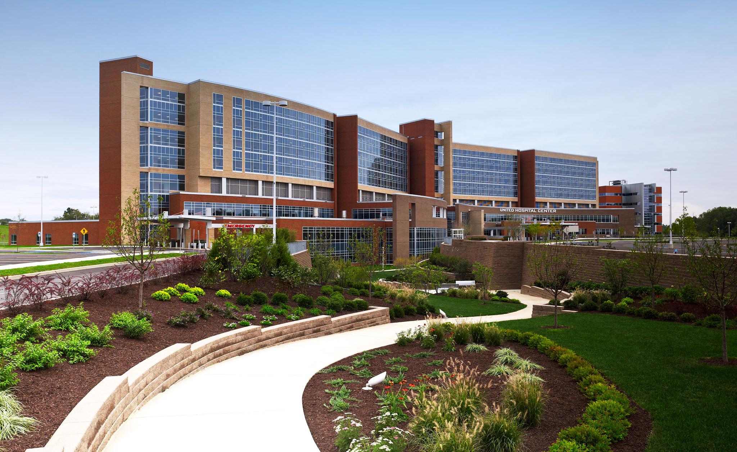
ECONOMIC GENERATORS - United Hospital Center
Part of the WVU Health System
Notes:
Adjacent to Charles Pointe, 250 private rooms in the first class WVU Health System Trauma Center.

Slide 11
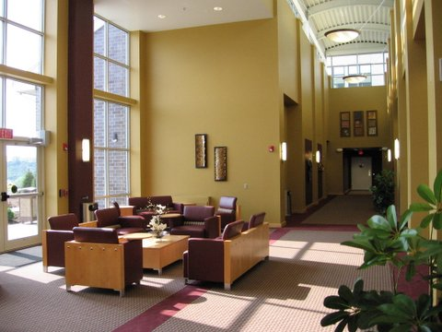
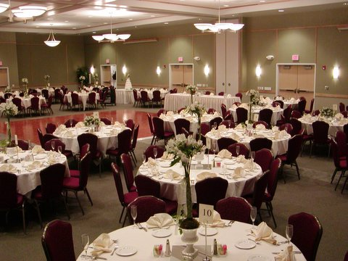

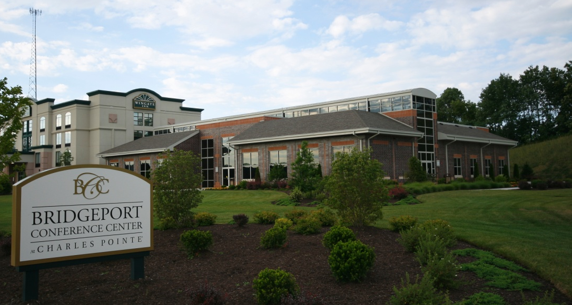
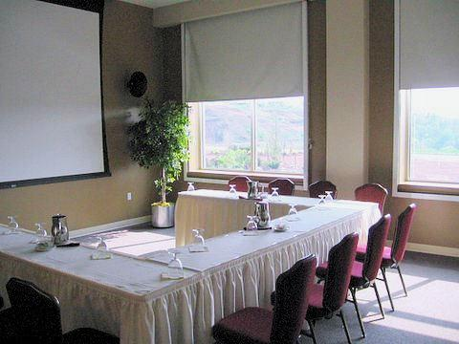
BRIDGEPORT CONFERENCE CENTER- Hospitality
Notes:
BCC is a Genesis Partners related business located in Charles Pointe with over 175 workers in the culinary and food service sector.

Slide 12

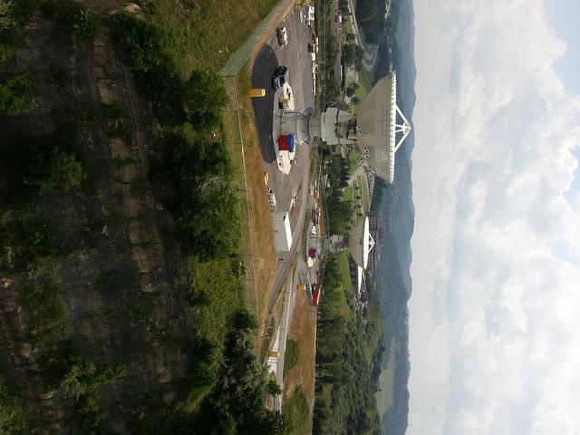
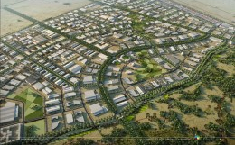
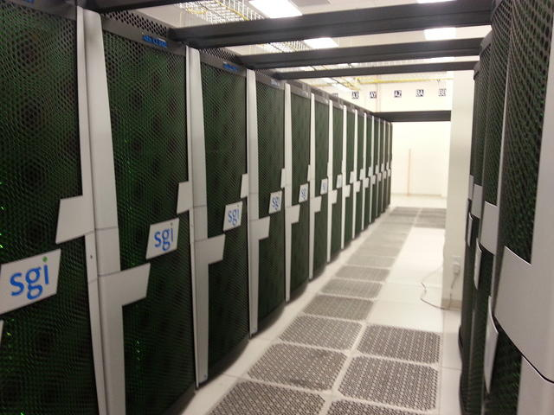

ECONOMIC GENERATORS - Engineering & Technology
NASA, NOAA and Biometrics
Notes:
Leading companies located in and near CP

Slide 13
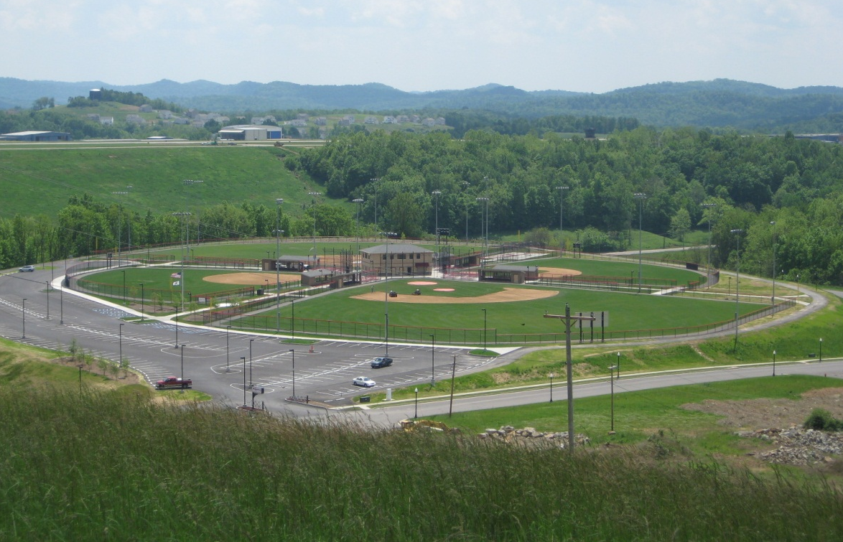
BRIDGEPORT RECREATION COMPLEX
Notes:
Bridgeport Rec Complex - baseball fields $10M

Slide 14
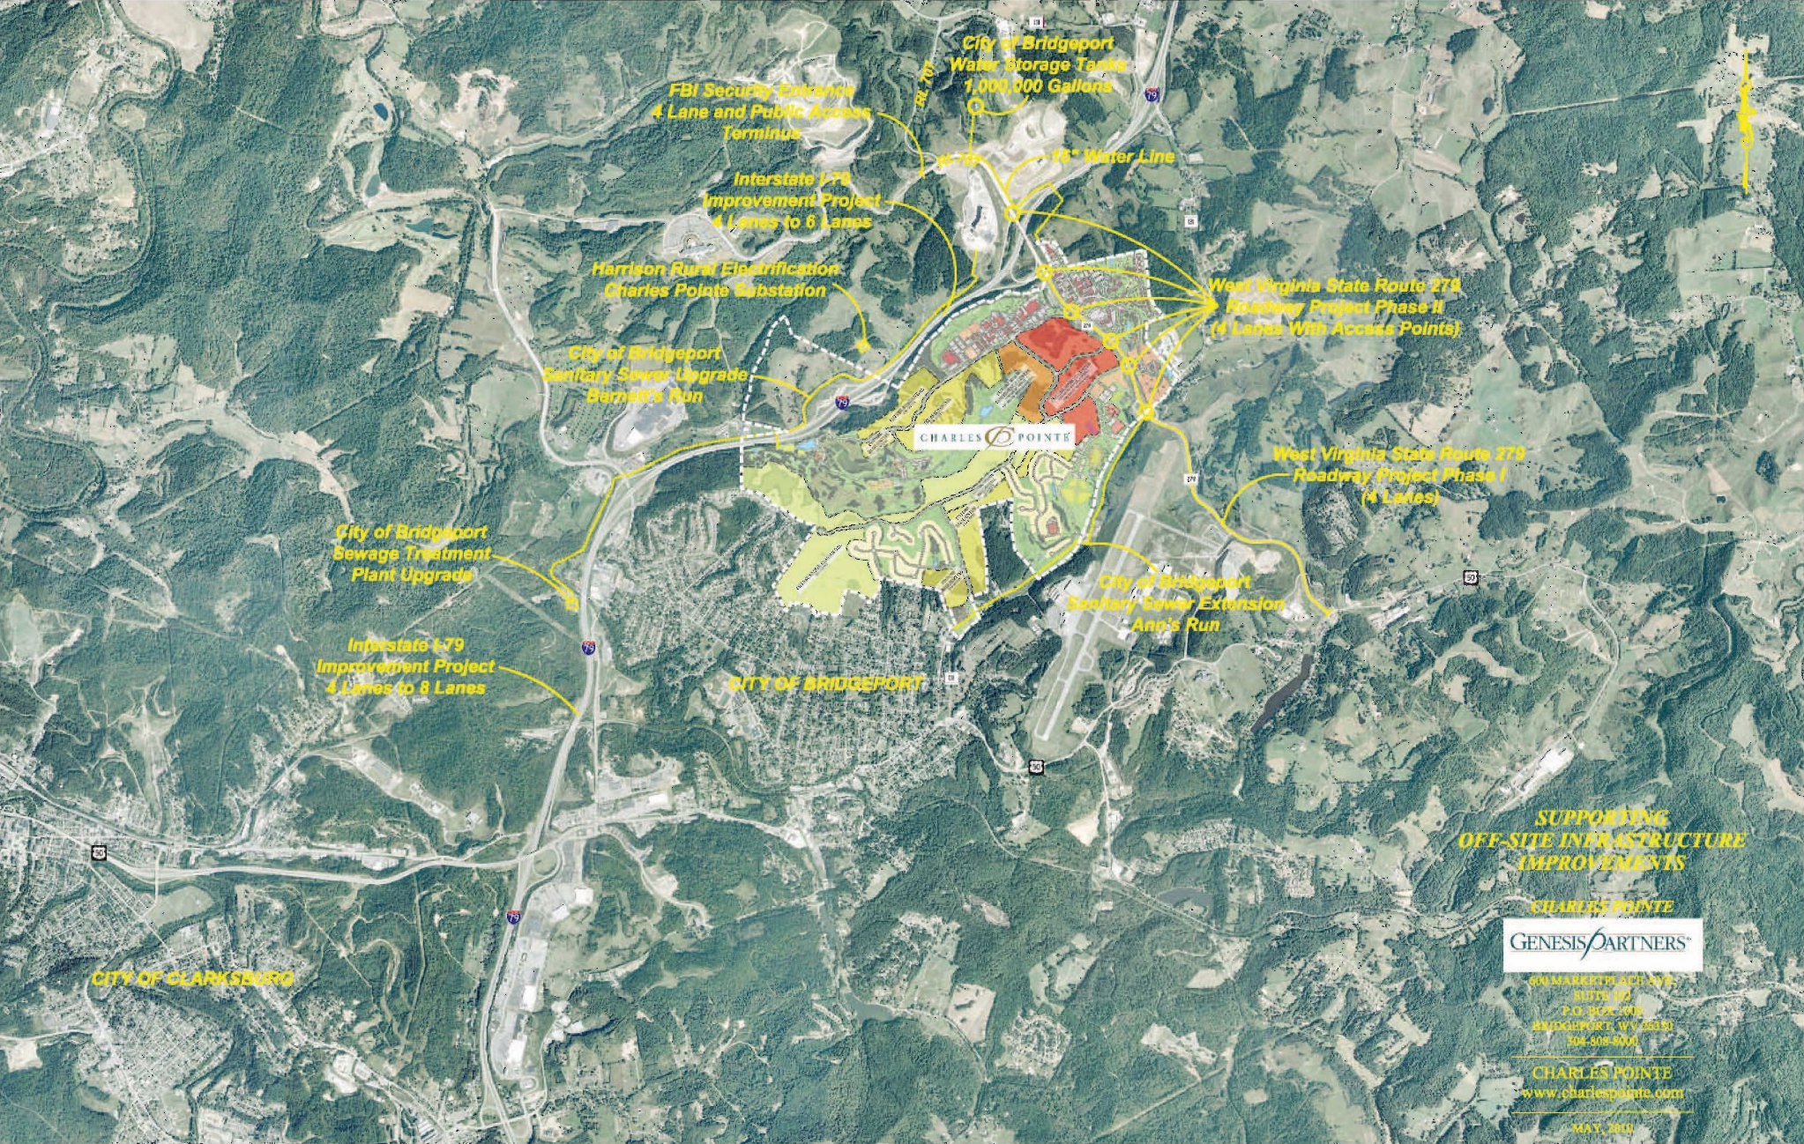
ECONOMIC GENERATORS - OFFSITE INFRASTRUCTURE
OLD
Notes:
Over $150M of infrastructure surrounding and supporting Charles Pointe (Water, Sewer, Airport, Highway to 8 lanes for a ten mile stretch.

Slide 15
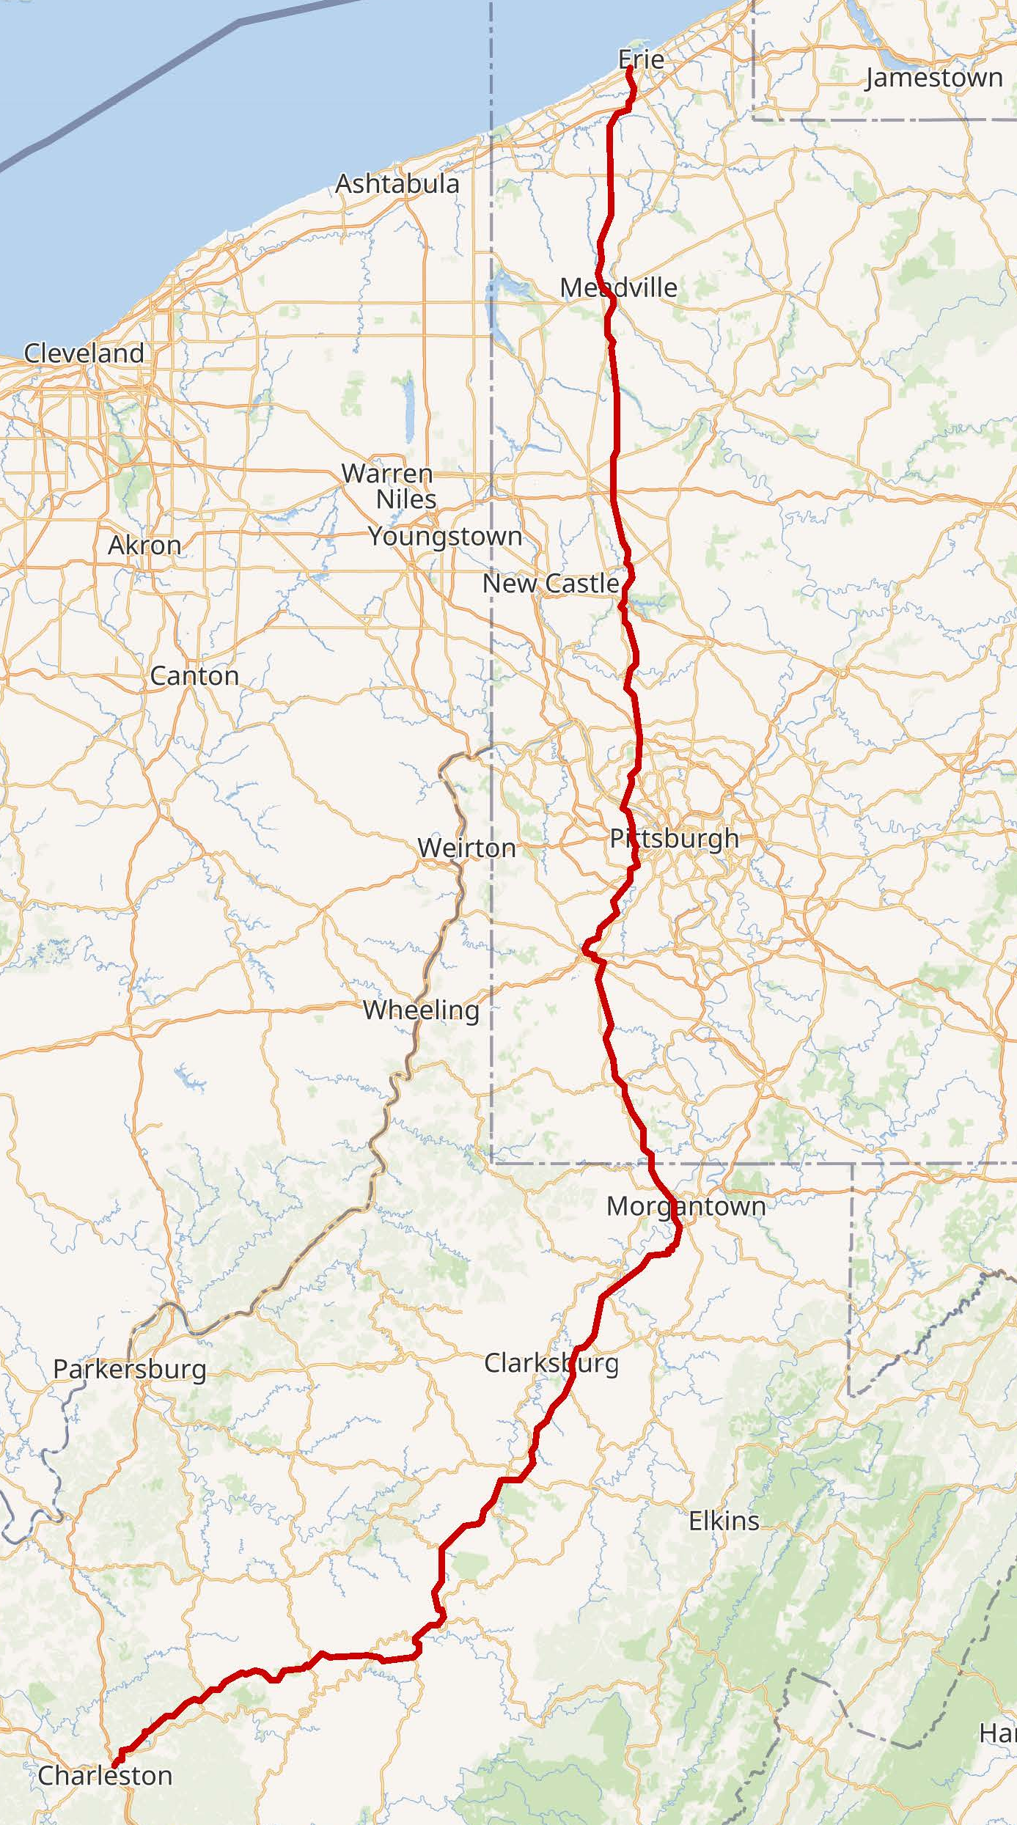

INITIAL CORE INFRASTRUCTURE
The number 79 was assigned in 1958, and an extension south along I-70 to Washington and beyond to Charleston was approved on October 18, 1961. This extension also paralleled US 19 to near Sutton, where it turned westerly to reach Charleston. (The part of US 19 from Sutton south to I-77 at Beckley, West Virginia, has since been four-laned as Corridor L of the Appalachian Development Highway System.)
On December 21, 1967, the first section of I-79 in West Virginia, between exits 125 (Saltwell Road) and 132 (South Fairmont), opened to traffic. This five-mile (8.0 km) section bypassed part of West Virginia Route 73 (WV 73) between Bridgeport and Fairmont. Another five miles (8.0 km) opened in July 1968, extending the highway on a bypass of downtown Fairmont to exit 137 (East Park Avenue). It was further extended 9.5 miles (15.3 km) toward Morgantown on October 15, 1970, bypassing more of WV 73 to exit 146 (Goshen Road) south of that city.
 | MILES
WV | 160.52
PA | 182.94
Total | 343.46
* Note – Excerpts from Wikipedia
Notes:
Jamie Corton with Senator Joe Manchin and former President Bill Clinton…Rob Stuart and Mark Dellana with family friend General Barry McCaffrey at annual Veterans Dinner Sponsored by Genesis Partners.

Slide 16
PERMIT APPROVALS AND AUTHORIZATIONS
PERMIT APPROVALS AND AUTHORIZATIONS ARE COMPLETE!
USACE 404 CWA PERMIT APPROVAL
U. S. Army Corp of Engineers – Dept. of Army Permit (33 CFR 325)
Approval
WVDEP 401 CWA CERTIFICATION
State of West Virginia Individual Water Quality Certification Approval
SECTION 106, NATIONAL HISTORIC PRESERVATION ACT
West Virginia State Historical Preservation Office (WVSHPO)
Authorization
SECTION 7, ENDANGERED SPECIES ACT
United States Fish and Wildlife Service (USFWS) Authorization
WEST VIRGINIA DEPARTMENT OF NATURAL RESOURCES
Right of Entry Authorization
Stream Crossing Approval
Public Land Corporation Approval
WEST VIRGINIA DEPARTMENT OF HIGHWAYS
Multiple Access Approvals for Total Build-out
ENVIRONMENTAL SITE ASSESSMENT
Phase I Environmental Site Assessment Complete
Notes:
Having all permit authorizations and approvals in place for the entire property!

Slide 17
Infrastructure at Charles Pointe
PEDESTRIAN FRIENDLY PLAN: Walking is encouraged by an interconnected system of sidewalks & trails. Pedestrian underpass and overpass will connect Charles Pointe North and South.
COMMUNICATIONS: Underground High-Speed Fiber Optic Infrastructure is provided to support the master plan and 100% all fiber to the premise and home. The only all fiber optic community in West Virginia. Currently installing 10 Gig equipment to the home.
ROADWAYS: Adjacent highways: Interstate I-79 ;WV State Route 279; WV State Route 131. Internal Roadways: Primarily Public Streets – City of Bridgeport.
SANITARY SEWER: Adequate sanitary sewer capacity is provided by the City of Bridgeport. Internal sanitary sewer extensions will be owned and maintained by the city.
WATER: Adequate water capacity is provided by the City of Bridgeport. Internal water line extensions will be owned and maintained by the city.
STORMWATER: A 100 Year Master Storm Water Plan has been designed to support the entire development. Only 10 years is required. Storm Water facilities construction will coincide with development.
OPEN SPACE: 446 Acres dedicated open space uses, including Charles Pointe Nature Conservancy.
Notes:
One of our objectives of Charles Pointe is to reduce risk to all of our partners and investors. To do that, an immense amount of infrastructure and forward thinking occurred in the early stages of Charles Pointe seen on this slide.
As well as ……

Slide 18
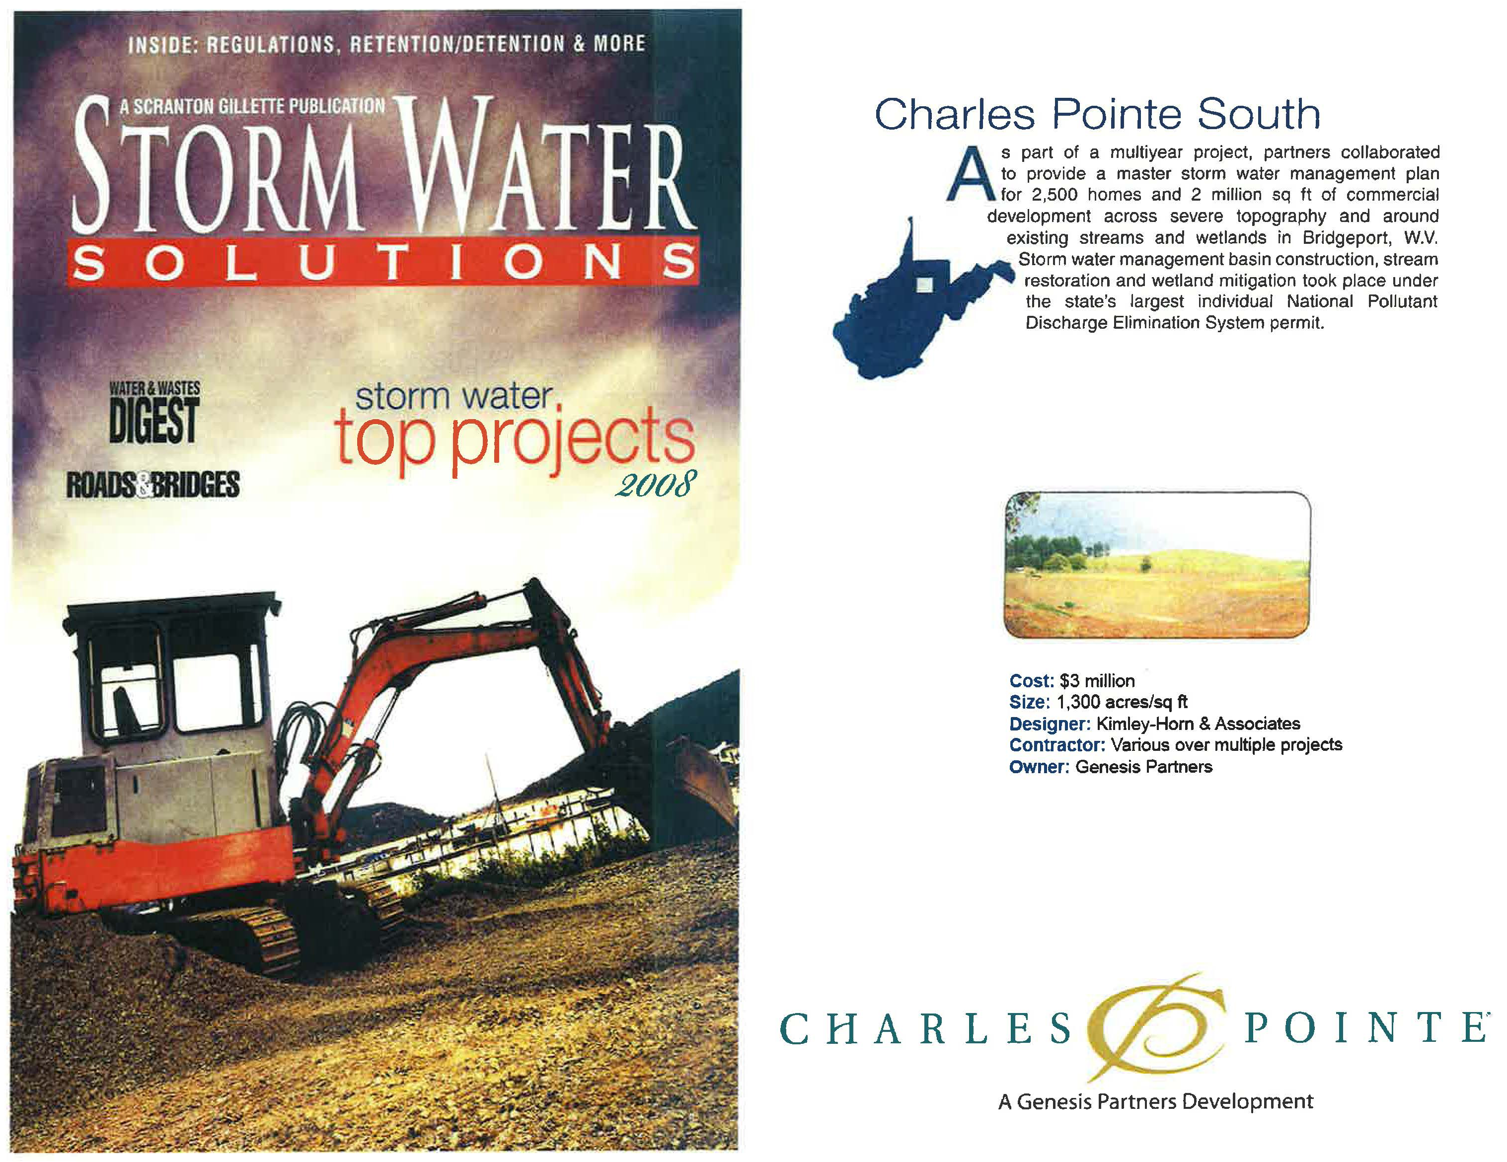
TOP STORM WATER PROJECTS - 2008

Slide 19
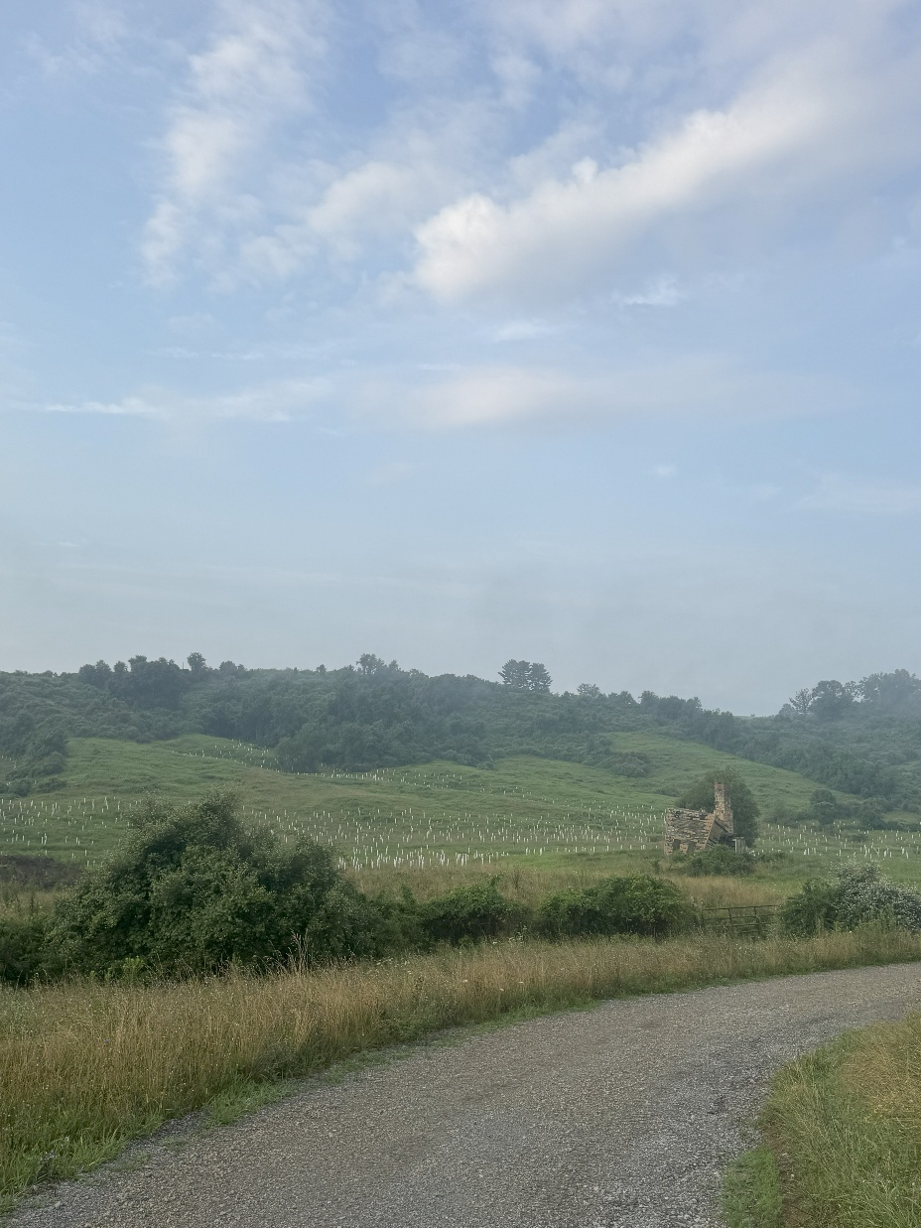

Stream and Wetland Mitigation - 2024

Slide 20
TIF Discussion…

Slide 21
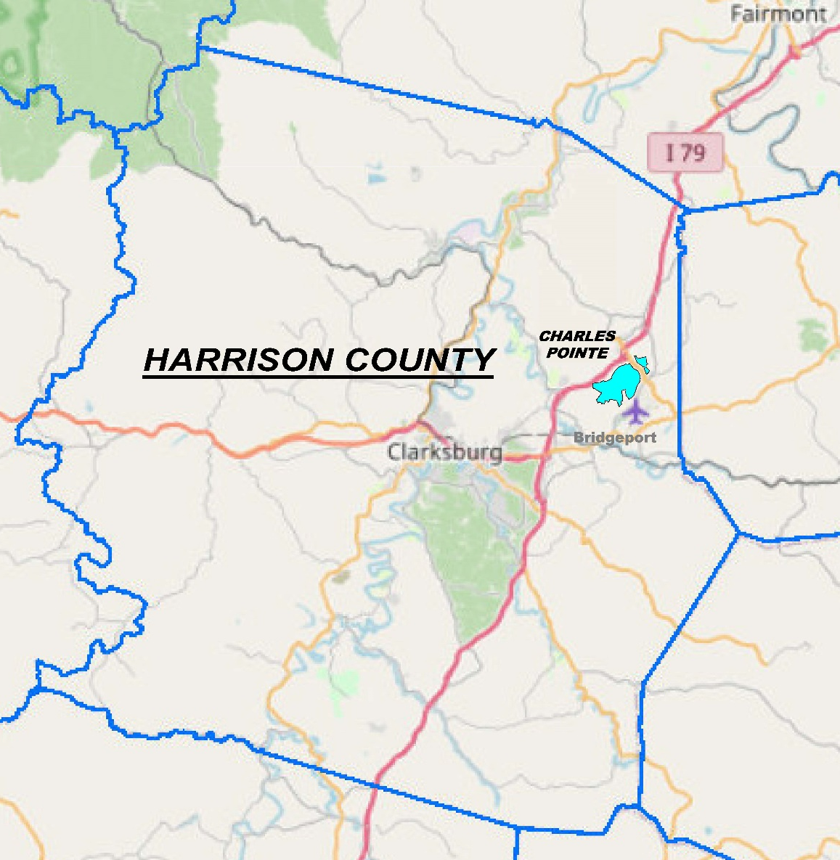
Harrison County Development District Property TIF Details
District #2 Effective Date Termination Date Acreage Acreage % of County Amount Approved Amount Obligated Public Financing Investor | Charles Pointe 12-01-05 12-01-35 1,700 0.63699% $97M $32M Invesco/Oppenheimer
Notes:
Even though Charles Pointe is 1,700 acres, it only represents a little over ½ a percent of the total acreage within Harrison County.
You can see the Property TIF, as mentioned before, was approved for up to $97 Million. To date, $32 Million in Property TIF bonds have been issued. We were able to successfully attract outside funds to invest into WV. Invesco and Oppenheimer, since merged, were the original investors in the Property TIF and remain fully committed, invested, and a great partner for Charles Pointe.

Slide 22
TIF PROCESS SUMMARY

Slide 23
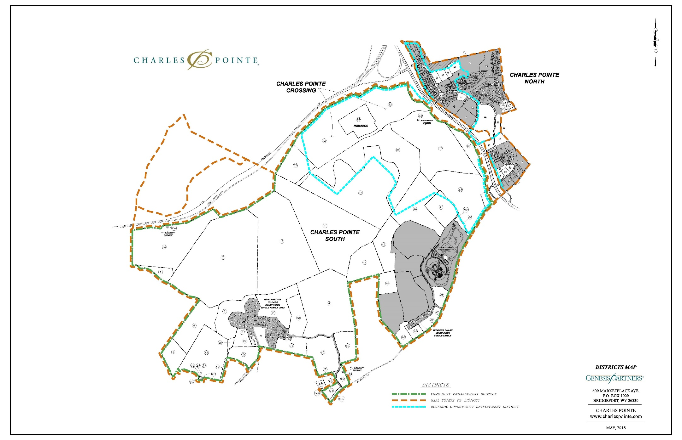
Charles Pointe Property and Excise TIF Districts Areas
Notes:
OVERVIEW
Charles Pointe is located within the high-growth area of North Central West Virginia along the I-79 High Technology Corridor, conveniently situated between Charleston and Pittsburgh.

Slide 24
No Increased Assessed Value Due to Lack of Infrastructure $
BASE – represents the certified base assessed value of the district area before the creation of the TIF
No TIF = No Infrastructure = No Development
* Actual % may vary
* Actual % may vary

Slide 25
Increased Assessed Value from New Development
INCREMENT – is the increased assessed value within the TIF district area after the redevelopment/development from the improvements financed by the TIF
58 % is Retained For TIF
42 % is Retained by the County and City + the Base
n Base Assessed Value n 42% Non TIF AV n 58% TIF AV
* Actual % may vary
* Actual % may vary

Slide 26
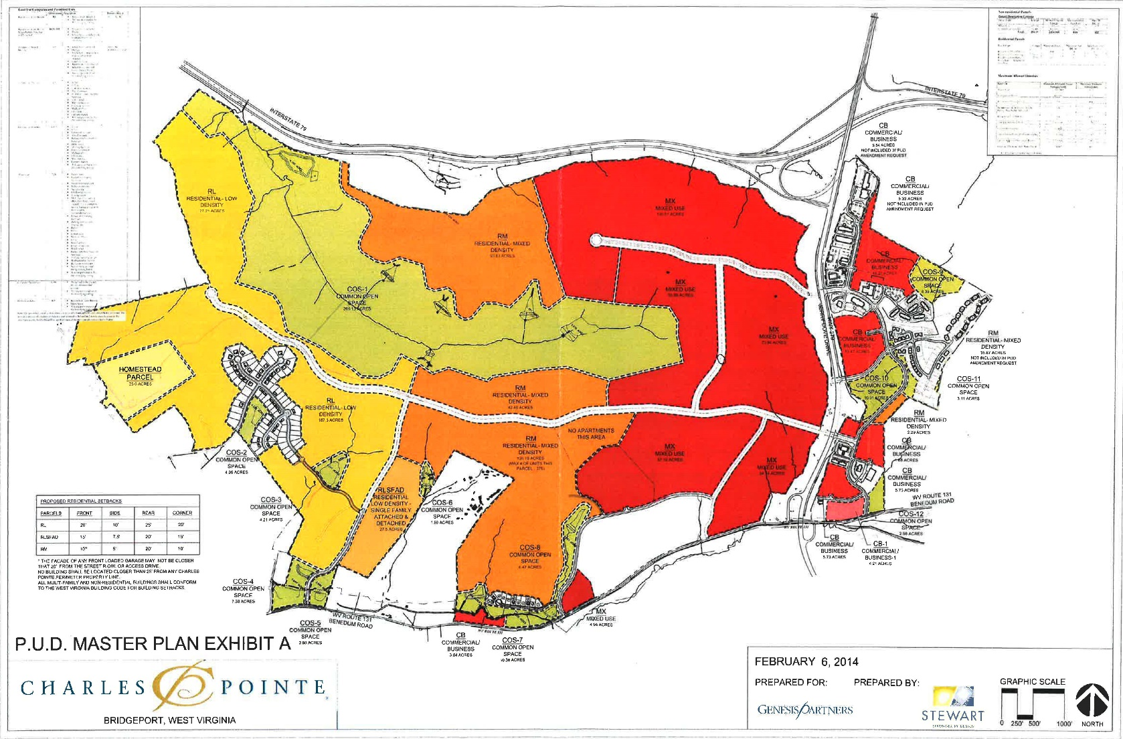
PLANNING, LAND USE & ZONING APPROVALS
THE CHARLES POINTE PLANNED UNIT DEVELOPMENTS (PUD) APPROVED BY THE CITY OF BRIDGEPORT IS 1,514.6 ACRES
MAXIMUM ALLOWABLE DENSITIES:
RESIDENTIAL : 2,347 UNITS
RETAIL and OFFICE: 3,133,612 SF
OPEN SPACE: 29.5% OR 446 AC
Notes:
This is the current approved PUD master plan exhibit that sets forth the Maximum Allowable Densities and Land Uses.

Slide 27
Award Winning - MASTER PLAN
Notes:
OVERVIEW
Charles Pointe is located within the high-growth area of North Central West Virginia along the I-79 High Technology Corridor, conveniently situated between Charleston and Pittsburgh.

Slide 28

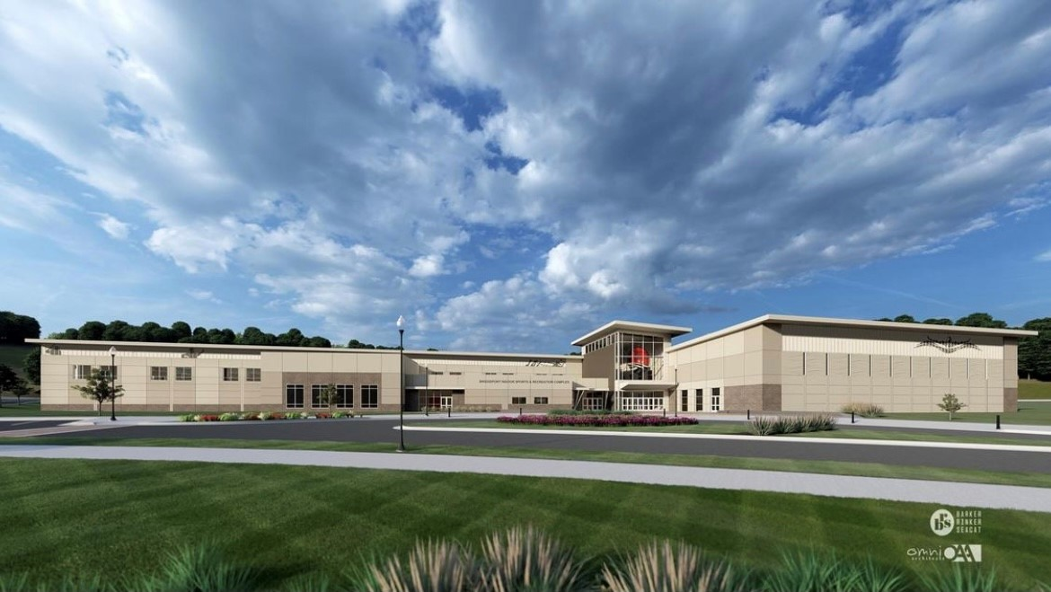
BRIDGEPORT RECREATION COMPLEX
“The Bridge”
Notes:
Bridgeport Rec Complex $50 expansion in the works

Slide 29
BRIDGEPORT CONFERENCE CENTER
Notes:
BCC is a Genesis Partners related business located in Charles Pointe with over 175 workers in the culinary and food service sector.

Slide 30

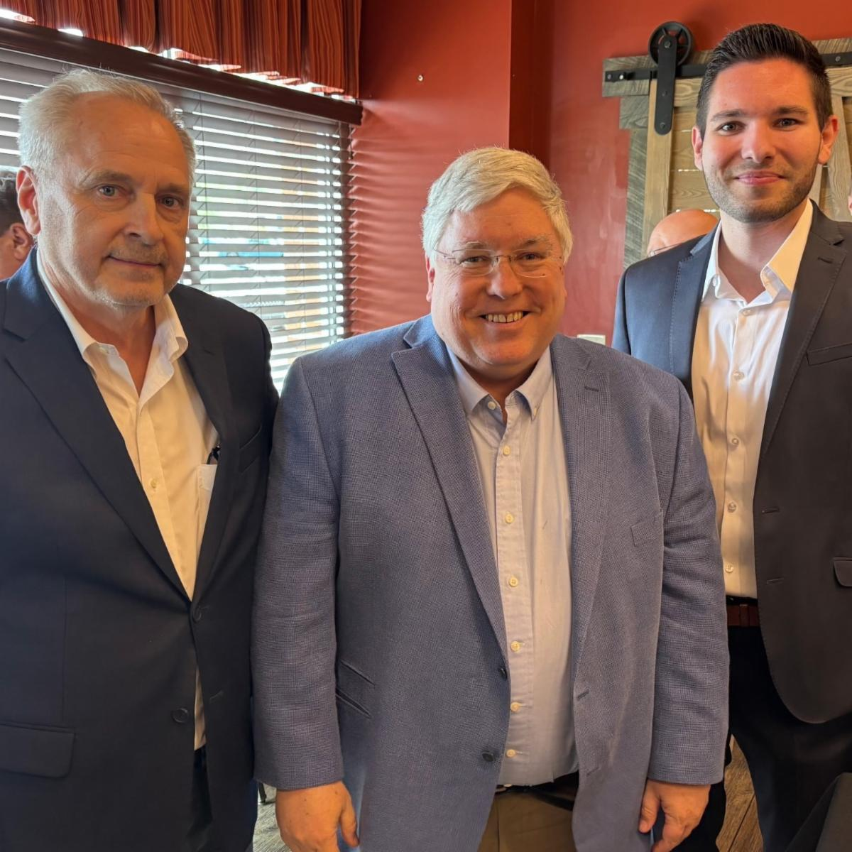

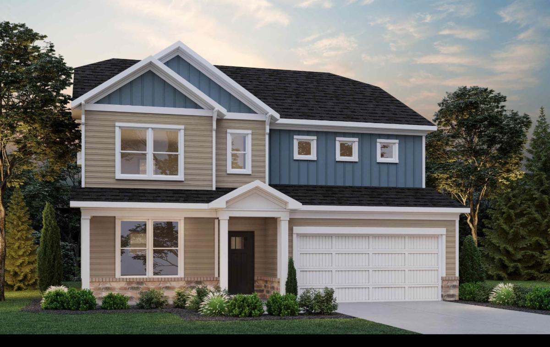
Charles Pointe Newsletter - May 23, 2025
Jamie Corton, developer of Charles Pointe, and West Virginia Governor Patrick Morrisey celebrate the Bridgeport arrival of D.R. Horton, America's Largest Homebuilder. From left to right are Jamie Corton, Governor Morrisey, and Zachary Soilis, Land Acquisition Manager for D.R. Horton
Governor Patrick Morrisey welcomes D.R. Horton Homebuilders to Charles Pointe On Wednesday, April 23, Genesis Partners welcomed D.R. Horton to Charles Pointe in Bridgeport, West Virginia. D.R. Horton is America's Largest Homebuilder, operating in 126 markets in 36 states.

Slide 31
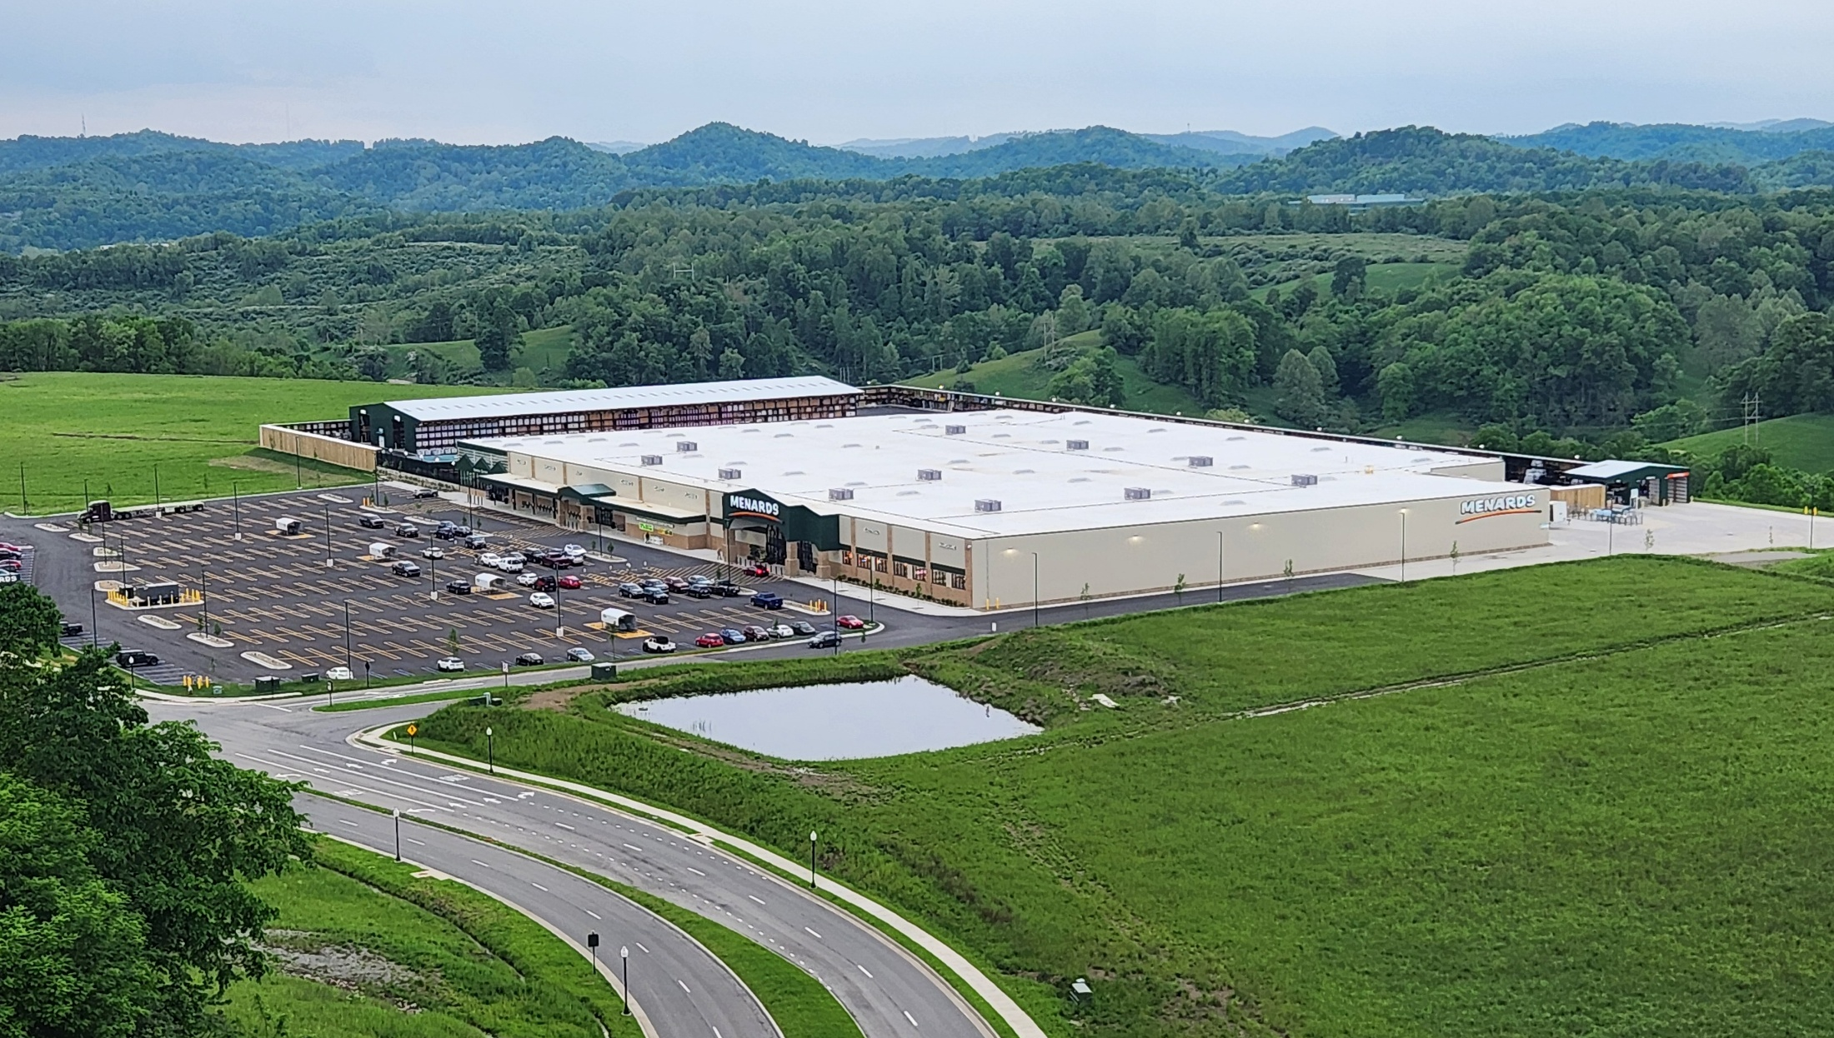
Menard’s Open

Slide 32
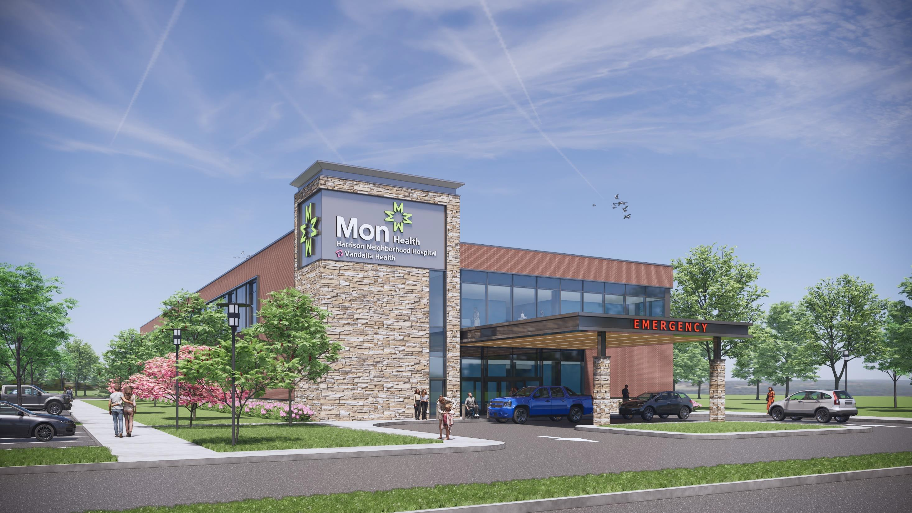
Conceptual of Mon Health’s Small Format Hospital

Slide 33
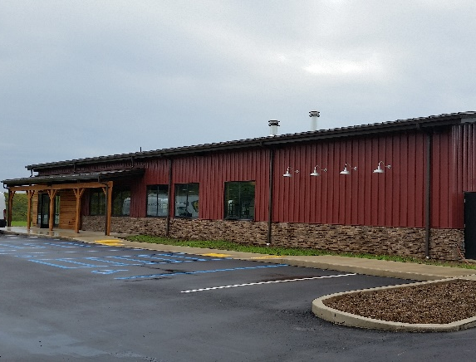
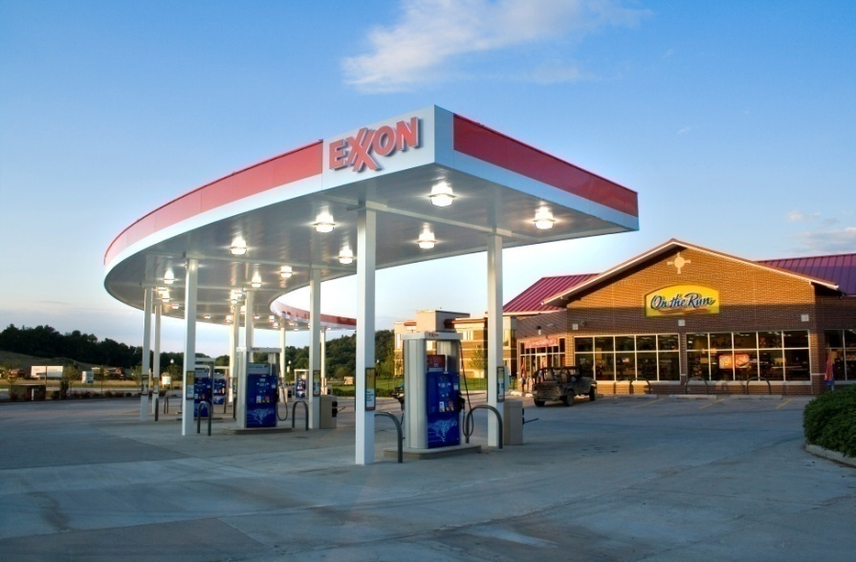

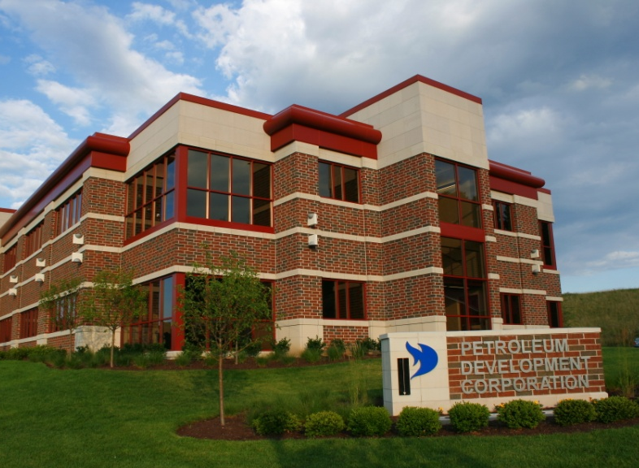
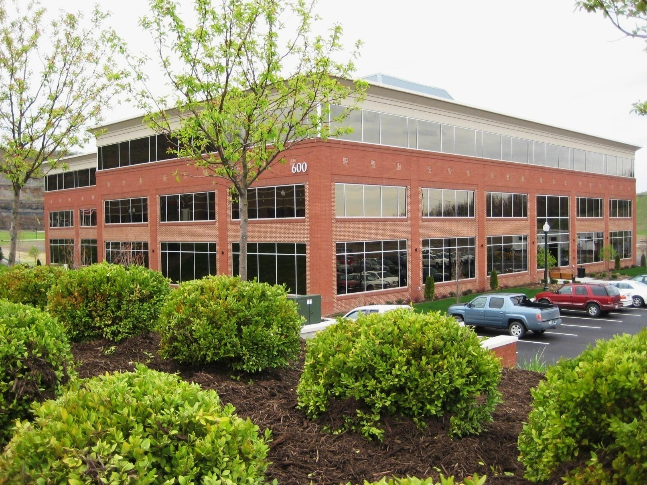

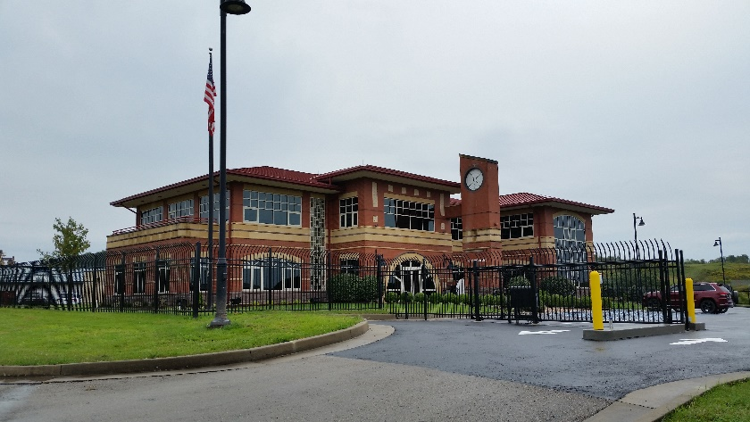
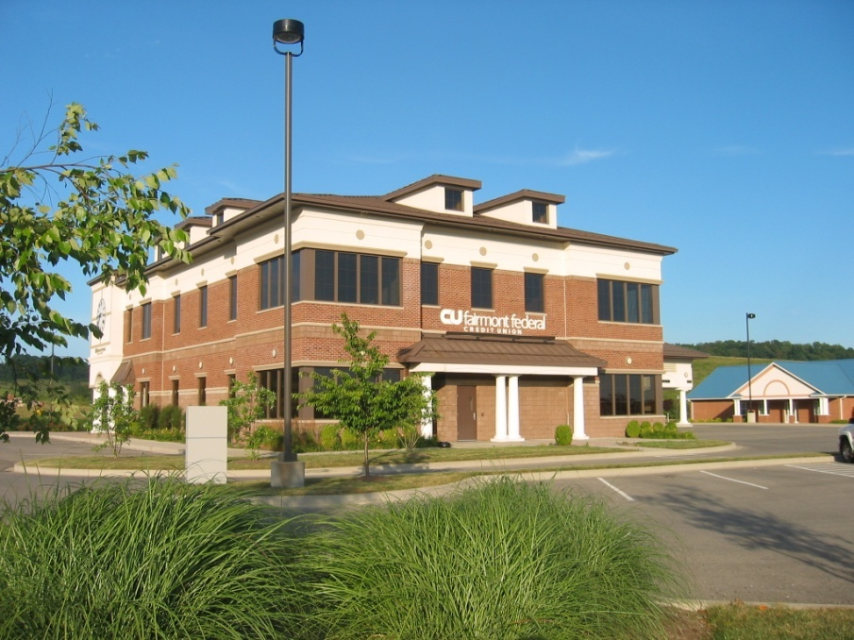
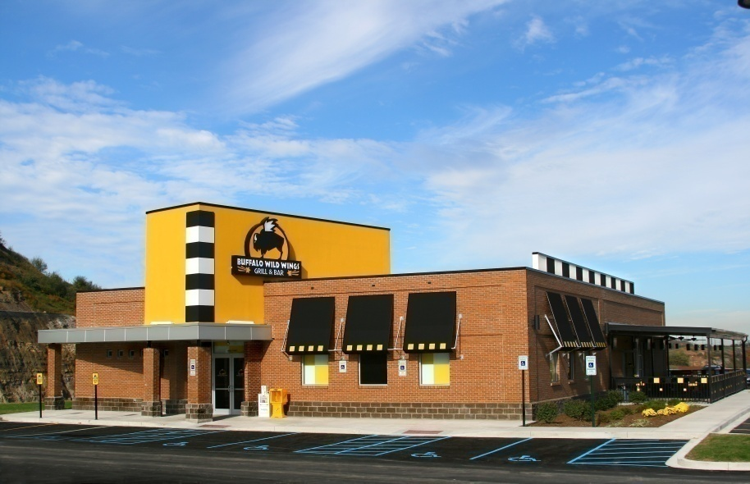
CHARLES POINTE
RETAIL AND OFFICE
Mountain State Brewery
Exxon & Dunkin Donuts
Cubbies Child Care
Petroleum Development Co
Genesis Partners Building 600
Harrison County 911 Center
Fairmont Federal Credit Union
Buffalo Wild Wings
Notes:
Complimentary to the residential development is the day care. Over 300 children are enrolled and a great amenity for residents and employees working at Charles Pointe. Many see their kids at lunchtime. (check) restaurants and more…Buffalo Wild Wings, typical US store sales $2.4M, at Charles Pointe Sales are around $3.6M…

Slide 34
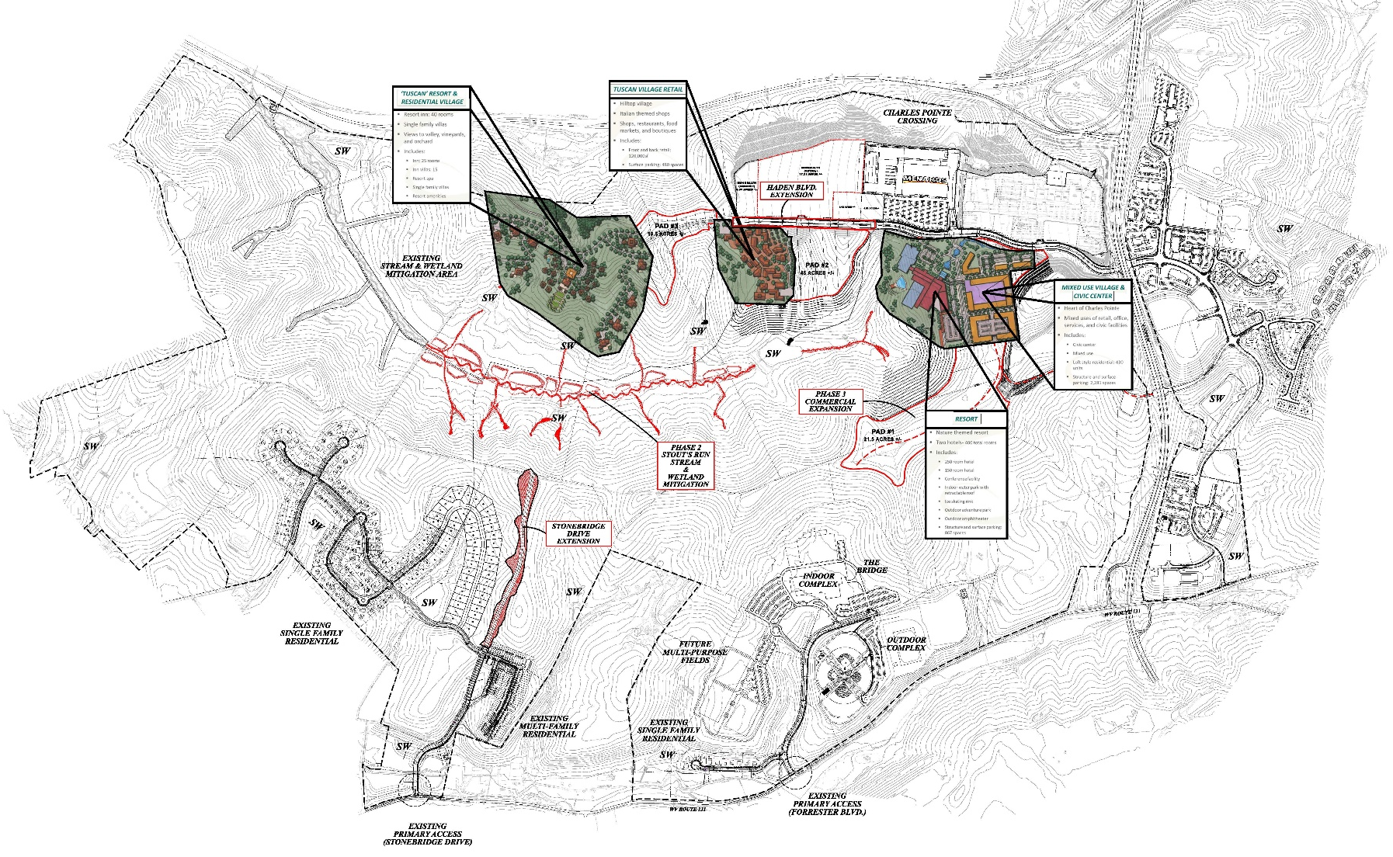
Charles Pointe Crossing – and Future Projects

Slide 35
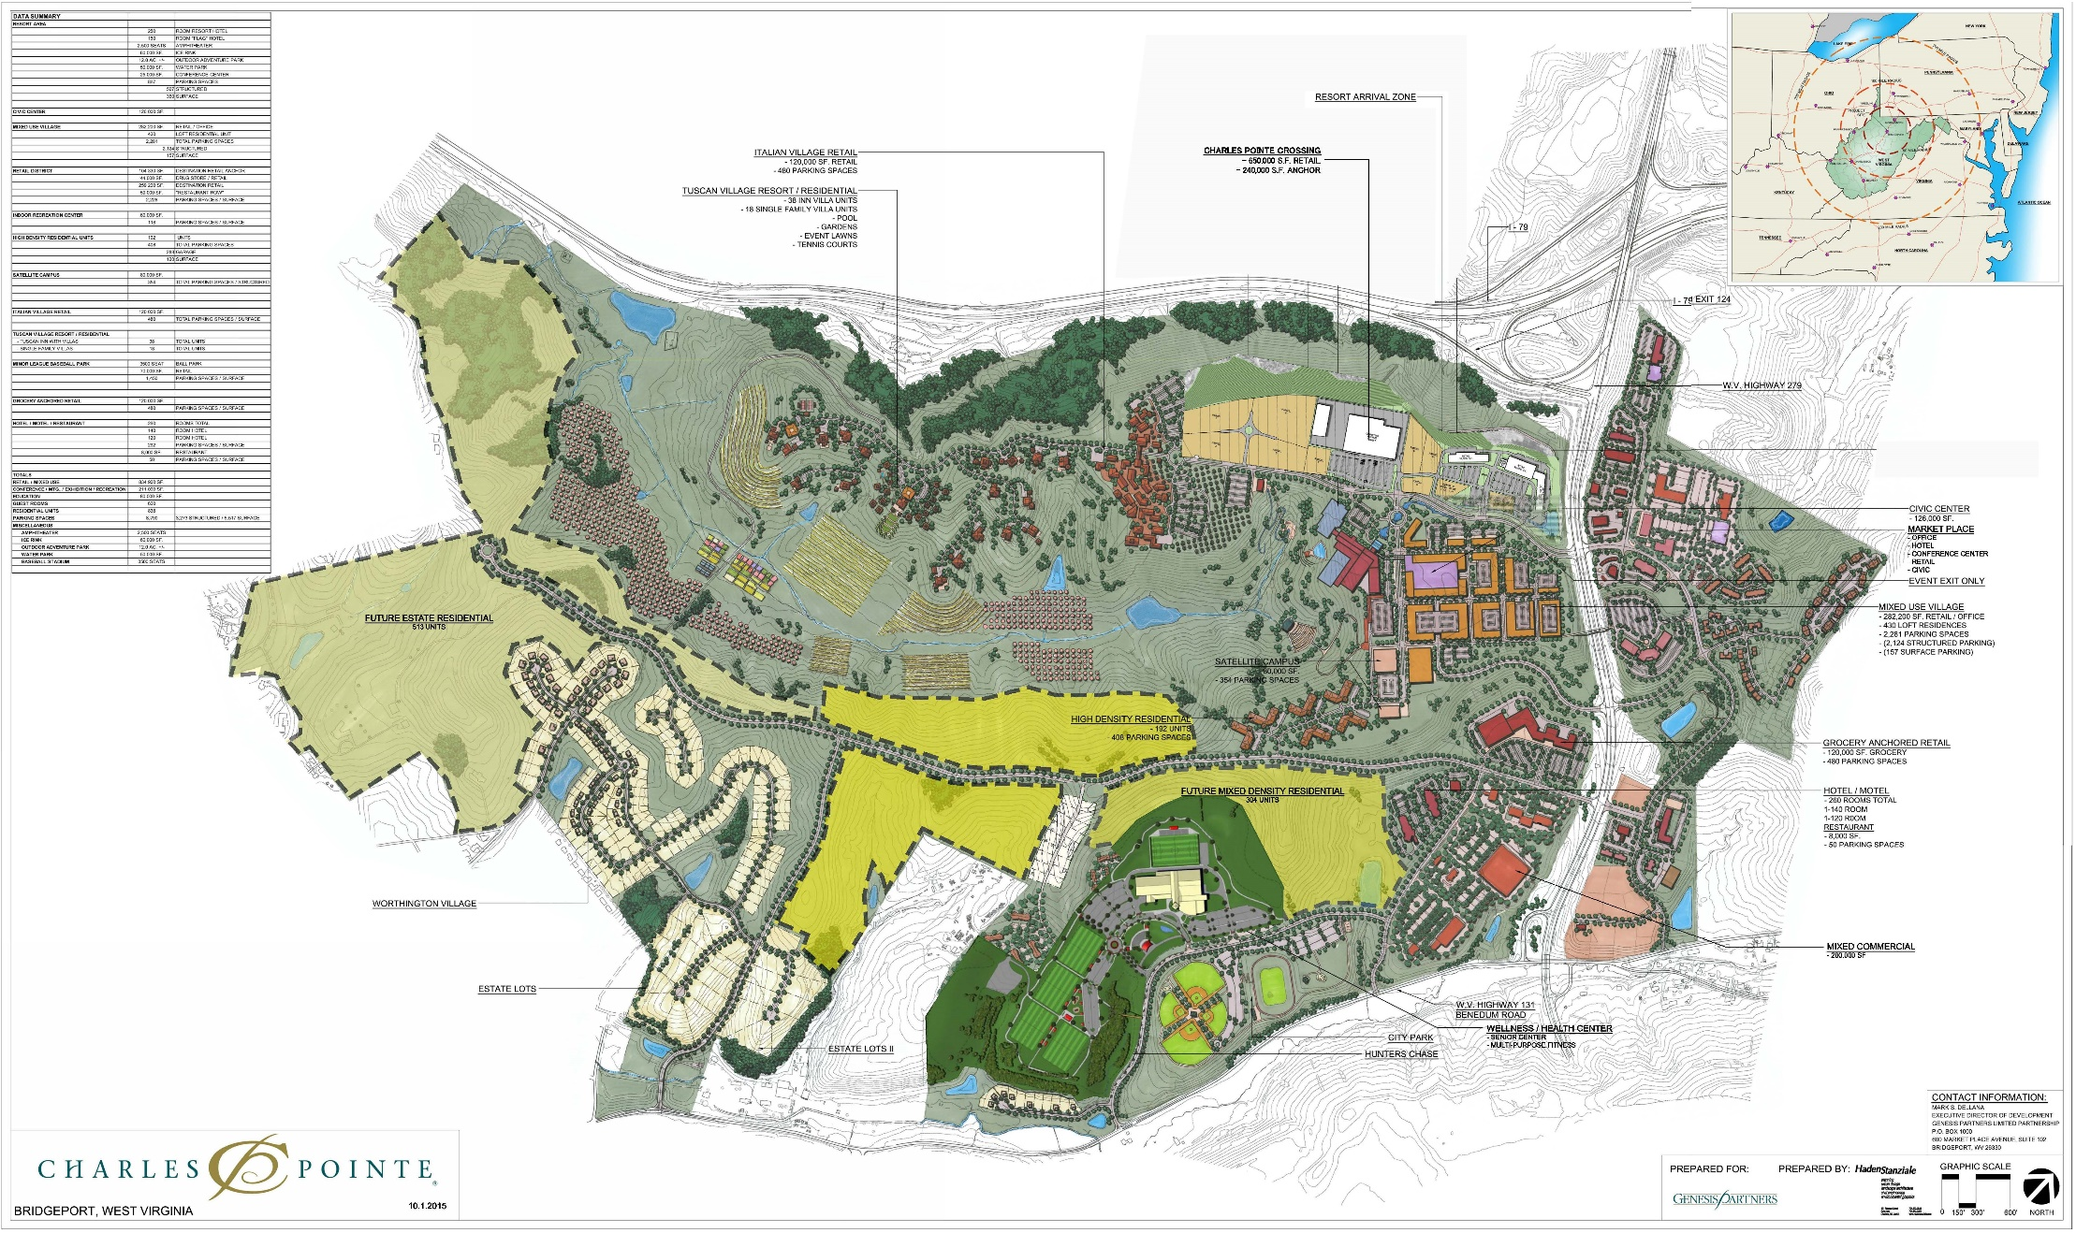
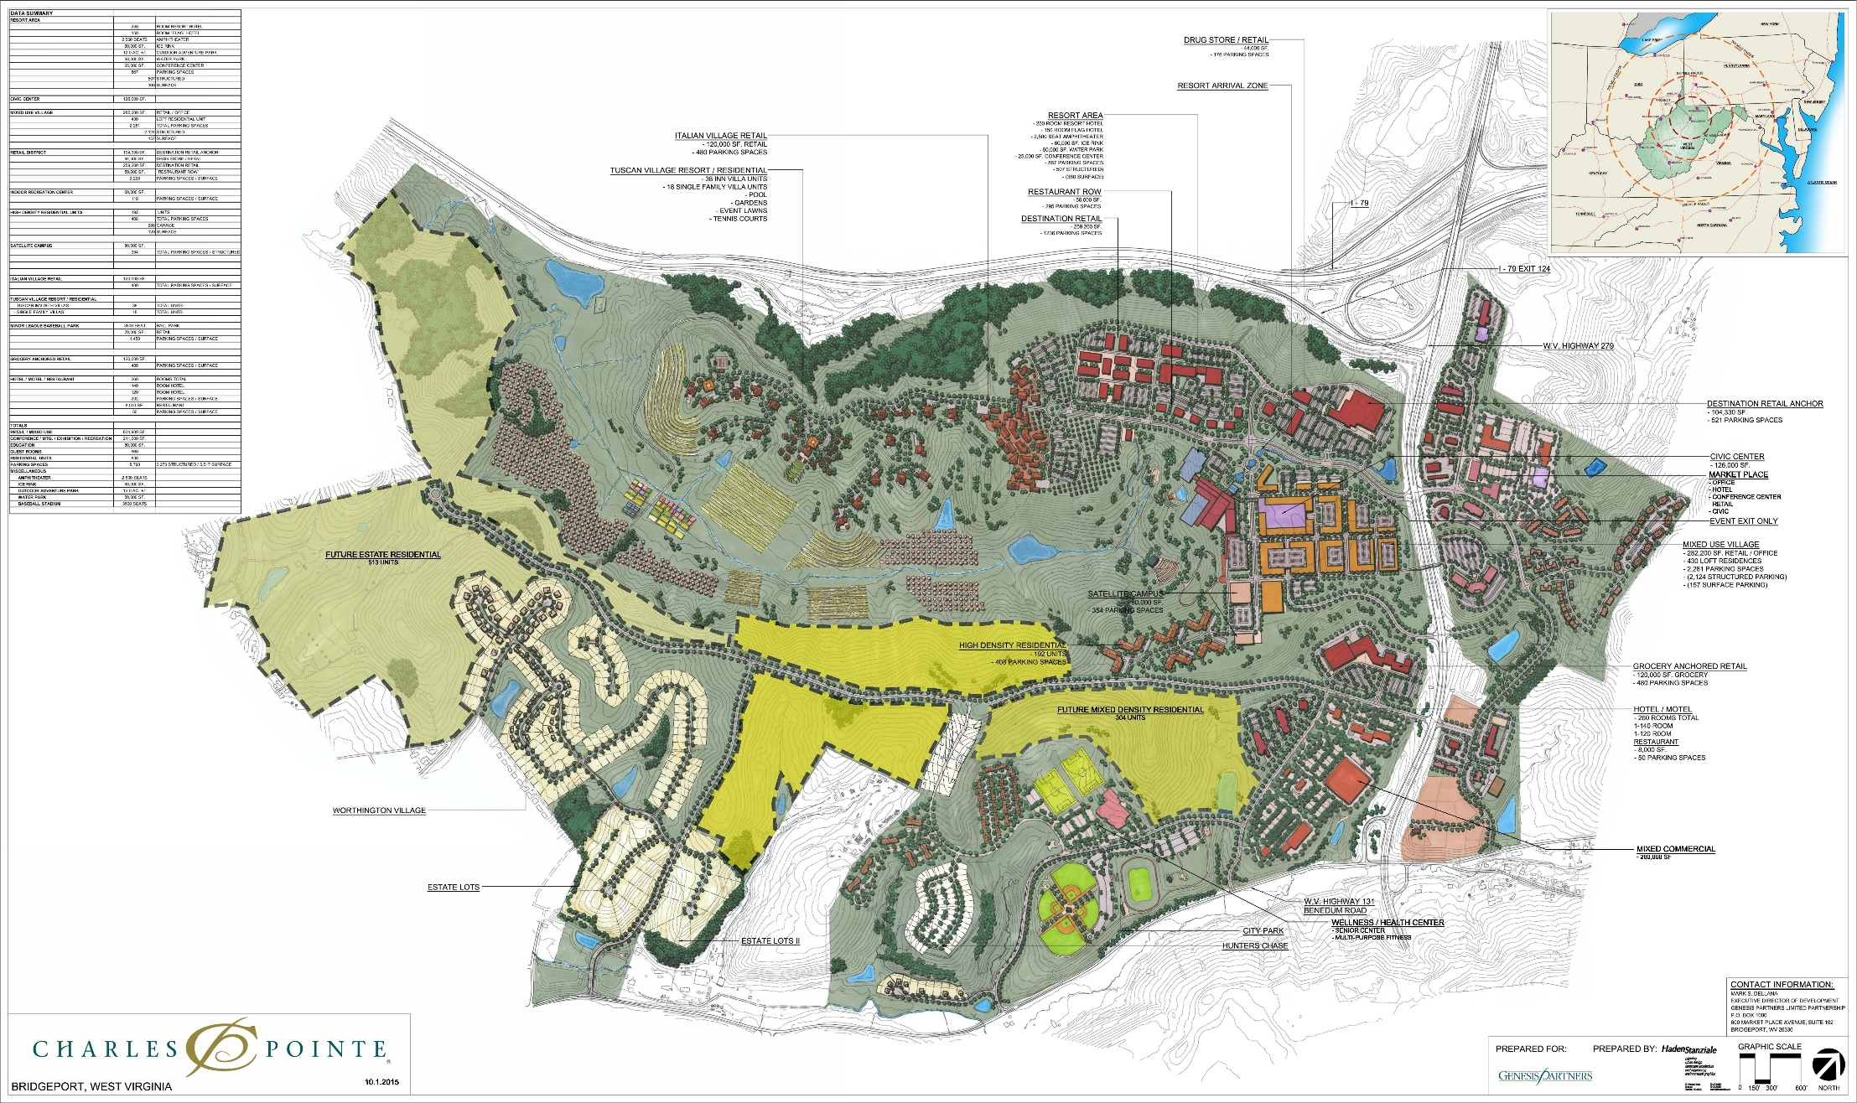
Master Plan –Destination Resort Area
Notes:
OVERVIEW
Charles Pointe is located within the high-growth area of North Central West Virginia along the I-79 High Technology Corridor, conveniently situated between Charleston and Pittsburgh.

Slide 36
DESTINATION RESORT
Nature themed resort
Two hotels- 400 total rooms
Includes:
  250 room hotel
  150 room hotel
  Conference facility
  Indoor water park with retractable roof
  Ice skating rink
  Outdoor adventure park
  Outdoor amphitheater
  Structure and surface parking: 867 spaces

Slide 37

DESTINATION RESORT

Slide 38


DESTINATION RESORT

Slide 39


DESTINATION RESORT

Slide 40


DESTINATION RESORT

Slide 41


DESTINATION RESORT

Slide 42
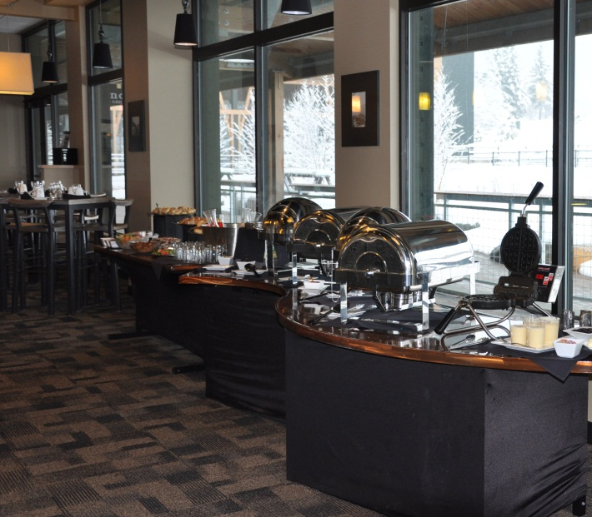
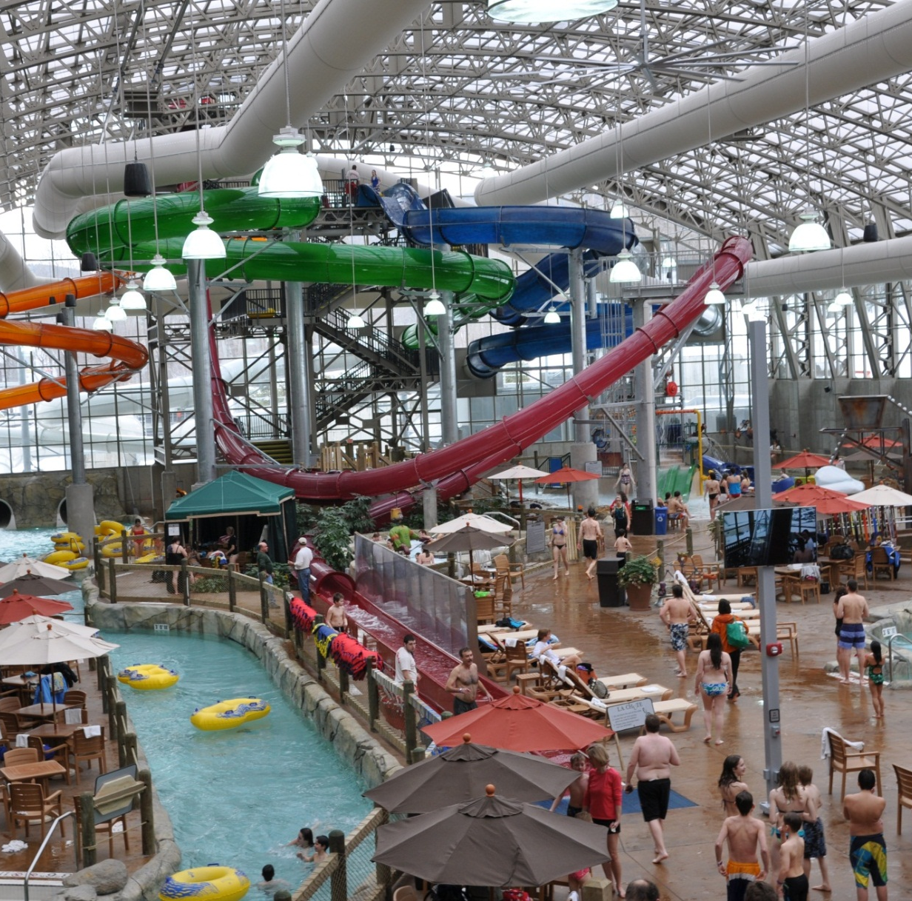
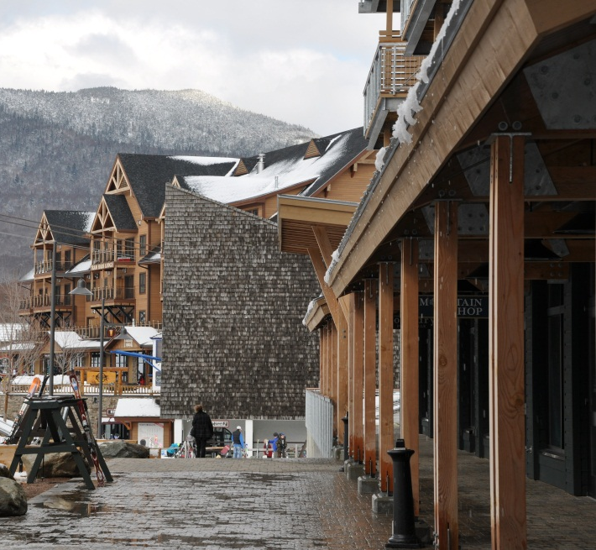
DESTINATION RESORT

Slide 43
MASTER PLAN - Mixed Use Village & Civic Center Area
Notes:
OVERVIEW
Charles Pointe is located within the high-growth area of North Central West Virginia along the I-79 High Technology Corridor, conveniently situated between Charleston and Pittsburgh.

Slide 44
MIXED USE VILLAGE & CIVIC CENTER
Heart of Charles Pointe
Mixed uses of retail, office, services, and civic facilities
Includes:
  Civic center
  Mixed use
  Loft style residential: 430 units
  Structure and surface parking: 2,281 spaces

Slide 45
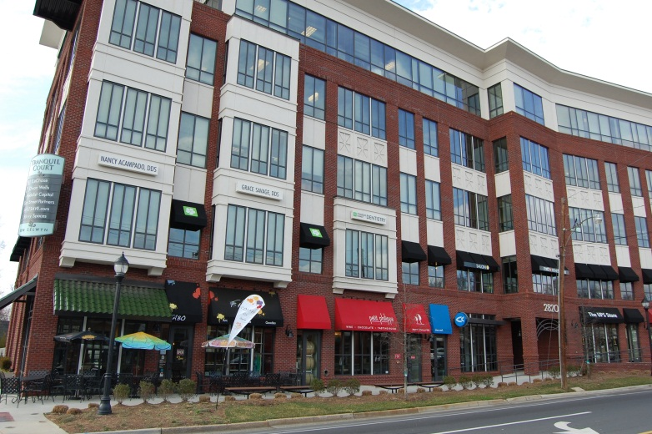
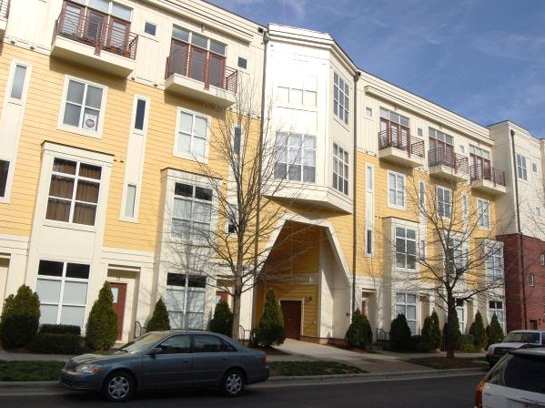
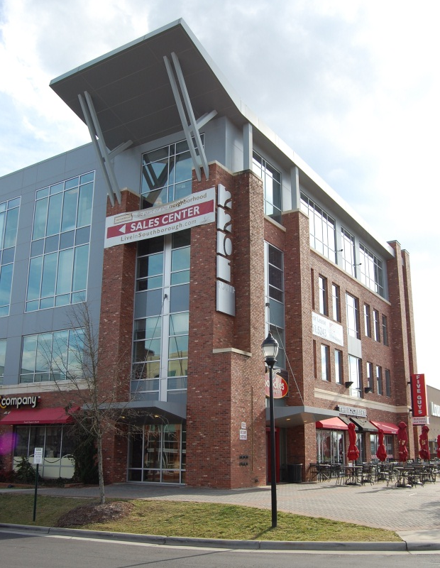
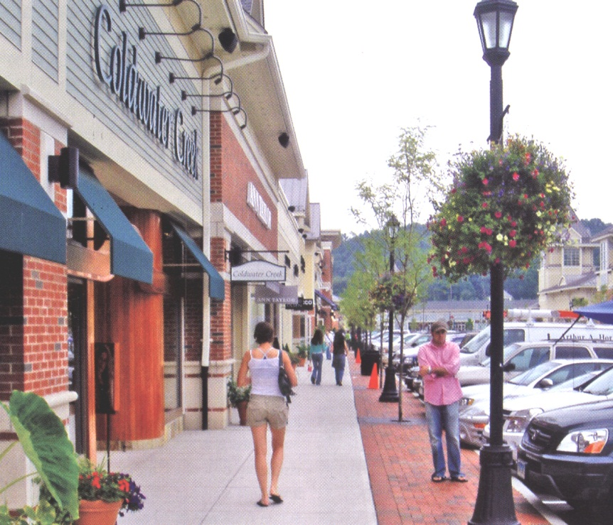
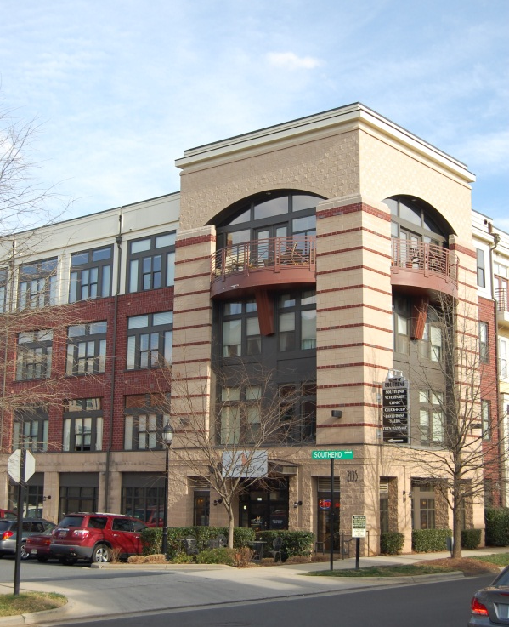

MIXED USE VILLAGE & CIVIC CENTER

Slide 46
MASTER PLAN - Tuscan Village Retail
Notes:
OVERVIEW
Charles Pointe is located within the high-growth area of North Central West Virginia along the I-79 High Technology Corridor, conveniently situated between Charleston and Pittsburgh.

Slide 47
TUSCAN VILLAGE RETAIL
Hilltop village
Italian themed shops
Shops, restaurants, food markets, and boutiques
Includes:
  Front and back retail: 120,000sf
  Surface parking: 480 spaces

Slide 48




TUSCAN VILLAGE RETAIL

Slide 49
MASTER PLAN - Tuscan Resort & Residential Village
Notes:
OVERVIEW
Charles Pointe is located within the high-growth area of North Central West Virginia along the I-79 High Technology Corridor, conveniently situated between Charleston and Pittsburgh.

Slide 50

‘TUSCAN’ RESORT &
RESIDENTIAL VILLAGE
Resort inn: 40 rooms
Single family villas
Views to valley, vineyards, and orchard
Includes:
  Inn: 25 rooms
  Inn villas: 15
  Resort spa
  Single family villas
  Resort amenities

Slide 51





‘TUSCAN’ RESORT &
RESIDENTIAL VILLAGE

Slide 52

Charles Pointe Innovation Technology Campus
Notes:
OVERVIEW
Charles Pointe is located within the high-growth area of North Central West Virginia along the I-79 High Technology Corridor, conveniently situated between Charleston and Pittsburgh.

Slide 53

Charles Pointe Innovation Technology Campus

Slide 54
Award Winning - MASTER PLAN
Notes:
OVERVIEW
Charles Pointe is located within the high-growth area of North Central West Virginia along the I-79 High Technology Corridor, conveniently situated between Charleston and Pittsburgh.

Slide 55

Thank You!

